Slide 1
802.11bd channelization for different regulatory domains
Date: 2019-09-10
Authors:

Slide 2
Background
The current FCC NPRM (19-138)^{[1]} proposes changes to US 5.9GHz band allocations.
IEEE 802.11bd^{[2]} should develop radio technology flexible for FCC, ETSI and other regulatory domains so it can be used around the world.

Slide 3
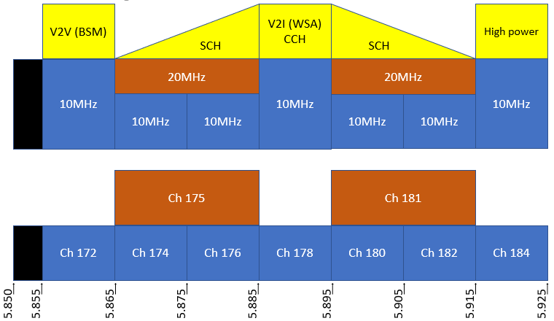
Previous FCC 5.9GHz channelization
Overlaid with SAE^{[3]} channel use recommendations
  V2V single channel
  5 channels for V2I based on WSAs and WSMP (IEEE 1609 multi-channel operation)
  1 channel for high power (government agency managed emergency vehicles, etc.)

Slide 4
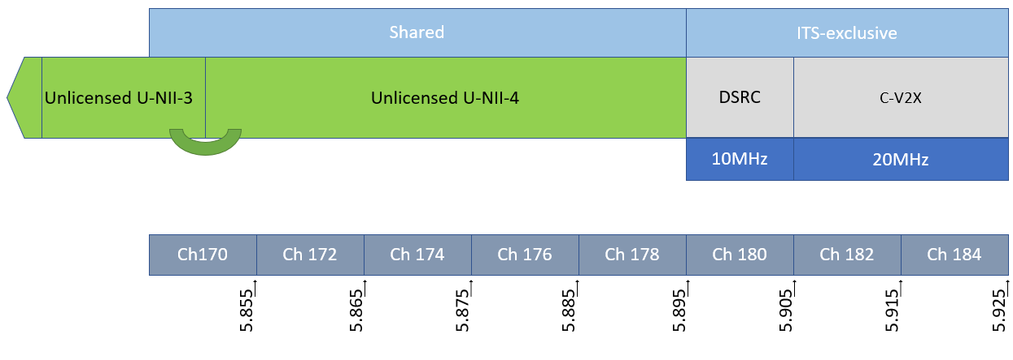
Proposal in FCC NPRM 19-138
Shrinks ITS-exclusive spectrum to 30MHz, and assigns 20MHz of it to non-802.11 radio protocols.
The new U-NII-4 has license-exempt rules. ITS users share this spectrum under license-exempt rules with other users.
Specific provisions enabling 802.11 channels that span U-NII-3 and U-NII-4

Slide 5
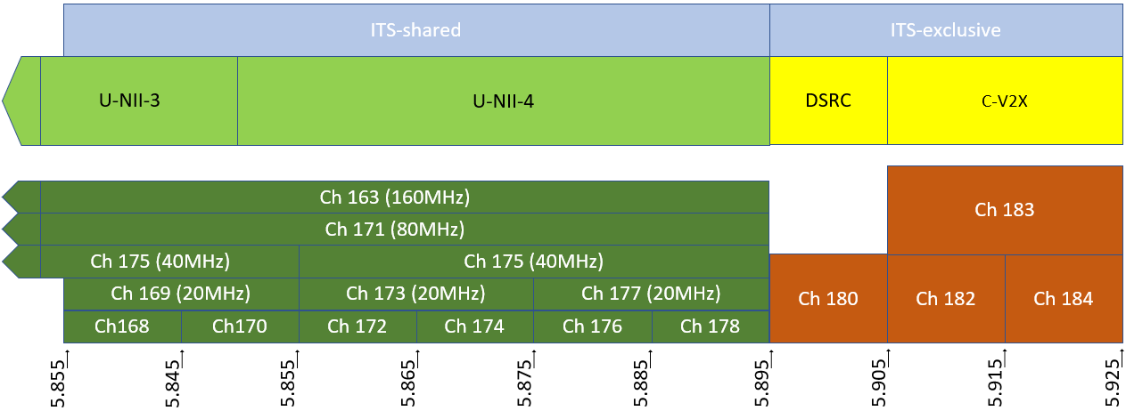
A potential 802.11 channelization post FCC NPRM

Slide 6
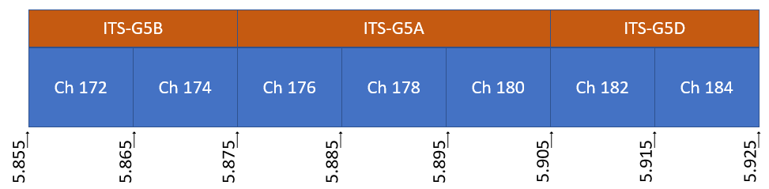
Factors for 802.11bd design
Document 802.11-20/0001 brings up the need for coexistence between 802.11bd and 802.11ac/ax/be in U-NII-4.
  Should we allow or disallow 10MHz channel 172/174/176/178 in this case?
  Should we define more 10Mhz and/or 20MHz channels that cross below U-NII-4 into U-NII-3?
  One comment is that for Wi-Fi backwards compatibility, APs will be unlikely to put primary 20MHz in the U-NII-4 band and use it only as 80MHz or 160MHz channels. (i.e. no APs on 169, 173, 175 or 177)
This Task Group has been discussing coexistence design between 10MHz 802.11p and 20MHz 802.11bd for months.
Some regulatory domains have 10MHz only allocations currently.
  This is where I finally mention Europe.^{[4]}
  Note that despite current EU channelization being 10MHz-only, stakeholders in this task group have often commented that we go ahead with 20MHz design.

Slide 7
Brief comments on Applications
Expectation that the DSRC V2V safety channel to move from 802.11p Ch 172 to 802.11p/bd Ch 180.
  No change in current 802.11bd direction required for this.
FCC NPRM envisages the other ITS applications moving to other radio spectrum. It mentions commercial cellular service Waze as an example^{[1]}, as well as unlicensed spectrum radios.
802.11bd (or more generally 802.11 operating outside the context of a BSS) in the U-NII bands can be the radio for those applications.
  Caveat being that there is no special regulatory protection between ITS services and other unlicensed services, and there is no regulated priority between them, but there is a long history of uncoordinated 802.11-based systems coexisting in the field.

Slide 8
Conclusion
The spectrum isn’t lost, 11bd just has to share it.
  We can wait until the FCC NPRM process concludes to make final decisions on the mechanism(s). This should still meet our 802.11bd timeline
Globally flexible 802.11bd channelization should include:
  10MHz transmissions in 10MHz channels
  20MHz transmissions designed to coexist with a pair of 10MHz channels
  20MHz transmissions designed to coexist with 20MHz unlicensed operation
802.11bd can be designed for US, EU and other regulatory domains.
Bottom line, regardless of FCC NPRM outcome, 802.11bd Task Group can still design the Next Generation V2X radio for all the 5850-5925MHz channels in the US and all regulatory domains.

Slide 9
References
1) FCC NPRM Docket 19-183
https://www.fcc.gov/ecfs/search/filings?limit=100&offset=0&proceedings_name=19-138&sort=date_disseminated,DESC
2) IEEE P802.11bd
https://standards.ieee.org/project/802_11bd.html
3) SAE J2945/0 (2017-12) Table 4
4) ETSI EN 302 663

Slide 10
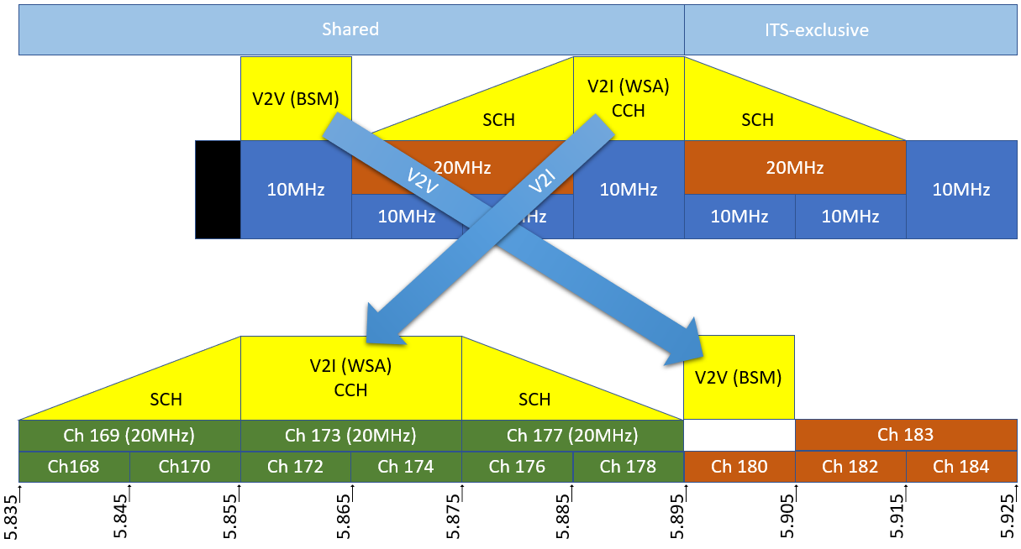
Background
Before
After

