Slide 1
Triggered P2P transmissions
Date: 2020-01-07
Authors:

Slide 2
Outline
P2P traffic characteristics
Multi-User OFDMA does not yet manage P2P flows
Proposal for Triggered P2P Transmissions
Advantages

Slide 3
Peer-to-peer (P2P) traffic characteristics
Direct transmission from one STA to another STA (no AP relay)
reduce the load on the BSS and simultaneously the latency delivery by a one-hop communication
Usually carries large amount of data and requires low latency (e.g. VR, or video streaming).
P2P traffic (because EDCA medium access based) provides high “interferences” that are damaging for AP operations.

Slide 4
Multi-User OFDMA
developed to address collision reduction in dense environments
allows for simultaneous operation of multiple non-AP stations
All MU transmissions are scheduled by the AP (e.g. STAs are under MU-EDCA control)
… currently (802.11ax) MU OFDMA does not support P2P traffic !!

Slide 5
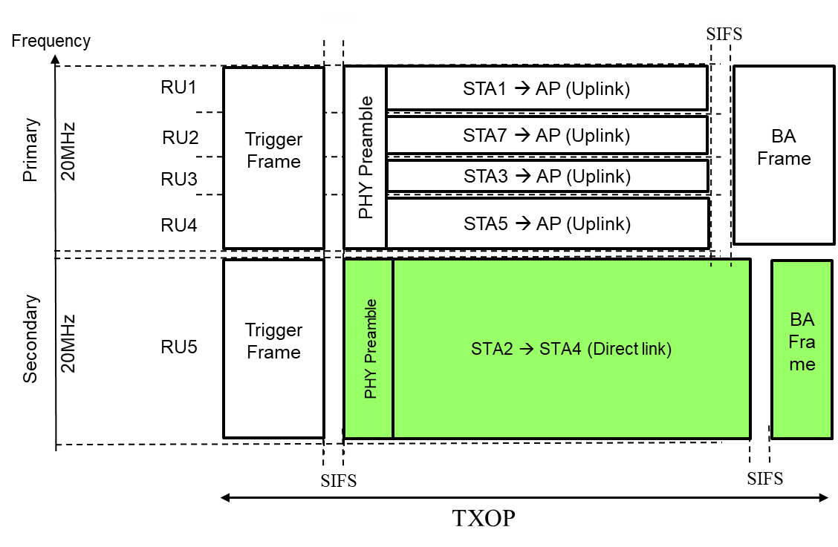
Triggered P2P Transmissions
P2P traffic is triggered by the AP for a “Single-User style” RU :
a 242-tones RU aligned on a 20Mhz channel (possibly multiple of 20Mhz)
Uses its own preamble on its distinct channel :
AP does not need to provide all trigger transmission parameters (e.g. MCS)
No synchronization requirement
PPDU format is TBD (e.g. EHT SU or MU PPDU format can be envisaged)
Preferably the selected RU location corresponds to secondary channel(s)
The allocated RU can be used as a classical 20 MHz channel .
Only condition is to guarantee the TXOP limitation.

Slide 6
Advantages
Take combined benefits of MU and SU operations :
Enhance global cell’s efficiency
More efficient compared to SU medium-access schemes (former EDCA Direct-Link protocols, RDP protocol, etc.)
AP can still simultaneously receive classical OFDMA Uplink RUs from other STAs
P2P stations communicate alone in their allocated 20MHz RU channel
AP does not need to be aware of P2P transmission characteristics (so does not provide all trigger parameters, e.g. MCS)
Can be used like a (multiple 20Mhz-unit) channel
Similar concept as ‘Coordinated OFDMA Operation’ proposals (#11-10-1788, 11-19-1582)
Trigger-based transmission
Based on one or more 20 MHz channels
MU
SU

Slide 7
Summary
Trigger Frame is the natural tools for scheduling non-AP stations, including P2P STAs
Triggered P2P operation is simple :
P2P stations are triggered over a RU multiple of 20MHz.
P2P stations use their own PPDU format in their allocated RU, and shall meet the TXOP (RU Length).

Slide 8
Straw Poll #1
Do you support that…
Results: Y/N/A

Slide 9
Reference
[1]. 11-18-1481-01: Technology for EHT
[2]. 11-10-1788-00: Coordinated OFDMA Operation
[3]. 11-19-1582-00: Coordinated AP Time/Frequency Sharing in a Transmit Opportunity in 11be

