Slide 1
Performance of parameterized spatial reuse (PSR) with coordinated beamforming/null steering for 802.11be
January 2020
Date: 2020-01-10
Authors:
Name | Affiliation | Address | Phone | Email
Adrian Garcia-Rodriguez | Nokia |  |  | adrian.garcia_rodriguez@nokia-bell-labs.com
David Lopez-Perez
Lorenzo Galati Giordano
Olli Alanen
Mika Kasslin
Eloise de Carvalho Rodrigues
Enrico Rantala

Slide 2
Introduction
January 2020
As shown in [19/1594r2], the 802.11ax parameterized spatial reuse (PSR)* framework
provides a good basis for coordinated beamforming/null steering, since it
allows APs to altruistically—but coordinately—‘share’ an uplink transmission opportunity (TXOP) with other inter-BSS devices
The performance gains of synchronous coordinated beamforming systems have been demonstrated in [19/0772r1] and [19/1212r2]
In this contribution, we
briefly review the PSR framework with coordinated beamforming/null steering of [19/1594r2], and
evaluate the performance of such scheme
*referred to as spatial reuse parameter (SRP) in drafts D1.0 – D5.1
*
Notes:
Parameterized spatial reuse

Slide 3
802.11ax PSR framework with null steering: Practical operation
January 2020
Standard PSR framework + coordinated null steering (see [19/1594r2])
Phase 1 – Coord.
Phase 2 – Implicit CSI acquisition
Phase 3 – Coordinated inter-AP DATA TX & ACK with nulls
Data transmission
Null steering
TF advertises spatial reuse opportunity
TF
AP1 nulls
STA21
C_{Request}
NDPA
TF
NDP
NDP
UL data reception
ACK
donor AP1
BSS1
NDP
NDP
UL data
STA11
NDP
UL data
STA12
AP2 nulls
STAs 11 and 12
C_{Response}
NDP
TF
UL data reception
ACK
BSS2
AP2
Contention
NDP
NDP
UL data
STA21
Transfer and return frames may be needed to coordinate AP1 and AP2 actions
STA21 measures power, and identifies a spatial reuse opportunity (SRO)
t
*Similar to 802.11ax, an alternative implementation could be based on AP2 sending the ACK while AP1 is still performing UL data reception

Slide 4
802.11ax PSR framework with null steering: Key implementation benefits
January 2020
Unsynchronized operation [19/0638r0]
Since the interference suppression is performed through the application of a spatial filter during data reception, APs can suppress both
the non-precoded PPDU preambles, and
the guard interval signals
from interfering devices, without requiring symbol-level synchronization
Easily adjusts to null steering impairments
APs granting the spatial reuse opportunities with null steering may set their acceptable receiver interference level accounting for impairments
If only 10 dB of interference suppression can be guaranteed through null steering, the UL Spatial Reuse field of the Trigger frame should be adjusted by that factor, when compared to the baseline PSR operation

Slide 5
System evaluation
January 2020
We will compare the performance of the following three systems:
Baseline system without PSR
Spectrum shared according to CSMA/CA
System with PSR
When triggering uplink transmissions, APs may grant SROs to inter-BSS STAs
System with PSR and coordinated beamforming/null steering
When triggering uplink transmissions, APs may a) steer radiation nulls, and b) grant SROs to inter-BSS STAs
BB
BB
BB
BB
URLLC
AP
1
Time sharing
beam
Devices may listen to each other
AP
2
URLLC
BB
BB
BB

Slide 6
System evaluation
January 2020
We will compare the performance of the following three systems:
Baseline system without PSR
Spectrum shared according to CSMA/CA
System with PSR
When triggering uplink transmissions, APs may grant SROs to inter-BSS STAs
System with PSR and coordinated beamforming/null steering
When triggering uplink transmissions, APs may a) steer radiation nulls, and b) grant SROs to inter-BSS STAs
BB
BB
SRO found
Constrained TX power
SRO not found
BB
URLLC
AP
1
beam
Power-based spatial reuse
beam
Spatial reuse enabled when inter-OBSS devices can guarantee the acceptable receiver interference level set by the AP triggering uplink transmissions
AP1 triggered uplink
AP
SRO found
Contention lost
2
SRO not found
SRO not found

Slide 7
System evaluation
January 2020
We will compare the performance of the following three systems:
Baseline system without PSR
Spectrum shared according to CSMA/CA
System with PSR
When triggering uplink transmissions, APs may grant SROs to inter-BSS STAs
System with PSR and coordinated beamforming/null steering [19/1594r2]
When triggering uplink transmissions, APs may a) grant SROs, and b) steer radiation nulls to inter-BSS STAs
BB
BB
SRO found
Contention lost
SRO found
Contention lost
BB
Radiation null at reception
placed by AP
URLLC
AP
1
Power-based spatial reuse
aided by null steering
beam
beam
Devices are more likely to
a) find spatial reuse opportunities, and
b) access the medium with larger transmission powers
SRO found
Contention lost
AP1 triggered uplink
AP
2
SRO not found
SRO found

Slide 8
802.11ax PSR framework with null steering: Performance evaluation
January 2020
We consider a scenario with both
uplink broadband traffic—modeled as a file transfer protocol (FTP) service—, and
uplink low-latency traffic—modeled as an augment reality (AR) application
When triggering uplink, APs spatially multiplex as many STAs as possible of a class per TXOP
Our main objective with the remaining spatial degrees of freedom is to reduce the worst-case latencies of the STAs with low-latency traffic
In our study, APs granting SROs will suppress interference only from neighboring low-latency STAs with the strongest average perceived interference
Broadband (BB) FTP3 model [A]
File size = 0.5 MBytes
Offered traffic = 100 Mbps
Latency-sensitive (LS) AR model [B]
File size = 32 bytes
Constant arrival rate, frequency = 10 ms
Per STA traffic
Per STA traffic
time
time

Slide 9
802.11ax PSR framework with null steering: Intuition
January 2020
Multiple short-packet transmissions may be performed within a long uplink-triggered transmission
Phases 1 and 2 – Coordination and CSI acquisition
(see slide 3)
Phase 3 – Coordinated inter-AP DATA TX & ACK with nulls
Data transmission
Null steering (RX)
Null steering (TX)
TF
UL data reception
AP1 nulls STAs 21 and 22
ACK
donor AP1
BSS1
UL data
STA11
UL data
STA12
AP2 nulls
STAs 11 and 12
UL data reception
ACK
UL data reception
ACK
AP2
UL data
BSS2
STA21
(low-latency)
Packet arrival to the queue
Contention
UL data
STA22
(low-latency)
STAs 21 and 22 identify SROs
t
This is the main benefit for latency-sensitive applications

Slide 10
Fundamental system model parameters*
January 2020
Frequency/Bandwidth | 5.18GHz/80MHz (1 channel)
AP deployment | 2 ceiling-mounted APs | Inter-AP distance = 15 m | AP height = 3 m
AP characteristics | 4x2 antenna array (0.5λ separation) | AP max. Tx power = 24 dBm | omni antenna element | NF = 7 dB
STA deployment | 16 broadband STAs uniformly distributed at height = 1 m 8 low-latency STAs uniformly distributed at height = 1 m
STA characteristics | STA max. Tx power = 15 dBm | 1 omni antenna | NF = 9 dB
Channel model | 3D spatial channel model (3GPP TR38.901 – InH [C])
MAC layer conf. | Max. # radiation nulls = 4 | IP/MAC header overhead considered | No EDCA | No RTS/CTS | Max. TXOP = 4 ms | SNR-driven MCS selection
PHY layer conf. | PHY header overhead considered | Spatial filter = ZF (with and without nulls) | Omni PLCP header | 11ax MCSs
*A complete description of the system model parameters can be found in the Appendix

Slide 11
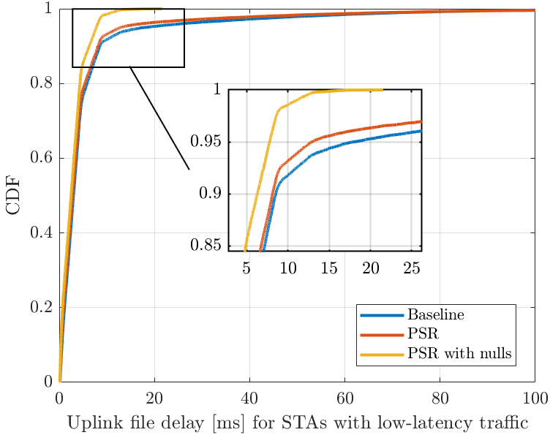
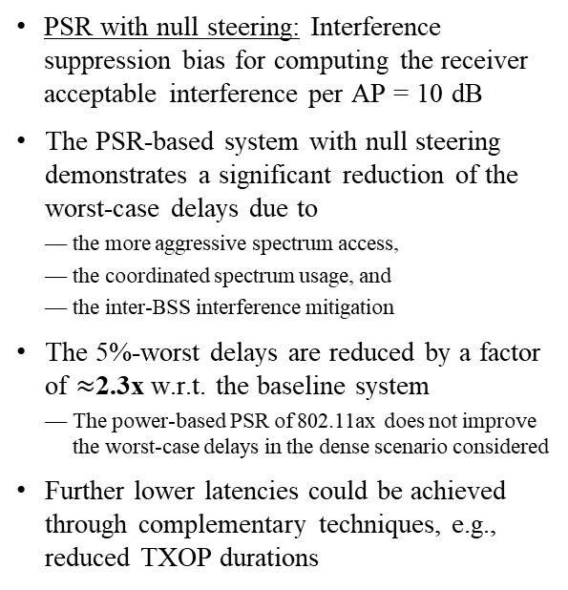
Performance of low-latency STAs
January 2020
PSR with null steering: Interference suppression bias for computing the receiver acceptable interference per AP = 10 dB
The PSR-based system with null steering demonstrates a significant reduction of the worst-case delays due to
the more aggressive spectrum access,
the coordinated spectrum usage, and
the inter-BSS interference mitigation
The 5%-worst delays are reduced by a factor of $≈$2.3x w.r.t. the baseline system
The power-based PSR of 802.11ax does not improve the worst-case delays in the dense scenario considered
Further lower latencies could be achieved through complementary techniques, e.g., reduced TXOP durations

Slide 12
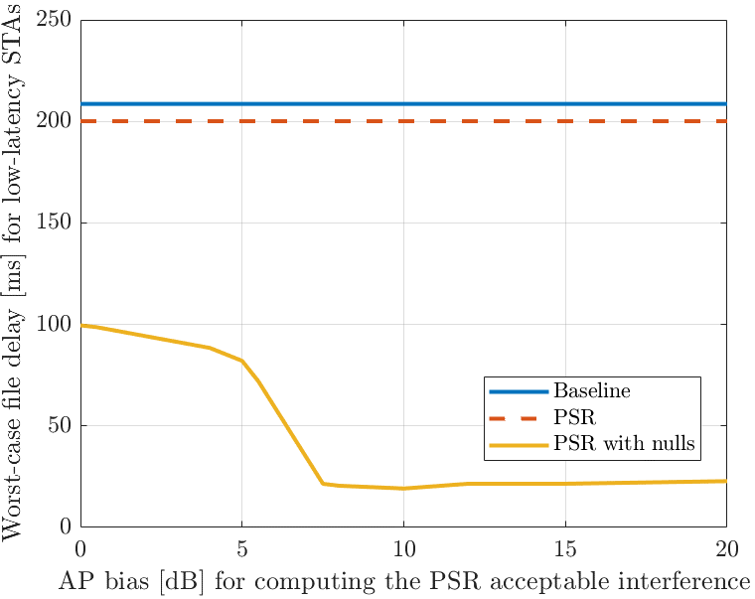
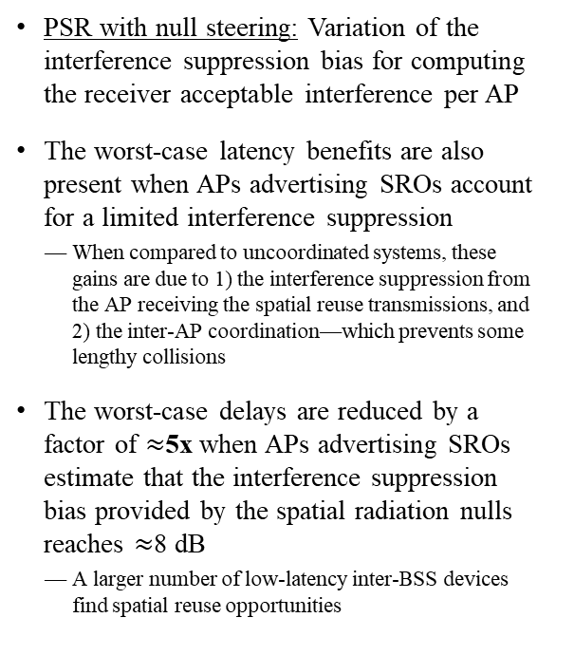
Performance of low-latency STAs as a function of null steering accuracy
January 2020
PSR with null steering: Variation of the interference suppression bias for computing the receiver acceptable interference per AP
The worst-case latency benefits are also present when APs advertising SROs account for a limited interference suppression
When compared to uncoordinated systems, these gains are due to 1) the interference suppression from the AP receiving the spatial reuse transmissions, and 2) the inter-AP coordination—which prevents some lengthy collisions
The worst-case delays are reduced by a factor of $≈$5x when APs advertising SROs estimate that the interference suppression bias provided by the spatial radiation nulls reaches $≈$8 dB
A larger number of low-latency inter-BSS devices find spatial reuse opportunities

Slide 13
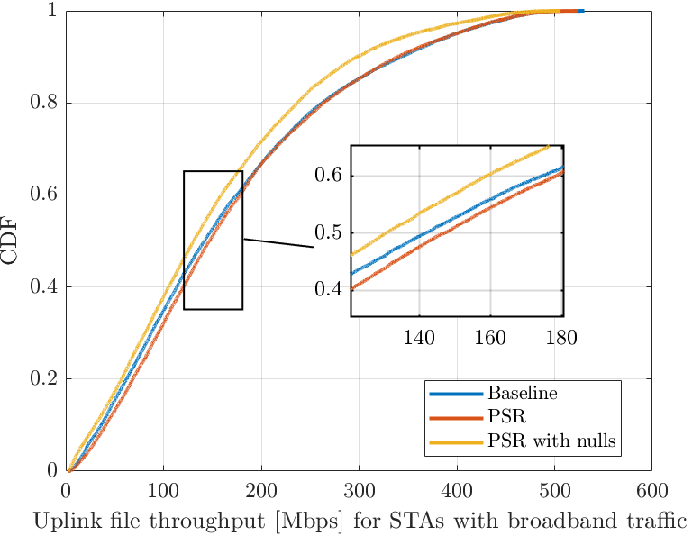
Performance of broadband STAs
January 2020
PSR with null steering: Interference suppression bias for computing the receiver acceptable interference per AP = 10 dB
The PSR-based system with null steering approximately preserves the throughput offered to the STAs with broadband traffic
The slight throughput decrease w.r.t. the baseline is mostly caused by
1) the decision of providing spatial reuse opportunities and focusing the available spatial radiation nulls towards inter-BSS low-latency STAs, and
2) the loss in AP receive beamforming gain due to the radiation null placement
The power-based PSR of 802.11ax preserves the throughput of the broadband STAs w.r.t. the baseline in the dense scenario considered
STAs with broadband traffic benefit from the spatial reuse opportunities offered by PSR

Slide 14
Conclusions
January 2020
In this contribution, we evaluated the worst-case latency benefits provided by a system implementing parameterized spatial reuse (PSR) with coordinated beamforming
The considered protocol does not require a tight synchronization
APs suppress interference through a receive spatial filter
The considered protocol significantly reduces the worst-case delays in a scenario with mixed low-latency and broadband traffic
This is mostly thanks to the more aggressive—albeit controlled—spectrum access

Slide 15
Straw poll #1
January 2020
Do you believe that enhancing the parameterized spatial reuse (PSR) with coordinated beamforming capabilities is appealing and should be further explored within the 802.11be task group?
Yes
No
Abstain

Slide 16
References
January 2020
[19/0772r1] Roya Doostnejad (Intel), “Multi-AP Collaborative BF in IEEE 802.11”, 19/0772.
[19/1212r2] David Lopez-Perez (Nokia), “Performance of Coordinated Null Steering in 802.11be”, 19/1212.
[19/1594r2] David Lopez-Perez (Nokia), “Coordinated Beamforming/Null Steering in 802.11be”, 19/1594.
[19/0638r0] Sigurd Schelstraete (Quantenna), “Nulling and coordinated beamforming”, 19/0638.
[A] 3GPP TR 36.814, “Evolved Universal Terrestrial Radio Access (E-UTRA); Further advancements for E-UTRA physical layer aspects,” March 2017.
[B] 3GPP TR 38.824, “Study on physical layer enhancements for NR ultra-reliable and low latency case (URLLC),” March 2019.
[C] 3GPP TR 38.901, “Study on channel model for frequencies from 0.5 to 100 GHz,” June 2018.

Slide 17
Acknowledgement
January 2020
This work was supported by the European Union’s Horizon 2020 research and innovation programme under the Marie Sklodowska-Curie grant agreement No 765224

Slide 18
Appendix
January 2020

Slide 19
Baseline uplink 802.11ax PSR Framework Enables spatial reuse during uplink transmissions
January 2020
Standard version
AP1 advertises the spatial reuse opportunity (SRO) in a trigger frame (TF), and provides information about
AP1 transmit power
AP1 acceptable uplink interference level
STA21 measures AP1 received power level, and determines whether using the SRO
STA21 derives, e.g. its maximum transmit power, based on the above information
If STA21 finds an SRO, it contends while AP1 is receiving uplink data
STA21 TXOP has to accommodate all transmissions within AP1 data reception
TF advertises SRO
Data transmission
TF
UL data reception
ACK
donor AP1
BSS1
UL data
STA11
UL data
STA12
UL data reception
ACK
BSS2
AP2
Contention
UL data (constrained TX power)
STA21
STA21 measures power, and identifies a spatial reuse opportunity
t

Slide 20
Complete list of system model parameters
January 2020
Frequency/Bandwidth | 5.18GHz/80MHz (1 channel)
Scenario size | 35 meters x 20 meters
AP deployment | 2 ceiling mounted APs at (10 m, 10 m) and (25 m, 10 m) | AP height = 3 m
STA deployment | 16 broadband STAs | 8 low-latency STAs | 2D uniform distribution | STA height = 1 m | Minimum inter-STA 2D distance = 0.1 m | Minimum AP-STA 2D distance = 0.5 m |
Channel model | 3D spatial channel model (3GPP TR38.901 – InH [C])
AP/STA MAC layer conf. | IP/MAC header overhead considered | No EDCA | No RTS/CTS | Max. TXOP = 4 ms | SNR-driven MCS selection
AP MAC layer conf. | Max. number of spatially multiplexed STAs = 8 | Uplink-triggered transmissions active | Scheduling logic = No joint multiplexing of broadband and low-latency STAs, priority to low-latency STAs, Round Robin scheduling policy | Uplink power control logic = Min. RSS to achieve selected MCS + 6 dB of margin | PSR safety margin value for calculating the acceptable receiver interference level = 3 dB (Eq. 26-7, 802.11ax D6.0) | Perfect channel state information acquisition | Max. number radiation nulls = 4 | Inter-BSS device null steering selection method = Low-latency STAs generating the strongest perceived interference | Max. interference suppression per radiation null = 10 dB (also considered when calculating the PSR acceptable interference level)
STA MAC layer conf. | PSR minimum Tx power to find spatial reuse opportunity = 3 dBm
AP/STA PHY layer conf. | PHY header overhead considered | 11ax OFDM numerology with cyclic prefix duration = 0.8 us | AP/STA sensitivity = - 90 dBm | Spatial filter = ZF (with and without nulls) | Omni PLCP header | 11ax MCSs with target PER = 10%
AP PHY layer characteristics | AP max. Tx power = 24 dBm | 4x2 array (0.5λ separation) | Omni antenna elements | NF = 7 dB
STA PHY layer characteristics | STA max. Tx power = 15 dBm | 1 omni antenna | NF = 9 dB

