Slide 1
Implicit Feedback, Feasibility and Gains (Update)
Date: 2020-01-11

Slide 2
Introduction
In [1, 2, 3], single-AP calibration is discussed.
In [4], Implicit Sounding sequence is discussed for Multi-AP.
In this contribution, we address calibration for Multi-AP architecture.
In [5], network overhead analysis is presented which proves significant improvement (network overhead for BF reports) compared to explicit sounding.
There has been a question with uplink channel measurement (implicit sounding) concerning with lower SNR (channel estimation) as a result of lower transmit power in uplink in some use cases.
  Smart phones
In this contribution, we consider re-transmission of training fields to improve UL link budget if needed, and review the network overhead.

Slide 3
Multi-AP Calibration
In multi-AP architecture, the schemes, which require single-AP processing, require only single-AP calibration.
Collaborative BF, and Coordinated OFDMA require Single-AP calibration.
Joint BF requires Multi-AP calibration.
  Option I: Local AP Calibration (AP-AP)
  Option II: AP-STA Calibration

Slide 4

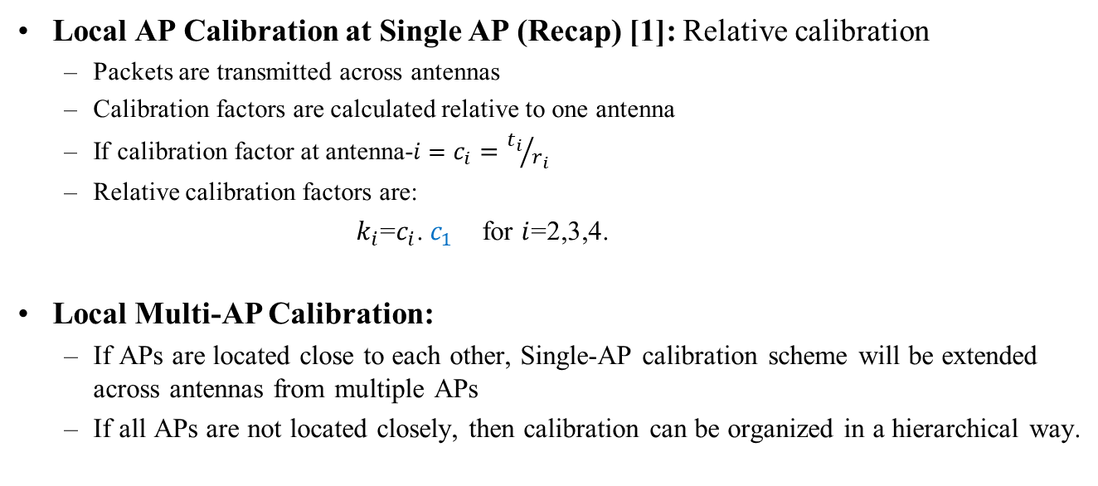
Multi-AP Calibration
Local AP Calibration at Single AP (Recap) [1]: Relative calibration
  Packets are transmitted across antennas
  Calibration factors are calculated relative to one antenna
  If calibration factor at antenna-$i=c_{i}={t_{i}}/{r_{i}}$
  Relative calibration factors are:
                $k_{i}$=$c_{i}$. $c_{1}$ for $i$=2,3,4.
Local Multi-AP Calibration:
  If APs are located close to each other, Single-AP calibration scheme will be extended across antennas from multiple APs
  If all APs are not located closely, then calibration can be organized in a hierarchical way.
1
2
3
$$4$$

Slide 5




Multi-AP Calibration
Multi-AP hierarchical Calibration
  Each AP is calibrated independently (the same as single AP). All APs calibrated in parallel.
  Then a second round of calibration is run between the reference antennas (one per AP) in order to calibrate the whole network.
  In some architectures, there might be some APs located sufficiently close. Those APs may form a cluster. All clusters calibrate in parallel and a second round of calibration is run between anchor nodes (one per each cluster) of clusters.
  Each AP/Cluster calibrate with its closest AP
$${AP}_{1}$$
$${AP}_{2}$$
$${AP}_{3}$$
$${AP}_{4}$$

Slide 6


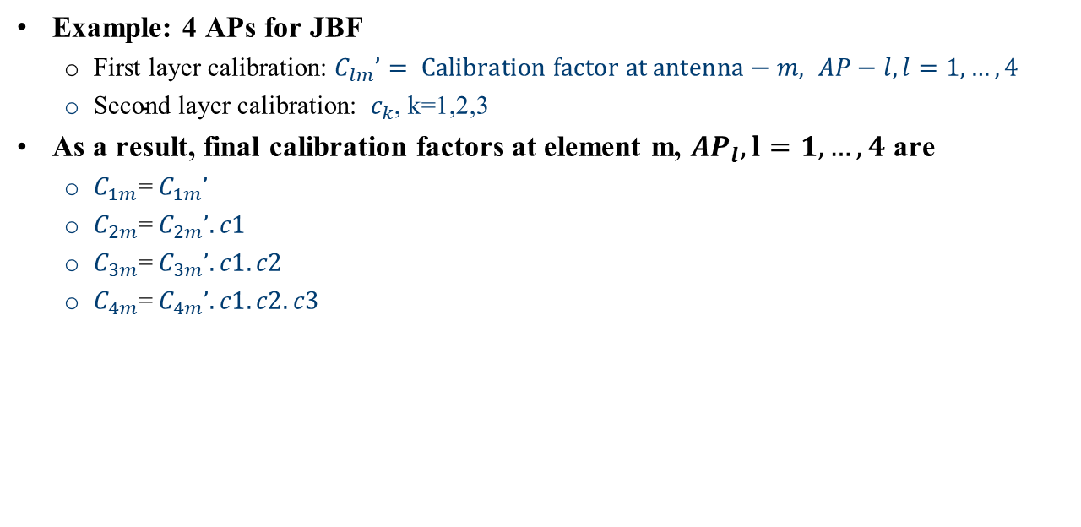





Multi-AP Calibration
Example: 4 APs for JBF
  First layer calibration: $C_{lm}’= Calibration factor at antenna−m, AP−l, l=1,…, 4$
  ${\text{Second} \text{layer} \text{calibration}\text{: } c}_{k}$, k=1,2,3
As a result, final calibration factors at element m, ${AP}_{l}, l=1,…, 4$ are
  $C_{1m}$=${ C}_{1m}’$
  $C_{2m}$=${ C}_{2m}’. c1$
  $C_{3m}$=${ C}_{3m}’. c1.c2$
  $C_{4m}$=${ C}_{4m}’. c1.c2.c3$
$${AP}_{1}{: C}_{1m}’$$
$${{AP}_{2}: C}_{2m}′$$
$${{AP}_{3}: C}_{3m}′$$
$${{AP}_{4}: C}_{4m}′$$
$$c_{2}$$
$$c_{3}$$
$$c_{1}$$

Slide 7
Multi-AP Calibration
AP-STA Calibration
  A STA is required with strong link budget (preferably LOS channel) to all APs
  Following calibration scheme in .11n, all APs may calibrate with the same STA.
  Following the proposal in [3], Multi-AP may be treated as one big AP, the same architecture as joint BF.
  Following the scheme in [3], getting explicit feedback (joint Multi-AP explicit feedback) from the STA on compound Multi-AP channel, and calculate the calibration factors.

Slide 8
Network Overhead

Slide 9
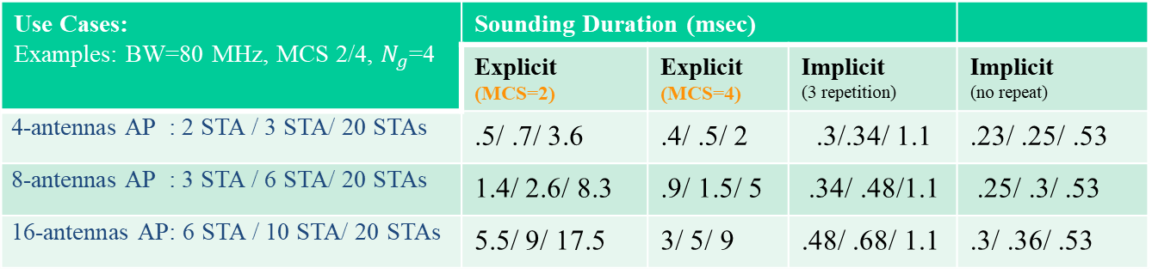
Network Overhead Evaluation: Implicit vs Explicit
Explicit Feedback: Network overhead is increased with number of antennas at AP and number of STAs.
Implicit Feedback: Overhead is only a function of number of STAs (number of antennas at STAs).
Implicit: Training signals may be repeated in UL to compensate the possible lower UL transmit power. There will be a very minor increase in overhead.
Example: 3 times repetition
Note: If UL MU MIMO is enabled for feedback reports, the network overhead of explicit feedback will be reduced.
Use Cases: Examples: BW=80 MHz, MCS 2/4, $N_{g}$=4 | Sounding Duration (msec)
 | Explicit (MCS=2) | Explicit (MCS=4) | Implicit (3 repetition) | Implicit (no repeat)
4-antennas AP : 2 STA / 3 STA/ 20 STAs | .5/ .7/ 3.6 | .4/ .5/ 2 | .3/.34/ 1.1 | .23/ .25/ .53
8-antennas AP : 3 STA / 6 STA/ 20 STAs | 1.4/ 2.6/ 8.3 | .9/ 1.5/ 5 | .34/ .48/1.1 | .25/ .3/ .53
16-antennas AP: 6 STA / 10 STA/ 20 STAs | 5.5/ 9/ 17.5 | 3/ 5/ 9 | .48/ .68/ 1.1 | .3/ .36/ .53

Slide 10
Conclusion
Implicit Feedback improves network overhead for higher dimension of MIMO
Implicit feedback requires calibration at AP
For Multi-AP/CBF and Co-OFDMA, calibration is performed in each single AP independently
For Multi-AP/JBF, calibration has to be performed across multiple APs
In Implicit sounding, NDP transmitted from each STA in UL will be available to all APs.
In Multi-AP/CBF, upon NDP transmission from all STAs in OBSS, each AP can individually process the channel measurements and perform BF/nulling
In Multi-AP/JBF, UL channel measurements at each AP has to be shared with master AP/ central processor to calculate JBF vector.

Slide 11
References
[1] IEEE802.11-19/0767r1, Implicit Channel Sounding in IEEE 802.11 (Feasibility Study)
[2]: IEEE802.11-19/1939r0, Calibration of Implicit Sounding
[3]: IEEE 802.11-20/0080, Calibration for Implicit Feedback
[4]: IEEE 802.11-20/0089, Multi-AP Implicit Channel Sounding
[5]: IEEE 802.11-19/0768r0, Implicit Channel Sounding in IEEE 802.11

