Slide 1
Multi-link TIM – follow up
Date: 2020-4-10
Authors:
Name | Affiliations | Address | Phone | Email
Minyoung Park | Intel |  |  | minyoung.park@intel.com
Alexander Min |  |  |  | alexander.w.min@intel.com
Laurent Cariou |  |  |  | laurent.cariou@intel.com
Po-kai Huang |  |  |  | po-kai.huang@intel.com
Chittabrata Ghosh |  |  |  | chittabrata.ghosh@intel.com
Dibakar Das |  |  |  | dibakar.das@intel.com
Notes:
September 2012

Slide 2
Introduction
In the current 802.11be SFD [19/1262r8], the group agreed on the following TID-to-link mapping and power save operations:
6.3 TID-to-link mapping
802.11be defines a directional-based TID-to-link mapping mechanism among the setup links of a MLD.
By default, after the multi-link setup, all TIDs are mapped to all setup links.
The multi-link setup may include the TID-to-link mapping negotiation.
TID-to-link mapping can have the same or different link-set for each TID unless a non-AP MLD indicates that it requires to use the same link-set for all TIDs during the multi-link setup phase.
NOTE – Such indication method by the non-AP MLD is TBD (implicit or explicit).
The TID-to-link mapping can be updated after multi-link setup through a negotiation, which can be initiated by any MLD.
Format TBD.
NOTE – When the responding MLD cannot accept the update, it can reject the TID-to- link mapping update.
[Motion 54, [9] and [40]]
6.4 Power save
An AP of an AP MLD may transmit on a link a frame that carries an indication of buffered data for transmission on other enabled link(s). [Motion 52, [9] and [47]]
An AP MLD can recommend a non-AP MLD to use one or more enabled links.
The AP’s indication could be carried in a broadcast or a unicast frame.
[Motion 106, [9] and [48]]

Slide 3
Introduction (continued)
In [11-20/66r0] the following TIM + link indication approach has been proposed:
“TIM + link indication:
Conventional TIM element is used as it is:
TIM bit for a STA/MLD is set to 0 if the AP MLD does not have any buffered frame to transmit to a non-AP MLD.
TIM bit for the STA/MLD is set to 1 if the AP MLD has one or more buffered frames to transmit to the non-AP MLD on any link to be used.
On top of conventional TIM element, another element is defined to indicate the buffered data to link mapping for each non-AP MLD that the TIM bit is set to 1”
Multi-link TIM concept has been introduced in [11-19/1544]
Based on the consensus in the 802.11be SFD and [11-20/66r0], we propose usages of the TIM element and a multi-link TIM (ML-TIM) for a multi-link operation

Slide 4
Proposed usages of TIM and ML-TIM
Default (TIDs mapped to all enabled links)
Each bit in the TIM element in a beacon indicates whether an AP MLD has BUs for a non-AP MLD
The AP MLD shall buffer individually addressed BUs addressed to a non-AP MLD if all the non-AP STAs affiliated with the non-AP MLD are in the PS mode
When different TIDs are mapped to different sets of links
Define a new ML-TIM (design TBD), which indicates BUs per link set
For a simpler design, we suggest to have non-overlapping TID-link mapping
TID 0-3 mapped to link 1 and link 2 (first link set), TID 4-7 mapped to link 3 (second link set)
Not allowed: TID 0-3 mapped to [link 1 and link 2] and TID 4-7 mapped to [link 2 and link 3]
When a TID is mapped to more than one link (including the default mode)
Define a new link recommendation element (design TBD) that indicates to a non-AP MLD one or more recommended links for DL/UL data exchange
E.g. a bitmap is assigned to a non-AP MLD, each bit of the bitmap is mapped to one link

Slide 5
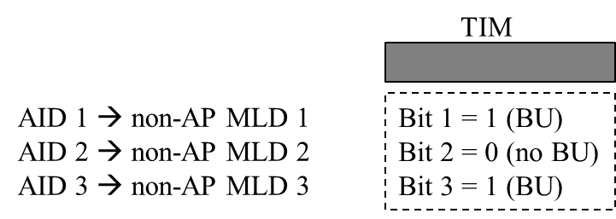
Default (TIDs mapped to all enabled links)
AID is assigned to a non-AP MLD
Each bit of TIM element corresponds to one non-AP MLD
If the bit is set to 1, non-AP MLD has BU
If the bit is set to 0, non-AP MLD doesn’t have BU
When the bit associated with a non-AP MLD is set to 1, the non-AP MLD can retrieve buffered data through any link
AP MLD may use a link recommendation (LR) element to indicate a recommended link(s)
A bitmap is assigned to a non-AP MLD, each bit of the bitmap is mapped to a link and indicates whether use of the link is recommended

Slide 6
Different TIDs are mapped to different sets of links
TIM indicates BU status of each non-AP MLD
Use a new multi-link TIM element to indicate BU status of different link-sets
A bitmap is assigned to a non-AP MLD
Each bit of the bitmap is mapped to a link set and indicates BU status (e.g. set to 1 if there is BU, set to 0 if no BU)
Link recommendation element may be used to indicate recommended link for a link-set

Slide 7
Summary
When TIDs are mapped to all enabled links (default)
AID is assigned to a non-AP MLD
Each bit of the TIM element corresponds to one non-AP MLD
When different TIDs are mapped to different sets of links
Use a new multi-link TIM (ML-TIM) element to indicate BU status of different link-sets
When a TID is mapped to more than one link (including the default mode)
Use a new link recommendation element that indicates to a non-AP MLD one or more recommended links for DL/UL data exchange

Slide 8
Straw Poll #1
Do you support to add the following text to 802.11be SFD?
Each bit of the TIM element corresponds to one non-AP MLD:
If the bit is set to 1, non-AP MLD has BU
If the bit is set to 0, non-AP MLD doesn’t have BU

Slide 9
Straw Poll #2
Do you support to add the following text to 802.11be SFD?
An AP MLD shall buffer individually addressed BUs addressed to a non-AP MLD if all the non-AP STAs affiliated with the non-AP MLD are in the PS mode

