Slide 1
Calibration for Implicit Feedback
Date: 2020-01-12
Authors:
Name | Affiliations | Address | Phone | email
Qinghua | Intel
Feng Jiang
Ziv Avital
Xiaogang Chen
Roya Doostnejad
Po-kai Huang
Assaf Gurevitz
Robert Stacey
Laurent Cariou

Slide 2
Background (1/2)
Explicit feedback suffers from large overhead and high complexity for large antenna arrays
Implicit feedback reduces the overhead and draws significant attentions [1-3]
However, implicit feedback requires accurate calibration
  Chain response varies with gain setting
  DL MU-MIMO is sensitive to cross-talk
Two calibration types i.e. self-calibration and mutual calibration
Li, Jiang, et al., Intel

Slide 3
Background (2/2)
Self-calibration
  Pros — Don’t need standard support
  Cons — Need additional hardware; Hard to achieve high accuracy
Mutual calibration (802.11n)
  Pros — No self-calibration hardware
  Cons — Incompatible with existing explicit feedback in terms of hardware and frame exchange sequence; Not adopted by the market
In [1], test results show that it’s possible to achieve -37dB@50% EVM for implicit channel estimation

Slide 4
Remark
Implicit feedback requires Tx/Rx chain calibration at the transmitter
Channel matrix feedback was in 802.11n spec but not implemented
In contrast, compressed beamforming feedback using Givens angles is widely implemented
It is desirable to have a backward-compatible calibration scheme i.e. reusing the implemented compressed beamforming feedback

Slide 5
Problem Statement
Want a simple calibration scheme for implicit feedback
  No self-calibration hardware
  Compatible to explicit feedback
  Low overhead

Slide 6
Proposed Solution
Reuse the hardware and frame exchange sequence of existing compressed beamforming feedback for mutual calibration

Slide 7
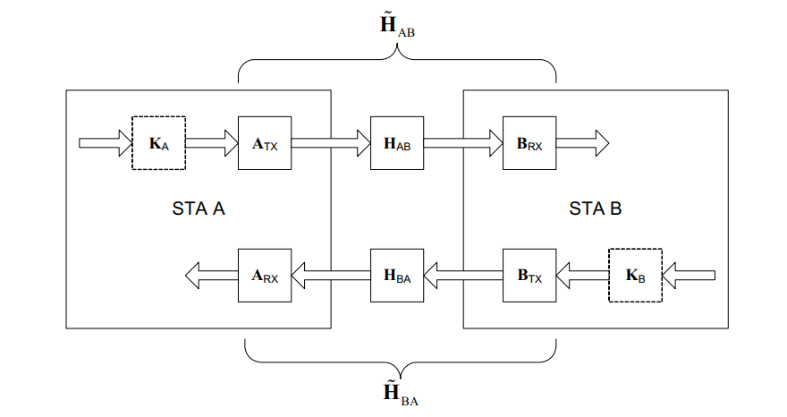
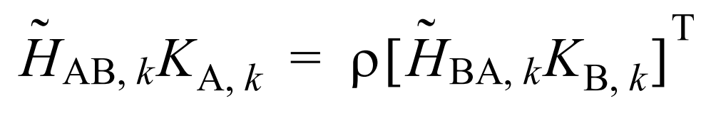
Recap of 11n Calibration
Beamformer obtains both DL and UL channels and compares them
AP
STA
Channel reciprocity:

Slide 8

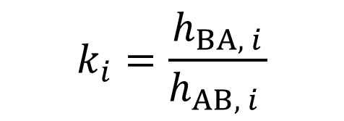
Calibration and Compensation
AP
STA
Uplink channel estimated by A
$$k_{i}=\frac{h_{BA, i}}{h_{AB, i }}$$
$$k_{i} h_{AB, i }=h_{BA, i}$$
Compensation factor at A
Downlink channel fed back by B

Slide 9
Remarks
Beamformer needs channel estimates of both forward and backward directions for estimating compensation factor
Beamformee only needs to feed back the channel estimates calculated from one of its receive antennas

Slide 10
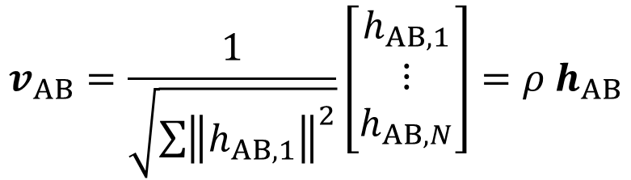
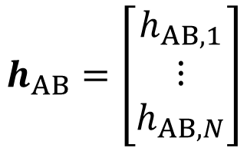
Channel Vector vs. Beamforming Vector
For an Nx1 MISO channel, a beamforming vector is just a normalized channel vector
Namely, for MISO channels, beamforming vector and channel vector only differ by a global factor, which doesn’t affect the beamforming
$$h_{AB}=\left[\begin{matrix}h_{AB, 1} \\ ⋮ \\ h_{AB, N}\end{matrix}\right]$$
$$v_{AB}=\frac{1}{\sqrt{\sum{{\left\|h_{AB, 1}\right\|}^{2}}}}\left[\begin{matrix}h_{AB, 1} \\ ⋮ \\ h_{AB, N}\end{matrix}\right]=ρ h_{AB}$$
Power normalization factor

Slide 11
Observation
The beamforming vector for the transmitter to beamform to a single receiver’s antenna preserves all the phases and amplitudes information required for calibrating the transmitter’s antennas
The existing feedback scheme i.e. the compressed beamforming feedback can be reused for feeding back the beamforming vector

Slide 12
Reusing Beamforming Vector for Calibration
For NxM MIMO channel, beamformee selects one antenna out of M receive antennas, downgrades the channel to Nx1 MISO, and feeds back the beamforming vector of the MISO as the channel vector
Beamformer uses the fed back beamforming vector as the channel vector in estimating the compensation factors
Reuse Givens quantization. Don’t need new hardware

Slide 13
Feedback Calculations
Conventional beamforming feedback
h₁
h_{N}
v
…
SVD of H_{M x N}
φ_{i} , ψ_{j}
H_{M x N}
Proposed calibration feedback skips the SVD step
h₁
h_{N}
h₁
v
…
φ_{i} , ψ_{j}

Slide 14
Explicit Feedback Sequence
Compressed beamforming report consists of quantized NxN_{STS} beamforming matrixes
Beamformer
NDPA
NDP
Beamformee
Compressed beamforming report

Slide 15
Calibration Feedback Sequence
Reuse explicit beamforming feedback sequence
Compressed beamforming report consists of quantized Nx1 beamforming vectors for the selected beamformee antenna
Beamformer
NDPA
NDP
Compressed beamforming report
Beamformee

Slide 16
Backward Sounding
Remember beamformer needs both forward and backward channels
The LTF of the calibration feedback frame itself can be used for backward sounding
Beamformer
NDPA
NDP
Beamformee
LTF
Compressed beamforming report
Backward channel sounding; implicit feedback; and channel training for demodulating payload
Nx1 vectors instead of NxN_{STS} matrixes, much smaller than conventional beamforming feedback

Slide 17
Remarks
Both calibration feedback and implicit feedback can be all fit into one explicit sounding/feedback sequence
The overhead of calibration plus implicit feedback is still smaller that of the explicit beamforming feedback
Calibrations can be done for each STA group for compensating the transceiver variations e.g. different AGC/PA settings
To avoid impact of low quality CSI feedback, the AP may calculate the calibration parameter for each STA separately and apply each STA’s calibration parameter to its own DL channel estimation

Slide 18
Simulation Settings (1/2)
DL MU-MIMO
  AP has 4 antennas and each STA has 2 antennas
  3 STAs each receiving 1 stream
Each Tx chain and each Rx chain response differ by a phase
Channel D, MCSs 7, 9
Two quantization schemes for calibration feedback
  Ideal quantization without quantization error
  802.11 (7, 9) bit quantization

Slide 19
Simulation Settings (2/2)
AP solicits calibration feedbacks from 2 STAs
Each STA sends calibration feedbacks for one of its 2 antennas
AP combines the two compensation weight estimates
Calibration is done for 1 channel and the compensation weights are used for 5000 channels
  For 3 STA MU-MIMO, calibration is done with 1 STA’s 2 antennas
  For 4 STA MU-MIMO, calibration is done with all 4 STAs’ 8 antennas

Slide 20
MCS 7, 3 Users
Less than 0.4 dB

Slide 21
MCS 7, 4 Users
Less than 0.3 dB

Slide 22
MCS 9, 3 Users
Less than 0.4 dB

Slide 23
MCS 9, 4 Users
0.65 dB

Slide 24
Lab Test Setup
Two 4-antenna 11ax devices: A and B
Antennas pairs are connected by cables
Measured several channels from device A to device B, and then measured several channels from device B to device A
Measurement results for 80MHz band and 2x LTF
The time interval between measurements is 5 seconds
DL
UL
A
B

Slide 25
Lab Measurement Results (1/4)

Slide 26
Lab Measurement Results (2/4)

Slide 27
Lab Measurement Results (3/4)

Slide 28
Lab Measurement Results (4/4)

Slide 29
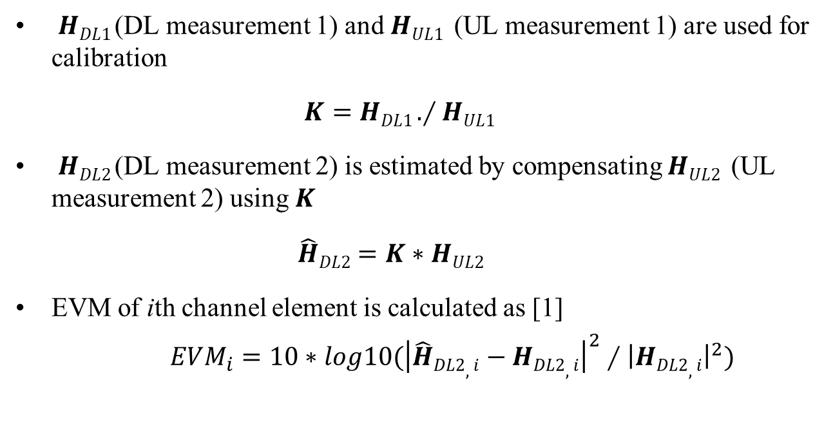
Performance Evaluation
$HDL1$(DL measurement 1) and $HUL1$ (UL measurement 1) are used for calibration
$K=HDL1 .∕HUL1$
$HDL2$(DL measurement 2) is estimated by compensating $HUL2$ (UL measurement 2) using $K$
$\hat{H}DL2=K∗HUL2$
EVM of ith channel element is calculated as [1]
$EVM_{i}=10∗log10({\left|\hat{H}DL2,i−HDL2,i\right|}^{2}∕{\left|HDL2,i\right|}^{2})$

Slide 30
Simulation vs. Measurement

Slide 31
Conclusions
Propose a calibration scheme with backward compatibility, simple implementation, and high efficiency
Achieve the performance of ideal calibration feedback
Enable implicit feedback without challenging self-calibration
Simulation results matched with lab test data

Slide 32
Reference
[1] IEEE 802.11-19/1193r0, Calibration of Implicit Sounding, Nov. 2019
[2] IEEE 802.11-19/1934r0, Precoding Performance Using Implicit Channel Estimation, Nov. 2019
[3] IEEE 802.11-19/0767, Implicit Channel Sounding in IEEE 802.11 (Feasibility Study), July 2019

Slide 33
Backup

Slide 34
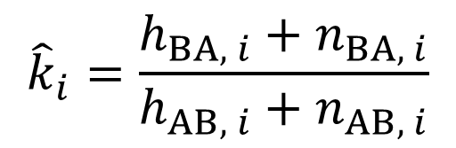
Fading Impact
Calibration signal can be in deep fade at some subcarriers
AP should solicit calibration feedbacks i.e. beamforming vectors for more than one STA antenna
Drop to zero and leave only noises
$${\hat{k}}_{i}=\frac{h_{BA, i}+n_{BA, i}}{h_{AB, i}+n_{AB, i}}$$
Channel response
Signal in deep fade
Freq

Slide 35
Diversity Combing (1/2)
AP solicits beamforming vectors for M STA antennas
STA
AP

Slide 36
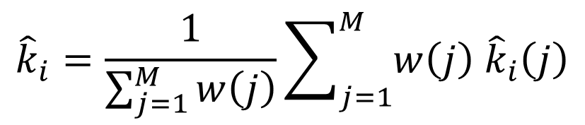

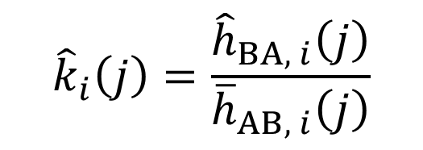
Diversity Combing (2/2)
AP estimates the compensation weight using the beamforming vectors fed back for the M STA antennas
AP combines the estimates using the received uplink sounding strengths as the weighting factors
$${\hat{k}}_{i}=\frac{1}{\sum_{j=1}^{M}{w\left(j\right)}}\sum_{j=1}^{M}{w\left(j\right) {\hat{k}}_{i}\left(j\right)}$$
where $i$ is AP antenna index; $j$ is STA antenna index;
Uplink channel estimate
$${\hat{k}}_{i}\left(j\right)=\frac{{\hat{h}}_{BA, i}\left(j\right)}{{\overline{h}}_{AB, i}\left(j\right)}$$
$$w\left(j\right)=\left\|{\hat{h}}_{BA, i}\left(j\right)\right\|$$
Downlink channel estimate, fed back and nomalized

Slide 37
Calibration Error

