Slide 1
Simulation Results of 4K QAM
Date: 2020-01-10
Authors:
Name | Affiliations | Address | Phone | email
Ron Porat | Broadcom |  |  | ron.porat@broadcom.com
Rethna Pulikkoonattu | Broadcom

Slide 2
Abstract
4K QAM can potentially boost the max PHY throughput by 20%
We investigate and show that in a 4x2 MIMO configuration, with beamforming, 4K QAM + rate 5/6 is a feasible operating scenario

Slide 3
Simulation Setup
PHY BW: 160MHz
QAM: Gray mapping, similar mapping as 802.11ax 1K QAM
MIMO:
2x2 AWGN
4x2 with BF (Nss=2)
RF Impairments: all impairments added for both Tx and Rx.
Including Phase Noise and IQ imbalance, CFO, Quantization noise, LO leakage etc.,
Channels: AWGN, 11nB, 11nD
LDPC
Packet Length= 4KB

Slide 4
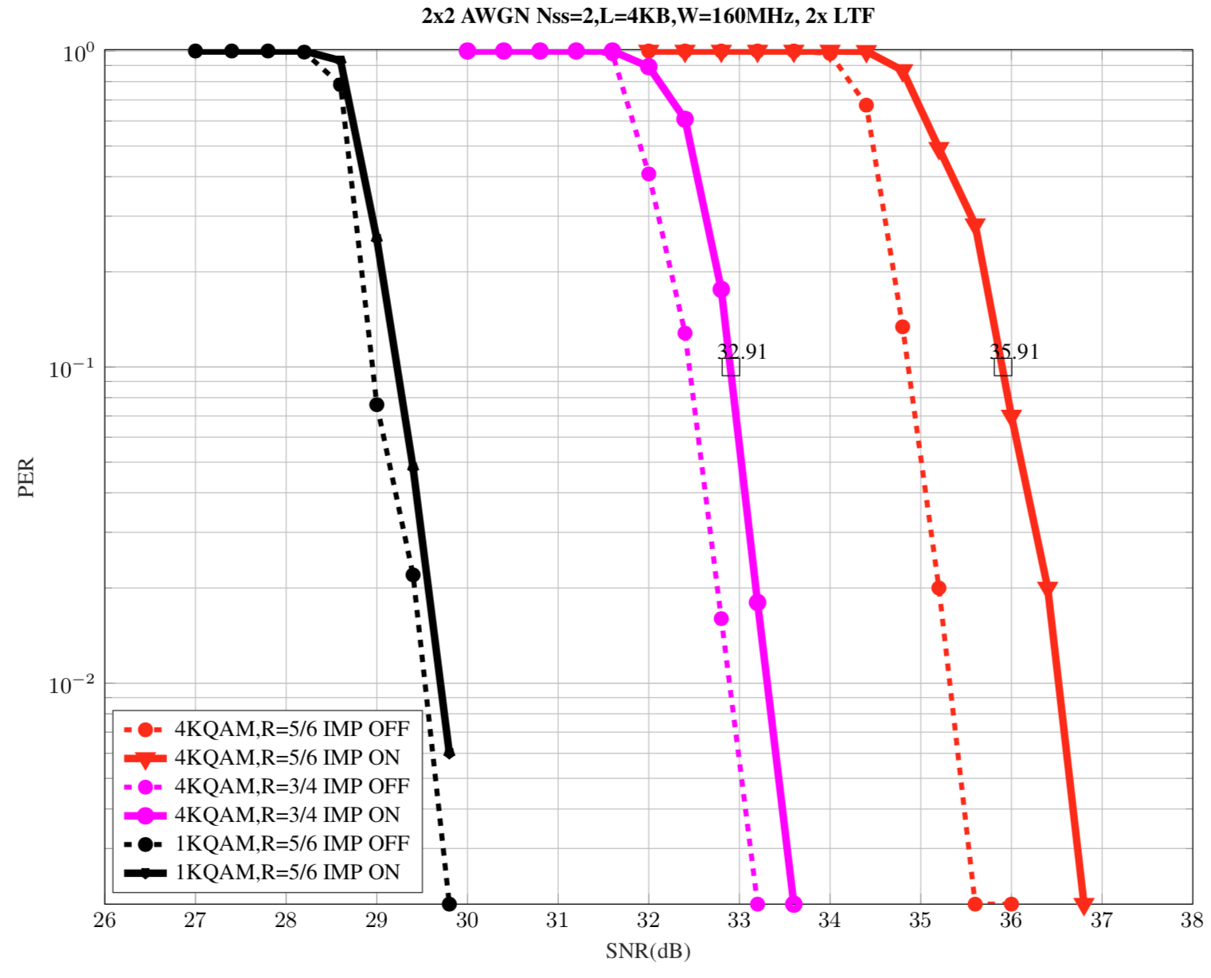
2x2 AWGN: RF Impairments ON/OFF
TxEVM=-42dB when RF IMP is ON
RF Impairments present in both Tx and Rx

Slide 5
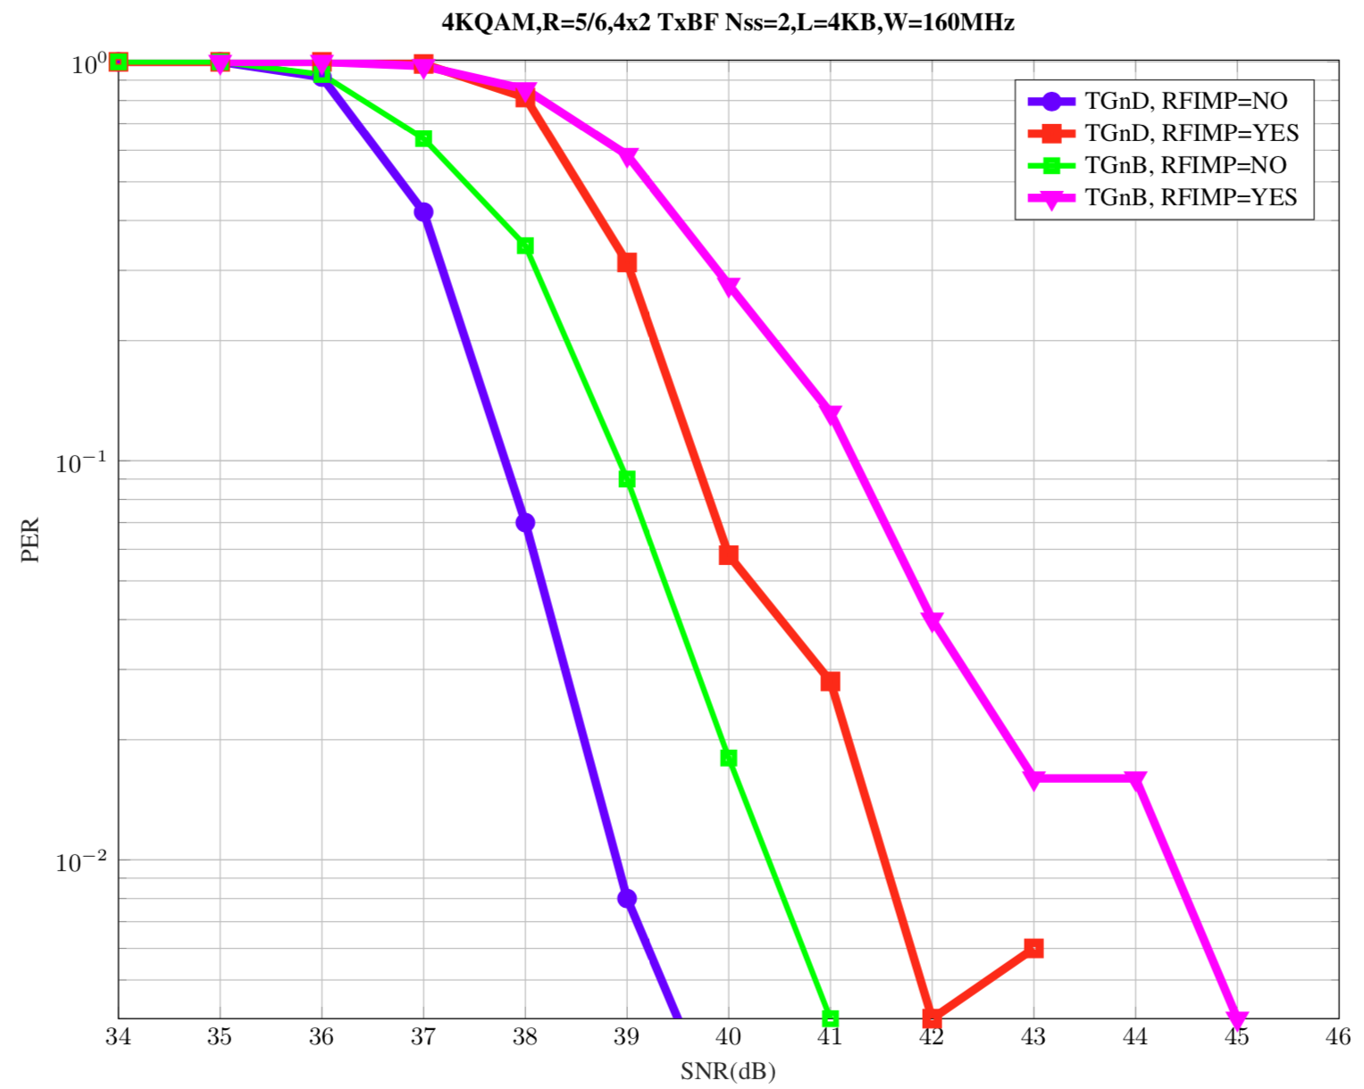
4x2 TxBF Fading Channels: RF Impairments ON/OFF
TxEVM=-42dB when RFIMP is ON
Impairments added at both Tx and Rx

Slide 6
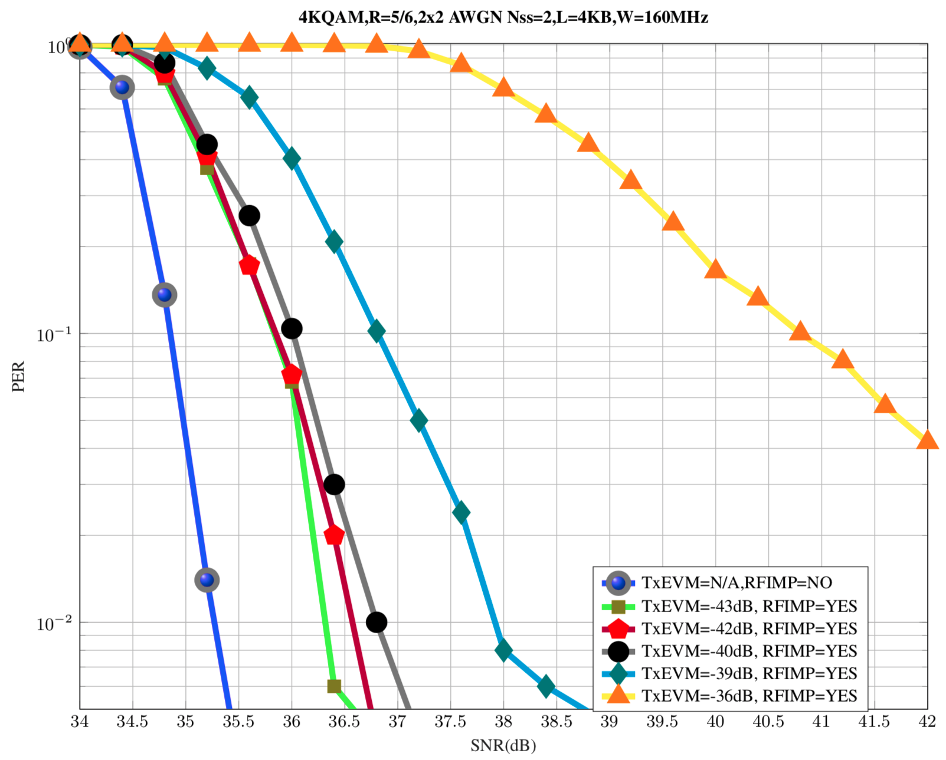
Tx EVM impact: AWGN 2x2: rate=5/6

Slide 7
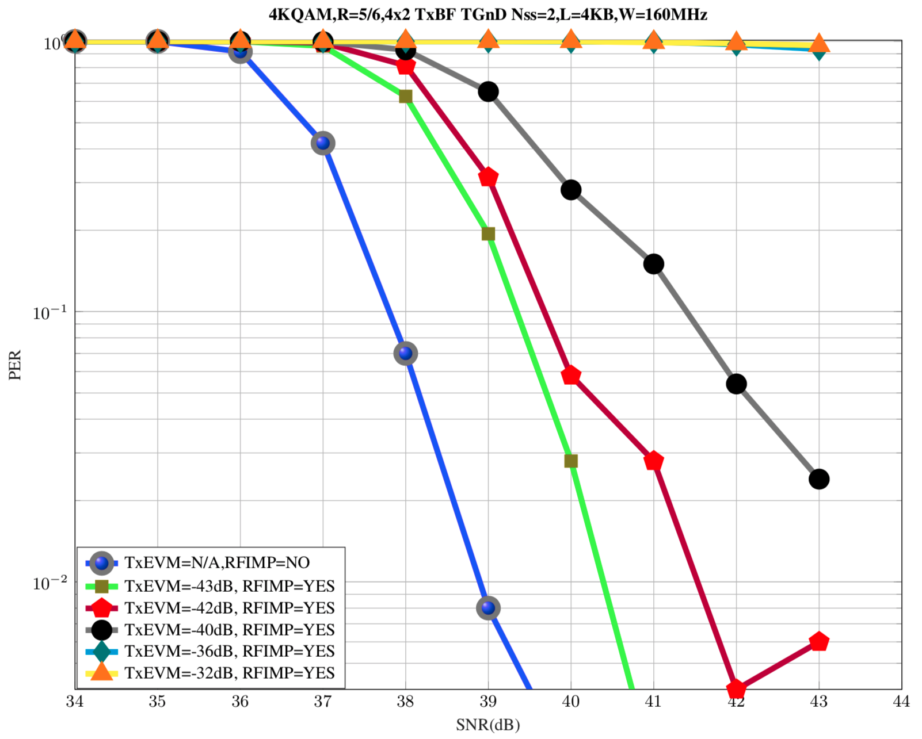
Tx EVM impact: TGnD 4x2: rate= 5/6

Slide 8
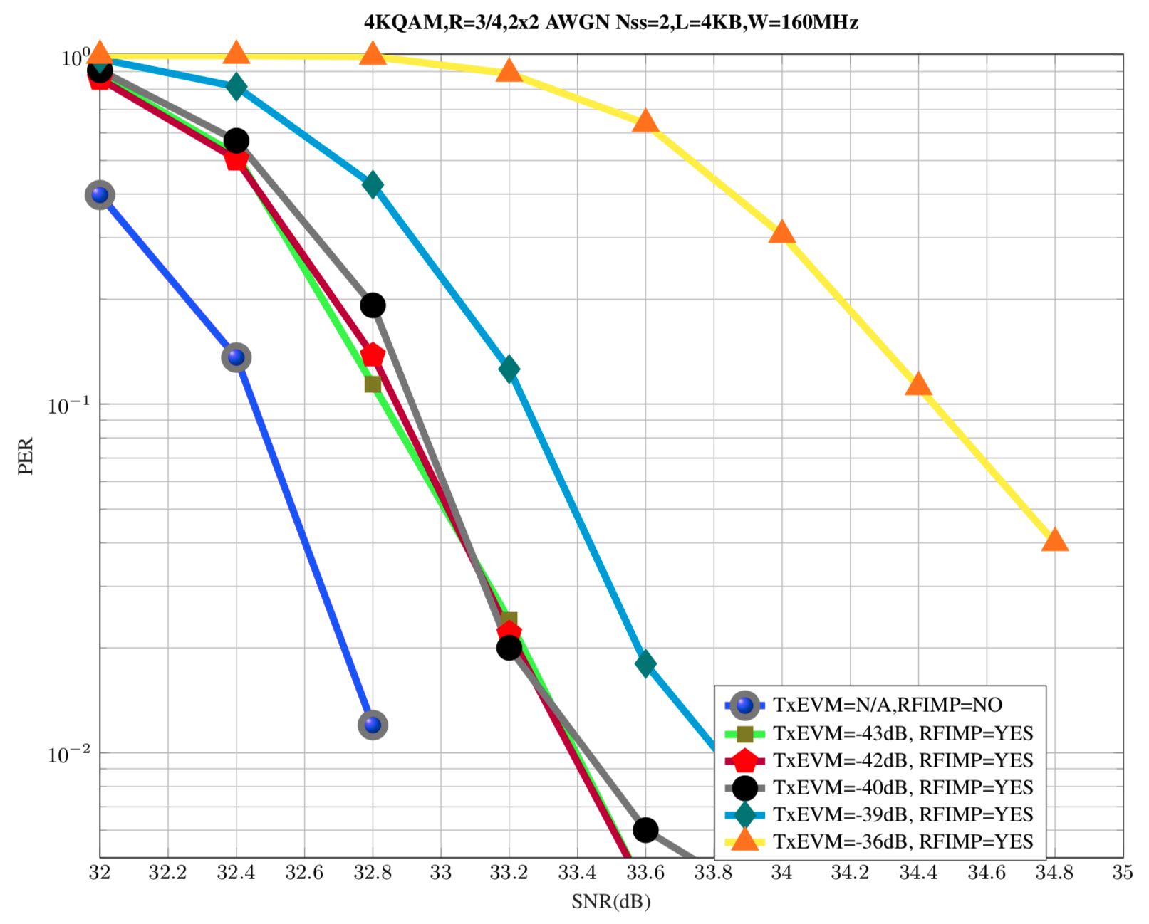
Tx EVM impact: AWGN 2x2: rate=3/4

Slide 9
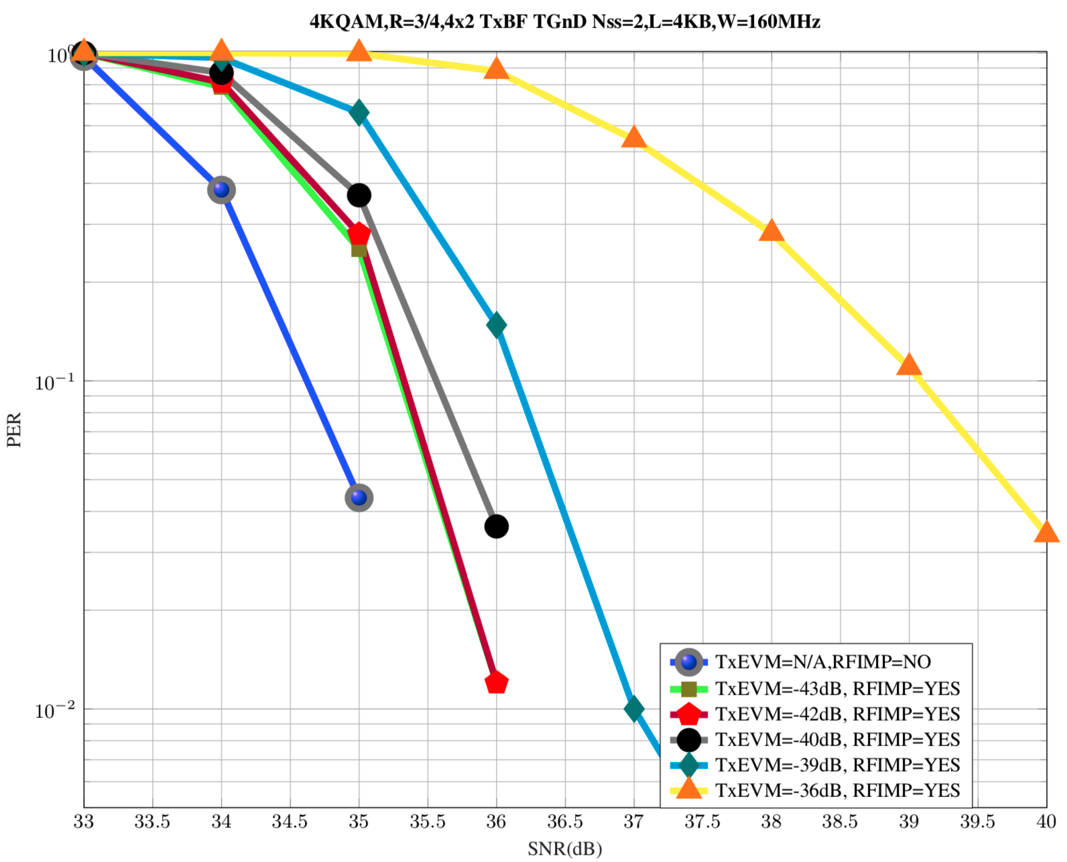
Tx EVM impact: TGnD 4x2: rate=3/4

Slide 10
Summary
4K QAM @ rate 5/6, 4x2 with Tx BF : SNR requirements are achievable
For best performance for rate 5/6 TxEVM of -43dB is needed

