Slide 1
Performance Comparison of LTF Designs in JT
Date: 2020-01-10
Authors:
Name | Affiliations | Address | Phone | email
Ron Porat | Broadcom |  |  | ron.porat@broadcom.com
Srinath Puducheri

Slide 2
Abstract
In [1] the authors compare two LTF designs - tone interleaving and orthogonal mapping in frequency
Here we provide further investigation of the preferred method in [1], tone interleaving, vs. regular P matrix as used in 11ax. Specifically we compare two methods with equal overhead – large P matrix using 2x LTF vs. small P matrix with tone splitting using 4x LTF.
The setting of the investigation uses JT where the impact is measured on the sounding NDP performance in the presence of residual AP-AP CFO and AP-STA CFO

Slide 3
JT performance with residual CFO during NDP (1)
We consider two types of NDP LTFs:
  “2x-all”: All streams present on all tones of 2x-LTFs, by making use of one big P matrix.
  “4x-split”: Streams are split equally between odd tones (1, …, Nss/2) and even tones (Nss/2+1, …, Nss ) of 4x-LTFs, by making use of half-size P matrices.
We consider two types of residual CFOs:
  AP-AP: Between slave APs and master AP.
  STA-AP: Between STA being sounded and master AP
AP-AP CFO:
  All slave APs have the same magnitude of CFO (10Hz, 50Hz, or 100Hz) for NDP, but with random and independent signs.
  For jointly steered data frame, this is modeled as fixed phase offset (4d) relative to master AP, with random signs across slave APs

Slide 4
JT performance with residual CFO during NDP (2)
STA-AP CFO:
  All STAs have same magnitude of CFO (1kHz) for NDP, but with random and independent signs
  Each STA estimates and compensates common phase rotation from one LTF to the next, via pilots
  Pilots same for both “2x-all” and “4x-split” cases :
    Each pilot has contributions from all the spatial streams (first-row of P-matrix repeated).
Simulated the impact of AP-AP and STA-AP CFO for 2AP and 4AP 75% loading scenarios (along with other impairments) as considered in [2].
  Baseline: single AP, “2x-all” LTF, non-zero STA CFO during NDP, phase correction based on pilots

Slide 5
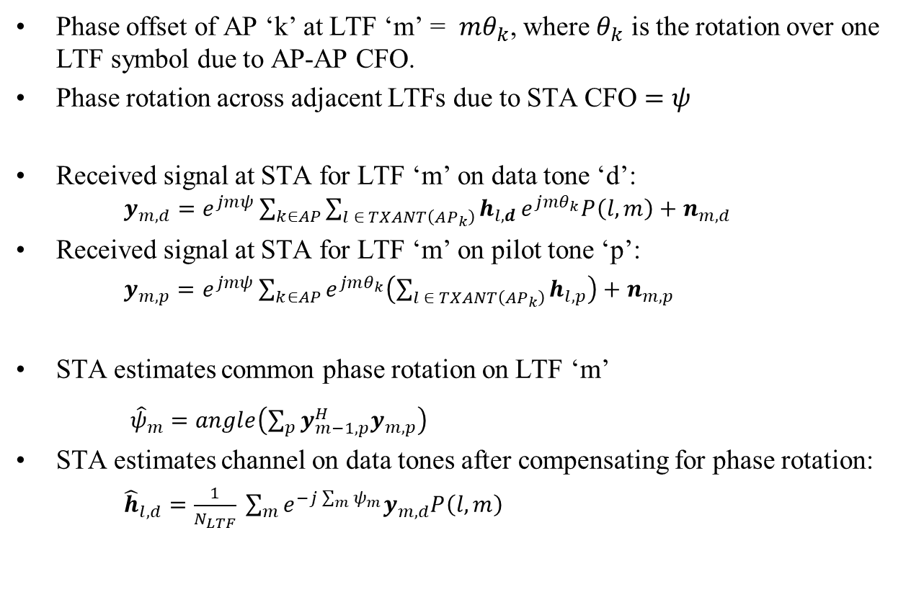
System model for NDP
Phase offset of AP ‘k’ at LTF ‘m’ = $mθ_{k}$, where $θ_{k}$ is the rotation over one LTF symbol due to AP-AP CFO.
Phase rotation across adjacent LTFs due to STA CFO $=ψ$
Received signal at STA for LTF ‘m’ on data tone ‘d’: $y_{m,d}=e^{jmψ}\sum_{k∈AP}{\sum_{l ∈ TXANT\left(AP_{k}\right)}{h_{l,d}}}e^{j{mθ}_{k}}P\left(l,m\right)+n_{m,d}$
Received signal at STA for LTF ‘m’ on pilot tone ‘p’:
  $y_{m,p}=e^{jmψ}\sum_{k∈AP}{e^{jmθ_{k}}\left(\sum_{l ∈ TXANT\left(AP_{k}\right)}{h_{l,p}}\right)}+n_{m,p}$
STA estimates common phase rotation on LTF ‘m’
  ${\hat{ψ}}_{m}=angle\left(\sum_{p}{y_{m−1,p}^{H}y_{m,p}}\right)$
STA estimates channel on data tones after compensating for phase rotation:
${\hat{h}}_{l,d}=\frac{1}{N_{LTF}} \sum_{m}{e^{−j\sum_{m}{ψ_{m}}}y_{m,d}P\left(l,m\right)}$

Slide 6
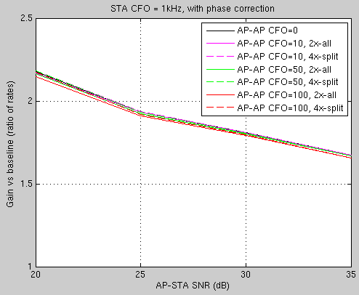
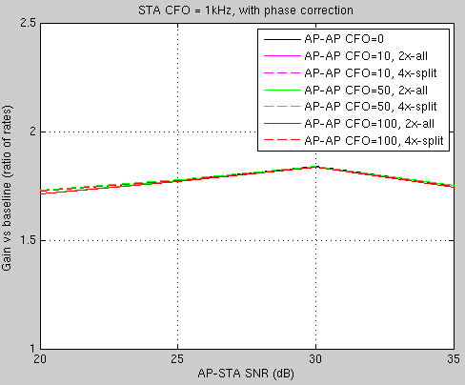
Simulation results– 2AP
X = 0dB
X = 10dB

Slide 7
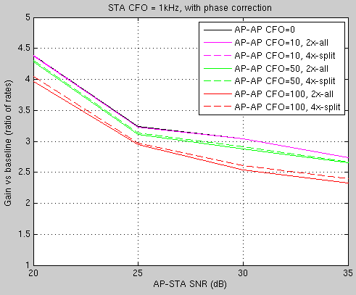
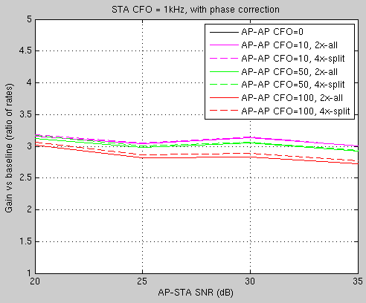
Simulation results– 4AP
X = 0dB
X = 10dB

Slide 8
Conclusions
The two LTF types provide practically similar performance
To ensure best performance for JT, residual AP-AP CFO needs to be <= 50Hz for the NDP.

Slide 9
References
“Performance Comparison of LTF Designs for EHT,” IEEE 802.11-19/1867
“JT performance with Multiple Impairments” IEEE 802.11-19/1597

