Slide 1
Simulation results with new 4 µs and 2 µs symbols
Date: 2020-01-13
Authors:

Slide 2
Introduction
Clause 30.3.12.5 of TGba Draft 5.0 specifies correlation test for the MC-OOK symbols, as part of the WUR transmit specification
Several of the existing MC-OOK example symbols does not pass the correlation test
In this presentation, we provide a new 4 µs and 2 µs MC-OOK symbols
Examine the correlation metric of the proposed symbols, compare it with the existing symbols
Study the PER performance in AWGN and Channel D
Provide the PAPR

Slide 3
Proposed 4 µs and 2 µs MC-OOK symbols
4 µs symbol | Center 13 subcarrier coefficients
Example 3 (Proposed) | $\frac{1}{\sqrt{2}}${-1+1j 1+1j -1+1j 1+1j -1-1j 1-1j 0 1-1j 1+1j -1-1j -1-1j 1+1j 1+1j}
2 µs symbol | Center 13 subcarrier coefficients
Example 3 (Proposed) | $\frac{1}{\sqrt{80.8}}$ {3+5j 0 -7+5j 0 -7-5j 0 0 0 -5+1j 0 7+7j 0 5-5j}
The scaling factor has been chosen so that the MC-OOK On symbol is normalized to have the same power as the current examples in the spec. D5.0

Slide 4
PAPR of MC-OOK symbols
4 µs symbols | PAPR (dB)
Example 1 | 2.07
Example 2 | 1.28
Example 3 | 2.25
New Example 1 (Steve) | 6.19
New Example 2 (Miguel) | 3.92
New Example 3 (Proposed) | 3.47
2 µs symbols | PAPR (dB)
Example 1 | 2.28
Example 2 | 0.95
Example 3 | 3.47
New Example 3 (Proposed) | 2.33
PAPR computed using the reference pulse (without any cyclic shifts) at 160 MHz sampling frequency. Windowing was not applied.

Slide 5
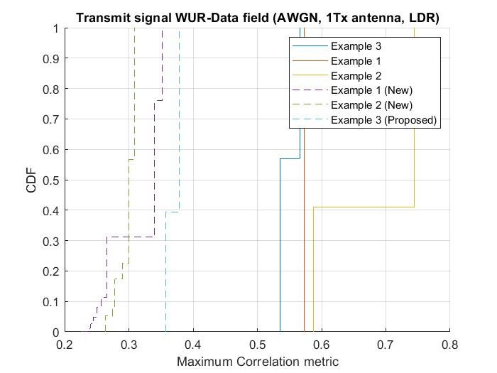
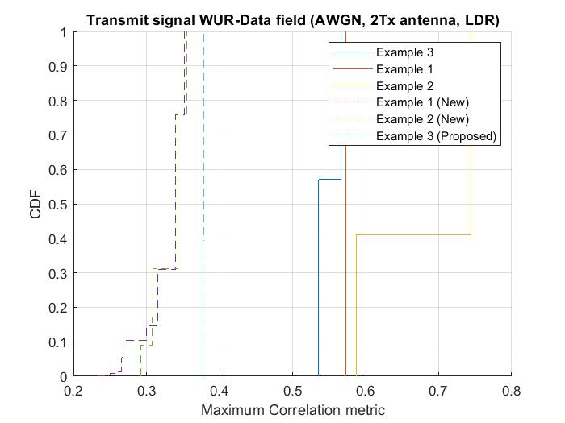
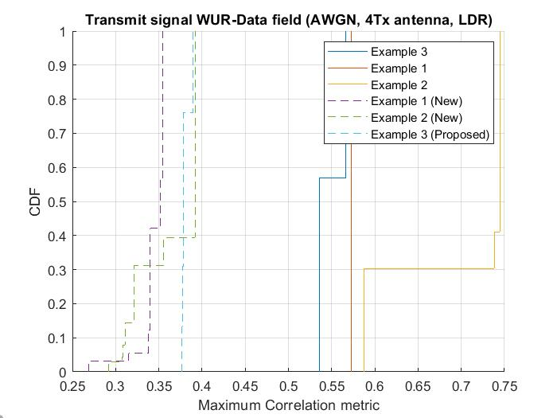
Correlation metric for LDR WUR-Data with 4 µs symbols
1 Tx antenna
2 Tx antenna
4 Tx antenna
8 Tx antenna
CDF obtained using 1000 realizations of WUR-PPDU with random data
Correlation metric can differ across packets due to randomness in data and cyclic shifts
For multiple Tx antennas, we take the worst case correlation metric across the TX antennas
The proposed 4 µs MC-OOK symbol has the maximum correlation metric below 0.4, and pass the correlation test
All 3 new 4 µs MC-OOK symbols pass the correlation test

Slide 6
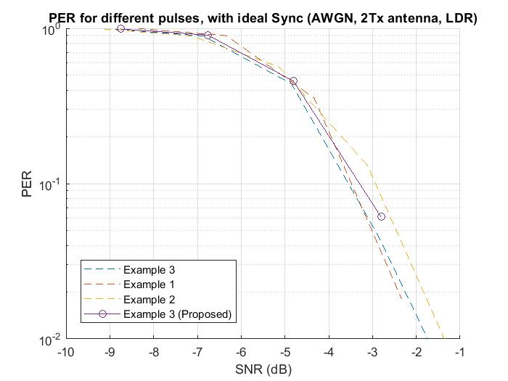
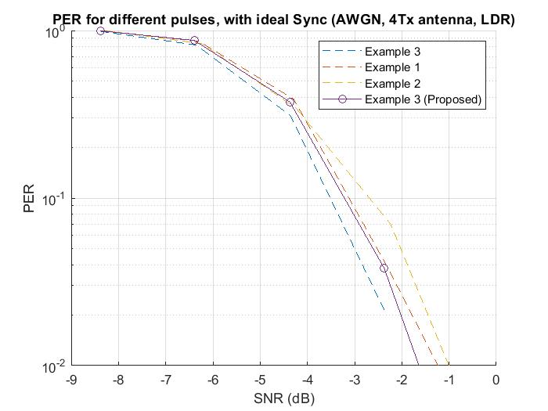
PER of proposed 4 µs symbol with ideal Sync in AWGN (LDR)
1 Tx antenna
2 Tx antenna
4 Tx antenna
The proposed 4 µs MC-OOK symbol has similar PER performance, and comparable to current examples in the spec.
< 0.3 dB performance gap (@10% PER), compared to the current example with the lowest PER
Here the SNR is computed over the 4 MHz WUR bandwidth
Both PA and receiver phase noise are modeled for these PER studies

Slide 7
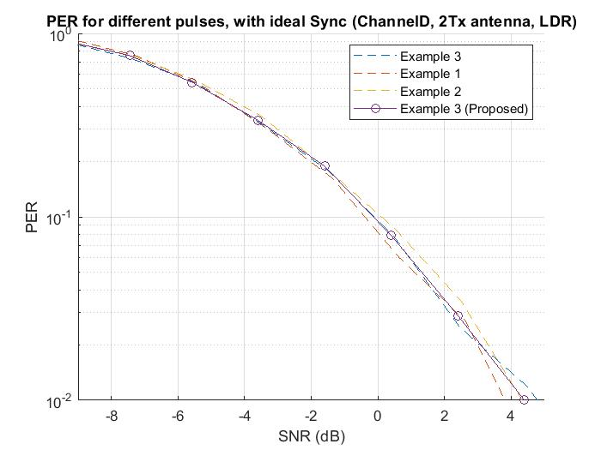
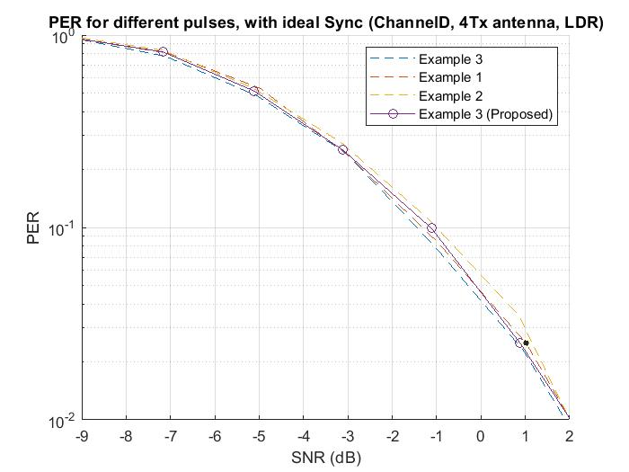
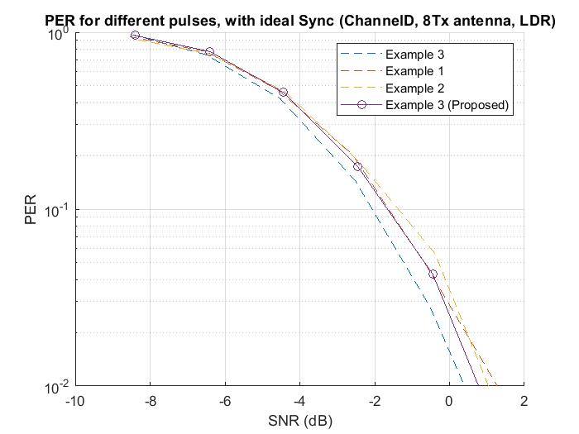
PER of proposed 4 µs symbol with ideal Sync in Channel D (LDR)
2 Tx antenna
4 Tx antenna
1 Tx antenna
The proposed 4 µs MC-OOK symbol has similar PER performance, and comparable to current examples in the spec
< 0.2 dB performance gap (@10% PER), compared to the current example with the lowest PER
8 Tx antenna

Slide 8
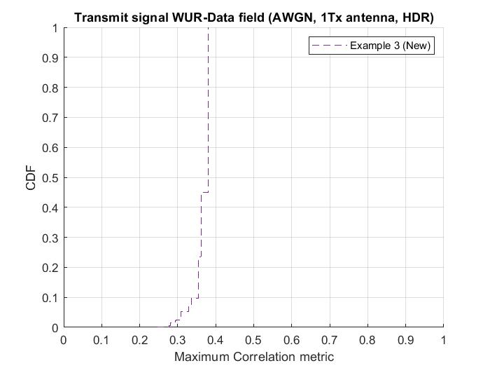
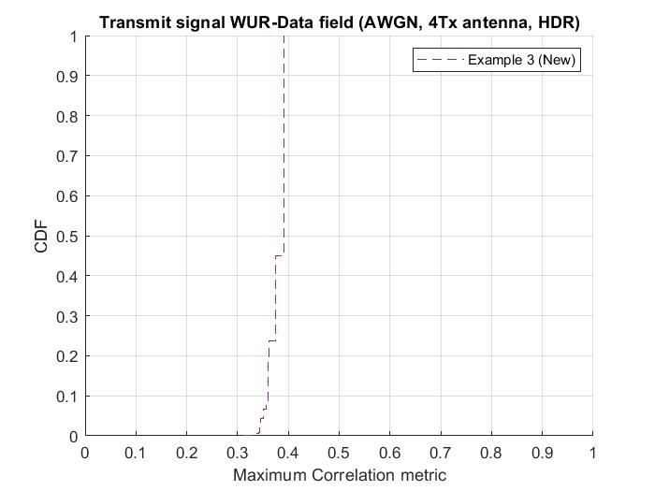
Correlation metric for HDR WUR-Data with 2 µs symbols
1 Tx antenna
2 Tx antenna
4 Tx antenna
CDF obtained using 1000 realizations of WUR-PPDU with random data
Correlation metric can differ across packets due to randomness in data and cyclic shifts
For multiple Tx antennas, we take the worst case correlation metric across the TX antennas
The proposed 2 µs MC-OOK symbol has the maximum correlation metric < 0.4, and pass the correlation test

Slide 9
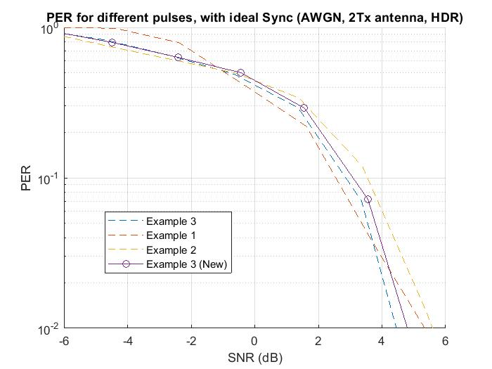
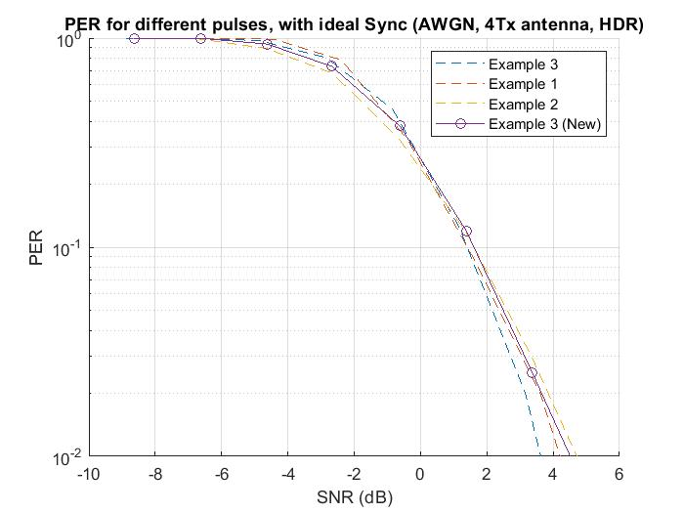
PER of proposed 2 µs symbol with ideal Sync in AWGN (HDR)
1 Tx antenna
2 Tx antenna
4 Tx antenna
The proposed 2 µs MC-OOK symbol has similar PER performance, and comparable to the current examples in the spec
< 0.3 dB performance gap (@10% PER), compared to the current example with the lowest PER
Here the SNR is computed over the 4 MHz WUR bandwidth
Both PA and receiver phase noise are modeled for these PER studies

Slide 10
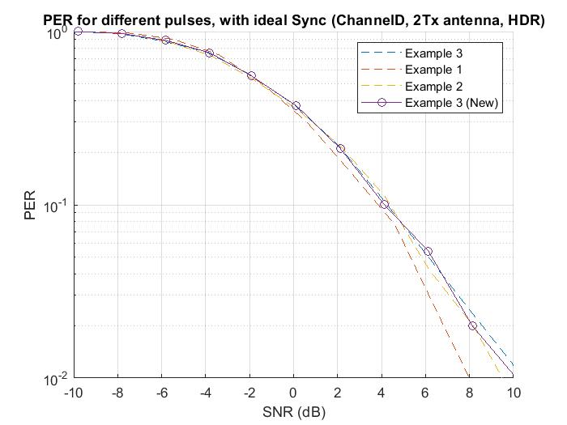
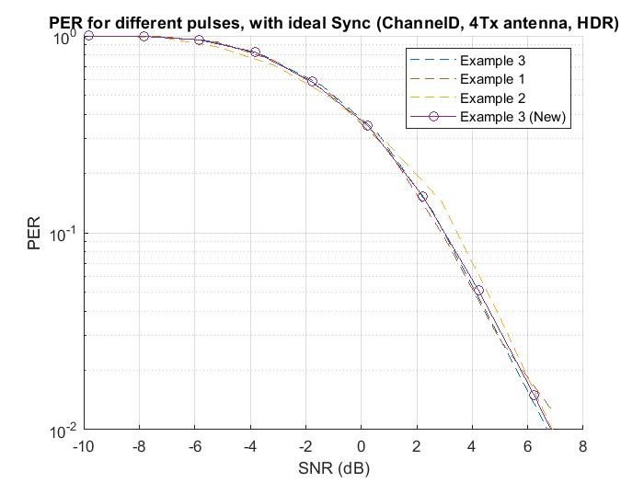
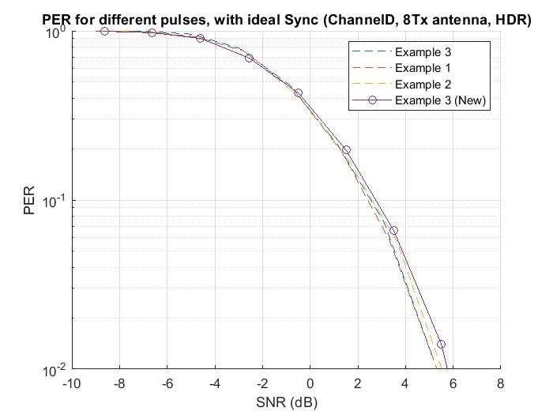
PER of proposed 2 µs symbol with ideal Sync in Channel D (HDR)
1 Tx antenna
2 Tx antenna
4 Tx antenna
The proposed 2 µs MC-OOK symbol has similar PER performance, and comparable to current examples in the spec
< 0.1 dB performance gap (@10% PER), compared to the current example with the lowest PER
8 Tx antenna

Slide 11
Conclusions
The proposed 4 µs and 2 µs MC-OOK symbols have reasonably low PAPR, good PER performance and pass the correlation test with multiple Tx antennas
We suggest to replace the existing Example 3 symbols with the proposed 4 µs and 2 µs MC-OOK symbols given in slide 3 of this presentation.

