Slide 1
On Coordinated Spatial Reuse in 11be
Date: 2019-xx-xx
Authors:
Name | Affiliations | Address | Phone | Email
Gary Anwyl | Mediatek | 2840 Junction Ave. San Jose, CA, 95134
Jianhan Liu |  |  |  | jianhan.liu@mediatek.com
Thomas Pare

Slide 2
Coordinated Spatial Reuse (CSR)
Spatial Reuse makes a lot of sense in coordinated multi-AP systems
  Different AP can transmit to STAs that are close to itself.
  Coordinated Power Control benefits the multi-AP BSSs
    Note that the fundamental difference from spatial reuse with OBSS in HE is that spatial reuse in EHT are within one network.
    Temporarily reduce power for one AP or one STA to increase the network throughput benefits every one in the network including itself.
Coordinated Spatial Reuse (CSR) is one of the Coordinated Multi-AP modes considered for 11be
  11-19-1534-00-00be “Coordinated Spatial Reuse Performance Analysis”
  11-19-0801-00-00be “AP Coordination in EHT”
  Simpler than Coordinated Beamforming and Joint Beamforming
    Doesn't require complete CSI between all APs and STAs
    Doesn't require rigorous synchronization among APs
  Only path loss information might be needed

Slide 3
Coordinated Spatial Reuse Diagram
APs coordinated transmit power to reduce interference and increase total throughput
AP1
AP2
STA2
STA1
Two Cents to think about CSR:
  1. If there are leakages in CBF due to channel estimation error or channel aging, it automatically behaves like CSR.
  2.The protocols used for CBF can be directly used for CSR.

Slide 4
Multi-AP Simulation
Modes
  Coordinated OFDMA (C-OFDMA) - Each AP TXs in a different 20M RU
  Spatial Reuse (SR) – All APs transmit simultaneously at full power
  Coordinated Spatial Reuse with TPC (CSR) - Exhaustive search to select Transmit Power Control (TPC) for each AP that maximizes sum goodput. MCS and TPC selection is based on path loss for all AP-STA combinations
  11ax OBSS_PD Spatial Reuse (SR 11ax) – 11ax OBSS_PD. First AP sends at full power. Each additional AP sends with OBSS_PD TPC based on AP-AP path loss
Simulation Sequence
  Performance metric is the Sum of the Goodput of each AP-STA pair
    For each STA use CSI to calculate RX signal from own AP and interference from each OBSS AP. Include thermal noise floor.
    Compute RBIR SINR based on per subcarrier signal and interference
    Use RBIR SINR to estimate PER for each MCS
    Estimate Goodput based on selected MCS and estimated PER

Slide 5
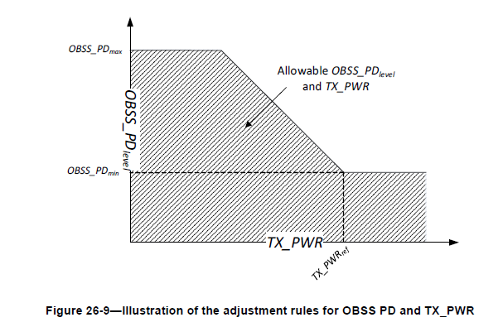
11ax OBSS PD settings
STA measures RX OBSS_PD_level for OBSS then jointly lowers TX level and raises PD level in order to TX
Parameters
  OBSS_PD_min = -82dBm
  OBSS_PD_max = -62 dBm
  Nominal TX = +21 dBm
  For OBSS_PD_level in range -82..-62 reduce Tx power by (-82-OBSS_PD_level) up to 20 dB

Slide 6
Simulation Configurations
Setup
  Four APs
  Randomly drop one STA in each BSS
  Tx power = +21 dBm
  TGn Path Loss Model
  D-NLOS channel
Configuration 2
  AP-AP distance=30m, BSS Radius=15m
  30m Loss = 83 dB, RSSI = -62 dBm
  TPC = -20 dB
AP1
AP2
AP3
AP4
BSS Radius
AP-AP Distance

Slide 7
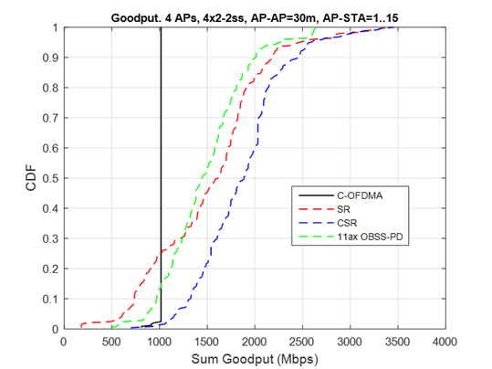
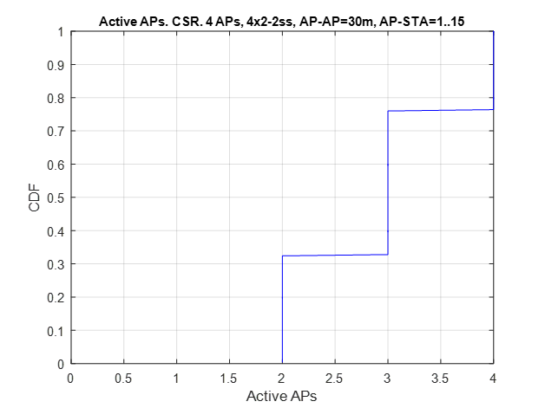
Results of Configuration 2

Slide 8
Additional Configurations
Configuration 3
  Same as Config 2 except BSS Radius=50m
  Same Loss and TPC as Config 2
Configuration 4
  Dynamic Point Select (reassign STAs to minimize sum distances)
Configuration 5
  STAs is in same quadrant as AP
AP1
AP2
AP3
AP4
BSS Radius
AP-AP Distance

Slide 9
Configuration 3 (BSS Radius=50m)
Left: CDF of Sum Goodput
  C-OFDMA is not maximum
Right: CDF of Active APs
  CSR: 60% One AP, 35% Two APs, 5% Three APs, 0% Four APs

Slide 10
Configuration 4 (DPS)
Left: CDF of Sum Goodput
  C-OFDMA is not maximum
Right: CDF of Active APs
  CSR: 30% One AP, 60% Two APs, 10% Three APs, 0% Four APs

Slide 11
Configuration 5 (STA in same Quadrant)
Left: CDF of Sum Goodput
  C-OFDMA is not maximum
Right: CDF of Active APs
  CSR: 20% One AP, 60% Two APs, 18% Three APs, 2% Four APs

Slide 12
Summary
CSR has significant performance gain compared to a Coordinated OFDMA and 11ax OBSS PD based spatial reuse in most scenarios.
CSR with TPC only needs Path Loss of other APs
  CSI of other APs are not required: much less sounding and feedback overhead.
CSR achieves very good trade-off on complexity and performance.
CSR can be implemented with the similar protocols defined for CBF.

Slide 13
Straw Poll #1
Do you agree to add support of Coordinated Spatial Reuse (CSR) in 11be multi-AP system?

