Slide 1
Performance and TX EVM Evaluation on 4096-QAM
Date: 2019-10-22
Authors:
Name | Affiliations | Address | Phone | Email
Shengquan Hu | Mediatek
Jianhan Liu |  |  |  | jianhan.liu@mediatek.com

Slide 2
Introduction
  4096-QAM can increase about 20% data rate comparing to 1024-QAM.
  In this contribution, we present simulations results with TX EVM for 4096-QAM.

Slide 3
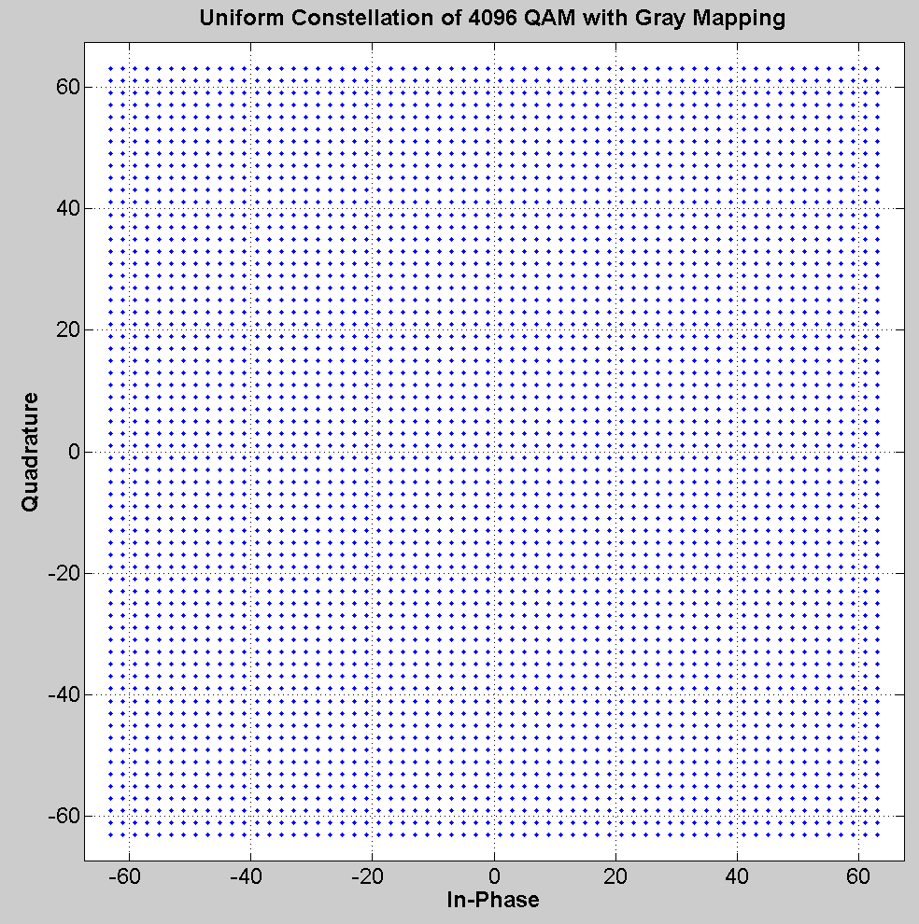

Regular 4096-QAM
4096-QAM: uniformly distributed Gray mapping.
B0b1b2b3b4b5
b6b7b8b9b10b11
real
imag

Slide 4
Simulations on 4096-QAM
MCS 12: 4096-QAM with 3/4 coding rate
MCS 13: 4096-QAM with 5/6 coding rate

Slide 5
4096-QAM (MCS13, R=5/6), 1ss, B-LOS (1x1)

Slide 6
4096-QAM (MCS13, R=5/6) , 1ss, B-LOS, BF (4x1)

Slide 7
4096-QAM (MCS12, R=3/4) , 2ss, B-LOS, BF (4x2)

Slide 8
4096-QAM (MCS13, R=5/6) , 2ss, B-LOS, BF (4x2)

Slide 9
TX EVM: 80MHz, 1ss, AWGN (1x1)

Slide 10
TX EVM: 1x1, BW80, 1ss, B-LOS (1x1)

Slide 11
TxEVM: 4kQAM/MCS12 with BF, 1ss, B-LOS

Slide 12
TxEVM: 4kQAM/MCS13 with BF, 1ss, B-LOS

Slide 13
EVM: 4kQAM/MCS12 with BF, 2ss, B-LOS

Slide 14
EVM: 4kQAM/MCS13 with BF, 2ss, B-LOS

Slide 15
Summary
We evaluate the performance of 4096-QAM with TX EVM.
  We showed that 4096-QAM is feasible with enhanced TX EVM requirement.

