Slide 1
Restrictions for 16 SS based MU-MIMO Scheduling
Date: 2020-01-14
Authors:
Name | Affiliation | Address | Phone | Email
Junghoon Suh | Huawei |  |  | junghoon.suh@huawei.com
Dandan Liang |  |  |  | dandan.liang@huawei.com
Yan Xin |  |  |  | yan.xin@huawei.com
Osama Aboul-Magd |  |  |  | osama.aboulmagd@huawei.com

Slide 2
Background
EHT MIMO configuration can be extended to maximum 16 Spatial Streams (SS) which is good to schedule more STAs for the MU-MIMO
However, MU-MIMO Spatial Configuration Table becomes completely complex for 16 Spatial Streams without any limit in the scheduling
We’d like to propose a certain limitation in the number of maximum SS per scheduled STA

Slide 3
MU-MIMO TX side
Multiple STAs are scheduled in a single PPDU transmitted from an AP over a different spatial domain through a beam-forming (BF) steering matrix
  BF Steering Matrix (Precoding Matrix) can be computed by aggregating the channels which correspond to STAs to be scheduled
    The channels are reconstructed at the TX side according to the CSI feedback during the Sounding period
    Some linear precoding matrix computation such as Zero-Forcing (ZF) BF requires an inversion of the reconstructed channels
    ZF-BF based Precoder includes a very large value in the elements when some Eigen vectors have bad corresponding Eigen values, and when TX power gets normalized, the actual transmitted signal becomes almost zero
Solution
  Limit the maximum number of streams for each STA to be scheduled to 4 streams regardless of MU-MIMO entire streams
  Sophisticated BF Steering Matrix without channel inversion

Slide 4
MU-MIMO RX side
MIMO detection can be simply achieved with the MMSE detection when an ML type of detection is not practical
  MMSE detection needs to be achieved with the estimated channels between RX of each scheduled STA and the entire TX antennas in order to avoid the inter-stream interferences
    Then, only the corresponding streams are passed to the LLR computation
  However, MMSE detection requires a matrix inversion, and its performance is dominated by the stream with the worst Eigen value
Solution
  Certain degree of freedom in TX antennas needs to be maintained (e.g. 12 entire streams out of 16 TX antennas)
  ML Detection for corresponding streams to each STA with the Whitening for the rest of the TX streams [1] in order to increase the entire rank in the TX side

Slide 5
Simulation Parameters
16 TX MU-MIMO with 3 STA MU-MIMO scheduling (4 streams each STA)
  16 LTF symbol based Channel Estimation for 12 entire streams
  Perfect sounding (No CSI Quantization error, No CSI feedback error, but real channel estimation using the 4X LTF based NDP)
  User Selection algorithm [2] to select 3 STAs from 8 total STAs for MU-MIMO scheduling
  Zero-forcing BF in the TX, and MMSE detection in each STA
  BCC for FEC
  MCS 1, and 7
  Packet size for PER: 120 bytes for MCS 1, and 600 bytes for MCS 7
  P-matrix based 16 Stream Channel Estimation in case of 16 LTF symbol based case

Slide 6
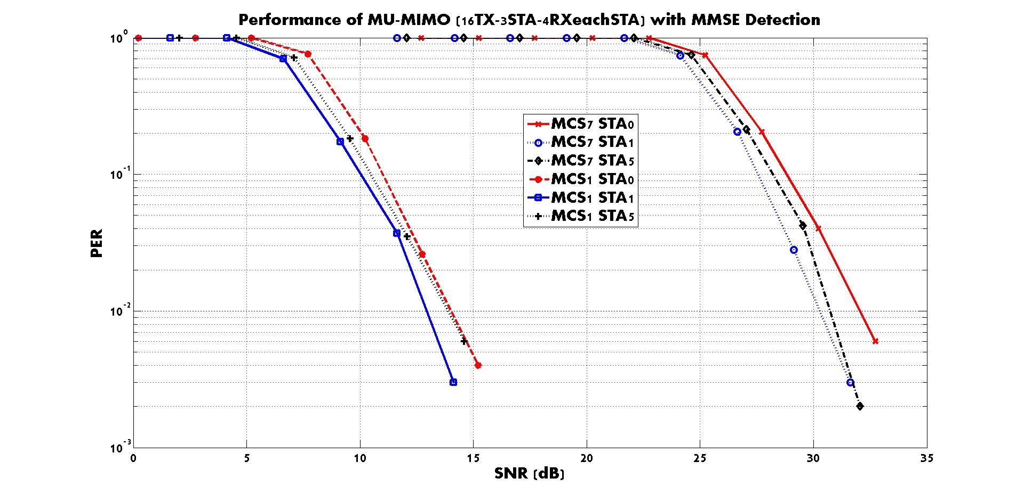
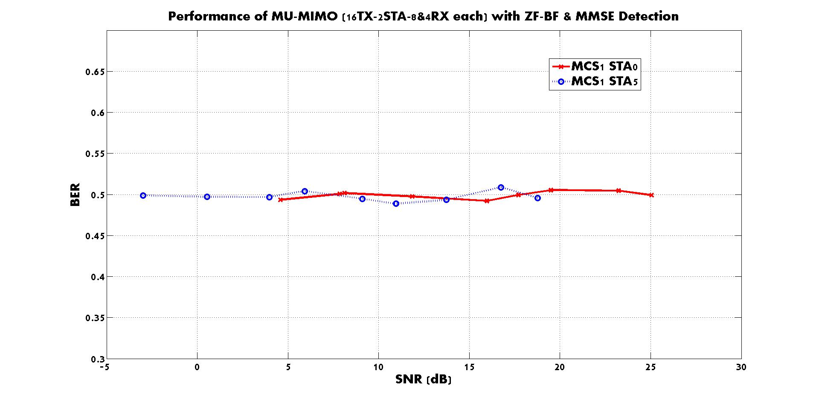
The MU-MIMO performance with 2 RX per each STA and various TX scheduled streams can be seen in [1]
The MU-MIMO performance with 4 RX per each STA is working fine and seen in the Left figure above
When one of the scheduled STA is allocated with a large streams, ZF-BF based MU-MIMO does not work due to the very large scale element of BF Precoder
  E.g. Two STA MU-MIMO with one of them having 8 RX and the other having 4 RX seen in the Right figure above

Slide 7
Conclusion
For MU-MIMO, maximum number of spatial stream for each STA needs to be limited to 4 streams
  Some Precoders such as ZF-BF have an issue with the TX power normalization in case TX streams beyond 4 streams are allocated to one of the scheduled STA
MU-MIMO Stream Allocation is indicated in the User Specific field through an MU-MIMO Spatial Configuration Table, and the Table becomes too complex for 16 Spatial Stream based MU-MIMO without limiting the maximum number of streams per STA
For a certain CSI feedback overhead scheme for MU-MIMO, a restriction on the number of streams per STA is required as well [3]

Slide 8
Reference
[1] Junghoon Suh et. al., “11-19/832r0 Performance Evaluation of 16 Spatial Stream based MU-MIMO”, May 2019
[2] T. Yoo and A. Goldsmith, “On the optimality of multiantenna broadcast scheduling using zero-forcing beamforming”, IEEE Journal on Selected Areas in Communications, Vol. 24, March 2006
[3] Wook Bong Lee et. al., “11-19/1495r1 Further Discussion on Feedback Overhead Reduction”, Nov 2019

Slide 9
SP 1
Do you agree to limit the maximum number of Spatial Streams allocated to each MU-MIMO scheduled STA to 4 ?
  Y/N/A

