Slide 1
Overview of Multi-AP Operation in 11be
Authors:
Name | Affiliations | Address | Email
Boyce Bo Yang | Huawei | Nanjing, China | yangbo59@huawei.com
Lily Yunping Lyu |  | Nanjing, China | lvyunping@huawei.com
Chenhe Ji |  | Nanjing, China | jichenhe@huawei.com

Slide 2
Introduction
Multi-AP operation is a significantly different feature for 802.11be comparing to previous standard versions, benefiting performance in typical deployments.
Many candidate technologies have been proposed, like: Joint Transmission[1][2], Coordinated Beamforming (uplink and downlink)[3][4], Coordinated OFDMA[5][6][7], Coordinated Spatial Reuse[8], etcetera, all necessitating AP-to-AP communication.
The unified architecture has not been fully discussed.
  Whether an anchor is needed for multi-AP operation, roaming anchor, scheduling anchor, managing anchor.
  Whether interfaces should be defined for inter-AP communication.
  Whether a backhaul is existed for inter-ap operation, wired or wireless.
  The scope of 802.11be has not been defined for multi-AP operation.

Slide 3
Anchor of a Multi-AP operation set
  Multi-AP operation set
  A Multi-AP operation set is a set of APs involving in multi-AP operation.
  A reliable link should exist within the Multi-AP operation set, wired or wireless.
  The requirement to form a Multi-AP operation set should be defined.
  Multi-AP operation set with anchor
  An anchor of an Multi-AP operation set is a logic coordinator \ scheduler \ distributor \ context manager, residing in one of the APs or an independent device.
  The Multi-AP operation set is a close coupled group of APs, with explicit hierarchical structure, dedicated wired or wireless backhaul, and intra-set interfaces.
  In the case of mesh APs, a fixed AP portal acts as the data distributor.
  In the case of enterprise APs, an AP is chosen semi-statically acting as the coordinator.
  Multi-AP operation set without anchor
  The Multi-AP operation set is a loosely coupled group of APs, which may be formed dynamically.
  Same wireless link is used to transmit inter-AP information and AP-to-STA information.
Anchor
AP
AP
AP
AP
AP
AP

Slide 4
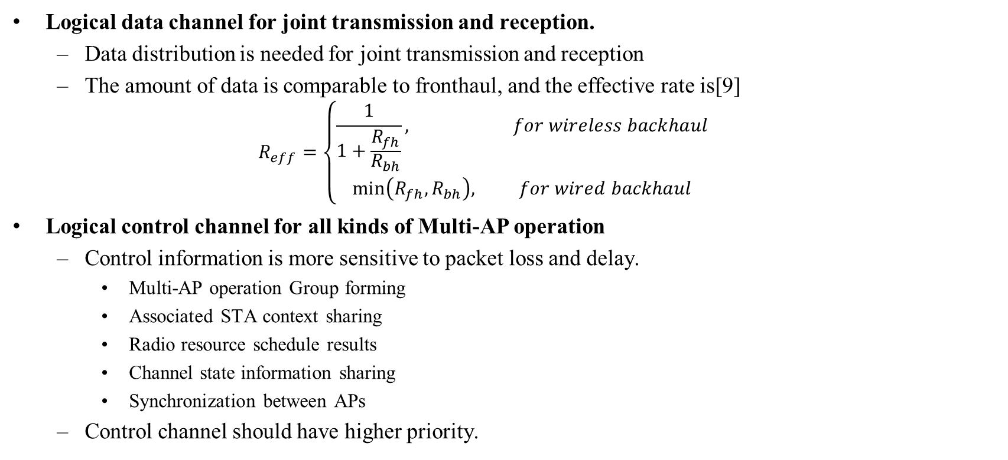
Interfaces for inter-AP communication
Logical data channel for joint transmission and reception.
  Data distribution is needed for joint transmission and reception
  The amount of data is comparable to fronthaul, and the effective rate is[9]
  $R_{eff}=\left\{\begin{matrix}\frac{1}{1+\frac{R_{fh}}{R_{bh}}}, for wireless backhaul \\ min⁡\left(R_{fh},R_{bh}\right), for wired backhaul\end{matrix}\right.$
Logical control channel for all kinds of Multi-AP operation
  Control information is more sensitive to packet loss and delay.
    Multi-AP operation Group forming
    Associated STA context sharing
    Radio resource schedule results
    Channel state information sharing
    Synchronization between APs
  Control channel should have higher priority.

Slide 5
Backhaul for inter-AP communications (1)
Dedicated Backhaul (Wired/Wireless)
  In enterprise and some residential scenarios, wired backhaul is part of the infrastructure.
  In home scenarios, wireless backhaul is a typical mesh deployment.
  Logical data channel and logical control channel between APs are mapped to wired/wireless physical backhaul.
Coordinated Scheduling
CSI Sharing
STA context sharing
Group forming
Data & clock Distributing
STA association
Transmission and acknowledgement
AP 1
AP 2
AP 3
Backhaul
STA 11
STA 21
STA 31
Notes:
We do not mean to show any technical opinion in the detailed procedure of the slash boxes
Fronthual is the link that can be heard by non-AP STAs.
Fronthaul

Slide 6
Backhaul for inter-AP communications (2)
No Dedicated Backhaul
  In scenarios where very limited information exchange is needed, coordinated information is transmitted at the fronthaul in a TDM manner.
  No data sharing needed for loose coupled group.
  Control information is exchanged before multi-AP data transmission/reception and acknowledgement.
Scheduling for STAs
Dynamic Group forming and scheduling for APs
Scheduling for STAs individually
Multi-AP transmission and acknowledgement
M AP 1
AP 2
AP 3
STA 11
STA 21
STA 31

Slide 7
Observations
Detailed procedures may vary for different presumptions and multi-AP operations (JT, C-OFDMA, C-BF, C-SR, etcetera).
A lot of work need to be done if we go through every potential multi-AP operations.
However, it would be much easier to move the first step forward if we just focus on MultiAP-to-STA operations, enabling multi-AP operations in 802.11be with necessary interactions only.

Slide 8
Priority of multi-AP operation in 802.11be development(1)
AP-AP communication is not mandatory in 802.11be. Multi-AP operation could also be accomplished if inter-AP communication was left to implementations.
AP-STA communication is mandatory in 802.11be. For non-AP STA operations, we shoud do it with minimal changes.
  The reception of Coordinated OFDMA PPDU should be operated like single-AP OFDMA.
  The reception of Coordinated Beamforming PPDU should be operated like single –AP SU/MU MIMO.
  The reception of Joint transmission PPDU should be operated like single-AP MU-MIMO.

Slide 9
Priority of multi-AP operation in 802.11be development(2)
First Priority - minimum requirement to achieve AP coordination
  New definitions and general mechanism
    New definitions introduced by multi AP, such as multi-AP operation group
    General mechanism of AP-AP communications over fronthaul, like, a vendor-specific inter-AP communication frame ( which may act as SyncTrigger in JT, COA in COFDMA, C_Request /C_response in C-BF, …)
  Non-AP STA related procedures
    Multi-AP Sounding
    STA to Multi-AP association
    Multi-AP acknowledgement and other immediate feedbacks
  Other necessary procedures to enable Multi-AP operation

Slide 10
Priority of multi-AP operation in 802.11be development(3)
Second Priority – could be left to later stage or left to implementation
  Detailed procedure of Data distribution
  Detailed procedure of multi-AP operation group forming
  Detailed procedure of associated STA context sharing
  Detailed procedure of radio resource scheduling
  Detailed procedure of channel state information sharing
  Detailed procedure of synchronization between APs
  Other procedures to optimize Multi-AP operation

Slide 11
Summary
We discussed architecture of Multi-AP operations with different presumptions for different scenarios.
Based on the wide variety of Multi-AP operation modes, we suggest 802.11be focus on necessary procedures involving non-AP STAs as the first priority.
Multi-AP operation could also be accomplished in practice if AP-to-AP communication was left to implementation. Meanwhile the standard work would be very simple.

Slide 12
References
[1] 11-19-1597-00-00be-jt-performance-with-multiple-impairments
[2] 11-19-1092-01-00be-evaluation-of-joint-transmission
[3] 11-19-1779-03-00be-downlink-spatial-reuse-parameter-framework-with-coordinated-beamforming-null-steering-for-802-11be
[4] 11-19-1903-00-00be-uplink-coordinated-multi-ap
[5] 11-19-1788-00-00be-coordinated-ofdma-operation
[6] 11-19-1879-00-00be-coordinated-ap-time-and-frequency-sharing-gain-analysis
[7] 11-19-1592-00-00be-simulation-results-for-coordinated-ofdma-in-multi-ap-operation
[8] 11-19-1534-00-00be-coordinated-spatial-reuse-performance-analysis
[9] 11-19-1588-00-00be-multi-ap-backhaul-analysis

Slide 13
Straw Poll
Do you agree that 802.11be should focus on developing new definitions, general mechanism and non-AP STA related procedures to enable multi-AP operation?
  Other operations which do not involve non-AP STA could be discussed in 802.11be or left to implementation.
Yes
No
Abstain

