Slide 1
Preamble Puncturing for Transmission to Multiple STAs in 802.11be
Date: 2020-01-15
Authors:

Slide 2
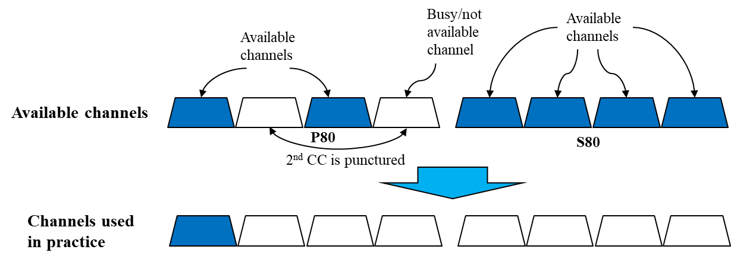
Background: Preamble Puncturing in 11ax
  In this presentation we aim at improving the preamble puncturing for PPDUs that are transmitted to multiple STAs so they include both U-SIG & EHT-SIG (resembles MU-PPDU in 802.11ax)
  As decided in the Nov-19 meeting, preamble puncturing shall be supported for transmission to multiple STAs (and for a single STA as well) passed motion
  Reminder to 802.11ax puncturing:
    Puncturing indication exists for P80 only
    If the two 20MHz channels corresponding to the content-channel that includes S20 (shall be denoted hereafter as “the 2nd CC in P80”) are simultaneously not available (as shown in the figure below) , this content-channel cannot be transmitted, therefore the BW reduces to 20MHz

Slide 3
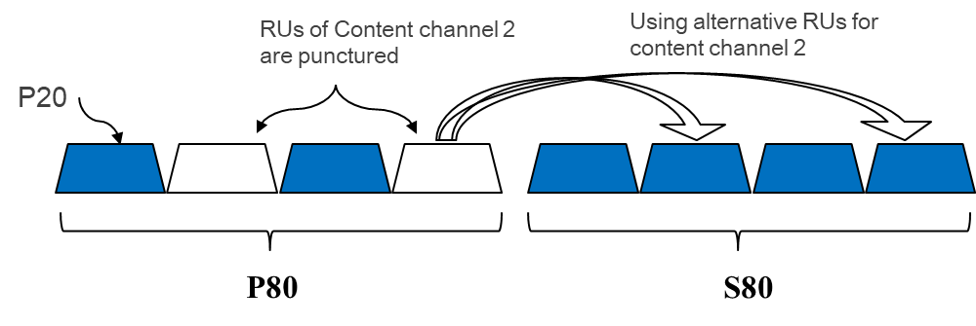
Preamble Puncturing in 802.11be
  We suggest to overcome the above limitation by allowing all (or most of the) available BW even when the 2nd CC in P80 is not available
  We can avoid adding too much overhead to U-SIG by maintaining the 11ax puncturing signaling principle with minor modifications
  Assuming U-SIG is duplicated in all 20MHz channels (similarly to HE-SIG-A in 802.11ax), we suggest to add to it puncturing indication about S80 (within P160)
  In this case, when the 2nd CC in P80 is unavailable, the corresponding CC in S80 is used for extracting the allocation map in the 2nd CC
  The channel utilization gain is expected to be significant as shown in [1] (up to 42%) and in [2]

Slide 4
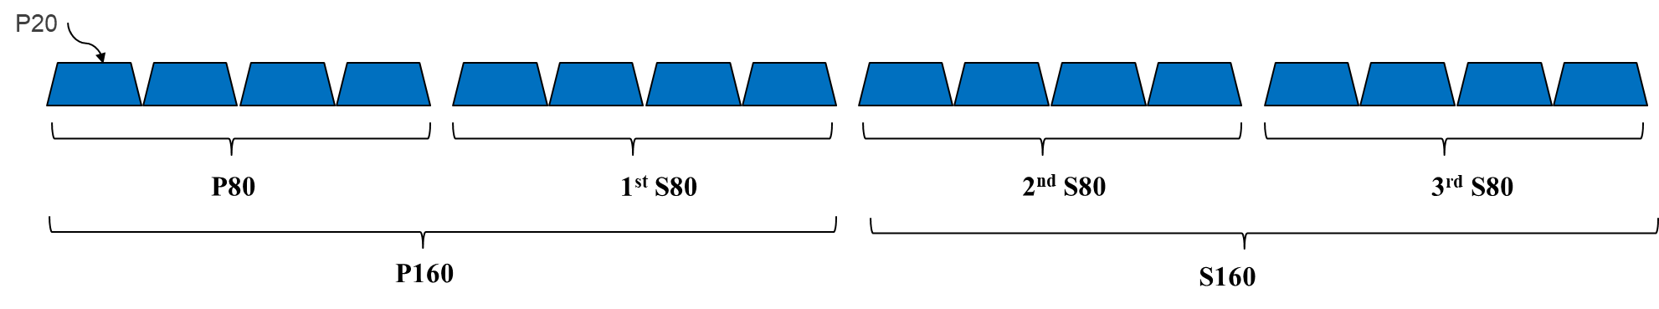
Preamble Puncturing in 11be
  In order to save overhead in U-SIG, we suggest not to indicate puncturing outside P160 in it
  Why should we refrain from expanding the puncturing indication in U-SIG to other S80s (outside P160)?
  We can focus on two different cases:
    Dense environment, where many APs of different BSSs operate simultaneously
    Sparse environment, where the number of OBSSs is likely to be very low
  In the next two slides, we give more information about these two cases

Slide 5
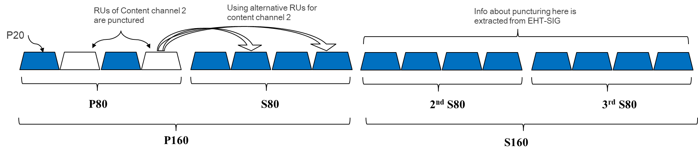
Preamble Puncturing in 11be - Dense
  In an unmanaged dense environment (e.g. apartment building), using 320MHz (or even 240MHz) by a given AP is very unlikely.
  In [3] it is presented that some data collected from a 160MHz capable AP show that 160MHz channel is rarely used, hence it is reasonable to assume that 320MHz and 240MHz will be at least unlikely as well.
  Hence there is no need to signal puncturing info for the 2nd and/or 3rd S80 (S160/S80 for BW=320MHz/240MHz respectively) in U-SIG and instead it may be implicitly signaled in EHT-SIG by using for example “242-tone RU empty” in the RU Allocation subfield (similarly to what is done in 802.11ax).

Slide 6
Preamble Puncturing in 11be - Sparse
  In a sparse environment, puncturing is unlikely, specifically in S160, due to absence of OBSS in the proximity of the serving AP.
  When supporting DFS, a long-term/persistent puncturing info (signaled in e.g. the beacon) may/should be applied.
  In this case, the AP assigns its S160 such that it coincides with the DFS channels, hence in case a Radar is detected, its corresponding channels do not need to be signaled as punctured in U-SIG.
  Alternatively in a sparse environment, in case persistent puncturing info is not available (not likely), enabling DFS may be planned such that the DFS channel coincides with P160 (so in case a Radar is detected, a puncturing indication exists in U-SIG) and non-DFS channels are used in the S160, hence again, puncturing indication in U-SIG for S160 is not required.

Slide 7
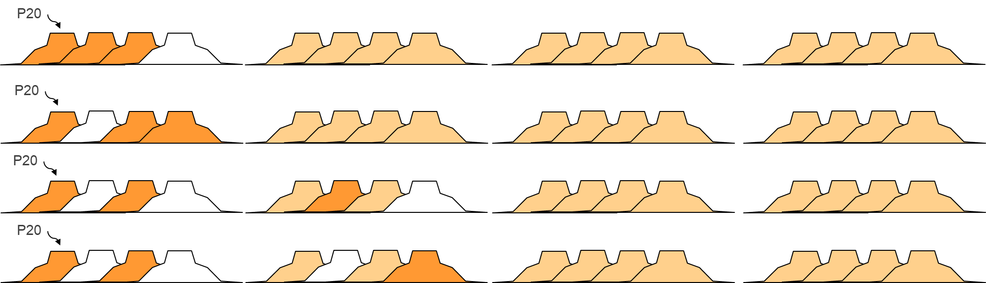
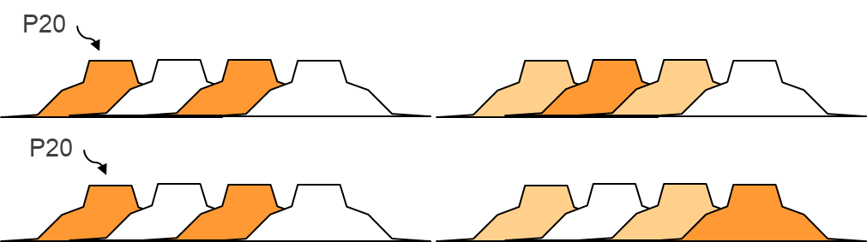
Preamble Puncturing in 11be - Signaling
  The following table suggests the new content of the BW field in EHT-SIG which is increased by 1 bit (relative to HE SIG-A BW field) to support 320MHz (total 4 bits for BW field)
BW (4 bits) | meaning
0000-0111 | Existing modes in 11ax.
1000 | Puncturing in 320 MHz: in the primary 80 MHz of the preamble the primary 40MHz is present.
1001 | puncturing in 320 MHz, where in the primary 80 MHz of the preamble only the secondary 20 MHz is punctured.
1010 | puncturing in 320 MHz, where in the preamble the following 3 20MHz channels are punctured: (1) the secondary 20 MHz (2) the other 20MHz channel corresponding to the same content channel of the secondary 20MHz in P80. (3) the highest 20 MHz channel in S80 corresponding to the same content channel.
1011 | puncturing in 320 MHz, where in the preamble the following 3 20MHz channels are punctured: (1) the secondary 20 MHz (2) the other 20MHz channel corresponding to the same content channel of the secondary 20MHz in P80. (3) the lowest 20 MHz channel in S80 corresponding to the same content channel.
1100 | puncturing in 160 MHz, where in the preamble the following 3 20MHz channels are punctured: (1) the secondary 20 MHz (2) the other 20MHz channel corresponding to the same content channel of the secondary 20MHz in P80. (3) the highest 20 MHz channel in S80 corresponding to the same content channel.
1101 | puncturing in 160 MHz, where in the preamble the following 3 20MHz channels are punctured: (1) the secondary 20 MHz (2) the other 20MHz channel corresponding to the same content channel of the secondary 20MHz in P80. (3) the lowest 20 MHz channel in S80 corresponding to the same content channel.
1110 | for 320 MHz, 2X160 MHz, and 4X80MHz non-preamble puncturing mode.
1111 | Reserved
Legend:
Used channel
Punctured channel
Don’t care

Slide 8
Conclusions
We suggest a puncturing signaling for 802.11be that is based on 802.11ax
The 2 main motivations:
  Overcome the limitation exists in 802.11ax when one of the CC in P80 is punctured
  Support of BW=320MHz
We suggest to add puncturing indication about S80 to U-SIG for PPDUs that are transmitted to multiple STAs
The additional overhead in U-SIG is minimal: only 1 additional bit respective to 802.11ax, which yields significant gain in channel utilization
We may consider adding 2 bits (instead of 1) to reserve BW & puncturing indication for future 802.11 versions
We also explained why adding more puncturing signaling about the remaining S80s in U-SIG is not necessary

Slide 9
Straw Poll 1
Do you agree to add preamble puncturing indication about S80 for BW=160MHz in U-SIG of a PPDU transmitted to multiple users?
Y/N/A xx/xx/xx

Slide 10
Straw Poll 2
Do you agree to add preamble puncturing indication about S80 of P160 for BW=320MHz in U-SIG of a PPDU transmitted to multiple users?
  Puncturing indication of S160 shall be performed in EHT-SIG
Y/N/A xx/xx/xx

Slide 11
Straw Poll 3
Do you agree that 802.11be should allow (support) 160 and 320 MHz BW when (1) the secondary 20 MHz and (2) the other 20MHz channel corresponding to the same content channel of the secondary 20MHz in P80 are punctured?
Y/N/A xx/xx/xx

Slide 12
References
[1] 11-19-1190-00-00be-improved-preamble-puncturing-in-802-11be (Oded Redlich et al, Huawei)
[2] 11-19-1606-00-00be-Preamble Puncturing and SIG-B Signaling (John Son et al, Wilus Inc)
[3] 11-18-1549-00-00be-Recommended Direction for EHT (Brian Hart et al, Cisco)

