Slide 1
Multi-AP Sounding Discussion
Date: 2019-12-30
Authors:
Name | Affiliation | Address | Email
Qichen Jia | ZTE Corporation | No.9 Wu Xing Section Xi Feng Road Xi’an, Shaanxi Province P.R.China
Ning Wei
Bo Sun |  |  | sun.bo1@zte.com.cn
Yonggang Fang
Sang Sun

Slide 2
Introduction (1)
Channel state information (CSI) provided by channel sounding is critical in joint and coordinated multi-AP transmissions.
  The multi-AP sounding procedure should be preceded before the multi-AP transmissions.
  The multi-AP sounding may impact on the performance of multi-AP transmissions.
Multi-AP sounding category
  [1-3] describe some channel sounding mechanisms for multi-AP transmission, in which the potential multi-AP sounding approaches can be categorized as a sequential or a joint sounding procedure.
  Multi-AP sequential sounding
    In this approach, an NDP sounding frame is sent sequentially by each AP of the multiple APs in the collaborated Multi-AP transmission.
    The sequential multi-AP sounding may utilize the existing single-AP sounding procedure without any change. However, this approach may have some major issues:
      The total time required by the multi-AP sequential sounding is proportional to the number of single-AP sounding. This may cause a latency concern in the multi-AP transmission.
      It may cause an issue of efficiency in the channel utilization as the sequential NDP sounding frame transmissions take longer time of channel occupancy.

Slide 3
Introduction (2)
Multi-AP sounding category (continued)
  Multi-AP joint sounding
    In a multi-AP joint sounding approach, NDP sounding frames are transmitted simultaneously by multiple APs in the collaboration. Therefore it can reduce the number of NDP transmissions in sounding procedure, which in turn reduces the time of sounding procedure comparing to the multi-AP sequential sounding and improves the efficiency of channel utilization.
    However, in the tone selection based multi-AP joint sounding [1], the NDP sounding signal transmitted by each AP is only on the selected tones. Therefore each AP may not have get the CSI result on the entire bandwidth.
    In the full bandwidth multi-AP joint sounding [1, 2], on the other hand, the NDP sounding signal transmitted by each AP occupies the entire channel bandwidth. But this approach requires a large number of LTF symbols in the NDP frame, which increases the length of NDP signal and generates a high dimension of P matrix causing the complexity in the computation of CSI.
      The number of LTF symbols depends on the number of all antennas in the multi-AP participating the joint sounding procedure.

Slide 4
A Proposal of New Multi-AP Joint Sounding
Code based multi-AP joint sounding
  Code division method has been adopted for channel-estimation in UL MU-MIMO. Each involved STA is assigned to an orthogonal LTF sequence to distinguish with other STAs in the UL MU-MIMO transmission.
  The new multi-AP code based joint sounding procedure
    An AP transmits a frame (e.g. Trigger) to other APs to initiate the multi-AP joint sounding procedure.
    All sounding APs send an MAP-NDPA + MAP-NDP simultaneously.
      A MAP-NDP sounding frame consists of a EHT-LTF sequence generated by the orthogonal sequence.
Coordinating AP
Trigger
Coordinated AP
MAP-NDPA
MAP-Joint NDP
Coordinated AP
MAP-NDPA
MAP-Joint NDP
time

Slide 5
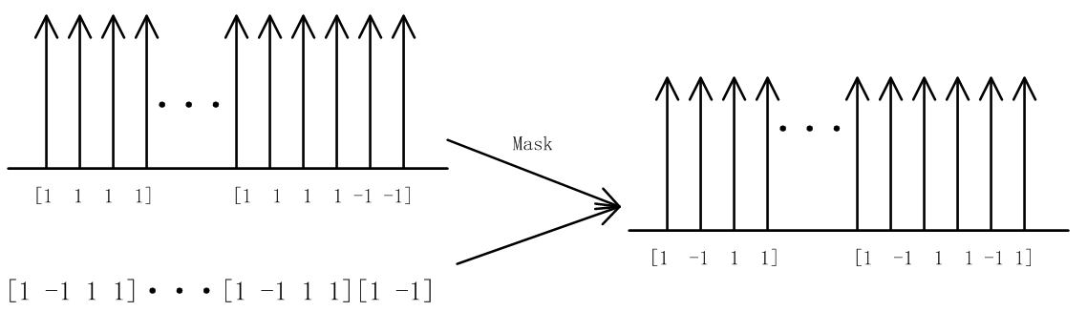
A Proposal of New Multi-AP Joint Sounding
Code based multi-AP joint sounding
  EHT-LTF sequence generation
    The EHT-LTF sequence is carried in a MAP-NDP sounding frame.
    An orthogonal sequence from P matrix is assigned to an AP in the multi-AP joint sounding to generate its EHT-LTF.
      The dimension of orthogonal matrix should be larger than or equal to the number of APs in the joint sounding.
      An example of orthogonal matrix is [1 -1 1 1, 1 1 -1 1, 1 1 1 -1, -1 1 1 1], the orthogonal sequences assigned to APs: AP1 = [1 -1 1 1 ], AP2 = [1 1 -1 1], AP3 = [1 1 1 -1] and AP4 = [-1 1 1 1].
    An AP creates its EHT-LTF sequence via multiplying the LTF sequence by its assigned orthogonal sequence.
      For example, EHT-LTF is generated by LTF (e.g. used in 11ax) multiplied by an orthogonal sequence.
LTF (e.g. 11ax)
Orthogonal sequence
EHT-LTF sequence

Slide 6
Simulation Setup
Objectives
  This simulation intends to compare the performance of the new multi-AP joint sounding method to other multi-AP sounding approaches.
Simulation setting
  4 APs : each AP has 4 Tx antennas; 1 STA: the STA has 4 Rx antennas
  LTF Type : 1x LTF
  Channel bandwidth: 20MHz
  Channel mode: Channel mode D with Gaussian noise
  Residual CFO: [0Hz, 200Hz, 400Hz, 800Hz].
  Perfect synchronization.
  Orthogonal matrix P:

Slide 7
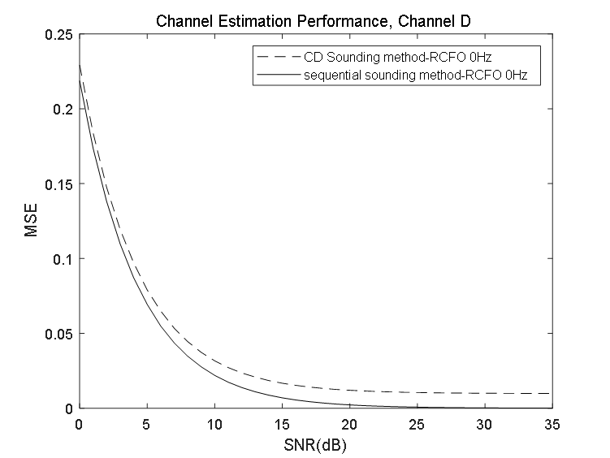
Simulation Results (1)
Channel Estimation Performance
  the multi-AP code-based joint sounding and the multi-AP sequential sounding methods
The MSE difference between the multi-AP CD sounding and the multi-AP sequential sounding is about 0.01 when RCFO equal to 0.

Slide 8
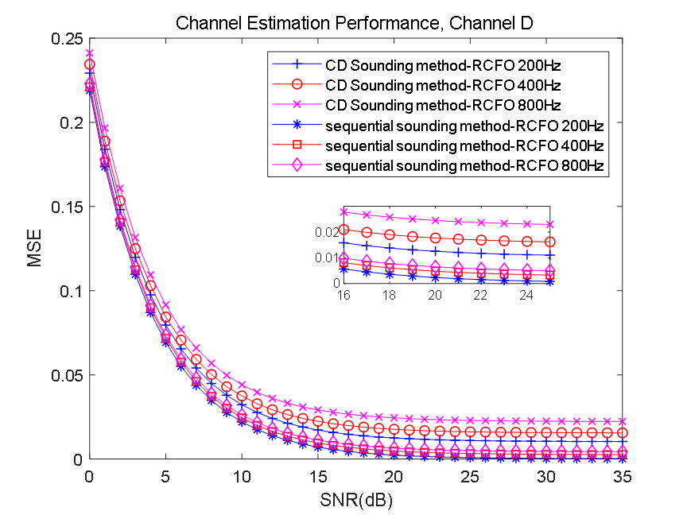
Simulation Results (2)
Channel Estimation Performance
  the multi-AP code-based joint sounding and the multi-AP sequential sounding
The MSE difference between the multi-AP code based joint sounding and the multi-AP sequential sounding is about 0.015 to 0.025 when RCFO is 200Hz, 400Hz and 800Hz.

Slide 9
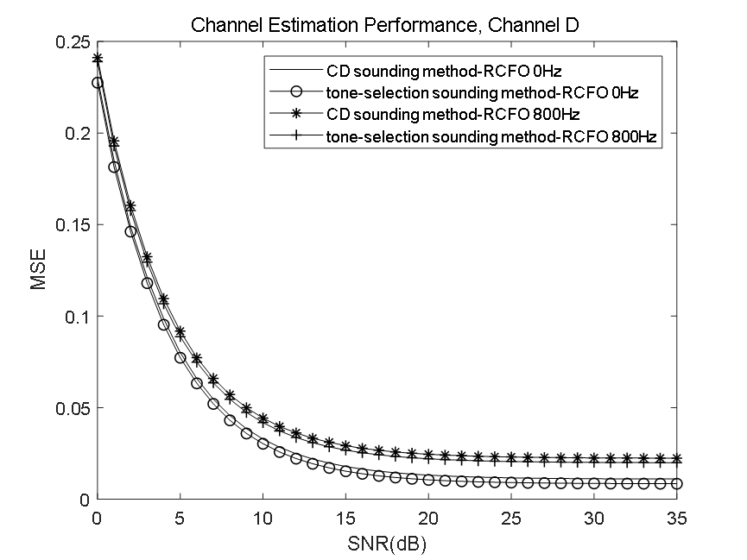
Simulation Results (3)
Channel Estimation Performance
  the multi-AP code-based joint sounding and the multi-AP tone-selection joint sounding
The Channel Estimation Performance of code-based joint sounding method is close to that of tone-selection joint sounding method.

Slide 10
Summary of Multi-AP Sounding Methods
 | Multi-AP Sequential Method | Multi-AP Joint Sounding Methods
 |  | Full bandwidth method | Tone selection method | Code based method
Latency | Higher latency | Lower latency than the multi-AP sequential sounding method (less NDPA and preambles than one in the multi-AP sequential sounding method) | Lower latency (less LTF symbols than one in the multi-AP full bandwidth method) | Similar latency to the multi-AP tone selection joint sounding method
Complexity | Lower complexity | Higher complexity than the multi-AP sequential method (the dimension of P matrix is greater than one in the multi-AP sequential sounding method ) | Lower complexity (the dimension of P matrix is similar to the multi-AP sequential sounding method) | Similar to the multi-AP tone selection sounding method
Performance | Higher performance | Similar to the multi-AP sequential sounding method | Slightly worse than the multi-AP sequential sounding method | Slightly worse than the multi-AP sequential method and similar to the multi-AP tone selection method

Slide 11
Conclusion
In this contribution, we investigate and simulated a new multi-AP joint sounding method which is based on an existing MU-MIMO HE-LTF Mode to generate EHT-LTF sequences for NDP sounding.

Slide 12
Reference
[1] 11-19-0448-01-0eht-multi-ap-transmission-procedure
[2] 11-19-1593-00-00be-joint-sounding-for-multi-ap-systems
[3] 11-19-1535-00-00be-sounding-for-ap-collaboration
[4] IEEE P802.11ax/D6.0

