Slide 1
Large RU Aggregation for 240 and 320 MHz
Date: 2020-01-10
Authors:
Name | Affiliations | Address | Phone | Email
Lin Yang | Qualcomm
Bin Tian |  |  |  | btian@qti.qualcomm.com
Youhan Kim
Notes:
September 2012

Slide 2
Overview
For large RU (>=RU242) aggregation, the allowed combinations for up to 160MHz have been proposed[1, 2]*
For non-OFDMA, 40/60MHz aggregated BW for up to 80MHz, 120/140MHz for 80~160MHz
For OFDMA, 60MHz aggregated BW for up to 80MHz, 100/120MHz for 80~160MHz
Large RU aggregation combinations for 240 and 320 MHz are proposed in this presentation
RU in each 160MHz segment is selected from the set of existing and proposed aggregated RUs in 160 MHz case
Intention is to cover typical and important puncture scenarios while limit the number of combinations to reduce implementation and testing cost
*Note: for easy understanding, the aggregated RU sizes are replaced by its approximate BW in this presentation

Slide 3
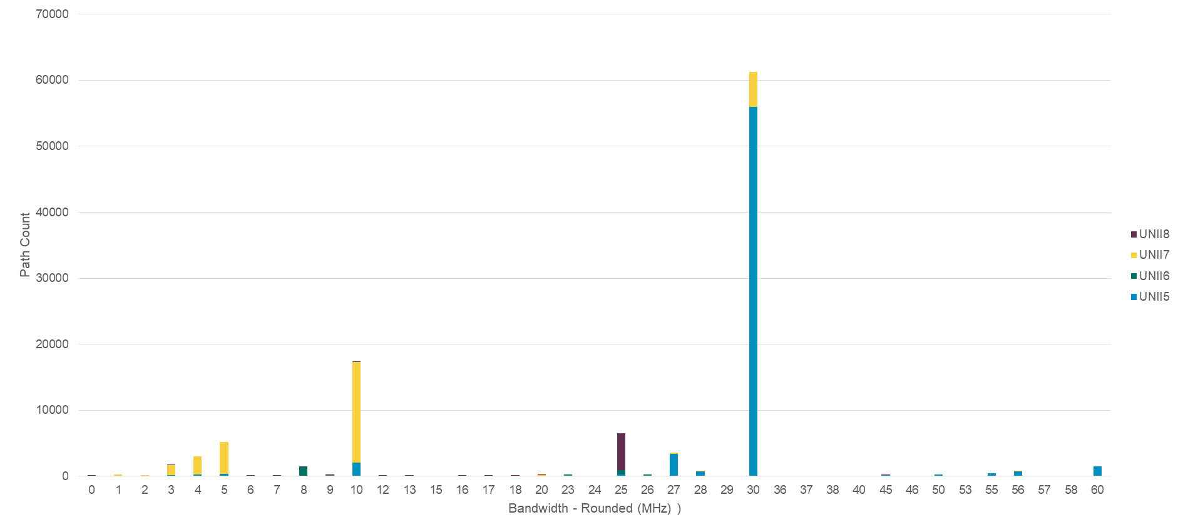
Typical Static Puncturing Scenarios
RU combinations should be mostly optimized for static puncturing cases
Distribution of incumbent bandwidth in 6 GHz [1]
30MHz incumbent happens with highest frequency
10MHz incumbent is also not negligible

Slide 4
High Level Thoughts On Puncturing Modes
One 10 MHz incumbent may affect one or two neighboring 20 MHz channels. One 30 MHz may affect two or three neighboring 20 MHz channels
Focus on the RU aggregation combinations that support one puncture hole
Puncture hole BW of 40 and 60 MHz need to be supported
Puncture hole BW of 20MHz less important
Too many combinations and less like to happen
Can be covered by 40 MHz puncture hole. For wide bandwidth, loss of 20MHz is tolerable
For two puncture hole in 240/320MHz, there are way too many combinations (see one example in Appendix)
Needs more discussion. May want to wait for FCC’s final rules on 6 GHz
If to be supported, need to significantly cut down combinations and only select only a few modes

Slide 5
Candidates for Non-OFDMA RU Aggregation in 320MHz
Agg. BW | Combinations | Notes | Recommendations
300 | 160+140 | One hole of 20MHz | Too many combinations, replaceable by 280 MHz Not supported
280 | 160+120 | One hole of 40 MHz | Support cases with one hole of 40MHz
 | 140+140 | Two 20 MHz holes One 40MHz hole | Too many combinations with two holes. Support one hole of 40MHz case only
260 | 140+120 and 160+100 | Two holes: 20 and 40MHz; One hole: 60 MHz | Too many combinations with two holes. Support one hole of 60 MHz case only
240 | 160+80 |  | support
 | 120+120 | Two holes: 40MHz each One hole: 80 MHz | Too many cases, need more discussions

Slide 6
Candidates for Non-OFDMA RU Aggregation in 240MHz
Agg. BW | Combinations | Notes | Recommendations
220 | 140+80 | One 20 MHz hole | Too many combinations, replaceable by 200 MHz Not supported
200 | 120+80 and 160+40 | One 40MHz hole | Support cases with one hole of 40MHz
 | 140+60 | Two holes: 20 MHz each One hole: 40 MHz | Too many combinations with two holes. Support one hole of 40MHz case only
180 | 120+60 and 140+40 | Two Hole: 40MHz and 20Mhz One hole: 60MHz | Too many combinations with two holes. Support one hole of 60 MHz case only
160 | 120+40 and 80+80 | Two Hole 40 and 40Mhz One Hole 80MHz | Too many cases with two holes. One 80 MHz hole less likely Not supported

Slide 7
Large RU Aggregation for OFDMA in 320 MHz
For the OFDMA case, the supported combinations of aggregated large RUs assigned to a single STA can be further cut down
Unused RUs can always be assigned to a different STA
For 320MHz OFDMA, propose no aggregated RU >= 160 MHz, except for
240 MHz: RU996x3
160 MHz: RU996x2
Other case may be considered but has to be proven useful in practical system
One example is 240+40 MHz ( RU 996x3 + 484)

Slide 8
Large RU Aggregation for OFDMA in 240 MHz
For 240 MHz OFDMA, propose no aggregated RU >= 160 MHz, except for
160 MHz: RU996x2
Other case may be considered but has to be proven useful in practical system
One example is 160+40 MHz ( RU 996x2 + 484)

Slide 9
Reference
[1] 11-19/1908r0, Multi-RU Support
[2] 11-19/1907r1, Multiple RU Combinations for EHT

Slide 10
Straw Poll 1
For non-OFDMA 320MHz, do you support the following RU aggregation combinations ?
Note: BW 160 is RU 996x2; BW 140 MHz is 996+(484+242); BW 120 MHz is either 996+484 or 996+(242+242); BW 100 MHz is 484+(484+242);
Yes/No/Abs
Agg. BW | Combinations | Notes | Recommendations
300 | 160+140 | One hole of 20MHz | Too many combinations, replaceable by 280 MHz Not supported
280 | 160+120 | One hole of 40 MHz | Support cases with one hole of 40MHz
 | 140+140 | Two 20 MHz holes One 40MHz hole | Too many combinations with two holes. Support one hole of 40MHz case only
260 | 140+120 and 160+100 | Two holes: 20 and 40MHz; One hole: 60 MHz | Too many combinations with two holes. Support one hole of 60 MHz case only
240 | 160+80 |  | Support
 | 120+120 | Two holes: 40MHz each One hole: 80 MHz | Too many cases, TBD

Slide 11
Straw Poll 2
For non-OFDMA 240MHz, do you support the following RU aggregation BW?
Note: BW 140 MHz is 996+(484+242); BW 120 MHz is either 996+484 or 996+(242+242);
Yes/No/Abs
Agg. BW | Combinations | Notes | Recommendations
220 | 140+80 | One 20 MHz hole | Too many combinations, replaceable by 200 MHz Not supported
200 | 120+80 and 160+40 | One 40MHz hole | Support cases with one hole of 40MHz
 | 140+60 | Two holes: 20 MHz each One hole: 40 MHz | Too many combinations with two holes. Support one hole of 40MHz case only
180 | 120+60 and 140+40 | Two Hole: 40MHz and 20Mhz One hole: 60MHz | Too many combinations with two holes. Support one hole of 60 MHz case only
160 | 120+40 and 80+80 | Two Hole 40 and 40Mhz One Hole 80MHz | Too many cases with two holes. One 80 MHz hole less likely Not supported

Slide 12
Straw Poll 3
For OFDMA in 320MHz, do you support no aggregated RU>=160 MHz except for
RU996x3
RU996x2
Note: RU996x3+484 (TBD)
Yes/No/Abs

Slide 13
Straw Poll 4
For OFDMA in 240 MHz, do you support no aggregated RU>=160 MHz except for
RU996x2
Note: RU996x2+484 (TBD)
Yes/No/Abs

Slide 14
Appendix

Slide 15
140+140 MHz Cases (Two 20 MHz holes)
Many many modes (including next 3 pages)
242
484
996
242
484
996
242
484
996
242
484
996
242
484
996
484
242
996
242
484
996
484
242
996
242
484
996
996
242
484
242
484
996
996
242
484
242
484
996
996
484
242
242
484
996
996
484
242
242
484
996
242
484
996
242
484
996
242
484
996
242
484
996
484
242
996
242
484
996
484
242
996
242
484
996
996
242
484
242
484
996
996
242
484
242
484
996
996
484
242
242
484
996
996
484
242

Slide 16
140+140 MHz Cases (cont.)
484
242
996
242
484
996
484
242
996
242
484
996
484
242
996
484
242
996
484
242
996
484
242
996
484
242
996
996
242
484
484
242
996
996
242
484
484
242
996
996
484
242
484
242
996
996
484
242
484
242
996
242
484
996
484
242
996
242
484
996
484
242
996
484
242
996
484
242
996
484
242
996
484
242
996
996
242
484
484
242
996
996
242
484
484
242
996
996
484
242
484
242
996
996
484
242

Slide 17
140+140 MHz Cases (cont)
More modes
996
242
484
242
484
996
996
242
484
242
484
996
996
242
484
484
242
996
996
242
484
484
242
996
996
242
484
996
242
484
996
242
484
996
242
484
996
242
484
996
484
242
996
242
484
996
484
242
996
242
484
242
484
996
996
242
484
242
484
996
996
242
484
484
242
996
996
242
484
484
242
996
996
242
484
996
242
484
996
242
484
996
242
484
996
242
484
996
484
242
996
242
484
996
484
242

Slide 18
140+140 MHz Cases (Cont)
996
484
242
242
484
996
996
484
242
242
484
996
996
484
242
484
242
996
996
484
242
484
242
996
996
484
242
996
242
484
996
484
242
996
242
484
996
484
242
996
484
242
996
484
242
996
484
242
996
484
242
242
484
996
996
484
242
242
484
996
996
484
242
484
242
996
996
484
242
484
242
996
996
484
242
996
242
484
996
484
242
996
242
484
996
484
242
996
484
242
996
484
242
996
484
242
Most cases are for two punctures, with each 160MHz segment punctured 20MHz. May not need to be supported
One important case (highlighted in red) for one puncture of 40MHz across two 160 MHz segments

