Slide 1
Feedback Enhancement
Date: 2020-01-15
Authors:

Slide 2
Introduction
CQI or Link adaptation feedback is crucial to the system throughput
HE Compressed Beamforming/CQI frames contains the CQI report in sounding procedures
HLA frame is introduced in 11ax standard to report the link adaptation feedback
  Receiver informs transmitter suggested MCS and NSS for certain RU and BW

Slide 3
Downside of Current Systems
HE Compressed Beamforming/CQI frames
  Convey SNR only, may not suggest proper MCS due to different estimation algorithms at Tx and Rx side
  When sounding procedure is less frequent, estimation becomes less accurate due to channel aging
HLA frame can be attached with data and management frames, and provide more link adaptation feedback
  Since HTC cannot be attached with control frames, the HLA report is only transmitted when there is data/management frames
    LA Feedback for downlink transmission is less frequent and less timely
    All MPDUs in one A-MPDU must contain same HTC field, and have larger overhead
  The current HLA frames cannot support 320MHz and 16SS due to limitation of bits

Slide 4
Suggested Changes
For each BA, the link adaptation feedback frame can be attached
  Channel quality information can be estimated based on previously received PPDUs
  Can use BA control reserved bits to indicate appearance of link adaptation feedback (LAFB) frame
  Can be attached with other BA subfield in BA information field

Slide 5
Suggested Changes
For each BA, the link adaptation feedback frame can be attached
  Feedback can be provided more frequently
  Especially for MU-MIMO case, AP may have problem pick proper MCS for each STA. By adding the LAFB with BA, link adaptation can be done within one round of packet exchange

Slide 6
Summary
Discussed about the current CQI and link adaptation feedback designs in 11ax standard
Explain the downside of the current designs
Proposed a new design for 11be system

Slide 7
SP 1
Do you agree to support a link adaptation report in the block ack?
  Y:
  N:
  A:

Slide 8
SP 2
Do you agree to use the BA control field to indicate the appearance of the LA field?
  Y:
  N:
  A:

Slide 9
Reference

Slide 10
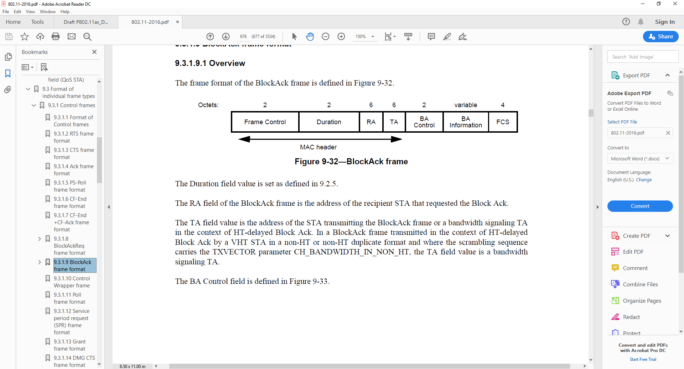
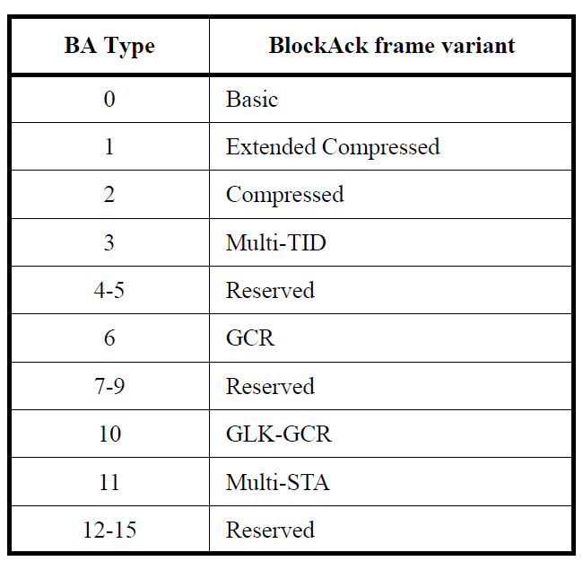
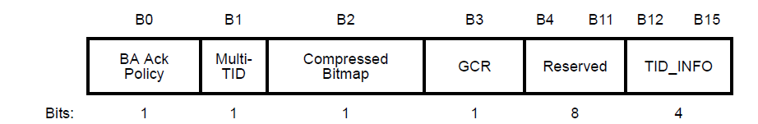
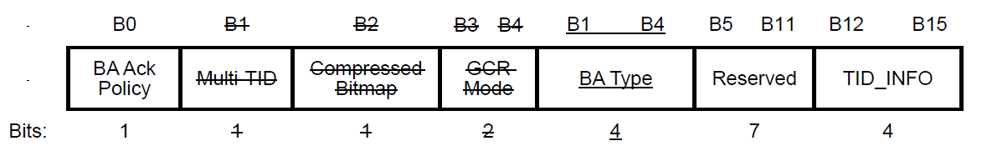
Current BA Design
BA frame format
BA control variant
  Reserved bits can be reused to indicate appearance of link adaptation feedback field in BA information field

