Slide 1
Power saving considering non-AP MLD without STR capability
Date: 2020-01-13
Authors:
Name | Affiliations | Address | Email
Namyeong Kim | LG Electronics | LG Seocho R&D Campus, Korea | namyeong.kim@lge.com
Insun Jang |  |  | insun.jang@lge.com
Jeongki Kim |  |  | jeongki.kim@lge.com
Sungjin Park |  |  | allean.park@lge.com
Taewon Song |  |  | taewon.song@lge.com
Jinsoo Choi |  |  | js.choi@lge.com

Slide 2
Overview
We agreed that 802.11be shall allow a MLD that has constraints to simultaneously transmit and receive on a pair of links to operate over this pair of links [1]
In terms of power management, we can consider the above mentioned constraints of operation over a pair of links to save power consumption of non-AP MLD
Note that we consider only the case where AP MLD has STR capability but other cases will be discussed in the next phase
Therefore, we propose the power saving mechanism considering the constraints of MLD that doesn’t support simultaneous TX/RX (STR) capability on a pair of links in 11be
In this contribution, we will refer to the proposing power saving mechanism as ‘non-STR PSM(Power saving mechanism)’ to explain simply.

Slide 3
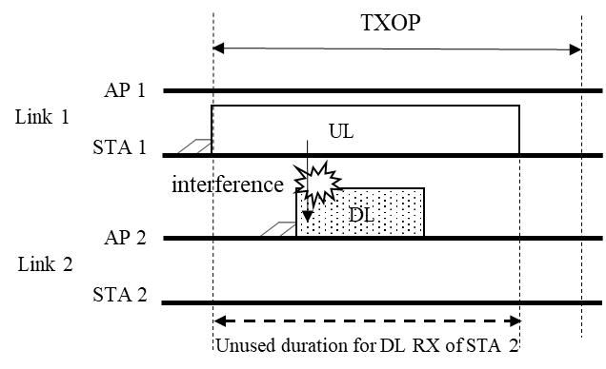
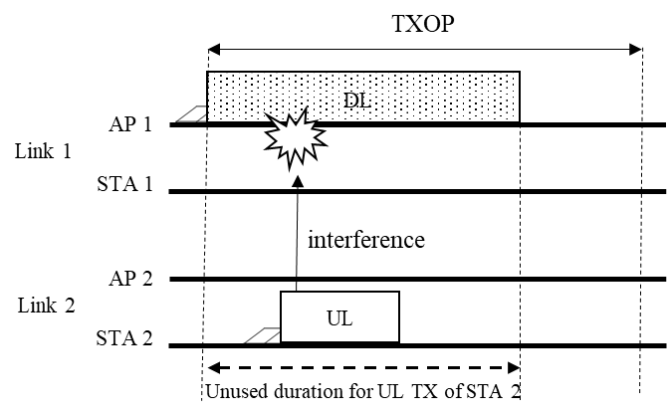
Motivation (1/2)
Non-STR non-AP MLD should consider the interference issue when it receives or transmits frames to avoid data conflict
By this constraints, there may be a period where a STA of non-STR non-AP MLD does not receive or transmit frames when another STA of the same non-AP MLD transmits or receives frames

Slide 4
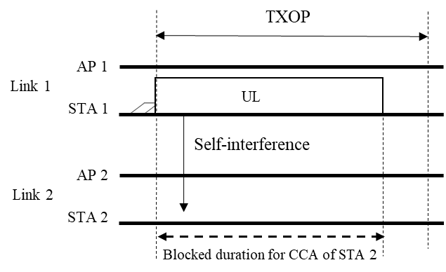
Motivation (2/2)
Non-STR non-AP MLD should consider the interference issue generated by itself when it transmits frames
By this constraints, there may be a period where the CS result of a STA of the non-STR non-AP MLD which does not transmit frames is 'busy' when another STA of the same non-STR MLD transmits frames.

Slide 5
Proposal 1: non-STR PSM for UL data TX
While a STA of non-STR non-AP MLD transmits the UL frames, if another STA of the same non-AP MLD does not transmit UL data, the another STA may enter doze state until end of the UL TX (e.g., UL PPDU duration or UL TXOP)
The STA that has entered doze state will awake after end of UL TX (e.g., UL PPDU duration or UL TXOP)
However, the STA can awake before the end of UL TX in some cases
If the STA has the UL frame, the STA can awake by itself to send the data
The STA may awake by TXOP early termination such as TXOP truncation (See appendix#1 for example)

Slide 6
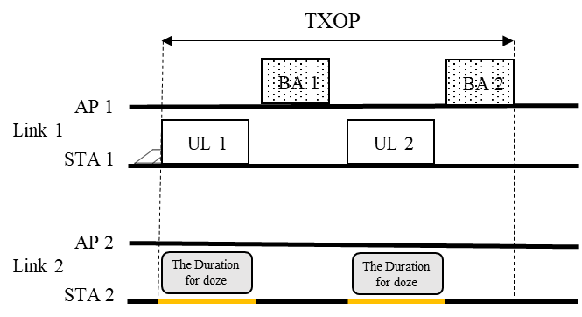
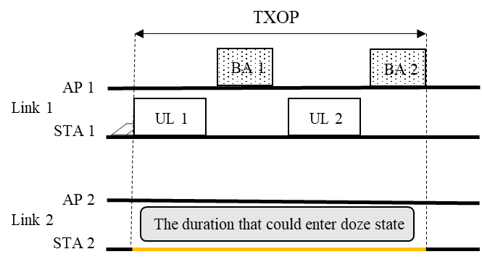
Example: Power saving considering UL TX
When only STA 1 transmits UL frames to AP 1 over Link 1, a STA 2 enters doze state until end of the UL PPDU duration or UL TXOP to save power
During BAs RXs period, the STA 2 may perform CCA for UL data but the STA 2 should not transmit the UL data during BAs RXs period to avoid data conflict
Note: the STA 2 can receive DL data during BAs RXs period. However, it may be more efficient in terms of power saving for the STA 2 to maintain doze state until UL TXOP
If the STA prefers to save more power, the STA can choose the power saving mechanism based on TXOP period instead of PPDU duration.

Slide 7
Proposal 2: non-STR PSM for DL data RX
While a STA of a non-STR non-AP MLD receives the DL frames, if another STA of the same non-AP MLD does not receive DL frames, the another STA may enter doze state until end of DL RX (e.g., DL PPDU duration or DL TXOP)
The STA that has entered doze state will awake after end of DL RX (e.g., DL PPDU duration or DL TXOP)
However, the STA can awake before the end of the DL RX in some cases
If DL data is generated for the STA that has entered doze state, the AP may awake it by transmitting a signal over other link in awake state
The STA may awake by TXOP early termination such as TXOP truncation (See appendix#2 for example)

Slide 8
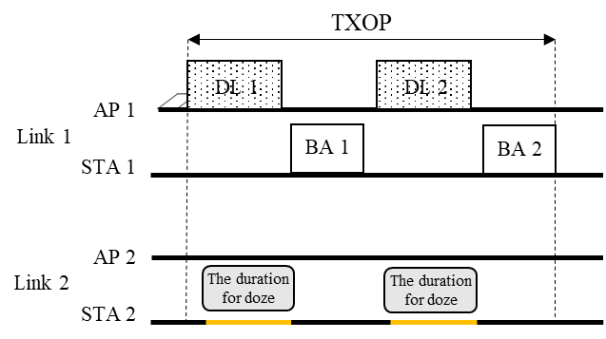
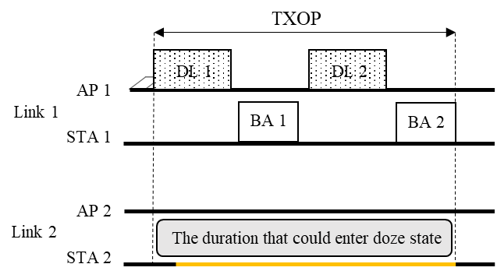
Example: Power saving considering DL RX (1/2)
When only STA 1 receives DL frame from AP 1 over Link 1, a STA 2 enters doze state until end of the DL PPDU duration or DL TXOP of AP 1 to save power
During BAs TXs period, the STA 2 may perform CCA but the CS result will be busy by self-interference of STA1. Therefore, it will be more efficient to maintain doze state during DL TXOP of AP 1 for more power saving
If the STA prefers to save more power, the STA can choose the power saving mechanism based on TXOP period instead of PPDU duration.
CS result will be busy due to BA TXs by STA1

Slide 9
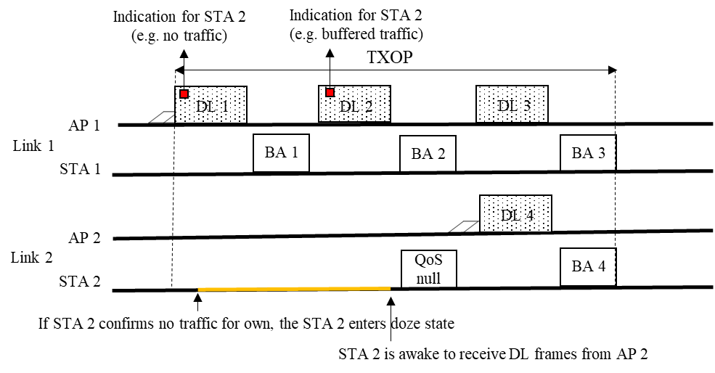
Example: Power saving considering DL RX (2/2)
When the AP 1 obtains TXOP for STA 1, AP 1 transmits DL frames including indication for no traffic of STA 2.
On receiving the indication for no traffic, the STA 2 enters doze state until end of TXOP for AP 1
Optionally, if AP 2 has buffered DL data for STA 2 after the STA 2 had entered doze state, the AP MLD can send a signal for awake over Link 1
The signal may indicate the buffered traffic for STA 2
On receiving the signal, STA 2 awakes and will transmit QoS null frame to AP 2
Note: the QoS null frame may be skipped

Slide 10
Signaling for non-STR PSM capability
A non-AP MLD can announce the capability of whether the STA supports the non-STR PSM.
During initial multi-link setup, an AP MLD and a non-AP MLD can negotiate with each other to enable the non-STR PSM.
After multi-link setup completion, the non-STR PSM is activated on the STA.
The example of operation of MLD which enables Non-STR PSM.
When an AP of AP MLD transmits DL frames to a STA of non-STR non-AP MLD, it carries an indication of buffered data for transmission on another STAs of the same non-AP MLD.
In SFD [1]: An AP of an AP MLD may transmit on a link a frame that carries an indication of buffered data for transmission on other enabled link(s)
On receiving the no buffered data indication, the STA may enter doze state.
Then, the AP does not transmit DL frames to the STA until the STA awakes even if the data for the STA is generated
Optionally, the AP can awake the STA that has entered doze state using the awake signaling

Slide 11
Conclusion
We need to consider the power efficiency for STAs of non-AP MLD in 11be
To save the power consumption, we propose the power saving mechanism considering the constraints of MLD operation without STR capability

Slide 12
Reference
[1] 11-19-1262-06-00be-specification-framework-for-tgbe

Slide 13
SP #1
Do you support 11be defines a power saving mechanism considering unused duration which is generated to avoid interference among links of non-STR non-AP MLD?
The details of unused duration is TBD (e.g., TXOP or PPDU)

Slide 14
SP #2
Do you support that 802.11be allows the following operation for power saving :
While a STA of a non-STR non-AP MLD transmits the UL frames, if another STA of the same non-AP MLD does not transmit UL data, the another STA may enter doze state until end of the UL TX.
The STA that has entered doze state will awake after end of UL TX.

Slide 15
SP #3
Do you support that 802.11be allows the following operation for power saving :
While a STA of a non-STR non-AP MLD receives the DL frames, if another STA of the same non-AP MLD does not receive DL frames, the another STA may enter doze state until end of DL RX.
The STA that has entered doze state will awake after end of DL RX.

Slide 16
SP #4
Do you support that 802.11be allows the following operation for power saving :
A non-AP MLD can announce the capability of whether the STA supports the non-STR PSM.
During initial multi-link setup, an AP MLD and a non-AP MLD can negotiate with each other to enable the non-STR PSM.

Slide 17
SP #5
Do you support that 802.11be allows the following operation for power saving :
When an AP MLD is associated with a non-STR non-AP MLD and the AP MLD or the non-AP MLD obtains a TXOP over a link, the other STA(s) of the same non-AP MLD that has(have) entered doze state in the TXOP may be awaken by a signaling from the AP MLD
The signaling method is TBD

Slide 18
Appendix

Slide 19
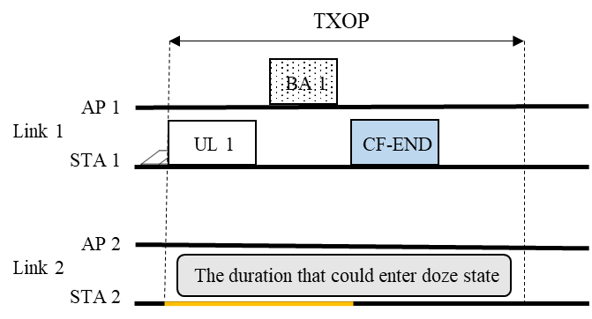
Appendix #1
Example: UL data TXOP early termination
The STA 2 that have entered doze state can awake before end of UL TXOP by transmitting CF-end frame over Link 1
Note that STA 2 awakes from doze state after end of UL TXOP for AP 1 in general case

Slide 20
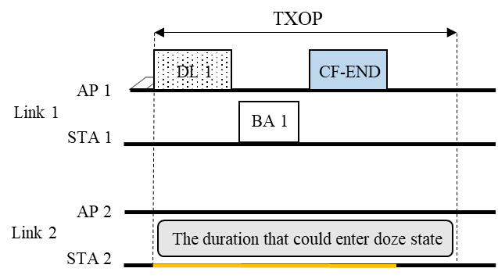
Appendix #2
Example: DL data TXOP early termination
The STA 2 that have entered doze state can awake before end of DL TXOP by receiving CF-end frame from Link 1
Note that STA 2 awakes from doze state after end of DL TXOP for AP 1 in general case

