Slide 1
Power saving considering non-AP MLD without STR capability
Date: 2020-01-13
Authors:
Name | Affiliations | Address | Email
Namyeong Kim | LG Electronics | LG Seocho R&D Campus, Korea | namyeong.kim@lge.com
Insun Jang |  |  | insun.jang@lge.com
Jinsoo Choi |  |  | js.choi@lge.com
Jeongki Kim |  |  | jeongki.kim@lge.com
Suhwook Kim |  |  | suhwook.kim@lge.com
Sungjin Park |  |  | allean.park@lge.com
Taewon Song |  |  | taewon.song@lge.com

Slide 2
Overview
We agreed that 802.11be shall allow a MLD that has constraints to simultaneously transmit and receive on a pair of links to operate over this pair of links [1]
In terms of power management, we can consider the above mentioned constraints of operation over a pair of links to save power consumption of non-AP MLD
Therefore, we propose the power saving mechanism considering the constraints of MLD that doesn’t support simultaneous TX/RX (STR) capability on a pair of links in 11be
In this contribution, “STR capability” means that a capability where downlink and uplink frames can be transmitted simultaneously over the multiple links. On the other hand, “without STR capability” means that it does not support the STR capability

Slide 3
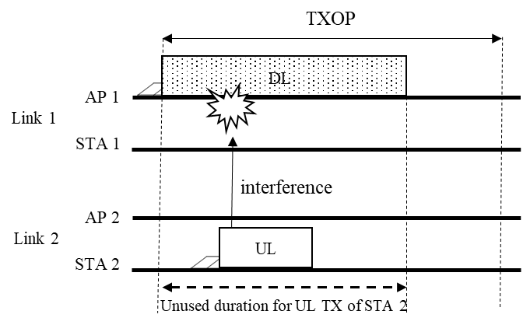
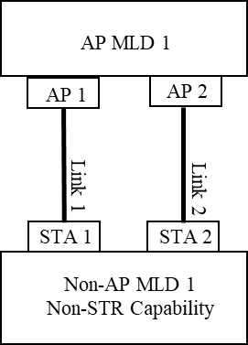
Operation without STR Capability – Case 1
Case 1: DL data RX over multiple links
Some STAs (e.g., STA 1) of non-AP MLD may receive the DL data from an AP MLD over some links. During the DL RX, the other STAs (e.g., STA 2) should not transmit UL data because the UL TX interferes with the DL RX
By this constraint of operation, there may be a duration in which Links (e.g., Link 2) can’t be used for UL TX until the end of DL RX. Therefore, we can utilize this duration for power saving of STAs (e.g., STA 2)

Slide 4
Proposal 1 - Power saving mechanism for DL data RX without STR capability
While some STAs of non-AP MLD without STR capability receive the DL frames, the other STAs which do not receive DL frames may enter doze state until end of DL RX (e.g., DL PPDU duration or TXOP)
In the existing power save mode, a STA that has UL data to transmit does not enter doze state. However, for a STA of non-AP MLD without STR capability, it may enter doze state regardless of whether the STA has UL data to be transmitted because it should not transmit UL data during DL reception to avoid data collision by interference
The STAs that have entered doze state shall awake after end of DL RX (e.g., DL PPDU duration or TXOP)
Depending on the situations, the STA may awake by TXOP early termination (e.g. TXOP truncation etc.)

Slide 5
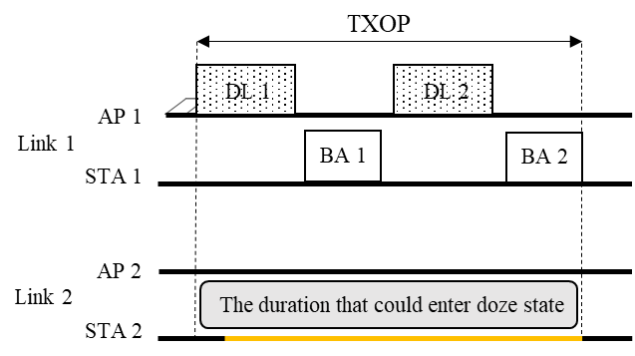
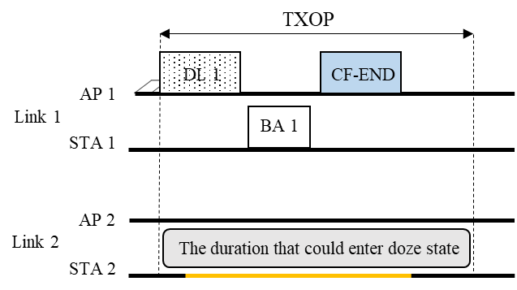
Example - Proposal 1
When only STA 1 receives DL frames from AP 1 over Link 1, STA 2 enters doze state until end of the DL TXOP
Therefore, the STA 2 can reduce power consumption during the doze state duration by removing unnecessary power consumption
STA 2 awakes from doze state after end of DL TXOP for AP 1 or when receiving CF-end frame from Link 1

Slide 6
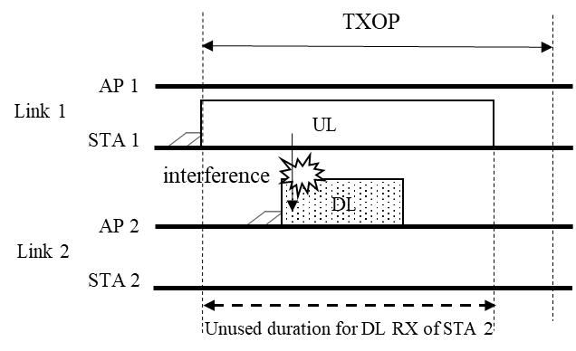
Operation without STR Capability – Case 2
Case 2 : UL data TX over multiple links
Some STAs (e.g., STA 1) may transmit the UL data to an AP MLD over some links. During the UL TX of STAs (e.g., STA 1), the APs (e.g., AP 2) should not transmit DL data because the UL TX interferes with the DL reception
By this constraint of operation, there may be a duration in which Links (e.g., Link 2) can’t be used for DL until the end of UL TX for the some STAs. Therefore, we can utilize this duration for saving power consumption of STAs (e.g., STA 2)

Slide 7
Proposal 2 - Power saving mechanism for UL data TX without STR capability
While some STAs of non-AP MLD without STR capability transmit the UL frames, the other STAs which do not transmit UL data may enter doze state by itself until end of the UL TX (e.g., UL PPDU duration or TXOP)
The STAs that have entered doze state shall awake after end of UL TX (e.g., UL PPDU duration or TXOP)
Depending on the situations, the STA may awake by TXOP early termination (e.g. TXOP truncation etc.)

Slide 8
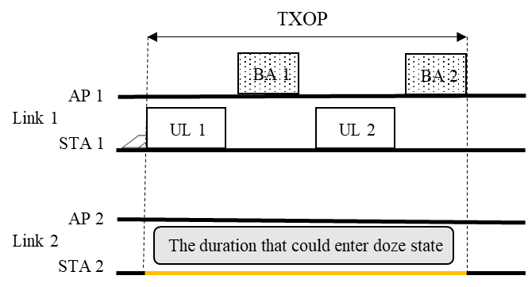
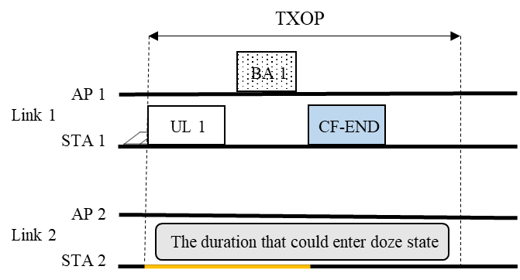
Example - Proposal 2
When only STA 1 transmits UL frames to AP 1 over Link 1, STA 2 enters doze state until end of the UL TXOP
Therefore, the STA 2 can reduce power consumption during the doze state duration by removing unnecessary power consumption
STA 2 awakes from doze state after end of UL TXOP for STA 1 or when transmitting CF-end frame over Link 1

Slide 9
Conclusion
We need to consider the power efficiency for STAs of non-AP MLD in 11be
To save the power consumption, we propose the power saving mechanism considering the constraints of MLD operation without STR capability

Slide 10
Reference
[1] 11-19-1262-06-00be-specification-framework-for-tgbe

Slide 11
SP #1
Do you support 11be defines a power saving mechanism for non-AP MLD that has constraints to simultaneously transmit and receive on a pair of links?

Slide 12
SP #2
Do you support that 802.11be allows the following operation for power saving :
While some STAs of non-AP MLD without STR capability receive the DL frames, the other STAs of the same non-AP MLD which do not receive DL frames may enter doze state until end of DL RX (e.g., DL PPDU duration or TXOP)
The STAs that have entered doze state shall awake after end of DL RX (e.g., DL PPDU duration or TXOP)

Slide 13
SP #3
Do you support that 802.11be allows the following operation for power saving :
While some STAs of non-AP MLD without STR capability transmit the UL frames, the other STAs of the same non-AP MLD which do not transmit UL data may enter doze state by itself until end of the UL TX (e.g., UL PPDU duration or TXOP)
The STAs that have entered doze state shall awake after end of UL TX (e.g., UL PPDU duration or TXOP)

