Slide 1
Consideration on Multi-AP Home Mesh AP Scenario
Date: 2020-1-13
Authors:
Name | Company | Address | Phone | Email
Kosuke Aio | Sony Corporation |  |  | Kosuke.Aio@sony.com
Yusuke Tanaka |  |  |  | Yusuke.YT.Tanaka@sony.com
Ryuichi Hirata |  |  |  | Ryuichi.Hirata@sony.com
Kazuyuki Sakoda |  |  |  | Kazuyuki.Sakoda@sony.com

Slide 2
Introduction
Multi-AP Coordination is one of the candidate features for 11be[1]
To identify the system level benefit quantitatively, we should set common preconditions on the Multi-AP scenarios
Enterprise scenario was discussed before [2]
However, residential scenario of Multi-AP Coordination has not been discussed yet
In this contribution, we propose a new simulation scenario: “Home Mesh AP Scenario” based on the TGax residential scenario.

Slide 3
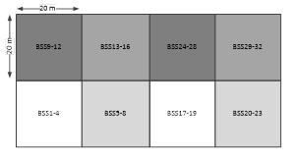
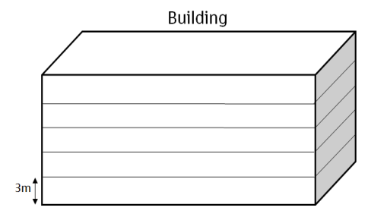
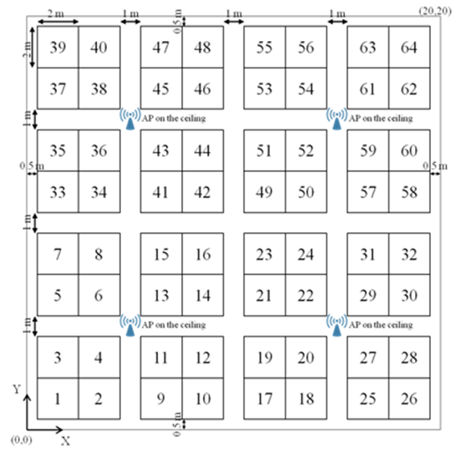
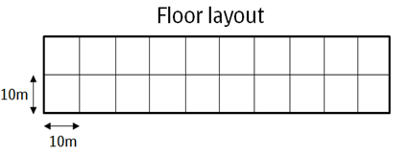
Recap of TGax/Indoor Scenarios [3]
TGax has defined three indoor scenarios, Residential, Enterprise and Hot spot, where multiple APs exist.
From next slides, we review the TGax/Residential Scenario.
 | Residential | Enterprise | Hot Spot
Topology
Channel Model | Indoor | Indoor | Indoor
Management | Unmanaged | Managed | Managed

Slide 4
Recap of TGax/Residential Scenario
TGax/Residential Scenario
One Home has one AP (owned by different users)
AP-AP is not connected.
Frequency Reuse is assumed among neighboring AP. (80MHz x 3)
In this scenario, Joint transmission is not applicable.
It is difficult to share the data among APs owned by different users.
Adjacent AP uses the different channel, not same channel.
This residential scenario should be reconsidered to evaluate Multi-AP coordination.

Slide 5
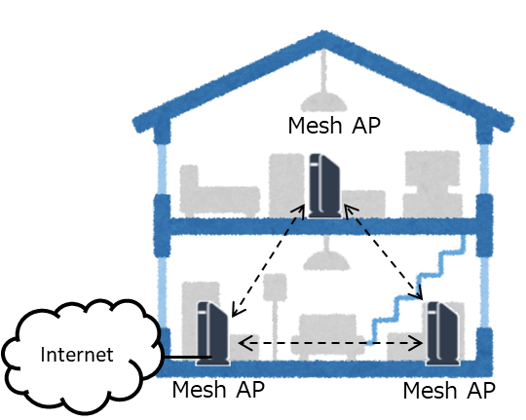
Consideration on Home Mesh AP
In EHT SG, some contributions assumed Home Mesh AP.[4, 5, 6]
Precondition
All AP are owned by the same user.
AP-AP is wireless connection
Wired connection (e.g. Ethernet) is not common due to cable handling at home scenario.
APs may connect each other via WAN/LAN port, but coordination via such ports are beyond the scope of 802.11.
Same channels among all APs (No Frequency Reuse)
Joint Tx can easily be performed in this scenario because:
It is easy to share the data among APs owned by the same users.
Adjacent AP uses the same channel.

Slide 6
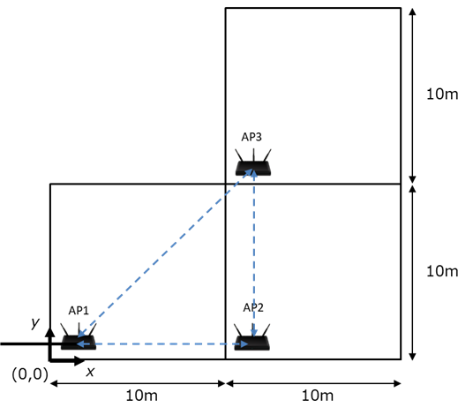
Home Mesh AP Scenario Proposal
We proposed to use Home Mesh Scenario for residential scenarios of Multi-AP Coordination
One solitary house configuration
Three 10m x 10m rooms
In each room, place an EHT AP and some STAs
Mesh Architecture
Only AP1 is connected to Internet Network.
APs are connected by backhaul, and APs and STAs are connected by fronthaul.
Backhaul & Fronthaul are different channel/antennas.
Mesh Data Flow (>>: backhaul, > fronthaul)
AP1 > STAs in room1
AP1 >> AP2 > STAs in room2
AP1 >> AP3 > STAs in room3 (or AP1 >> AP2 >> AP3 > STAs in room3)

Slide 7
Example Parameters of Home Mesh AP Scenario (1/3)
Deployment Parameters
Environment description | One solitary house configuration (10m x 10m rooms x 3)
APs location | In each room, install AP at: AP1: (x=1, y=1, z=1.5) AP2: (x=11,y=1, z=1.5) AP3: (x=11,y=11, z=1.5)
AP Type | EHT
STAs location | In each room, place STAs in random xy-locations (uniform distribution) at z = 1.5m.
Number of STA and STAs type | N STAs in each room. STA_1 to STA_N1: EHT STA_{N1 +1} to STA_N: non-EHT N = [2] N1 = [2] Non-EHT = 11ax (TBD) in 5GHz
Channel Model And Penetration Losses | Fading model TGac channel model D NLOS for all the links.
 | Pathloss model PL(d) = 40.05 + 20*log10(fc/2.4) + 20*log10(min(d,5)) + (d>5) * 35*log10(d/5) + 10*W d = max(3D distance [m], 1) fc = frequency [GHz] W = number of walls traversed in x-direction plus number of walls traversed in y-direction
 | Shadowing Log-normal with 5 dB standard deviation, iid across all links

Slide 8
Example Parameters of Home Mesh AP Scenario (2/3)
PHY Parameters
Center frequency, BSS BW and primary channels | All BSSs all at 5GHz For fronthaul, all AP are using the same 80MHz channel [Same primary channel] or Different primary channel For backhaul, AP1 is using the different 80MHz channel from the fronthaul’s 80MHzchannel.
Preamble Type | Control: legacy 20us; Data: 11ax (TBD for 1antenna case)
AP TX Power | 17 dBm per antenna
STA TX Power | 12 dBm per antenna
AP #of TX antennas | All EHT APs with [4] or all with 2 for backhaul and [4] or all with 2 for fronthaul
AP #of RX antennas | All EHT APs with [4] or all with 2 for backhaul and [4] or all with 2 for fronthaul
STA #of TX antennas | All EHT STAs with [2] or all with 1
STA #of RX antennas | All EHT STAs with [2] or all with 1
AP antenna gain | 0dBi
STA antenna gain | -2dBi
Noise Figure | 7dB
CCA-ED threshold | -56 dBm (measured across the entire bandwidth after large-scale fading)
Rx sensitivity/CCA-SD | -76 dBm (a packet with lower rx power is dropped)
Link Adaptation | [Fixed MCS 9 for all transmission] or Genie MCS Selection
Channel estimation | Ideal unless otherwise specified
Guard Interval, Symbol Length | 13.6us with 800ns GI per OFDM symbol
PHY abstraction | Use PER table from BCC, 1458byte in EMD Appendix.3

Slide 9
Example Parameters of Home Mesh AP Scenario (3/3)
MAC Parameters
Access protocol parameters | [EDCA with default parameters according to traffic class] [CWmin = 15, CWmax = 1023, AIFSn=3 ]
Queue length | A single queue for each traffic link is set inside AP/STA sized of 2000 packets
Traffic type | TBD Mbps/STA, CBR, Random start time during a 10ms interval
Traffic direction | DL only
MPDU size | 1544 Bytes (1472 Data + 28 IP header + 8 LLC header + 30 MAC header + 4 delimiter + 2 padding)
Aggregation | [A-MPDU / 64 or [256] MPDU aggregation size / BA window size, No A-MSDU, with immediate BA]
Max # of retries | Max retries: 10
RTS/CTS Threshold | [No RTS/CTS]
Association | Backhaul [AP2, AP3 are associated to AP1] or AP2 is associated to AP1 and AP3 is associated to AP2. Fronthaul X% of STAs in a room are associated to the AP in the room, 100-X% of the STAs are not associated [X=100]
Management | It is allowed to assume that all APs belong to the same management entity

Slide 10
Summary
We reviewed the residential scenarios defined in TGax.
TGax residential scenario is not suitable for the evaluation of Multi-AP coordination, especially Joint transmission.
We propose a new simulation scenario “Home Mesh AP Scenario” for Multi-AP evaluation.
In EHT SG, some contributions assumed Home Mesh AP.
Home Mesh AP Scenario like Slide.6 –9 could be useful for Multi-AP Discussion in TGbe.

Slide 11
Reference
[1] 11-18-1231-01-0eht-eht-draft-proposed-par
[2] 11-19-1595-00-00be-consideration-on-joint-transmission
[3] 11-13-1001-09-0hew-simulation-scenarios-document-template
[4] 11-18-1116-00-0eht-multi-ap-harq-for-eht
[5] 11-18-1155-01-0eht-multi-ap-enhancement-and-multi-band-operations
[6] 11-18-1161-00-0eht-eht-technology-candidate-discussions
[7] 11-14-0882-04-00ax-tgax-channel-model-document

Slide 12
SP
Do you think it is beneficial to use the “Home Mesh AP Scenario” in Slide 6-9 for evaluation of the Multi-AP Coordination?
Yes
No
Abstain

