Slide 1
Multi-link Association Follow Up
Date: 2020-01-10
Authors:
Name | Affiliations | Address | Phone | Email
Guogang Huang | Huawei | Shenzhen, China |  | huangguogang1@huawei.com
Yunbo Li |  |  |  | liyunbo@huawei.com
Yuchen Guo |  |  |  | guoyuchen@huawei.com
Ming Gan |  |  |  | ming.gan@huawei.com
Dandan Liang |  |  |  | dandan.liang@huawei.com
Jian Yu |  |  |  | ross.yujian@huawei.com

Slide 2
Introduction (1/2)
A non-AP multi-link device (MLD) associates with an AP MLD through a single link is mentioned in several presentations, in order to save signaling overhead [1,2];
Several potential solutions are proposed in [3];
Solution 1. Using Neighbor Report elements to indicate the multi-link info
Solution 2. Through carrying a new element in the current Association Request/Response frame to perform the multi-link association
Solution 3. Using aggregated multiple OCT MMPDUs to perform the multi-link association

Slide 3
Introduction (2/2)
The question is how to indicate the info on multiple links in a high-efficient manner?
For a multi-link device, most of the capability/operating info on each link is normally the same.
Considering the above fact, Solution 1 and Solution 3 are not likely to save signaling overhead.
Hence, we consider Solution 2 and a detailed design is provided for discussion.

Slide 4
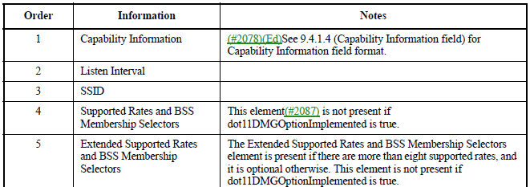
Recap-Association Request frame
The format of Association Request frames is shown as following

Slide 5
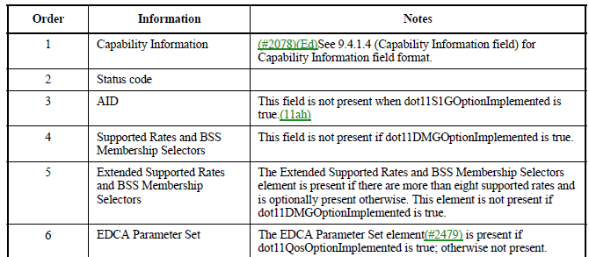
Recap-Association Response frame
The format of Association Response frame is shown as following

Slide 6
Multi-link Association Request/Response
(1/3)
Multi-link Association Procedure
Step 1. Non-AP MLD sends an Association Request frame which carries info on Link 1, Link 2 and Link 3 to AP MLD in Link 1, referred as transmitted link
Step 2. AP MLD replies an Association Response frame which carries info on Link 1, Link 2 and Link 3 to non-AP MLD in Link 1
Step 3. Then non-AP STA1, STA2 and STA3 affiliated non-AP MLD respectively associated with AP1, AP2 and AP3 affiliated AP MLD
Multi-link AP device
AP1 operating
on 2.4 GHz
AP2 operating
on 5 GHz
AP3 operating
on 6 GHz
Transmitted link
Non-transmitted links
Link 1
Link 2
Link 3
Non-AP STA1
Non-AP STA2
Non-AP STA3
Multi-link non-AP device

Slide 7
Multi-link Association Request/Response
(2/3)
A newly defined element, named as Multi-link Association element, can be included in the Association Request/Response frames. The specific format is given as the below figure
Multi-link common info, which maybe contain the following info, e.g.
MAC SAP Address and STR bitmap indication across links of STA side
which may be reserved when this Multi-link Association element is included in an Association Request frame
MAC SAP Address of AP side
STA MAC Address Present
Non-transmitted multi-link profile subelement is used to indicate the info on non-transmitted links
Element ID | Multi-link common info | non-transmitted multi-link profile subelement
Link-index element | … | Xx element | Link-index element | … | Xx element | … | Link-index element | … | Xx element
Link #2
Link #3
Link #N

Slide 8
Multi-link Association Request/Response
(3/3)
For the non-transmitted multi-link profile subelement
The info on each non-transmitted link is began with a newly defined element, named as link-index element, which maybe contain the following info, e.g.
Link ID, BSSID, Operating class, Channel Number
TSF Offset
If STA MAC Address Present is set to 1, then the STA MAC Address is presented in the following each Link-index element. If STA MAC Address Present is set to 0, then the STA MAC Address is not presented in the following each Link-index element.
Capability info, Listen Interval, which are the same with fixed fields carried in the current Association Request frame
Status code, AID. These two fields are valid only in an Association Response frame; Otherwise, they are reserved
Only when some element of the non-transmitted link is different from the one of the transmitted link, it needs to be carried in the non-transmitted multi-link profile subelement.
Element ID | Multi-link common info | non-transmitted multi-link profile subelement
Link-index element | … | Xx element | Link-index element | … | Xx element | … | Link-index element | … | Xx element
Link #2
Link #3
Link #N

Slide 9
Summary
In this contribution, we propose a signaling indication method for multi-link association.
For the non-transmitted links, only the elements that have different content from elements for the transmitted link need to be carried.
This method can significantly reduce the signaling overhead especially when most info on affiliated STAs of MLD is the same.

Slide 10
Reference
[1] 11-19-0821-00-00be-multiple-band-discussion
[2] 11-19-0773-00-00be-multi-link-operation-framework
[3]11-19-1549-01-00be-multi-link-accociation

Slide 11
Straw Poll 1
Do you agree that MLD can reuse the Association Request/Response frame to do multi-link association?
Note that each non-AP STA affiliated with a non-AP MLD also can separately do the association
Yes
No
Abstain

Slide 12
Straw Poll 2
Do you agree that only the elements that have different content from elements in the transmitted link are included in the non-transmitted link profile subelement ?
Yes
No
Abstain

