Slide 1
Indication of Multi-link Information
Date: 2020-01-13
Authors:
Name | Affiliation | Address | Phone | Email
Insun Jang | LG Electronics | 19, Yangjae-daero 11gil, Seocho-gu, Seoul 137-130, Korea |  | insun.jang@lge.com
Jinsoo Choi |  |  |  | js.choi@lge.com
Jeongki Kim |  |  |  | jeongki.kim@lge.com
Suhwook Kim |  |  |  | suhwook.kim@lge.com
Sungjin Park |  |  |  | allean.park@lge.com
Taewon Song |  |  |  | taewon.song@lge.com
Namyeong Kim |  |  |  | namyeong.kim@lge.com

Slide 2
Introduction
For multi-link (ML) operation, we decided a single ML setup including an association and the indication of ML information using a newly defined element (especially for capabilities) [1]
  We can add more information to the new element as well
In this contribution, we discuss the format and the transmission of a newly defined element
  We call the element ML element (temporarily)

Slide 3
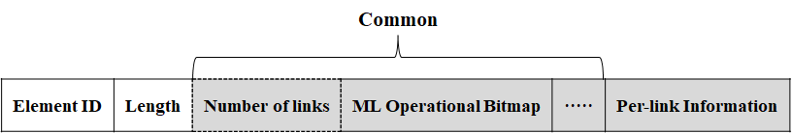
High-level Format of ML Element
Basically, ML element would include Common information and Per-link information [2]
  Common information can include the indication across the links regarding ML setup and operation, called ML Operational Bitmap*
    For example, which link(s) are operating links or primary link (e.g., for power saving or channel access), simultaneous TX/RX (STR) capability,…
  Per-link information includes the information of the other link(s) except for a link where the element is transmitted for a single setup
Example
  If a size of each field increases in proportional to the number of links, the field “number of links” can be removed
*The Name can be changed

Slide 4
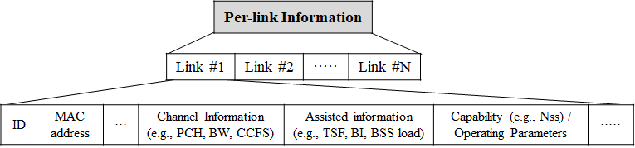
ML Element: Per-link Information
Field “Per-link Information” indicates information per link only needed for multi-link setup/operation
  Therefore, Indicated links are the other link(s) except for a link* where the element is transmitted for a single setup
    Basically, the information of association link is included in EHT capabilities/operation elements with additional elements (if needed) which will be discussed in the next slide
Per-link Information can be the following example
  Link #1 ~ Link #N do not include the association link
*We call a link on which multi-link information is transmitted “Association link”

Slide 5
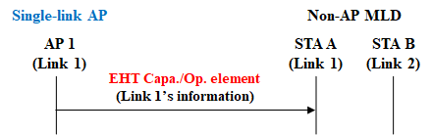
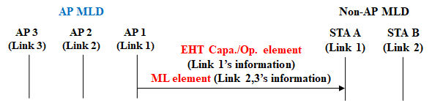
Discussion on Per-link Information
Single-link EHT AP or an AP of AP MLD would include the information of association link in EHT Capa./Op.* elements
  Single-link non-AP would also include its capabilities in EHT capability element
  The elements also include the information regarding other features (e.g., Multi-AP)
  If needed (e.g., switching), single-link non-AP needs to understand the ML element
Meanwhile, necessary information only for the other link(s) would be transferred on the association link
  In other words, all of fields regarding the information of association link (as in EHT capability/operation element) wouldn’t be necessary for the other link(s)
  After setup, the additional information will be obtained on the other link(s)
*Capabilities/
Operation

Slide 6
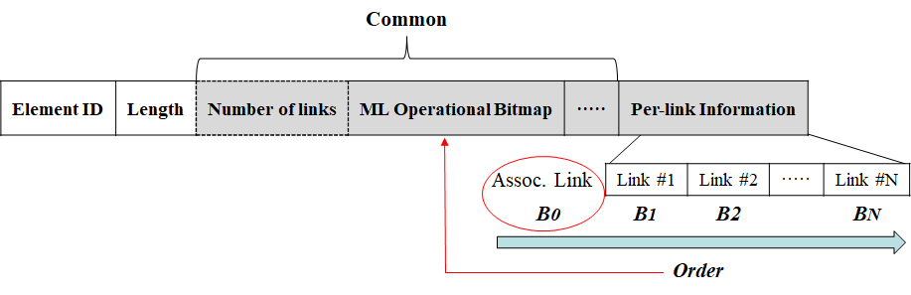
ML Element: ML Operational Bitmap (Common)
We can use a bitmap indication implicitly by considering the order for indicated links in Per-link information field
  Bitmap can include bit(s) for the association link
It can be also extended depending on what is indicated (e.g., STR capability) and utilized for other frames (e.g., ADDBA for a single BA agreement)

Slide 7
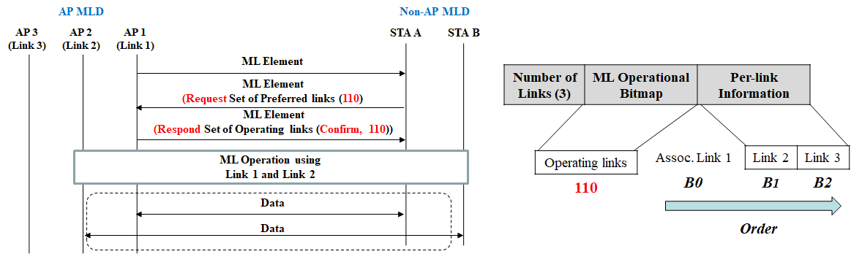
ML Operational Bitmap Example #1
#1: Set of links that are requested or responded for some use cases (e.g., indication of operating links or primary link)
  Using bitmap in order of indication including the association link
  Non-AP MLD requests link 1 and 2 as operating links and AP MLD confirms it

Slide 8
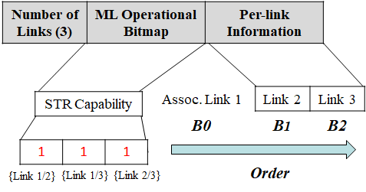
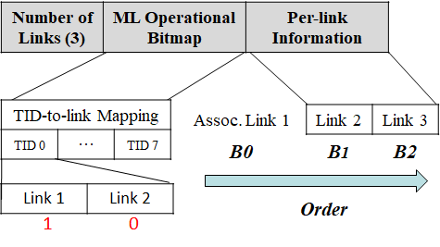
ML Operational Bitmap Example #2, #3
#2: STR Capability that whether STR is allowed on a pair of links
  Using bitmap in order of indication including the association link
  Pre-defined fields depending on Number of links
  As an example, an MLD can perform asynchronous channel access on all of links
#3: TID-to-link Mapping
  For Each TID and selected operating links (e.g., link 1, link 2), using bitmap in order of indication including the association link
  As an example, an MLD assigns TID 0 to link 1 only (not link 2)

Slide 9
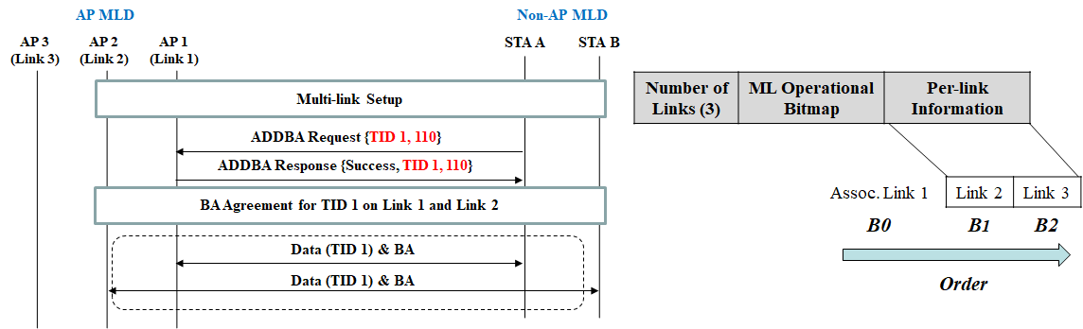
Example for Other frames
Single BA Agreement
  Using bitmap in order of indication including the association link
  This is an example of utilization for a single BA agreement using ADDBA request/response frames [1] (already agreed)
  For example, An MLD agree BA for TID 1 over link 1 and link 2

Slide 10
ML Element for
AP MLD and Non-AP MLD
Regarding Sub-fields
  ML element of AP MLD actually would include more information than that of non-AP MLD
  Non-AP MLD does not include AP-only information e.g., channel information, Beacon Interval
  Therefore, some sub-fields of ML element transmitted by non-AP MLD can be excluded
Regarding transmission
  ML element of AP MLD is included in Beacon and Association/Probe Response
  ML element of non-AP MLD is included in Association Request
  Whether we define a new management frame including the ML element has to be discussed
    However, we can just transmit the proposed ML element in existing management frames

Slide 11
Summary
We discussed the format and the transmission of a newly defined element
ML element includes a Common information and Per-link information
  Per-link information includes the information of the other link(s) except for a link where the element is transmitted for a single setup
  Common information can include the number of links and the bitmap indications across the links regarding ML setup and operation (e.g., operating links, TID-to-link Mapping)
    It considers the order for links indicated in ML information field, implicitly
ML element of AP MLD is included in Beacon and Association/Probe Response while ML element of non-AP MLD is included in Association Request
    Some sub-fields of ML element transmitted by non-AP MLD can be excluded because AP-only information isn’t‘ needed to be included

Slide 12
SP #1
Do you support that an STA of an MLD can provide MLD-level information that is common to all STAs affiliated with the MLD and per-link information that is specific to the STA on each link in management frames during multi-link setup?
  The specific information is TBD
Y/N/A

Slide 13
SP #2
Do you support that the following?
  Existing frames are reused for discovering APs that are affiliated with AP MLD
  Association Request and Association Response frames are reused for multi-link setup
  NOTE: After association, new signaling to query AP link specific parameters or AP MLD parameters by using Protected Management Frames (PMF) encrypted Management frames is TBD
Y/N/A

Slide 14
References
[1] 802.11-19/1262r8 Specification Framework for TGbe
[2] 802.11-19/1509r5 Discussion on Multi-link Setup
[3] 802.11-19/1583r0 Multi-link BSS Operations
[4] 802.11-19/1823r0 Multi-link Setup Follow up
[5] 802.11-19/1549r1 Multi-link Association

