Slide 1
Indication of Multi-link Information
Date: 2020-01-13
Authors:
Name | Affiliation | Address | Phone | Email
Insun Jang | LG Electronics | 19, Yangjae-daero 11gil, Seocho-gu, Seoul 137-130, Korea |  | insun.jang@lge.com
Jinsoo Choi |  |  |  | js.choi@lge.com
Jeongki Kim |  |  |  | jeongki.kim@lge.com
Suhwook Kim |  |  |  | suhwook.kim@lge.com
Sungjin Park |  |  |  | allean.park@lge.com
Taewon Song |  |  |  | taewon.song@lge.com
Namyeong Kim |  |  |  | namyeong.kim@lge.com

Slide 2
Introduction
For multi-link operation, we decided a single multi-link setup including an association and the indication of multi-link information on a link (discovered) [1]
In this contribution, we propose a new element, called multi-link element for indicating the multi-link information

Slide 3
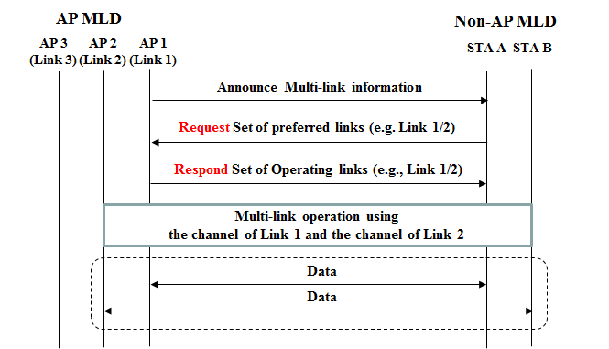
Recap: Multi-link Setup [2]-[4]
After discovering an AP MLD, STA A negotiates with AP 1 to determine operating links
STA A would consider the information of links supported by AP MLD

Slide 4
Discussion on Multi-link information
Single-link EHT STA
It just would include the information of its operating link by using EHT capability/operation element, and other elements (e.g., TSF, BSS load)
These would also include the information regarding other features (e.g., PHY/Multi-AP)
MLD (with more than one link)
Except for an association* link, it needs to send the information of the other link(s)
Necessary information for the other link(s) would be transferred on the association link
In other words, all of fields regarding the information of association link (as in EHT capability/operation element) wouldn’t be necessary for the other link(s)
After setup, the other information will be received on the other link(s)
Multi-link
Single-link
*We call a link on which multi-link information is transmitted “Association link”

Slide 5
Proposal: Multi-link Element
Multi-link Element includes the information of the other link(s) link except for a link where the element is transmitted
Additionally, it can also include the indication across the links regarding ML setup and operation
For example, simultaneous TX/RX capability, which link(s) are operating links or primary link (e.g., for power saving or channel access)
An example of format
Length of each field is variable depending on the number of links

Slide 6
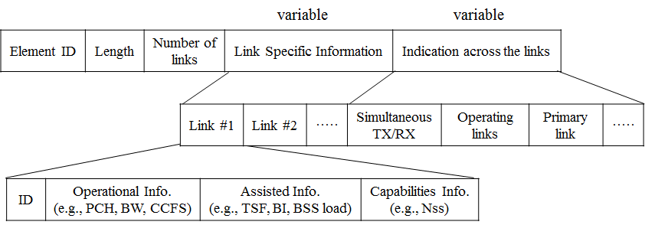
Proposal: Multi-link Element (Cont’d)
Specifically, the link specific information includes the information per link such as capability/operational parameters/assisted information (e.g., TSF, Beacon interval, BSS load)
It can be included in Management frames (e.g., Beacon, Assoc.)
It may be included in a new management frame for setup (if defined)
Several sub-fields may be omitted depending on the type of frames
A specific example is as follows

Slide 7
Indication based on Multi-link Element
By utilizing the Multi-link element, an STA can simply indicate several information across the indicated links, especially when we consider the indication order for links
Example #1: Set of links that are requested or responded for some use cases (e.g., indication of operating links or primary link)
Using bitmap in order of indication including the association link
Non-AP MLD requests link 1 and 2 as operating links and AP MLD confirms it

Slide 8
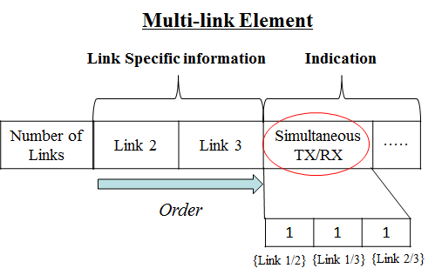
Indication based on Multi-link Element (Cont’d)
Example #2: Simultaneous TX/RX (STR) Capability indication [1]
Using bitmap in order of indication including the association link
MLDs can perform asynchronous channel access on all of links

Slide 9
Indication based on Multi-link Element (Cont’d)
Example #3: Single BA Agreement [1]
Using bitmap in order of indication including the association link
An MLD agree BA for TID 1 over link 1 and link 2

Slide 10
Discussion: Alternative
Legacy STAs can already transmit Neighbor report (NR) element which can include not only channel information but also TSF, capability, etc., by utilizing optional sub-elements
By utilizing reserved bits, we can also describe other information
Therefore, by adding multiple modified NR elements [5], they can include link specific information instead of multi-link element, e.g.,

Slide 11
Summary
We proposed a new element, i.e., Multi-link Element
It includes the specific information of the other link(s) link except for a link where the element is transmitted
It also includes the indication across the links regarding ML setup and operation
Existing neighbor report (NR) element can be also utilized to replace a part of multi-link element by including additional information to NR element
By utilizing the order in the Multi-link element, we presented examples of indicating several information, i.e., Set of links, Simultaneous TX/RX (STR) Capability indication, Single BA agreement

Slide 12
SP #1
Do you support 11be defines the following type of element for multi-link operation?
Multi-link* element: the element including the information of the other link(s) except for a link where the element is transmitted and the indication across the supported links
The specific information is TBD
*NOTE: Exact name can be changed
Y/N/A

Slide 13
References
[1] 802.11-19/1262r6 Specification Framework for TGbe
[2] 802.11-19/1509r5 Discussion on Multi-link Setup
[3] 802.11-19/1583r0 Multi-link BSS Operations
[4] 802.11-19/1823r0 Multi-link Setup Follow up
[5] 802.11-19/1549r1 Multi-link Association

