Slide 1
SN Expansion for 11be
Date: 2020-01-09
Name | Affiliation | Address | Phone | Email
Duncan Ho | Qualcomm Inc. |  |  | dho@qti.qualcomm.com
Abhishek Patil | Qualcomm Inc.
George Cherian | Qualcomm Inc.
Alfred Asterjadhi | Qualcomm Inc.

Slide 2
Motivation
Let’s assume 10Gbps transmission rate on an 11be link and 1500-byte packets
  The current 12-bit Sequence Number will be exhausted in 4.9ms (i.e., within the PPDU itself)
  Therefore, the peak data rate would be limited (throttled) by the 12 bit SN (see this slide)
  Note a single EHT PHY might support a data rate up to ~45Gbps
    320 MHz, 16 SS, and 4096 QAM for a max. PPDU of 5.484 ms, this is expected to carry a PSDU of ~31.203 Mbytes => ~45Gbps
With MLA, the total throughput will be even higher (i.e., multiplied by the number of links)
In general, when the MPDUs are distributed and sent on multiple links, any lost MPDUs (due to PER) on one link can prevent the transmitting MLD from advancing its tx window. Despite the medium is free on the other links, the transmitter is throttled for no good reason
Although the lost MPDUs can be transmitted on the other links, that requires tight co-ordinations between the STAs of the transmitting MLD (which may not be a good assumption for some AP MLDs)

Slide 3
Motivation (Cont’d)
The MAC protocol design should ensure the achievable data rate is not throttled by the protocol itself
Although a regular non-AP MLD (e.g., smartphone or laptop) may not support the max data rate mentioned above, the AP MLDs and non-AP MLDs for popular mesh-type home networking could support and take advantage of the extremely high throughput offered by 11be for backhaul connections between them
We explore a few schemes to expand the sequence number beyond what is allowed by the current spec

Slide 4
Option 1: Bits in HE Control
Bits in HE Control field are used to carry additional bits for expanding the sequence number space
  The SN information needs to be present in every MPDU
    Spec could set aside a fixed set of bits in HE Control field to carry the expanded SN instead of defining a new A-Control type
Advantage:
  Keeps existing meaning of SN/FN fields with additional bits HE Control field providing extended space
Requirement:
  Requires expansion of HE Control to carry SN extension + additional A-Control field(s)

Slide 5
Option 2: PN as SN (1/2)
Use portion of the PN space to represent SN
  Use a concept that is similar to 11ah PV1 MPDUs where the 11ah PN = BPN || SN || FN
  We define 11be PN (48 bits) = TID (4 bits) || SN (36 bits) || pool (8 bits)
  36-bit SN space is per TID
  TID is included to ensure uniqueness of the Nonce sequence between TIDs
    Note 11ah uses CCMP whose Nonce already includes TID so TID is not needed in the 11ah PN
    However, GCMP does not contain TID so we have to include the TID in the PN to ensure Nonce uniqueness
  The pool value is incremented for each retx on same or different link to maintain uniqueness of the Nonce and straightly increasing value of PN at the receiver side

Slide 6
Option 2: PN as SN (2/2)
TBD what to do with the TID and SN fields in the MAC header
  One option is
    Include the 12 LSB of the 36-bit SN in the 12-bit SN field in the MAC header and check at the receiver if it matches the corresponding value carried in the PN of the MPDU
    Keep the TID in the MAC header and check at the receiver if it matches the corresponding value carried in the PN of the MPDU
Advantages:
  Provides a very large SN space (of up to 2^36)
  No changes to security aspect (reuse GCMP/CCMP nonce space and anti-replay check)
  SN is protected by the MIC
Note:
  Effective PN space reduced to 40-bit (from 48-bit) – still a large space
  40 bits exhausted in ~15 days (1500-byte packets @ 10Gbps)

Slide 7
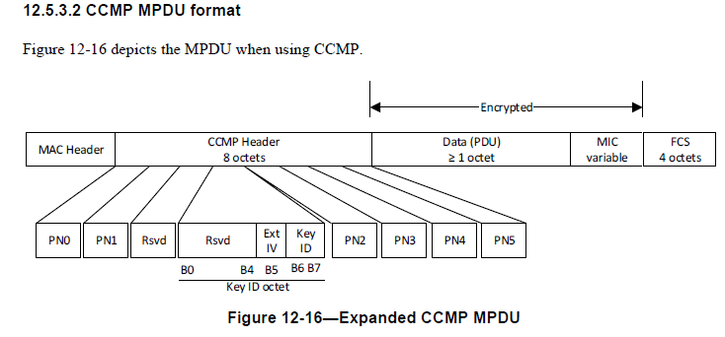
Option 3: Use the Reserved Bits in the CCMP/GCMP header (1/2)
Currently 13 reserved bits not used. These bits are NOT protected by the MIC.
The current 12-bit SN is NOT protected by the MIC either
Advantage:
  Simple and it provides 13 extra bits of SN space

Slide 8
Tx Window Can Get Stuck due to insufficient SN size in case of Tx Errors
Simplistic example to illustrate the point
Although the MPDU with SN=1 can be retx’ed on Link 1, it takes time to reshuffle the MPDUs between links

