Slide 1
Multiple RU Aggregation
Date: 2020-01-13
Authors:
Name | Affiliation | Address | Phone | Email
Eunsung Park | LG Electronics | 19, Yangjae-daero 11gil, Seocho-gu, Seoul 137-130, Korea |  | esung.park@lge.com
Dongguk Lim |  |  |  | dongguk.lim@lge.com
Jinmin Kim |  |  |  | jinmin1230.kim@lge.com
Jinyoung Chun |  |  |  | jiny.chun@lge.com
Jinsoo Choi |  |  |  | js.choi@lge.com

Slide 2
Introduction
In the September F2F meeting, TGbe agreed that more than one RU can be assigned to a single STA, i.e., multiple RU aggregation was allowed
In this contribution, we propose various combinations of multiple RU aggregation for a PPDU transmission in all of the bandwidths
We deal with both SU and MU PPDU transmission
  For SU PPDU, preamble puncturing is taken into account
  For MU PPDU, restrictions on RU aggregation are introduced

Slide 3
RU Aggregation for SU PPDU (1/4)
In the last meeting, TGbe agreed that preamble puncturing is applied to SU PPDU
There is no other existing way to support SU PPDU with preamble puncturing than multiple RU aggregation
In consideration of the 20MHz based preamble puncturing dealt with in [1], we propose various combinations of multiple RU aggregation
In addition, we further design multiple RU aggregation by carefully considering that several RUs adjacent to the punctured channel should not be assigned for interference reduction as described in [2]

Slide 4
RU Aggregation for SU PPDU (2/4)
For the 80MHz bandwidth, we propose the following various RU combinations by considering preamble puncturing
  RU combinations: 242+242, 484+242, 996
  Primary 20 is always used
  For 242+242, 242-tone RUs on primary 20 and on one of the 20MHz in secondary 40
  For 484+242, 484-tone RU on primary 40 and 242-tone RU on one of the 20MHz in secondary 40 or 484-tone RU on secondary 40 and 242-tone RU on primary 20
  In 80MHz, using only 242-tone RU or 484-tone RU is not permitted since it is 20MHz or 40MHz bandwidth transmission
242+242
484+242
996
Examples for RU combinations
: punctured

Slide 5
RU Aggregation for SU PPDU (3/4)
For the bandwidth > 80MHz, we can come up with the following RU combinations in each 80MHz segment by considering preamble puncturing and propose to combine them, i.e., combine RUs across 80MHz channels
  RU combinations in each 80MHz: 242, 242+242, 484, 484+242, 996
  Primary 20 is always used
  E.g., (484+242)+(996) in 160 / 80+80 MHz
As specified in [3], we only propose RU combinations which guarantee that the non-punctured portion is more than or equal to 50% of the bandwidth
  E.g., (484)+(242) is not permitted in 160 / 80+80 MHz
→ The bracket means the RU combination used in each 80MHz channel
Secondary 80

Slide 6
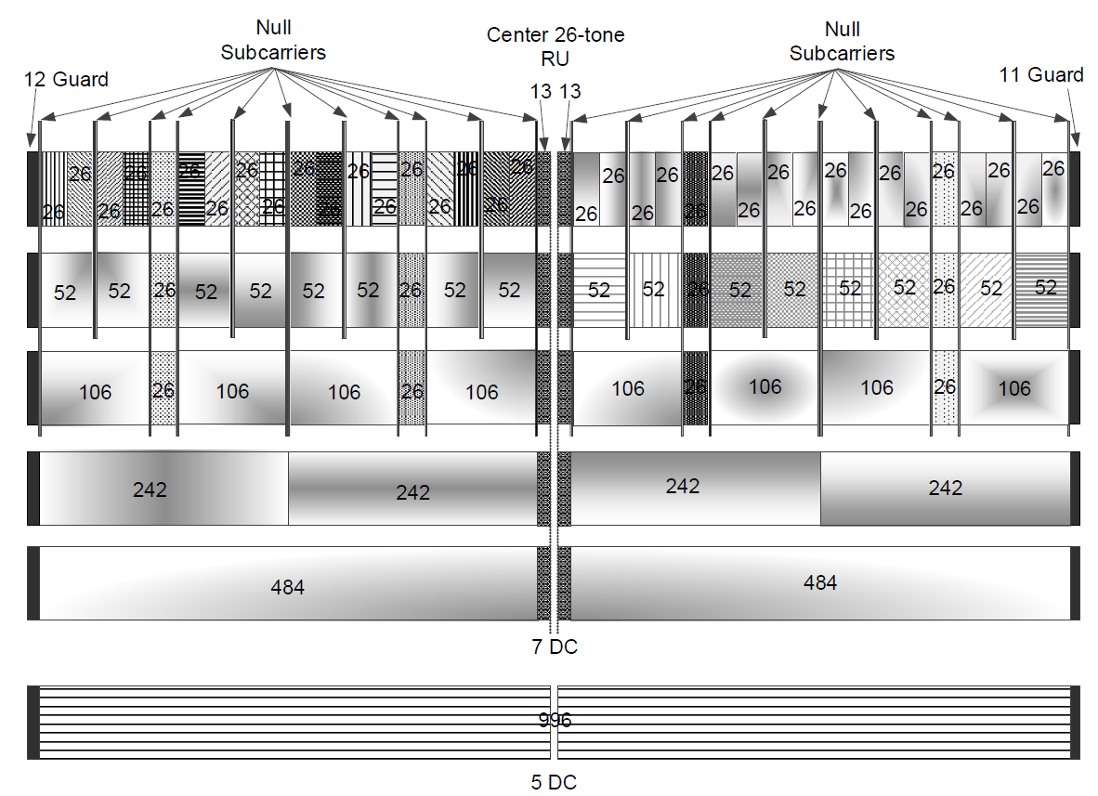
RU Aggregation for SU PPDU (4/4)
For SU PPDU with preamble puncturing, we can also consider the following RU combination to mitigate the interference to / from the punctured channel and this should be used instead of 242 in the previous two slides
If the second lowest 20MHz channel is punctured, RU combination of 106+26+52+26 in red can be considered because 242, 106, 52 and 26 marked by X should not be used
In this case, we eventually have the following RU combination in 80MHz
106+26+52+26 + 484
We can consider RU combination of 106+26+52+26 as one big RU used instead of 242-tone RU
We can use this RU combination only in the second and third lowest 20MHz channels in each 80MHz for simplicity
In addition, RU combination of 106+52 can be used instead to alleviate the complexity
punctured
→ In Appendix, various RU combinations for SU PPDU are depicted in all of the bandwidths

Slide 7
RU Aggregation for MU PPDU (1/5)
We focus only on the OFDMA case
  For MU MIMO, RU aggregation proposed in SU PPDU can be used
When designing multiple RU aggregation for OFDMA, we need to balance the scheduling complexity / signaling overhead and efficiency / average throughput
  The gain may not be big enough compared to the increase in complexity and overhead because various RUs were already defined
Hence, we focus on restrictions on RU aggregation
  Small and large size RUs are only combined with small and large size RUs, respectively, as in [2-3]
    Small size RU: 26, 52, 106
    Large size RU: RUs ≥242 and 106+26+52+26 as well
  RU aggregation is allowed only within limited channels
  Based on these two restrictions, large size RU aggregation is proposed

Slide 8
RU Aggregation for MU PPDU (2/5)
In the proposed RU aggregation below and in the next few slides, the RU combination of 106+26+52+26 should be used instead of 242 when preamble puncturing is applied to the adjacent 20MHz channel
For the 80MHz bandwidth, we propose the following RU combinations
  242, 484, 484+242, 996
  242+242 doesn’t have to be considered because it is better to assign 484-tone RU rather than 242+242 when 40+20 / 60 / 80 MHz is available in 80MHz
    Even if only two 20MHz channels which are not consecutive (i.e., 20+20MHz) are available in 80MHz, several STAs (note that OFDMA is considered) are assigned within these channels, and thus, whole 242+242 can not be allocated to any STA at all

Slide 9
RU Aggregation for MU PPDU (3/5)
For the bandwidth>80MHz, we propose that large size RU aggregation is allowed only within limited channels
  In a wide bandwidth transmission, it may be less probable that contiguous bandwidth mode is used
  In non-contiguous bandwidth mode, it may be hard to guarantee that both two non-contiguous segments always have a good channel quality for all STAs
  Thus, the performance gain may be marginal even if RUs are combined across the whole bandwidth
  Given this situation, it would be better to reduce the complexity and overhead by limiting the set of possible RU combinations
  Also, it may be beneficial to receiver power saving since some of the receivers can stop decoding the user specific field of EHT-SIG early

Slide 10
RU Aggregation for MU PPDU (4/5)
For the 160/80+80 MHz bandwidth, we propose that large size RU aggregation is allowed only within primary 80 or secondary 80, respectively
  RU combinations in each 80MHz: 242, 242+242, 484, 484+242, 996
  242+242 can be considered in each 80MHz, because in a particular 80MHz channel, only this combination can be available and only one STA can be assigned to this 80MHz channel
For the 320/160+160 MHz bandwidth, we propose that large size RU combination is allowed only within primary 160 or secondary 160, respectively
  RU combinations in 160MHz are shown in the next slide which deals with the 240/160+80 MHz bandwidth

Slide 11
RU Aggregation for MU PPDU (5/5)
For the 240/160+80 MHz bandwidth, we propose that large size RU aggregation is allowed only within 160MHz or 80MHz
  For contiguous 240MHz, large size RU aggregation is allowed only within 160MHz which is composed of two adjacent 80MHz channels
  For non-contiguous 160+80MHz, large size RU aggregation is allowed only within contiguous 160MHz or the other 80MHz, respectively
  RU combinations in 80MHz: 242, 242+242, 484, 484+242, 996
  RU combinations in 160MHz
    RU combinations within 80MHz are also possible: 242, 242+242, 484, 484+242, 996
    RU combinations across two 80MHz channels: (242)+(242), (242)+(484), (242)+(242+242), (242)+(484+242), (242)+(996), (484)+(484), (484)+(242+242), (484)+(484+242), (484)+(996), (242+242)+(242+242), (242+242)+(484+242), (242+242)+(996), (484+242)+ (484+242), (484+242)+(996), 2x996
    For simplicity, we can further consider that RUs are combined across two 80MHz channels only when there is no further RUs available in each 80MHz channel
→ The bracket means the RU combination used in each 80MHz channel
→ When 60MHz and 20MHz are available in two 80MHz channels, respectively, we use (484+242) rather than (484)+(242)

Slide 12
Conclusion
We have proposed multiple RU aggregation for SU and MU PPDU
For SU PPDU, by considering the preamble puncturing, various RU combinations have been proposed including the RU combination of 106+26+52+26
For MU PPDU especially for the OFDMA case, limited large size RU aggregation has been proposed according to the bandwidth
  160/80+80MHz
    Large size RU aggregation only within primary 80 or secondary 80
  240/160+80MHz
    Contiguous 240MHz: Large size RU aggregation only within 160MHz composed of two adjacent 80MHz channels
    Non-contiguous 160+80MHz: Large size RU aggregation only within contiguous 160MHz or the other 80MHz
  320/160+160MHz
    Large size RU aggregation only within primary 160 or secondary 160

Slide 13
Straw Poll #1
Do you agree to add the following text to the TGbe SFD?
  For the PPDU transmitted to SU, the following RU combinations of 106+26+52+26 in each 80MHz segment of all bandwidths should be used for each 20MHz channel when the adjacent 20MHz channel is punctured
Y/N/A: //
106+26+52+26 in red should be used when the second lowest 20MHz channel is punctured in each 80MHz segment
106+26+52+26 in blue should be used when the lowest 20MHz channel is punctured in each 80MHz segment
106+26+52+26 in green should be used when the highest 20MHz channel is punctured in each 80MHz segment
106+26+52+26 in yellow should be used when the second highest 20MHz channel punctured in each 80MHz segment

Slide 14
Straw Poll #2
Do you agree to add the following text to the TGbe SFD?
  For the PPDU transmitted to SU, the RU combinations described in Appendix are used in each bandwidth
    RU combination of 106+26+52+26 should be used instead of 242
Y/N/A: //

Slide 15
Straw Poll #3
Do you agree to add the following text to the TGbe SFD?
  For the OFDMA transmission in the bandwidth larger than 80MHz, large size RU aggregation is allowed only within limited channels
Y/N/A: //

Slide 16
Straw Poll #4
Do you agree to add the following text to the TGbe SFD?
  For the OFDMA transmission in 160/80+80 MHz, large size RU aggregation is allowed only within primary 80 or secondary 80, respectively
Y/N/A: //

Slide 17
Straw Poll #5
Do you agree to add the following text to the TGbe SFD?
  For contiguous 240MHz, large size RU aggregation is allowed only within 160MHz which is composed of two adjacent 80MHz channels
  For non-contiguous 160+80MHz, large size RU aggregation is allowed only within contiguous 160MHz or the other 80MHz, respectively
Y/N/A: //

Slide 18
Straw Poll #6
Do you agree to add the following text to the TGbe SFD?
  For the OFDMA transmission in 320/160+160 MHz, large size RU aggregation is allowed only within primary 160 or secondary 160, respectively
    Note that primary 160 is composed of primary 80 and secondary 80 and secondary 160 is 160MHz channel other than primary 160 in 320/160+160 MHz
Y/N/A: //

Slide 19
Straw Poll #7
Do you agree to add the following text to the TGbe SFD?
  For the OFDMA transmission, the following RU combinations are used for each bandwidth
    RU combinations in 80MHz bandwidth
      242, 484, 484+242, 996
    RU combinations allowed within 80MHz for the 160/80+80 MHz and 240/160+80 MHz
      242, 242+242, 484, 484+242, 996
    RU combinations allowed within 160MHz for the 240/160+80 MHz and 320/160+160 MHz
      RU combinations within 80MHz channel: 242, 242+242, 484, 484+242, 996
      RU combinations across two 80MHz channels: (242)+(242), (242)+(484), (242)+(242+242), (242)+(484+242), (242)+(996), (484)+(484), (484)+(242+242), (484)+(484+242), (484)+(996), (242+242)+(242+242), (242+242)+(484+242), (242+242)+(996), (484+242)+ (484+242), (484+242)+(996), 2x996
      Note that the bracket means the RU combination used in each 80MHz channel
    RU combination of 106+26+52+26 should be used instead of 242 when the adjacent 20MHz channel is punctured
Y/N/A: //

Slide 20
References
[1] 802.11-20/0022r0 Consideration on 240MHz and Preamble Puncturing
[2] 802.11-19/1907r0 Multiple RU Combinations for EHT
[3] 802.11-19/1908r0 Multi-RU Support

Slide 21
Appendix – RU combinations for SU PPDU (Non-OFDMA) (1/4)
The bracket means the RU combination used in each 80MHz channel
In the proposal for all bandwidths, RU combination of 106+26+52+26 should be used instead of 242
80MHz
  (242+242), (484+242), (996)
160/80+80 MHz
  (242)+(484+242), (242)+(996), (242+242)+(242+242), (242+242)+(484), (484)+(484), (242+242)+(484+242), (484)+(484+242), (242+242)+(996), (484)+(996), (484+242)+(484+242), (484+242)+(996), 2x996

Slide 22
Appendix – RU combinations for SU PPDU (Non-OFDMA) (2/4)
240/160+80 MHz
  (242+242)+(996), (484)+(996), (484+242)+(484+242), (484+242)+(996), 2x996
  (242)+(242)+(996), (242)+(242+242)+(484+242), (242)+(484)+(484+242), (242)+(242+242)+(996), (242)+(484)+(996), (242)+(484+242)+(484+242), (242)+(484+242)+(996), (242)+(996)+(996), (242+242)+(242+242)+(242+242), (242+242)+(242+242)+(484), (242+242)+(484)+(484), (484)+(484)+(484), (242+242)+(242+242)+(484+242), (242+242)+(448)+(484+242), (448)+(448)+(484+242), (242+242)+(242+242)+(996), (242+242)+(448)+(996), (448)+(448)+(996), (242+242)+(484+242)+(484+242), (484)+(484+242)+(484+242), (242+242)+(484+242)+(996), (484)+(484+242)+(996), (242+242)+(996)+(996), (484)+(996)+(996), (484+242)+(484+242)+(484+242), (484+242)+(484+242)+(996), (484+242)+(996)+(996), 3x996

Slide 23
Appendix – RU combinations for SU PPDU (Non-OFDMA) (3/4)
320/160+160 MHz
  (996)+(996) / 2x996
  (242)+(484+242)+(996), (242)+(996)+(996), (242+242)+(242+242)+(996), (242+242)+(448)+(996), (448)+(448)+(996), (242+242)+(484+242)+(484+242), (484)+(484+242)+(484+242), (242+242)+(484+242)+(996), (484)+(484+242)+(996), (242+242)+(996)+(996), (484)+(996)+(996), (484+242)+(484+242)+(484+242), (484+242)+(484+242)+(996), (484+242)+(996)+(996), 3x996

Slide 24
Appendix – RU combinations for SU PPDU (Non-OFDMA) (4/4)
320/160+160 MHz (cont.)
  (242)+(242)+(242+242)+(996), (242)+(242)+(484)+(996), (242)+(242)+(484+242)+(484+242), (242)+(242)+(484+242)+(996), (242)+(242)+(996)+(996), (242)+(242+242)+(242+242)+(484+242), (242)+(242+242)+(484)+(484+242), (242)+(484)+(484)+(484+242), (242)+(242+242)+(242+242)+(996), (242)+(242+242)+(484)+(996), (242)+(484)+(484)+(996), (242)+(242+242)+(484+242)+(484+242), (242)+(484)+(484+242)+(484+242), (242)+(242+242)+(484+242)+(996), (242)+(484)+(484+242)+(996), (242)+(242+242)+(996)+(996), (242)+(484)+(996)+(996), (242)+(484+242)+(484+242)+(484+242), (242)+(484+242)+(484+242)+(996), (242)+(484+242)+(996)+(996), (242)+(996)+(996)+(996), (242+242)+(242+242)+(242+242)+(242+242), (242+242)+(242+242)+(242+242)+(484), (242+242)+(242+242)+(484)+(484), (242+242)+(484)+(484)+(484), (484)+(484)+(484)+(484), (242+242)+(242+242)+(242+242)+(484+242), (242+242)+(242+242)+(484)+(484+242), (242+242)+(484)+(484)+(484+242), (484)+(484)+(484)+(484+242), (242+242)+(242+242)+(242+242)+(996), (242+242)+(242+242)+(484)+(996), (242+242)+(484)+(484)+(996), (484)+(484)+(484)+(996), (242+242)+(242+242)+(484+242)+(484+242), (242+242)+(484)+(484+242)+(484+242), (484)+(484)+(484+242)+(484+242), (242+242)+(242+242)+(484+242)+(996), (242+242)+(484)+(484+242)+(996), (484)+(484)+(484+242)+(996), (242+242)+(242+242)+(996)+(996), (242+242)+(484)+(996)+(996), (484)+(484)+(996)+(996), (242+242)+(484+242)+(484+242)+(484+242), (484)+(484+242)+(484+242)+(484+242), (242+242)+(484+242)+(484+242)+(996), (484)+(484+242)+(484+242)+(996), (242+242)+(484+242)+(996)+(996), (484)+(484+242)+(996)+(996), (242+242)+(996)+(996)+(996), (484)+(996)+(996)+(996), (484+242)+(484+242)+(484+242)+(484+242), (484+242)+(484+242)+(484+242)+(996), (484+242)+(484+242)+(996)+(996), (484+242)+(996)+(996)+(996), 4x996

