Slide 1
Consideration for EHT-SIG transmission
Apr. 2020
Date: 2020-04-06
Authors:
Name | Affiliation | Address | Phone | Email
Dongguk Lim | LG Electronics | 19, Yangjae-daero 11gil, Seocho-gu, Seoul 137-130, Korea |  | dongguk.lim@lge.com
Eunsung Park |  |  |  | Ensung.park@lge.com
Jinyoung Chun |  |  |  | jiny.chun@lge.com
Jinsoo Choi |  |  |  | js.choi@lge.com

Slide 2
Introduction
In this contribution, we introduce the configuration of the EHT-SIG content channel in wide bandwidth (e.g., 160Mz, 240MHz, and 320MHz) by considering the operation of 80MHz segment and the signaling of the RU allocation including the MRU aggregation efficiently.

Slide 3
Aggregation of large size RU
In 11be SFD, the following agreements are defined.
  For the OFDMA transmission in 320/160+160 MHz, for one STA large size RU aggregation is allowed only within primary 160 MHz or secondary 160 MHz, respectively.
  For the OFDMA transmission in contiguous 240 MHz, for one STA large size RU aggregation is allowed only within 160 MHz which is composed of two adjacent 80 MHz channels.
  For the OFDMA transmission in non-contiguous 160+80 MHz, for one STA large size RU aggregation is allowed only within contiguous 160 MHz or the other 80 MHz, respectively.
As described in 11be SFD, since we consider the use of tone plan for 80/160MHz for 240MHz bandwidth, the 160MHz in contiguous 240MHz can be aligned with 160MHz channelization.

Slide 4
EHT-SIG content channel (1/2)
Thus, we can consider the following composition of the EHT-SIG content channel according to BW.
  In 20/40/80/160MHz
    the EHT-SIG content channel for Multiple user transmission is configured as below
    In 160MHz, the content channels(i.e., EHT-SIG CC1 and EHT-SIG CC2) per 80MHz may be different.
  EHT-SIG content channel in 80MHz
    The two EHT-SIG content channels are present in 80MHz.

Slide 5
EHT-SIG content channel (2/3)
  EHT-SIG content channel in 160MHz
    In 160MHz, we can consider the two cases of EHT-SIG content channel.
      One example is that EHT-SIG content channels per 80MHz contain the same information.
      Another example is that EHT-SIG content channels per 80MHz contain the different information.
  In 240MHz and 320MHz, the EHT-SIG content channel can be similarly configured.

Slide 6
EHT-SIG content channel (3/3)
  Since the large size RU aggregation is only allowed within 160MHz, the EHT-SIG content channels which configure 160MHz should include the allocation information for the whole 160MHz.
  Whereas, since the allocation for large size RU aggregation can different per 160MHz, EHT-SIG can be configured independently per 160MHz.
  Thus, in 240/320MHz, we can also consider the another approach to apply the restriction of current large RU aggregation in SFD.
    The EHT-SIG content channels per each 160Mhz only contain the information of each 160MHz in which the EHT-SIG content channels are included.
    Within 160MHz, the EHT-SIG content channel can be configured as described in slide 5.
  By configuring the EHT-SIG differently per 160MHz, the overhead for RU allocation as a BW increase can be reduced.
    The signaling overhead of 320MHz is the same as that of 160MHz.

Slide 7
Straw poll 1
Do you agree that in BW ≤ 160MHz, the EHT-SIG content channel for Multiple user transmission is configured as following?
  A EHT-SIG content channel is composed of a 20 MHz frequency segment.
  EHT-SIG content channels carry EHT-SIG common information and the user-specific information.
  The EHT-SIG field of MU PPDU consists of the two EHT-SIG content channels in 80MHz
  In 80MHz and 160MHz, EHT-SIG content channel can be configured as below, respectively.
    The content channels(i.e., CC1 and CC2) per each 80MHz may carry different information.
      Where, SST operation using TWT is one potential applicable scenario, other scenarios are TBD
  Y/N/A

Slide 8
Straw poll 2
Do you agree that in BW> 160MHz, the EHT-SIG content channels only contain the information for 160MHz in which EHT-SIG content channel is included?
  The content channels(i.e., CC1 and CC2 / CC3 and CC4) per each 80MHz may carry different information.
    Where, SST operation using TWT is one potential applicable scenario, other scenarios are TBD.
  Y/N/A

Slide 9
Straw poll 3
Do you agree that 11be STA can recognize the full preamble puncturing pattern it needs by using the BW field and puncturing information of U-SIG and EHT-SIG field in Multiple user transmission?
  Details for how to convey the puncturing information is TBD.
  Y/N/A

Slide 10
Backup : previous slides (20r1)

Slide 11
Introduction
In the previous meeting, for the enhancement of spectral efficiency, we agreed that EHT supports the preamble puncturing mechanism.
  It was not determined yet, but various patterns and the large size of unit(i.e., 40MHz) for puncturing were discussed.
And, some of options considering the preamble puncturing for EHT-SIG content channel were introduced in [1].
  Where in, the puncturing pattern as in 11ax was considered.
In this contribution, we discuss the EHT-SIG content channel options for supporting of flexible preamble puncturing and reduction of signaling overhead.

Slide 12
BW and STA capability
As described in [2], to support the high throughput, EHT will mainly use the wide bandwidth such as 160MHz, 240MHz, and 320MHz in 6GHz band.
  Channelization of 6GHz
  Also, to protect the incumbent STA that operates in 6GHz band, the various preamble puncturing patterns may be considered.
    The 40MHz size of puncturing was considered to accommodate 30MHz incumbent link in [3]
And, to utilize the wide bandwidth efficiently, EHT STA may have the enhanced receiver capability to support the decoding of the signal field which is transmitted through on the BW larger than 80MHz.
  We can take into account for the decoding of the HE-SIGB transmitted through on 160MHz.
We will consider the three options for EHT-SIG transmission by taking into account enhanced STA capability and various preamble puncturing patterns.
 | UNII5 | UNII6 | UNII7 | UNII8
Band(GHz) | 5.925-6.425 (500MHZ) | 6.425-6.525 ( 100MHz) | 6.525-6.875 (350MHz) | 6.875-7.125 (250MHz)

Slide 13
EHT-SIG content channel
We can consider the following three options for EHT-SIG content channel.
  Option 1 (1,2,1,2,1,2,1,2) : same with 11ax
  Option 2 (1,2,1,2,3,4,3,4) : duplicating the EHT-SIG information per 40MHz in each 80MHz separately, with different EHT-SIG information in each 20MHz within 40MHz.
  Option 3 (1,2,3,4,1,2,3,4) : duplicating EHT-SIG information per 80MHz, with different EHT-SIG information in each 20MHz within 80MHz
1
2
1
2
1
2
1
2
1
2
1
2
1
2
1
2
40MHz
320MHz
1
2
1
2
3
4
3
4
1
2
1
2
3
4
3
4
40MHz
320MHz
80MHz
1
2
3
4
1
2
3
4
1
2
3
4
1
2
3
4
320MHz

Slide 14
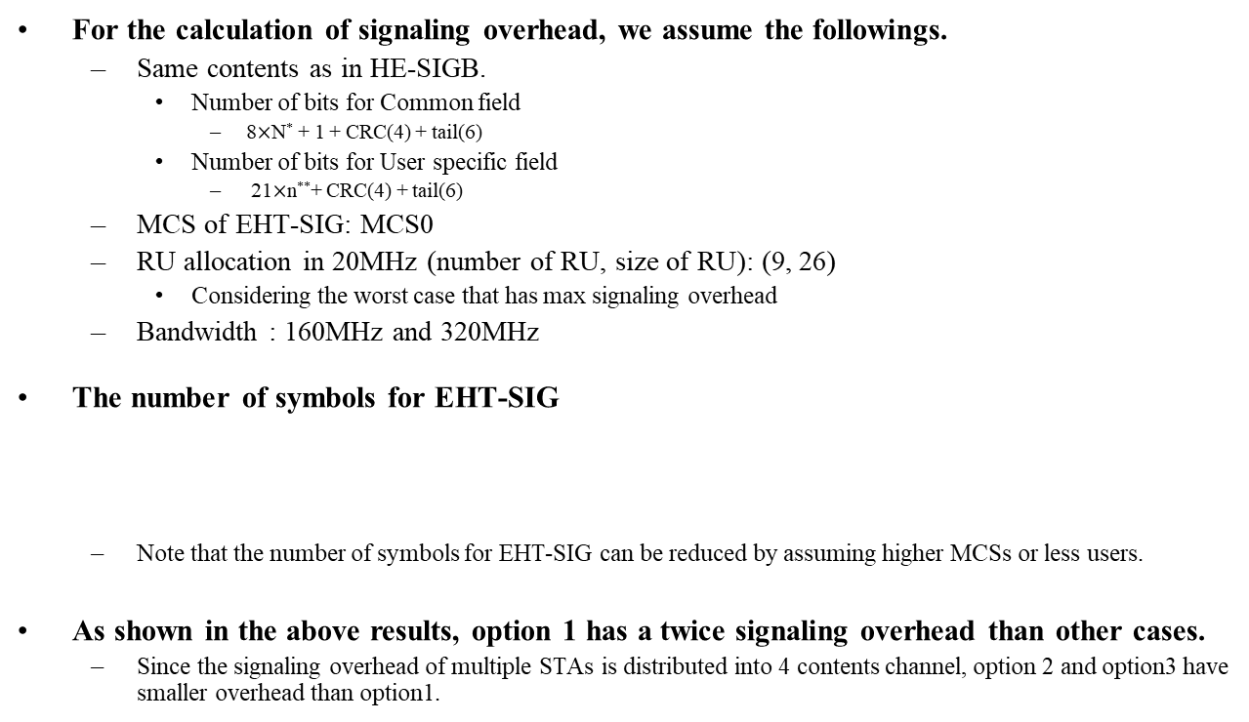
Signaling overhead
For the calculation of signaling overhead, we assume the followings.
  Same contents as in HE-SIGB.
    Number of bits for Common field
      8$×$N* + 1 + CRC(4) + tail(6)
    Number of bits for User specific field
      21$×$n**+ CRC(4) + tail(6)
  MCS of EHT-SIG: MCS0
  RU allocation in 20MHz (number of RU, size of RU): (9, 26)
    Considering the worst case that has max signaling overhead
  Bandwidth : 160MHz and 320MHz
The number of symbols for EHT-SIG
  Note that the number of symbols for EHT-SIG can be reduced by assuming higher MCSs or less users.
As shown in the above results, option 1 has a twice signaling overhead than other cases.
  Since the signaling overhead of multiple STAs is distributed into 4 contents channel, option 2 and option3 have smaller overhead than option1.
 | Option 1 | Option 2 | Option 3
160MHz | 74 (296us) | 38(152us) | 38(152us)
320MHz | 147(588us) | 74(296us) | 74(296us)
* N: number of RU allocation field in HE-SIGB content channel, ** n : number of user field in user block field

Slide 15
Consideration for puncturing pattern(1/2)
Unlike supporting of limited puncturing patterns in 11ax, various puncturing patterns based on 20MHz can be considered in 11be due to the enhancement of STA capability.
  For example, we can support the [1 0 0 0], [1 0 1 0], and [1 0 0 1] configurations in 80MHz for 160MHz operating mode device
    Where in, Primary 20 is assumed as the first 20MHz channel
Also, for the protection of the incumbent link (ex., 30MHz in [3]), we can consider the 40MHz size of puncturing cases as wall as 20MHz size of puncturing cases.
  The 40MHz size of puncturing can be considered in primary 80/primary 160.
    For example, the punctured 40MHz is located in 160MHz as following
And, we may further take into account larger size of puncturing than 40MHz if there are incumbent links larger than 40MHz or not use the aligned channelization in 6GHz.
P20
Punctured
P20
P20
160MHz
P20
160MHz

Slide 16
Consideration for puncturing pattern(2/2)
In [3][4], for the efficient utilization of BW, the various large-RU combinations were introduced in 11be.
  It assumed the large-RU size is configured based on 20MHz (i.e., RU 242).
So, for the consistent operation with multiple RUs, the preamble puncturing pattern can be designed by considering the multiple RU combinations.
  For example, we may take into account following multiple RU combinations as the puncturing patterns in 160MHz.
Possible transmission BW | RU in one 80MHz | RU in another 80MHz
100MHz | 242 | 996
120MHz | 484 | 996
120MHz | 242+242* | 996
120MHz | 484+242** | 484+242
140MHz | 242+484 | 996
*: non-continuous combination is considered, ** : both continuous and non-continuous combinations are considered

Slide 17
Preamble puncturing in 320MHz (option 1)
EHT-SIG content channel is configured as same as HE-SIGB content channel.
  And, since the two content channels are used, the transmission on wide bandwidth incurs large signaling overhead.
This content channel design is able to be applied both 80MHz and 160MHz that STAs are capable to receive EHT-SIG.
It is possible to support the preamble puncturing in wide bandwidth by using the extension of the preamble puncturing pattern defined in 11ax.
  However, due to the limited puncturing pattern in P80, it is difficult to support some of the patterns described in slide 6 and 7.
1
2
1
2
1
2
1
2
1
2
1
2
1
2
1
2
40MHz
320MHz

Slide 18
Preamble puncturing in 320MHz (option 2)
Four content channels are used for EHT-SIG transmission in 320MHz
  The two different content channels are included in each 80MHz within 160MHz.
  So, It has low signaling overhead because the information for EHT-SIG is distributed to four content channels.
And, since the receiver should decode the two content channels in each 80MHz within 160MHz, in 320MHz, there is some restriction to support the flexible puncturing pattern and the reception of 160MHz for EHT-SIG is demanded.
Also, it is difficult to support the non-continuous 240MHz such as 80+160 in 320MHz because STA can’t decode the content channel 3 and 4 even though STA has a capability for decoding 160MHz for EHT-SIG.
1
2
1
2
3
4
3
4
1
2
1
2
3
4
3
4
40MHz
320MHz

Slide 19
Preamble puncturing in 320MHz (option 3)
1
2
3
4
1
2
3
4
1
2
3
4
1
2
3
4
The four different content channels are used in 80MHz and these channels are duplicated per 80MHz.
  Due to the distribution of information for EHT-SIG into the four channels, it can have low signaling overhead.
This design can be applied to the reception of EHT-SIG through 80MHz and 160MHz.
While it is difficult to support a flexible preamble puncturing in 80MHz EHT-SIG reception as in [1], we can relax the restriction with wide BW EHT-SIG reception, e.g. 160MHz.
  The receiver can get the information of punctured 20MHz channel in an 80MHz by using the 20MHz content channel which has the same information in another 80MHz.
  It is also able to support the various patterns of non-continuous 240MHz in 320MHz because of duplication of SIG content channels per 80MHz.
80MHz
320MHz

Slide 20
Indication of puncturing
In 11ax, STA can know the preamble puncturing pattern by using the BW field in HE-SIGA and RU allocation field in HE-SIGB.
We can take into account a similar way with 11ax regardless of options for EHT-SIG configuration.
  We think that it is a simple way to indicate the puncturing pattern without increasing complexity.
So, preamble puncturing can be indicated by using the BW field in U-SIG and pattern information in EHT-SIG.
  For example, BW and pattern information for preamble puncturing can be consisted of as following
    BW field
      The bits assigned for this can be equal to or more than 4 bits.
      20MHz / 40MHz / 80MHz (non-punctured) / 160MHz (non-punctured) / 240MHz (non-punctured) / 320MHz (non-punctured) / 80MHz (punctured) / 160MHz (punctured) / 240MHz (punctured) / 320MHz (punctured)
        Details for punctured BW are TBD.
    Pattern information
      For this information, we can consider the RU allocation field which is defined in 11ax or other information bits that is configured differently.

Slide 21
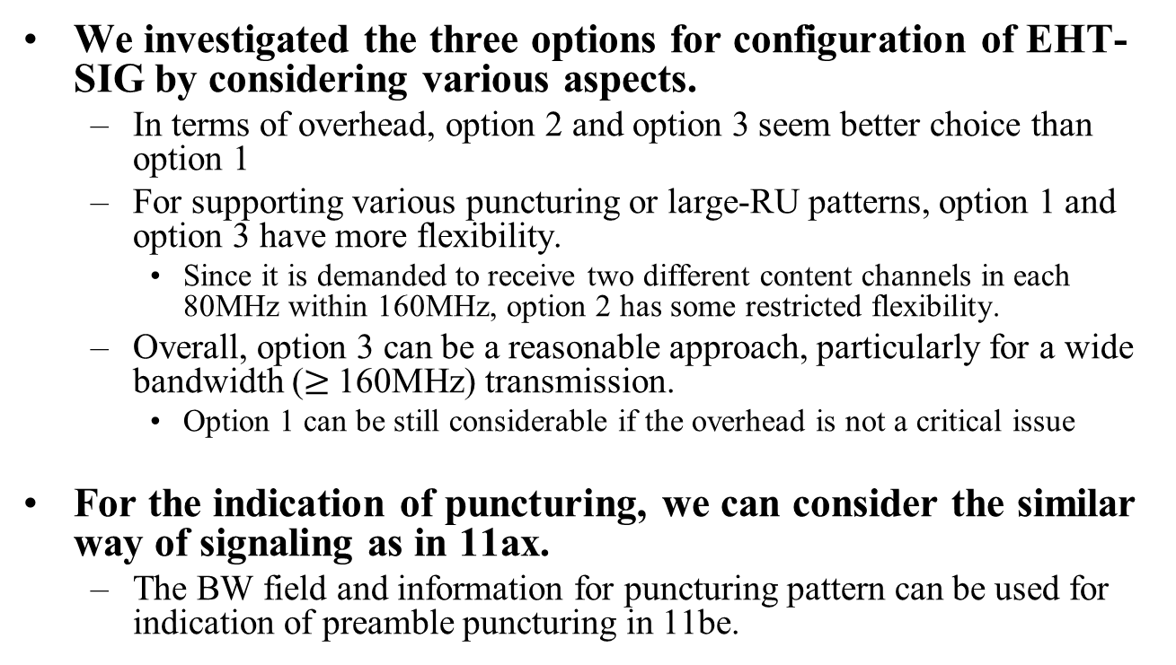
Conclusion
We investigated the three options for configuration of EHT-SIG by considering various aspects.
  In terms of overhead, option 2 and option 3 seem better choice than option 1
  For supporting various puncturing or large-RU patterns, option 1 and option 3 have more flexibility.
    Since it is demanded to receive two different content channels in each 80MHz within 160MHz, option 2 has some restricted flexibility.
  Overall, option 3 can be a reasonable approach, particularly for a wide bandwidth ($≥$160MHz) transmission.
    Option 1 can be still considerable if the overhead is not a critical issue
For the indication of puncturing, we can consider the similar way of signaling as in 11ax.
  The BW field and information for puncturing pattern can be used for indication of preamble puncturing in 11be.

Slide 22
Reference
[1] 11-19/1606r0, Preamble Puncturing and SIG-B Signaling
[2] 11-18/1231r6, eht-draft-proposed-par
[3] 11-19/1908r0, Multi-RU Support
[4] 12-19/1907r0, Multiple RU Combinations for EHT

