Slide 1
Consideration for EHT-SIG transmission
Jan. 2020
Date: 2020-01-13
Authors:
Name | Affiliation | Address | Phone | Email
Dongguk Lim | LG Electronics | 19, Yangjae-daero 11gil, Seocho-gu, Seoul 137-130, Korea |  | dongguk.lim@lge.com
Eunsung Park |  |  |  | Ensung.park@lge.com
Jinyoung Chun |  |  |  | jiny.chun@lge.com
Jinsoo Choi |  |  |  | js.choi@lge.com

Slide 2
Introduction
In the previous meeting, for the enhancement of spectral efficiency, we agreed that EHT supports the preamble puncturing mechanism.
  It was not determined yet, but various patterns and the large size of unit(i.e., 40MHz) for puncturing were discussed.
And, some of options considering the preamble puncturing for EHT-SIG content channel were introduced in [1].
  Where in, the preamble pattern as in 11ax was considered.
In this contribution, we discuss the EHT-SIG content channel options for supporting of flexible preamble puncturing and reduction of signaling overhead.

Slide 3
BW and STA capability
As described in [2], to support the high throughput, EHT will mainly use the wide bandwidth such as 160MHz, 240MHz, and 320MHz in 6GHz band.
  Channelization of 6GHz
  Also, to protect the incumbent STA that operates in 6GHz band, the various preamble puncturing patterns may be considered.
    The 40MHz size of puncturing was considered to accommodate 30MHz incumbent link in [3]
And, to utilize the wide bandwidth efficiently, EHT STA may have the enhanced receiver capability to support the decoding of the signal field which is transmitted through on the BW larger than 80MHz.
  We can take into account for the decoding of the HE-SIGB transmitted through on 160MHz.
We will consider the three options for EHT-SIG transmission by taking into account enhanced STA capability and various preamble puncturing patterns.
 | UNII5 | UNII6 | UNII7 | UNII8
Band(GHz) | 5.925-6.425 (500MHZ) | 6.425-6.525 ( 100MHz) | 6.525-6.875 (350MHz) | 6.875-7.125 (250MHz)

Slide 4
EHT-SIG content channel
We can consider the following three options for EHT-SIG content channel.
  Option 1 (1,2,1,2,1,2,1,2) : same with 11ax
  Option 2 (1,2,1,2,3,4,3,4) : duplicating the EHT-SIG information per 40MHz in each 80MHz separately, with different EHT-SIG information in each 20MHz within 40MHz.
  Option 3 (1,2,3,4,1,2,3,4) : duplicating EHT-SIG information per 80MHz, with different EHT-SIG information in each 20MHz within 80MHz
1
2
1
2
1
2
1
2
1
2
1
2
1
2
1
2
40MHz
320MHz
1
2
1
2
3
4
3
4
1
2
1
2
3
4
3
4
40MHz
320MHz
80MHz
1
2
3
4
1
2
3
4
1
2
3
4
1
2
3
4
320MHz

Slide 5
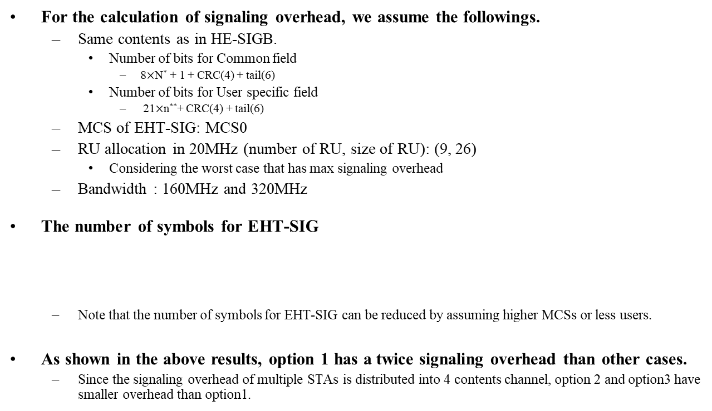
Signaling overhead
For the calculation of signaling overhead, we assume the followings.
  Same contents as in HE-SIGB.
    Number of bits for Common field
      8$×$N* + 1 + CRC(4) + tail(6)
    Number of bits for User specific field
      21$×$n**+ CRC(4) + tail(6)
  MCS of EHT-SIG: MCS0
  RU allocation in 20MHz (number of RU, size of RU): (9, 26)
    Considering the worst case that has max signaling overhead
  Bandwidth : 160MHz and 320MHz
The number of symbols for EHT-SIG
  Note that the number of symbols for EHT-SIG can be reduced by assuming higher MCSs or less users.
As shown in the above results, option 1 has a twice signaling overhead than other cases.
  Since the signaling overhead of multiple STAs is distributed into 4 contents channel, option 2 and option3 have smaller overhead than option1.
 | Option 1 | Option 2 | Option 3
160MHz | 74 (296us) | 38(152us) | 38(152us)
320MHz | 147(588us) | 74(296us) | 74(296us)
* N: number of RU allocation field in HE-SIGB content channel, ** n : number of user field in user block field

Slide 6
Consideration for puncturing pattern(1/2)
Unlike supporting of limited puncturing patterns in 11ax, various puncturing patterns based on 20MHz can be considered in 11be due to the enhancement of STA capability.
  For example, we can support the [1 0 0 0], [1 0 1 0], and [1 0 0 1] configurations in 80MHz for 160MHz operating mode device
    Where in, Primary 20 is assumed as the first 20MHz channel
Also, for the protection of the incumbent link (ex., 30MHz in [3]), we can consider the 40MHz size of puncturing cases as wall as 20MHz size of puncturing cases.
  The 40MHz size of puncturing can be considered in primary 80/primary 160.
    For example, the punctured 40MHz is located in 160MHz as following
And, we may further take into account larger size of puncturing than 40MHz if there are incumbent links larger than 40MHz or not use the aligned channelization in 6GHz.
P20
Punctured
P20
P20
160MHz
P20
160MHz

Slide 7
Consideration for puncturing pattern(2/2)
In [3][4], for the efficient utilization of BW, the various large-RU combinations were introduced in 11be.
  It assumed the large-RU size is configured based on 20MHz (i.e., RU 242).
So, for the consistent operation with multiple RUs, the preamble puncturing pattern can be designed by considering the multiple RU combinations.
  For example, we may take into account following multiple RU combinations as the puncturing patterns in 160MHz.
Possible transmission BW | RU in one 80MHz | RU in another 80MHz
100MHz | 242 | 996
120MHz | 484 | 996
120MHz | 242+242* | 996
120MHz | 484+242** | 484+242
140MHz | 242+484 | 996
*: non-continuous combination is considered, ** : both continuous and non-continuous combinations are considered

Slide 8
Preamble puncturing in 320MHz (option 1)
EHT-SIG content channel is configured as same as HE-SIGB content channel.
  And, since the two content channels are used, the transmission on wide bandwidth incurs large signaling overhead.
This content channel design is able to be applied both 80MHz and 160MHz that STAs are capable to receive EHT-SIG.
It is possible to support the preamble puncturing in wide bandwidth by using the extension of the preamble puncturing pattern defined in 11ax.
  However, due to the limited puncturing pattern in P80, it is difficult to support some of the patterns described in slide 6 and 7.
1
2
1
2
1
2
1
2
1
2
1
2
1
2
1
2
40MHz
320MHz

Slide 9
Preamble puncturing in 320MHz (option 2)
Four content channels are used for EHT-SIG transmission in 320MHz
  The two different content channels are included in each 80MHz within 160MHz.
  So, It has low signaling overhead because the information for EHT-SIG is distributed to four content channels.
And, since the receiver should decode the two content channels in each 80MHz within 160MHz, in 320MHz, there is some restriction to support the flexible puncturing pattern and the reception of 160MHz for EHT-SIG is demanded.
Also, it is difficult to support the non-continuous 240MHz such as 80+160 in 320MHz because STA can’t decode the content channel 3 and 4 even though STA has a capability for decoding 160MHz for EHT-SIG.
1
2
1
2
3
4
3
4
1
2
1
2
3
4
3
4
40MHz
320MHz

Slide 10
Preamble puncturing in 320MHz (option 3)
1
2
3
4
1
2
3
4
1
2
3
4
1
2
3
4
The four different content channels are used in 80MHz and these channels are duplicated per 80MHz.
  Due to the distribution of information for EHT-SIG into the four channels, it can have low signaling overhead.
This design can be applied to the reception of EHT-SIG through 80MHz and 160MHz.
While it is difficult to support a flexible preamble puncturing in 80MHz EHT-SIG reception as in [1], we can relax the restriction with wide BW EHT-SIG reception, e.g. 160MHz.
  The receiver can get the information of punctured 20MHz channel in an 80MHz by using the 20MHz content channel which has the same information in another 80MHz.
  It is also able to support the various patterns of non-continuous 240MHz in 320MHz because of duplication of SIG content channels per 80MHz.
80MHz
320MHz

Slide 11
Indication of puncturing
In 11ax, STA can know the preamble puncturing pattern by using the BW field in HE-SIGA and RU allocation field in HE-SIGB.
We can take into account a similar way with 11ax regardless of options for EHT-SIG configuration.
  We think that it is a simple way to indicate the puncturing pattern without increasing complexity.
So, preamble puncturing can be indicated by using the BW field in U-SIG and pattern information in EHT-SIG.
  For example, BW and pattern information for preamble puncturing can be consisted of as following
    BW field
      The bits assigned for this can be equal to or more than 4 bits.
      20MHz / 40MHz / 80MHz (non-punctured) / 160MHz (non-punctured) / 240MHz (non-punctured) / 320MHz (non-punctured) / 80MHz (punctured) / 160MHz (punctured) / 240MHz (punctured) / 320MHz (punctured)
        Details for punctured BW are TBD.
    Pattern information
      For this information, we can consider the RU allocation field which is defined in 11ax or other information bits that is configured differently.

Slide 12
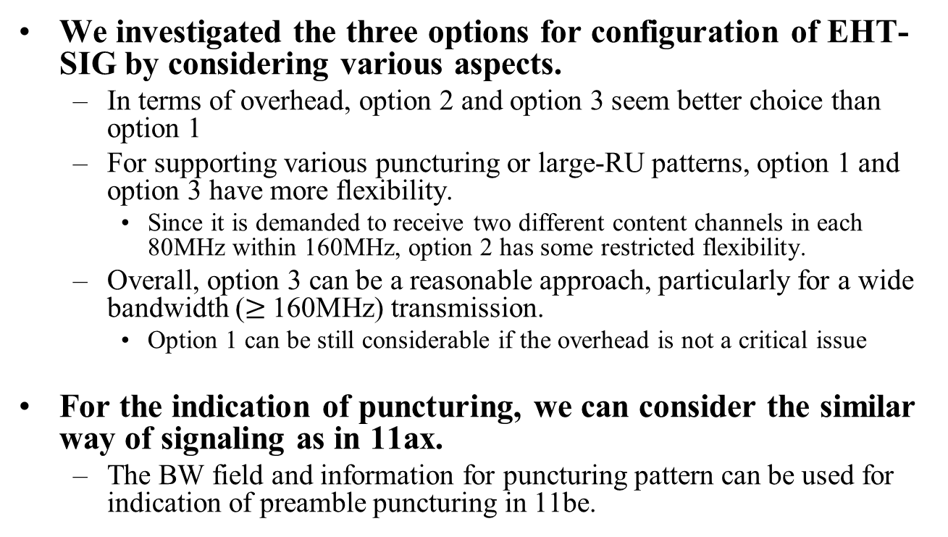
Conclusion
We investigated the three options for configuration of EHT-SIG by considering various aspects.
  In terms of overhead, option 2 and option 3 seem better choice than option 1
  For supporting various puncturing or large-RU patterns, option 1 and option 3 have more flexibility.
    Since it is demanded to receive two different content channels in each 80MHz within 160MHz, option 2 has some restricted flexibility.
  Overall, option 3 can be a reasonable approach, particularly for a wide bandwidth ($≥$160MHz) transmission.
    Option 1 can be still considerable if the overhead is not a critical issue
For the indication of puncturing, we can consider the similar way of signaling as in 11ax.
  The BW field and information for puncturing pattern can be used for indication of preamble puncturing in 11be.

Slide 13
Straw poll 1
Do you agree that 11be supports a capability of EHT-SIG reception by more than 80MHz?
    The configuration of EHT-SIG content channel is TBD.
  Y/N/A

Slide 14
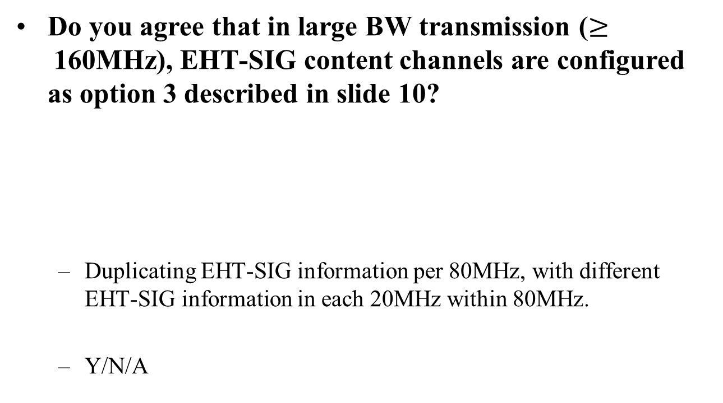
Straw poll 2
Do you agree that in large BW transmission ($≥$160MHz), EHT-SIG content channels are configured as option 3 described in slide 10?
  Duplicating EHT-SIG information per 80MHz, with different EHT-SIG information in each 20MHz within 80MHz.
  Y/N/A
1
2
3
4
1
2
3
4
1
2
3
4
1
2
3
4
80MHz
320MHz

Slide 15
Straw poll 3
Do you agree that the EHT-SIG content channel consists of the same configuration defined in 11ax?
  Y/N/A

Slide 16
Straw poll 4
Do you agree that the preamble puncturing can be indicated by using the BW field and puncturing pattern field?
  The details on configuration for the preamble puncturing are TBD.
  Y/N/A

Slide 17
Reference
[1] 11-19/1606r0, Preamble Puncturing and SIG-B Signaling
[2] 11-18/1231r6, eht-draft-proposed-par
[3] 11-19/1908r0, Multi-RU Support
[4] 12-19/1907r0, Multiple RU Combinations for EHT

