Slide 1
Operation of Non-AP MLD with Constraints
Date: 2020-01-13
Authors:
Name | Affiliation | Address | Phone | Email
Insun Jang | LG Electronics | 19, Yangjae-daero 11gil, Seocho-gu, Seoul 137-130, Korea |  | insun.jang@lge.com
Jinsoo Choi |  |  |  | js.choi@lge.com
Jeongki Kim |  |  |  | jeongki.kim@lge.com
Suhwook Kim |  |  |  | suhwook.kim@lge.com
Sungjin Park |  |  |  | allean.park@lge.com
Taewon Song |  |  |  | taewon.song@lge.com
Namyeong Kim |  |  |  | namyeong.kim@lge.com

Slide 2
Introduction
Several contributions [1]-[3] have discussed the operation of MLD with the constraints to simultaneously transmit and receive (STR) on a pair of links
  In this contribution, we call the constraint non-STR
Specifically, we discuss additional considerations on the operation of STAs belonging to a non-AP MLD with non-STR on their operating links

Slide 3
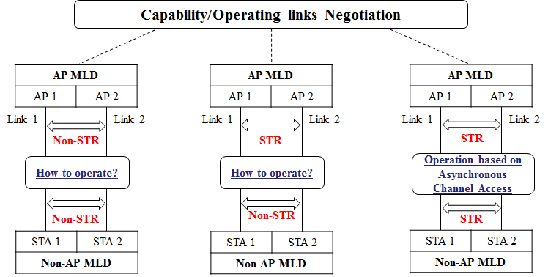
Recap: STR Capability and Operation [1]
We already discussed the first case [1]
We consider the second case that two or more APs have STR capability on their operating links while STAs affiliated with the APs don’t have STR capability (non-STR)

Slide 4
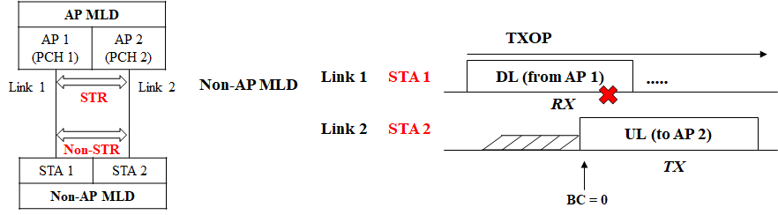
Observation for Non-AP MLD’s Operation with Constraint
Each AP of AP MLD has its own primary channel (PCH)
  Each STA of Non-AP MLD without STR can perform back-off through its PCH
If non-AP STAs just use independent channel access only, a problem can occur, e.g.,
  At AP MLD side, the UL frame can be received successfully
  At non-AP MLD side, the DL frame cannot be received successfully

Slide 5
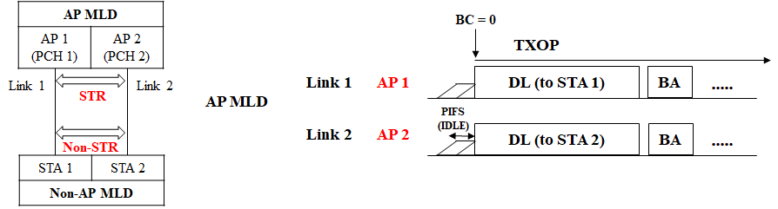
How to Handle: Aggregation
AP MLDs or non-AP MLDs may transmit aligned PPDUs by aggregating all supported links
  For example, PIFS-based multi-link aggregation depending on the level of coordination to share channel states
    If the states can be shared immediately, links are aggregated based on PIFS
    Otherwise, before aggregation, several frames may be exchanged (e.g., RTS/CTS)
  It can enable TX/TX or RX/RX to mitigate non-STR
However, such a method cannot be always utilized to handle non-STR, e.g., BUSY indication during PIFS
  In other words, other scenarios need to be considered

Slide 6
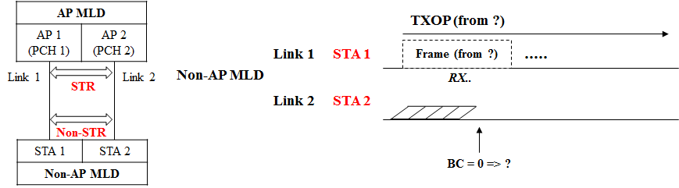
Focusing on Another Scenario
  We need to consider a scenario, e.g., while RX on a link 1, when back-off count (BC) = 0 on link 2, Should STA 2 transmit frames?
  If STA 2 transmits any frame on link 2, frames on link 1 cannot be received correctly
  To decide whether to transmit a frame on link 2, STA 1 needs to share the information regarding the reception on link 1 (e.g., RX, transmitter) with STA 2
    For example, an STA which is receiving a PPDU, the receiver of PPDU is not the STA, the STA can transmit frames

Slide 7
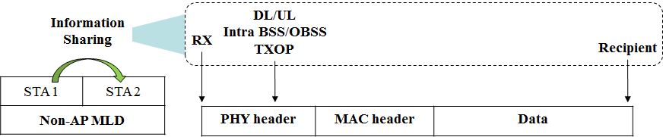
Information Sharing
STA checks DL/UL, BSS color, TXOP from U-SIG field in PHY header and RA field in MAC header
  In DL case, STA has to check MAC header (in SU case)
  In the other cases, STA just has to check PHY
Consequently, STA can obtain the transmitter/receiver of PPDU and TXOP
  If the decoding is failed, the failure information can be also shared
The information may be shared immediately or in a little time depending on the level of coordination to share the information

Slide 8
Overview of Operation
For a pair of links, Depending on the level of information of frame being received by a STA (STA 1) of non-AP MLD on a link, the other STA (STA 2) of non-AP MLD can decide whether to transmit a frame on the other link when its BC = 0
  If no information is shared, the other STA transmits a frame
  If the information is RX state and not enough regarding the frame (e.g., If Intra BSS/DL, but recipient is not detected), the operation is described in slide 7
  If the information is RX state and enough regarding the frame (e.g., OBSS, UL), the operation is described in the slide 8
  To simplify, the information of RX state may not be considered

Slide 9
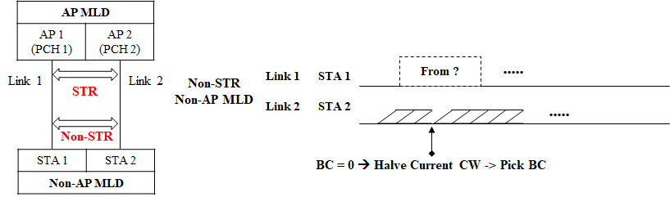
Operation based on Information
If the information is RX state and not enough regarding the frame
  Option 1: Reset BC
    It may increase the channel access delay; however, it can be compensated as the follows
      E.g., by halving the CW
  Option 2: Deferral by the time that the information is enough while maintaining BC = 0
    In case of DL in intra-BSS, BCs of many STAs might become 0 during that time, which would increase collision probability
Example: Only RX state

Slide 10
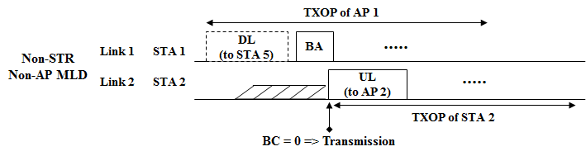
Operation based on Information (Cont’d)
If the information is RX state and enough regarding the frame
  If the transmitter is an AP of AP MLD which the STA of non-AP MLD is affiliated with and the STA is the receiver on a link
    The other STA of non-AP MLD doesn’t transmit a frame on the other link to receive the frame from the AP on the link
      At this point, BC can be reset or deferral by the time of end of TXOP of the AP
  For the other cases (e.g., not receiver, OBSS, UL) including the failure of transmitter detection
    The other STA of non-AP MLD can transmit a frame on the other link because the STA doesn’t need to receive frames of the AP on the link
Example: OBSS

Slide 11
Summary
We discussed the operation of STAs belonging to a non-AP MLD with non-STR on their operating links
Specifically, we proposed mechanisms considering STAs of a non-AP MLD with non-STR, when each link has its own primary channel to access
  An STA of non-AP MLD decides whether to transmit a frame on its link when its back-off count = 0, depending on the information shared by the other STA of non-AP MLD, e.g.,
    If no information is shared, the other STA transmits a frame
    If the information is RX state and not enough regarding the frame (e.g., Intra BSS/DL, but recipient is not detected)
    If the information is RX state and enough regarding the frame (e.g., OBSS, UL)

Slide 12
SP #1
Do you agree that 11be defines channel access mechanism(s) for STAs of a non-AP MLD with constraints to simultaneously transmit and receive on a pair of links including a primary channel each?
Y/N/A

Slide 13
SP #2
Do you support to add the followings to the 11be SFD:
  When STAs of a non-AP MLD have constraints to simultaneously transmit and receive on a pair of links and each link has its own primary channel, they can perform the following channel access mechanisms:
    An STA of non-AP MLD decides whether to transmit a frame on its link when its back-off count = 0, depending on the information shared by the other STA of non-AP MLD
      What the information are and when to share them are TBD

Slide 14
References
[1] 802.11-19/1917r1 Considerations for Multi-link Channel Access
Without Simultaneous TX/RX Capability
[2] 802.11-19/1405r7 Multi-link Channel Access Discussion
[3] 802.11-19/1548r1 Channel Access Design for Synchronized Multi-Links

