Slide 1
Considerations on Coordinated OFDMA
Date: 2020-01-13
Authors:
Name | Affiliation | Address | Phone | Email
Sungjin Park | LG Electronics | 19, Yangjae-daero 11gil, Seocho-gu, Seoul 137-130, Korea |  | allean.park@lge.com
Jeongki Kim |  |  |  | jeongki.kim@lge.com
Suhwook Kim |  |  |  | suhwook.kim@lge.com
Insun Jang |  |  |  | insun.jang@lge.com
Taewon Song |  |  |  | taewon.song@lge.com
Namyeong Kim |  |  |  | namyeong.kim@lge.com
Jinsoo Choi |  |  |  | js.choi@lge.com

Slide 2
Introduction
The Coordinated OFDMA (C-OFDMA) operation has been discussed as one of the Multi-AP coordination schemes.
In C-OFDMA operation, there are two options of resource allocation to be considered.
This contribution deals with detailed procedures of C-OFDMA operation with considerations on resource allocation.

Slide 3
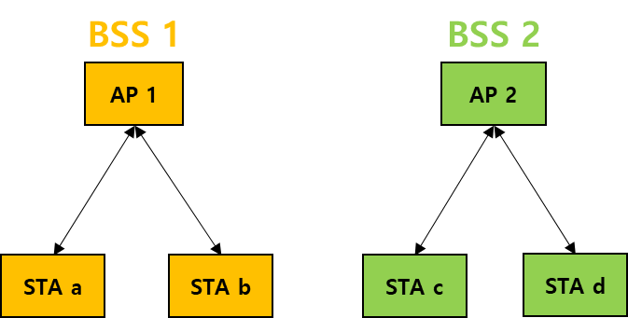
Topology of C-OFDMA
We consider the following environments.
  Each AP can establish its own BSS
  STA “a” and STA “b” are associated with AP 1 in BSS 1.
  STA “c” and STA “d” are associated with AP 2 in BSS 2.
  APs are connected each other with wireless backhaul.
  APs which are hearable each other can participate in C-OFDMA.

Slide 4
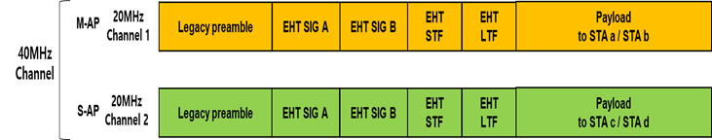
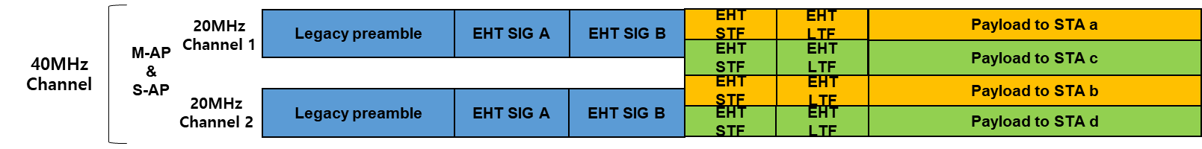
Resource allocation in C-OFDMA
There are two options for the method of resource allocation in C-OFDMA.
Option 1: Slave AP schedules RU to be allocated to the STA associated with itself, and the allocated RU should be within the allocated bandwidth from the Master AP.
Option 2: Mater AP schedules RU to be allocated to the STA associated with Slave AP as well as the STA associated with Master AP, and the allocated RU should be within the entire bandwidth used in C-OFDMA.

Slide 5
C-OFDMA capability announcement
Both options follow same procedure of C-OFDMA capability announcement.
APs can discover each other by receiving Beacon frame or management frames sent by neighboring APs.
When the AP sends Beacon frame or management frame, the neighboring AP should be informed that there is a capability and an intention to participate in C-OFDMA operation.
APs know which of neighboring APs is hearable and has C-OFMDA capability and intention.

Slide 6
Negotiation for resource allocation
Mater AP and Slave APs establish C-OFDMA configuration set.
  The AP which obtains TXOP and initiates C-OFDMA operation is the Master AP.
  The AP which is coordinated by Master AP is the Slave AP.
Master AP selects neighboring APs as candidate Slave APs and requests information for resource allocation.
Slave AP responds to the Master AP if the channel status of Slave AP receiving the request from Master AP is idle.
Based on the information reported by Slave APs, Master AP finally selects the Slave APs to participate in C-OFDMA.

Slide 7
Negotiation for resource allocation (Cont.)
The information required for resource allocation between Master AP and Slave AP is as follows:
Option 1
  Master AP needs Slave AP’s buffer status (e.g., BSR).
  Mater AP needs Slave AP’s available channels (e.g., BQR) or preferred channels of the available channels.
  Based on these information, the Master AP allocates bandwidth to the Slave AP.
Option 2
  Master AP needs the identifiers (with CQI) of STAs associated with Slave APs.
  Master AP needs the resource size for STAs associated with the Slave AP.
  Slave AP may report information of only specific STAs to reduce overhead.
  Based on these information, the Master AP schedules RU allocated to the STAs associated with the Slave AP as well as the Master AP.

Slide 8
Channel switching
Channel switching procedure is only needed for the option 1, the option 2 doesn’t need this procedure.
Based on the results of negotiation, the Master AP allocates bandwidth of 20MHz unit to the selected Slave APs for C-OFDMA data transmission.
The selected Slave AP informs STAs belonging to its BSS to switch the operating channel into the allocated channel.
  The Slave AP may inform channel switching to only specific STAs participating in C-OFDMA. Unnecessary channel switching of STAs not participating in C-OFDMA can be prevented.
The Slave AP and STAs may switch operating channel back at the end of TXOP duration or by an explicit indication by Master AP.

Slide 9
C-OFDMA data transmission
The Master AP triggers the selected Slave APs to send data by using C-OFDMA, the information included in the trigger frame is as follows:
Option 1
  If Master AP and Slave APs send data in synchronization, the Master AP indicates TX parameters to the Slave APs: the number of EHT LTF symbols, GI, the number of SIG-B symbols, PPDU length and etc..
Option 2
  Master AP indicates TX parameters to the Slave APs: the number of EHT LTF symbols, GI, the number of SIG-B symbols, PPDU length and etc..
  Master AP indicates the information of RU allocation for the STAs associated with the Slave AP as well as the Master AP.

Slide 10
C-OFDMA data transmission (Cont.)
Master AP and triggered Slave APs send data by using C-OFDMA.
Option 1
  Slave AP sends data through allocated bandwidth within the bandwidth used in C-OFDMA.
  Slave AP allocates RU to the STA associated with itself.
  The allocated RU should be within the allocated bandwidth from the Master AP.
Option 2
  Slave AP sends data through allocated RUs indicated by the Master AP within the entire bandwidth used in C-OFDMA.

Slide 11
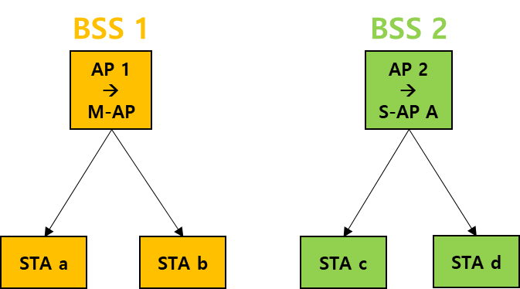
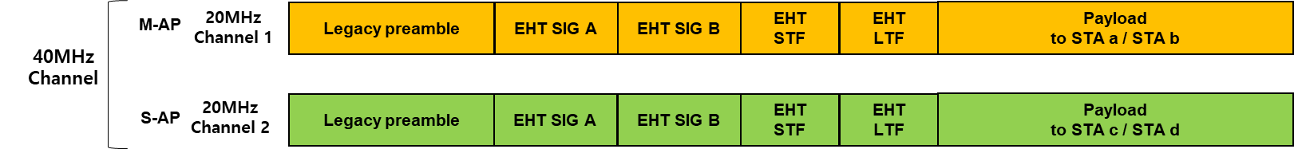
Comparison of options
(Efficiency of RU allocation)
Case 1:
In BSS 1, Channel 1 is suitable for STA a and channel 2 is suitable for STA b.
In BSS 2, Channel 1 is suitable for STA c and channel 2 is suitable for STA d.
Option 1
Option 2
Regardless of the CQI of the STAs, RUs should be allocated to the STAs only within the bandwidth allocated to the AP itself.
In consideration of the CQI of the STAs, the RUs can be allocated to the most suitable STA.

Slide 12
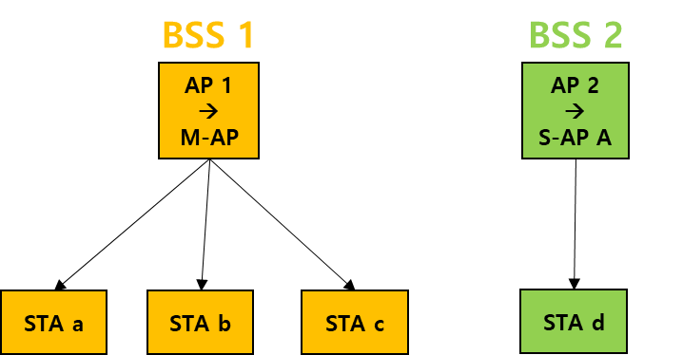
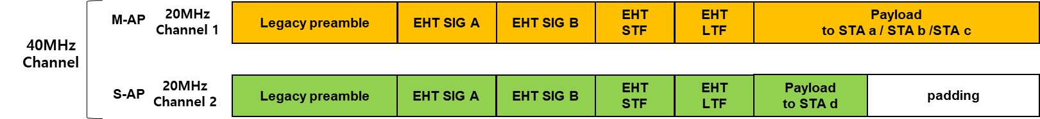
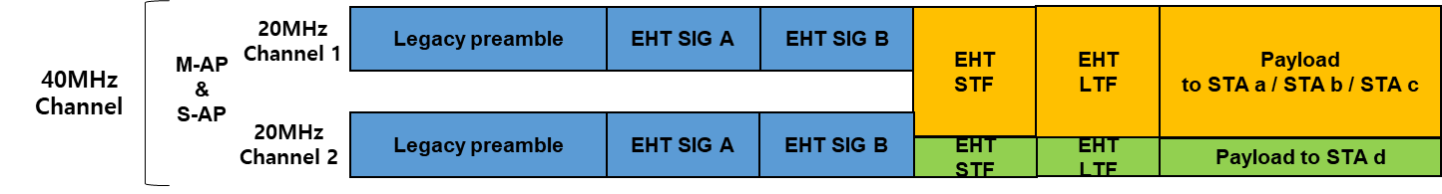
Comparison of options
(Channel Utilization)
Case 2:
In BSS 1, STA a, b, c participate in C-OFDMA.
In BSS 2, STA d participates in C-OFDMA.
M-AP needs more resources than S-AP A.
Option 1
Option 2
Regardless of the buffer status of the APs, the bandwidth should be allocated to the AP at least 20MHz channel unit.
In consideration of the buffer status of the APs, the bandwidth can be allocated flexibly to the AP.

Slide 13
Summary for comparison of options
 | Option 1 | Option 2
Signaling overhead | low | High
Efficiency of RU allocation | low | High
Channel utilization | low | High
Supporting C-OFDMA by using only single 20MHz channel | Not supported | Supported

Slide 14
Conclusion
This contribution introduces the procedures for operating C-OFDMA and the information required in each procedure.
  Capability announcement, negotiation, channel switching and data transmission.
Furthermore, the considerations on resource allocation are introduced.

Slide 15
Straw Poll
Which option do you prefer to adopt in the TGbe?
Option 1:
  Slave AP schedules RU to be allocated to the STA associated with itself and the allocated RU should be within the allocated bandwidth from the Master AP.
Option 2:
  Mater AP schedules RU to be allocated to the STA associated with Slave AP as well as the STA associated with Master AP and the allocated RU should be within the entire bandwidth used in C-OFDMA.

