Slide 1
WLAN sensing TIG: summary and recommendation
Date: 2019-11-08
Author:
Name | Affiliation | Address | Phone | Email
Tony Xiao Han | Huawei Technologies Co., Ltd. | F3, Huawei Base, Shenzhen, China |  | Tony.hanxiao@huawei.com

Slide 2
Abstract
This presentation contains
  Summary of WLAN sensing activities in IEEE 802.11
  Recommendation to the 802.11 WG for the next step of SENS TIG

Slide 3
Summary of WLAN sensing in IEEE 802.11
WLAN sensing discussions in IEEE 802.11 were initiated by [1, 2] in WNG
2 SENS TIG teleconference calls were held,
and 6 more contributions [8-13] were discussed.
Now
2019.7
8
9
10
11
12
5 more contributions [3-7] were discussed in WNG,
and WLAN sensing TIG was established
(The TIG motion could be found in Appendix I)
3 sessions scheduled for SENS TIG,
10 more contributions [14-20] were discussed,
formed a recommendation to the 802.11 WG (Straw poll result could be found in the next slide)
Since the WNG in July, a total of 23 contributions were discussed in WNG and SENS TIG, including the following topics:
  Usage models, use cases (Some examples could be found in Appendix II)
  Broad market potential
  Technical feasibility
  Measurement and evaluation results
  Technology and standardization gaps to support WLAN sensing (More details could be found in Appendix III)

Slide 4
Straw poll result by SENS TIG
Form a recommendation to the 802.11 WG for the next step of SENS TIG
  When do you support making a request to the 802.11 WG to form a SG to develop a PAR and CSD on WLAN sensing?
  November 2019 plenary; or
  Future meeting; or
  Never; or
  Don’t know (need more info).
Result: a 44, b 9, c 0, d 10

Slide 5
Conclusion
WLAN sensing discussion has drawn a lot of attention in IEEE 802.11. A total of 23 contributions were discussed, covering many topics.
Straw poll results showed strong support to form a SG to develop a PAR and CSD.
Notes:
Straw poll results showed that the group prefer to “Continue with the TIG until the next session”

Slide 6
SP
Do you agree to
  Terminate the TIG and form a SG to develop a PAR and CSD
Result: Y51 / N 0 / A 11
Notes:
Moved by Tony Xiao Han on behalf of WLAN sensing TIG

Slide 7
References
[1] 11-19-1164-00-0wng-wi-fi-sensing.pptx
[2] 11-19-1293-00-0wng-wi-fi-sensing-usages-requirements-technical-feasibility and standards gaps.pptx
[3] 11-19-1500-00-0wng-wi-fi-sensing-follow-up.pptx
[4] 11-19-1416-00-0wng-wi-fi-sensing-cooperation-and-standard-support.pptx
[5] 11-19-1551-00-0wng-wi-fi-sensing-in-60ghz-band.pptx
[6] 11-19-1626-01-0wng-802-11-sensing-applications-feasibility-standardization.pptx
[7] 11-19-1580-00-0wng-wi-fi-sensing-application-multipath-enhanced-device-free-localization.pptx
[8] 11-19-1725-00-SENS-usage-models-for-wlan-sensing.pptx
[9] 11-19-1725-00-SENS-usage-models-for-wlan-sensing.pptx
[10] 11-19-1745-00-SENS-wireless-sensing-use-cases-feasibility-and-standardization.pptx
[11] 11-19-1769-00-SENS-csi-based-wi-fi-sensing-results-and-standardization-challenges.pptx
[12] 11-19-1772-00-SENS-presence-and-proximity-detection-using-wlan-sensing.pptx
[13] 11-19-1803-00-SENS-wi-fi-sensing-technical-feasibility-standardization-gaps.pptx
[14] 11-19-1850-00-SENS-Wi-Fi Sensing: Technical Feasibility, Standardization Gaps
[15] 11-19-1852-00-SENS-In Car Sensing – a 60GHz Usage example
[16] 11-19-1854-00-SENS-WLAN-based-radars-in-the-60GHz-band
[17] 11-19-1885-00-SENS-Passive radar: a potential solution for WLAN sensing
[18] 11-19-1897-00-SENS-Wi-Fi Sensing with Doppler measurement in 60GHz band
[19] 11-19-1886-00-SENS-Indoor sensing with FMCW radar
[20] 11-19-1815-00-SENS-WLAN Sensing - Future Steps and Recommendation
[21] 11-19-1987-00-SENS-csi-based-context-assisted-indoor-localization.pptx
[22] 11-19-1994-00-SENS-overview-of-wba-wi-fi-sensing-whitepaper.pptx
[23] 11-19-2052-00-SENS - CSI Profiles: Public Database for WiFi Sensing

Slide 8
Appendix I
SEN TIG motion
Approve formation of a WLAN sensing (SEN) TIG to investigate use cases, requirements, technical approaches and changes to the 802.11 standard to support WLAN sensing.
The TIG is to bring a recommendation to the 802.11 WG at the November 2019 session to either
  Continue with the TIG until the next session; or
  Terminate the TIG with no further work; or
  Terminate the TIG and request formation of a SG to develop a PAR and CSD
Moved: Carlos Cordeiro
Seconded: Jim Lansford
Result: 123/0/8

Slide 9
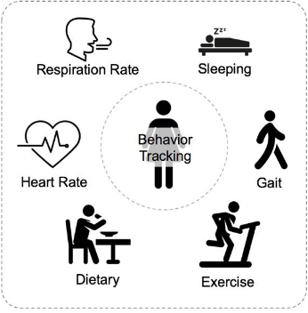
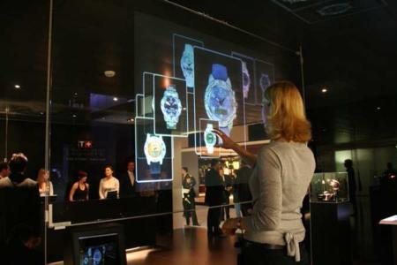
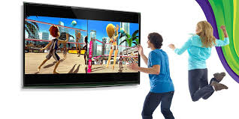
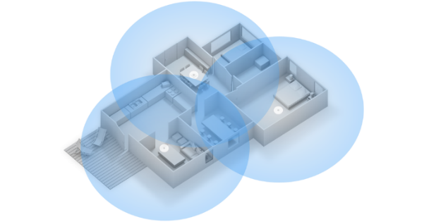

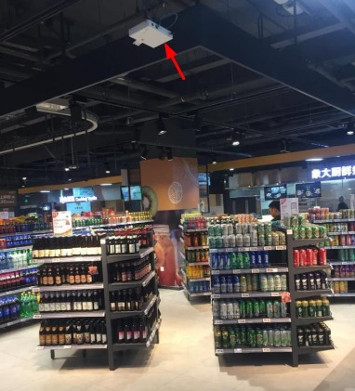
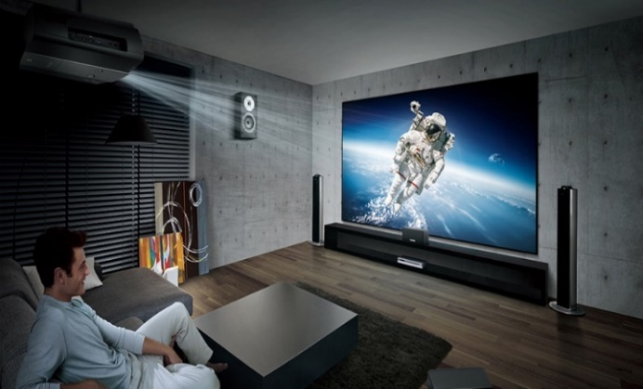
Appendix II
Some use cases
1. Smart home [1, 12]
2. Gesture recognition [1, 2, 5]
3. Gaming control [1, 5]
4. Presence and proximity detection (Home/Car) [5, 12, 15]
https://www.cse.ust.hk/~qianzh/research/sensing-2.jpg
https://www.pressebox.com/pressrelease/gb-pronova-gmbh/HoloPro-and-the-magic-of-interactive-control/boxid/129647#
http://4.bp.blogspot.com/-_krIAHPdn-8/T02hISBvOnI/AAAAAAAAA1A/jAufr2N8k4c/s1600/Kinect%2BGames.jpg
5. Liveness [5]
6. Location in store [1]
7. Audio with user tracking (Follow-me sound) [1]

Slide 10
Appendix III
Technology and standardization gaps to support WLAN sensing
  Target frequency bands could be
  Sub 7GHz: e.g., 802.11 n/ac/ax/be… in 2.4/5/6GHz
  Above 7GHz: e.g., 802.11 ad/ay/… in 60GHz
Technical direction | Potential technologies | Potential standard impact
CSI based
Existing training sequence based solution
e.g., LTF/CEF/Pilot/Midamble
New signal / waveform / sequence design
Measurement and reporting support
Radar based
New signal / waveform / sequence design
e.g., CW/FMCW， Time/frequency radar sequence design
Active radar based schemes
e.g., Mono-static/Bi-static/
Multi-static/MIMO Radar
Specific sensing frame definition
Passive radar based schemes
Sensing procedures/protocols design
Other
Security and privacy based schemes
Angular measurement based solution
Multiple STAs negotiation and cooperation

