Slide 1
CSI-Profiles: Public Database for
Wi-Fi Sensing
Authors:

Slide 2
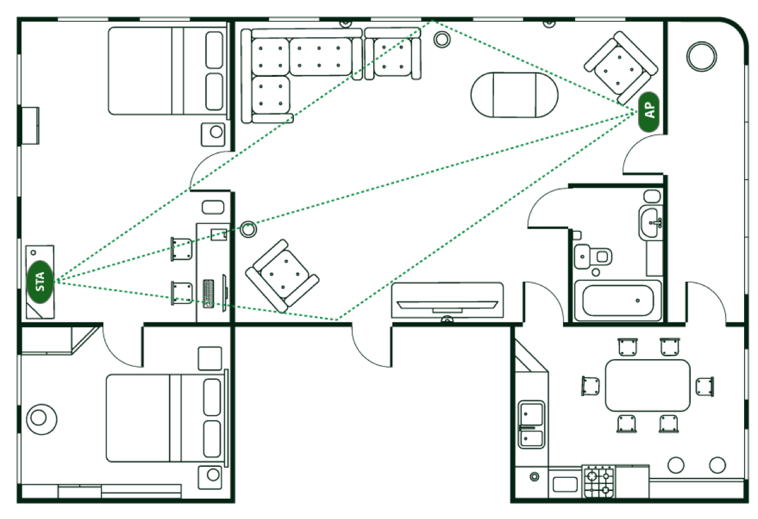
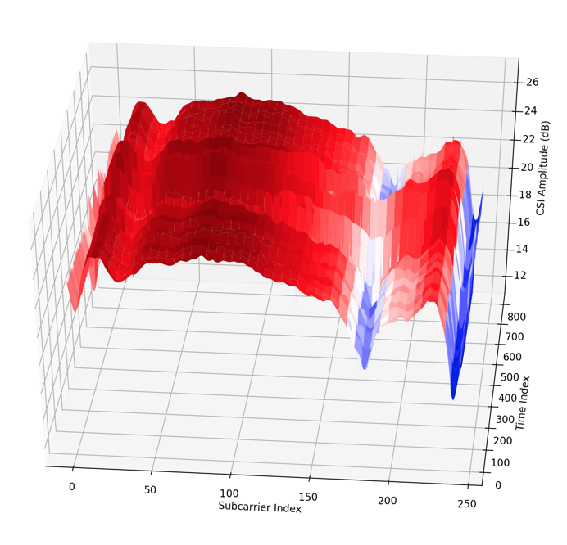
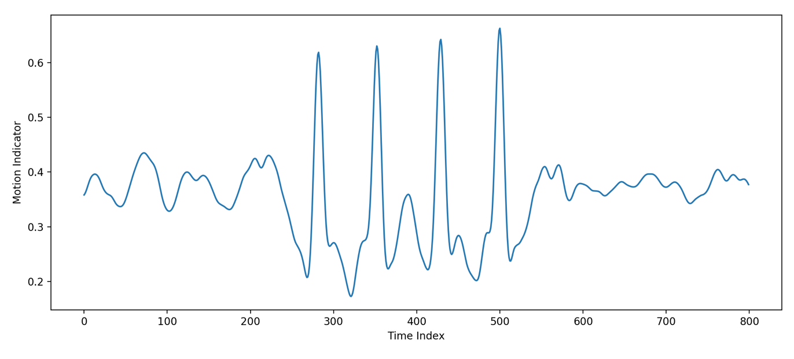
Introduction
What is Wi-Fi Sensing? [1, 2, 3]
  Using existing standardized 802.11-based protocols to sense and track changes in the environment
  Ubiquitous availability of Wi-Fi networks and devices
  Feasibility of good use cases
Algorithms for CSI use cases
  Independent from CSI collection
  Dependent on availability and compatibility
What is missing?
  Easily available data for application development
  Interoperability and standardized data format
Data
Algorithm

Slide 3
CSI Data Collection Challenges
Availability
  Not all Wi-Fi devices have easily accessible CSI
Time
  Experiment setup and data collection involves considerable data collection time
Cost
  CSI extraction includes non-trivial costs for equipment and data collection
Possible solution
  Easily available public CSI dataset

Slide 4
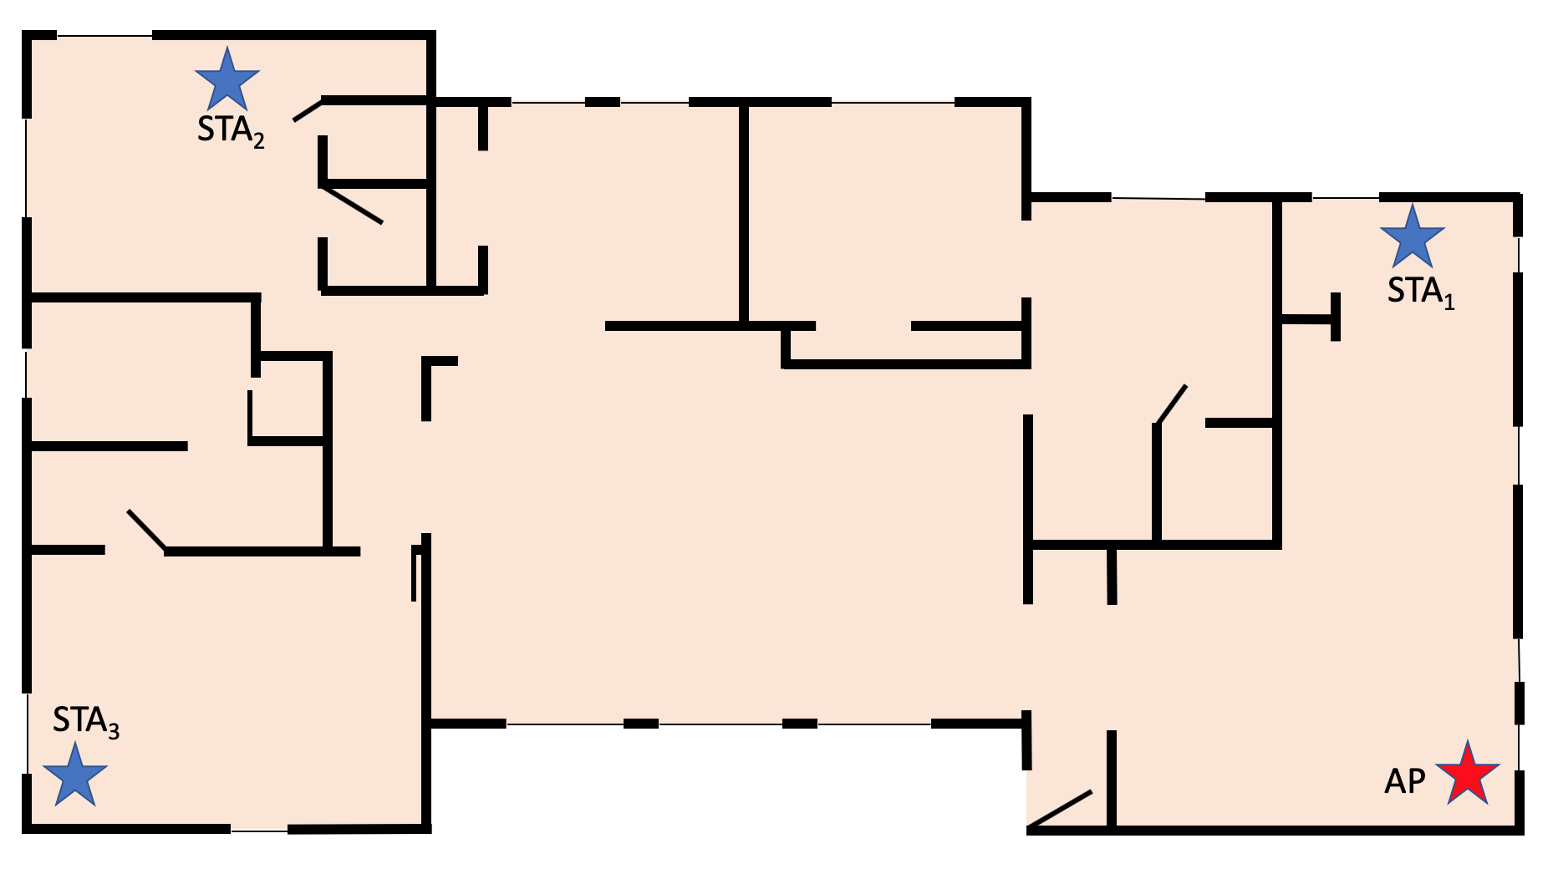
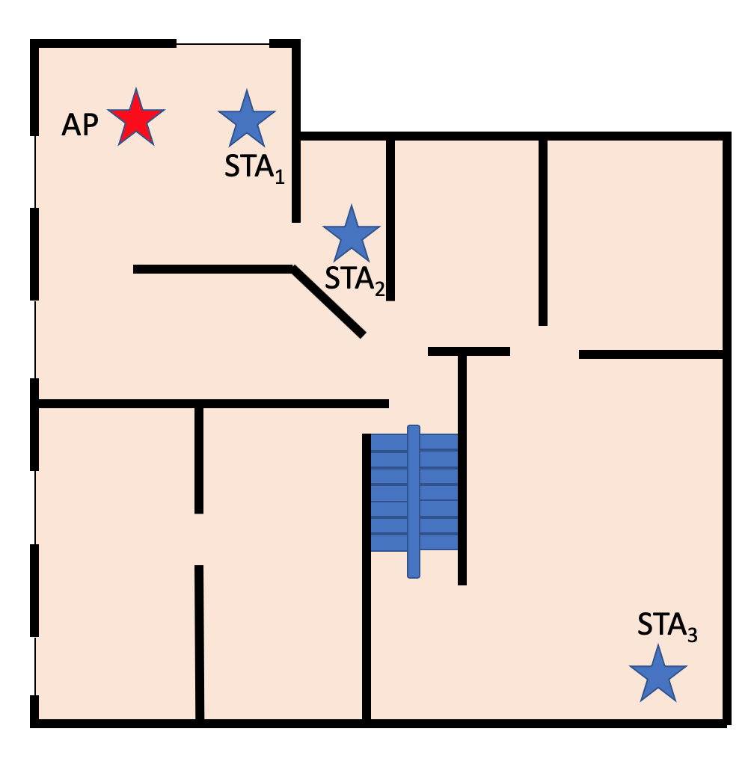
CSI Profiles: Public Database of CSI
Collection Summary
  Three different locations
  Two home setups
  One office setup
  Up-to 4x4 MIMO order
  Up-to 80MHz bandwidth
  Different types of motion and human behavior in vicinity
Loc 1
Loc 2

Slide 5
CSI Profiles: Public Database of CSI (2)
AP
STA₁
Collection Procedure
  Data collected at the AP
  Extraction using QoS data frames
    Periodic CSI collection
    Ping traffic initiated from AP side
  Using 1-3 STAs for simultaneous CSI collection
STA₂
STA₃
AP
STA
Echo Request
CSI
Echo Response
CSI
Interval
Echo Request
CSI
Echo Response
Collection interval = 50ms

Slide 6
CSI Profiles: Public Database of CSI (3)
Data Format
Binary
Conversion scripts to Matlab and Pickle
Header and payload with H matrix
N_{rx}, N_{ss}, Mcs
BW, N_{g}, RSSI, etc.
CSI Report:
{
Header,
Payload
}
Link Param.
CSI
…
h₁₁
h₁₄
…
…
h₁₁
h₁₄
h₄₁
…
h₄₄
…
s₂₃₄
…
…
h₄₁
h₄₄
s₁

Slide 7
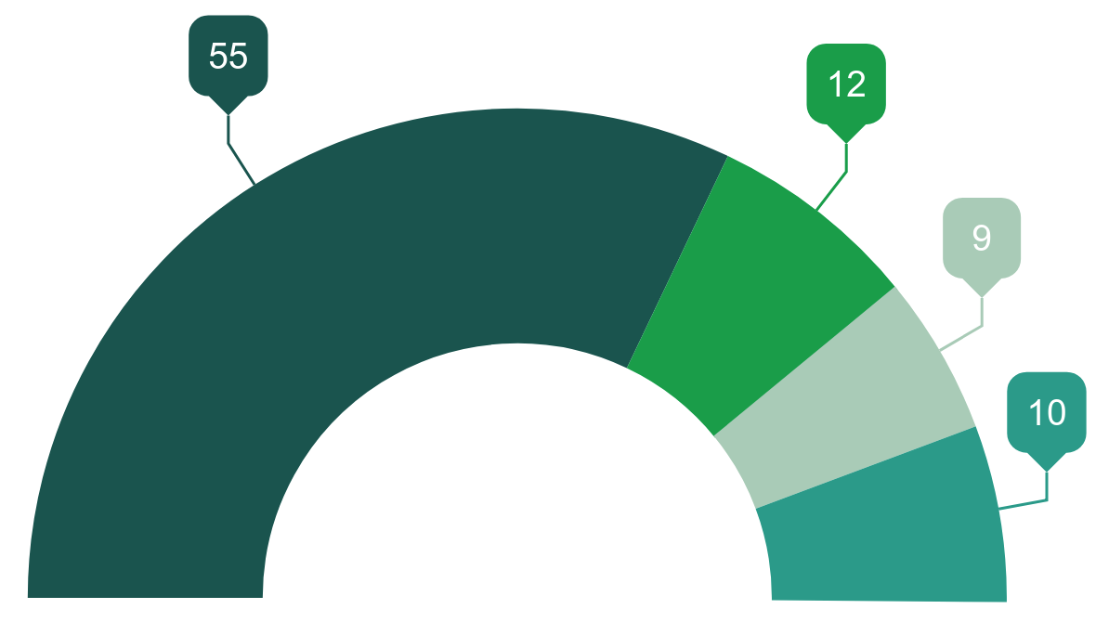
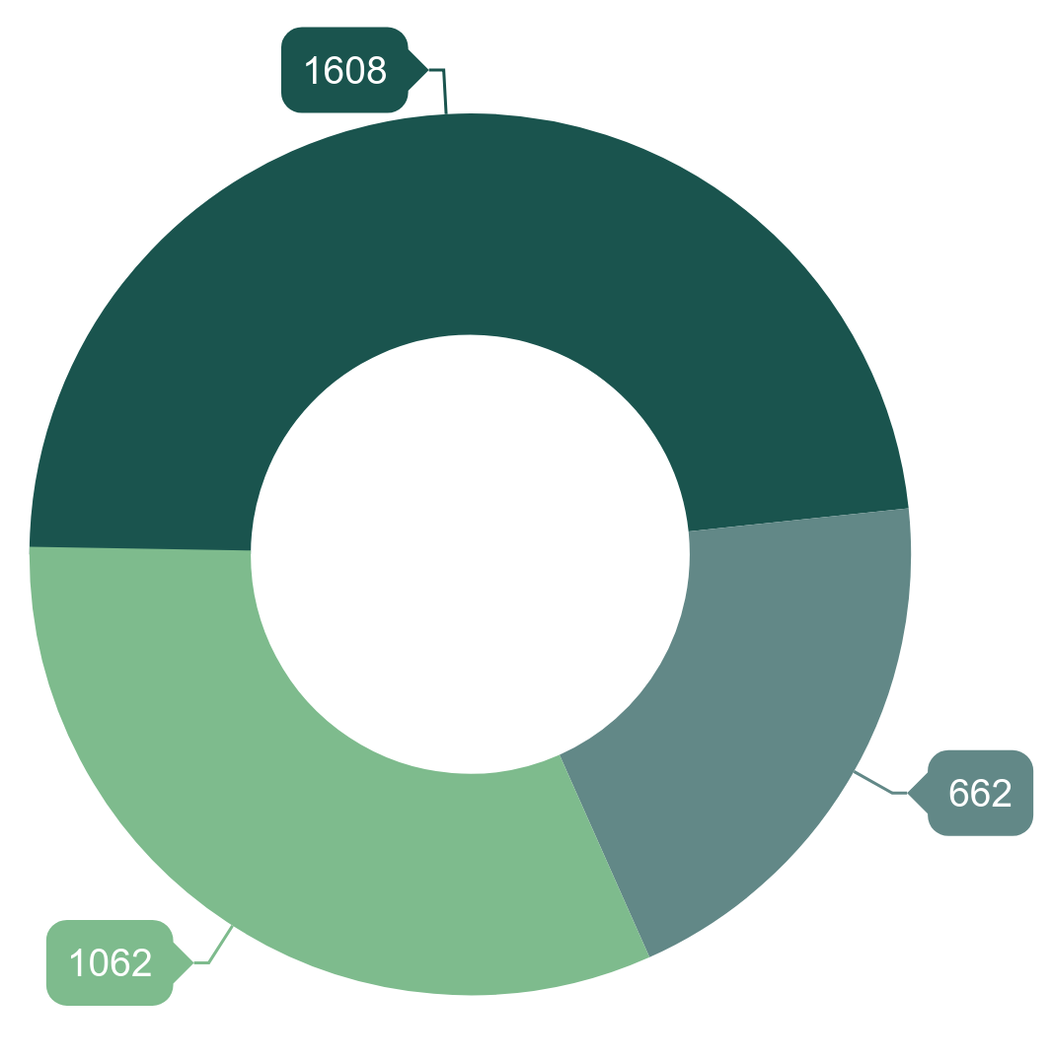
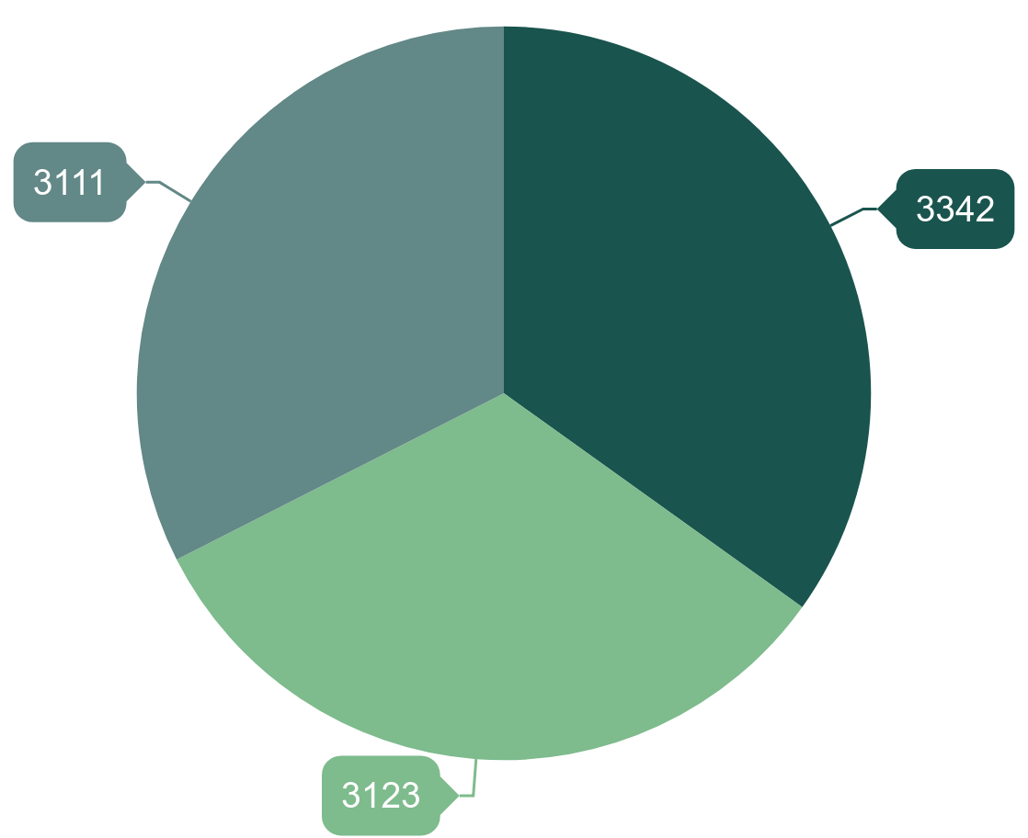
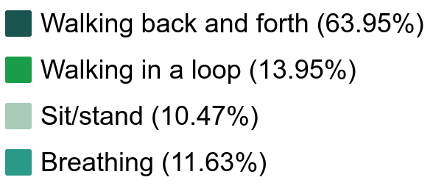
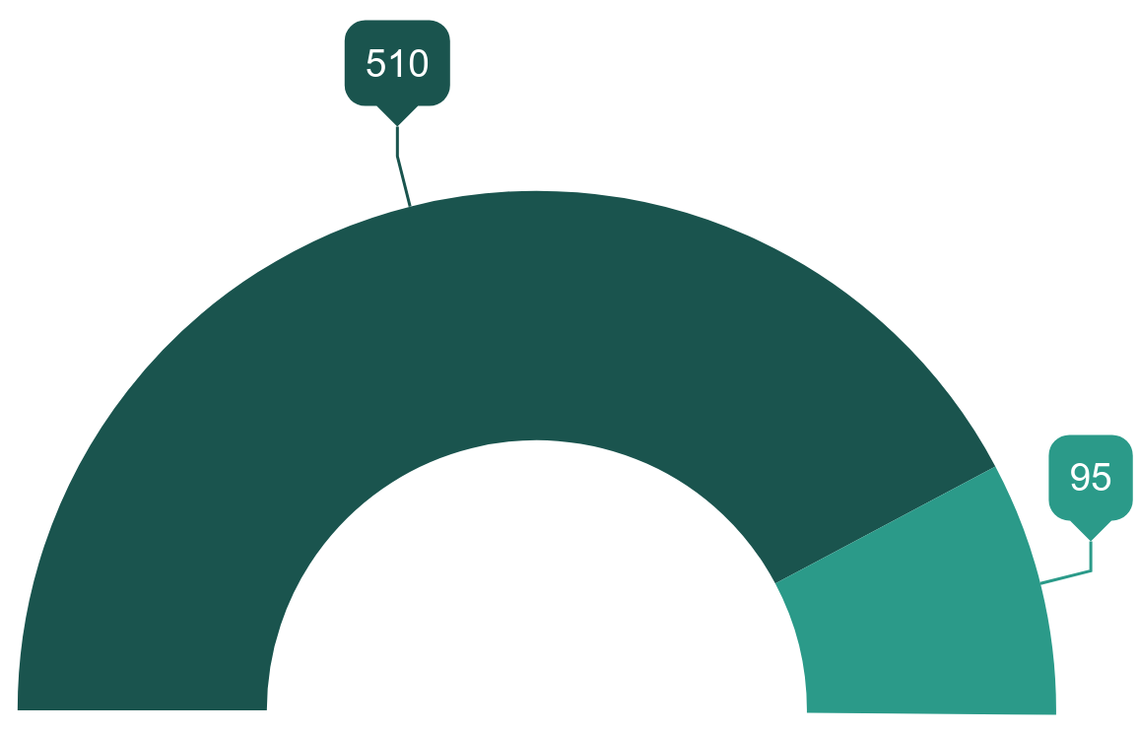
Profile Data Distribution
48.26%
Location 1
Link Quality
Un-controlled
34.9%
Short Range
Long Range
32.5%
Controlled
Static
Mid Range
19.87%
31.87%
Location 2
32.6%
Short: -45 dBm < RSSI
Mid: -60 dBm < RSSI < -45dBm
Long: RSSI < -60 dBm

Slide 8
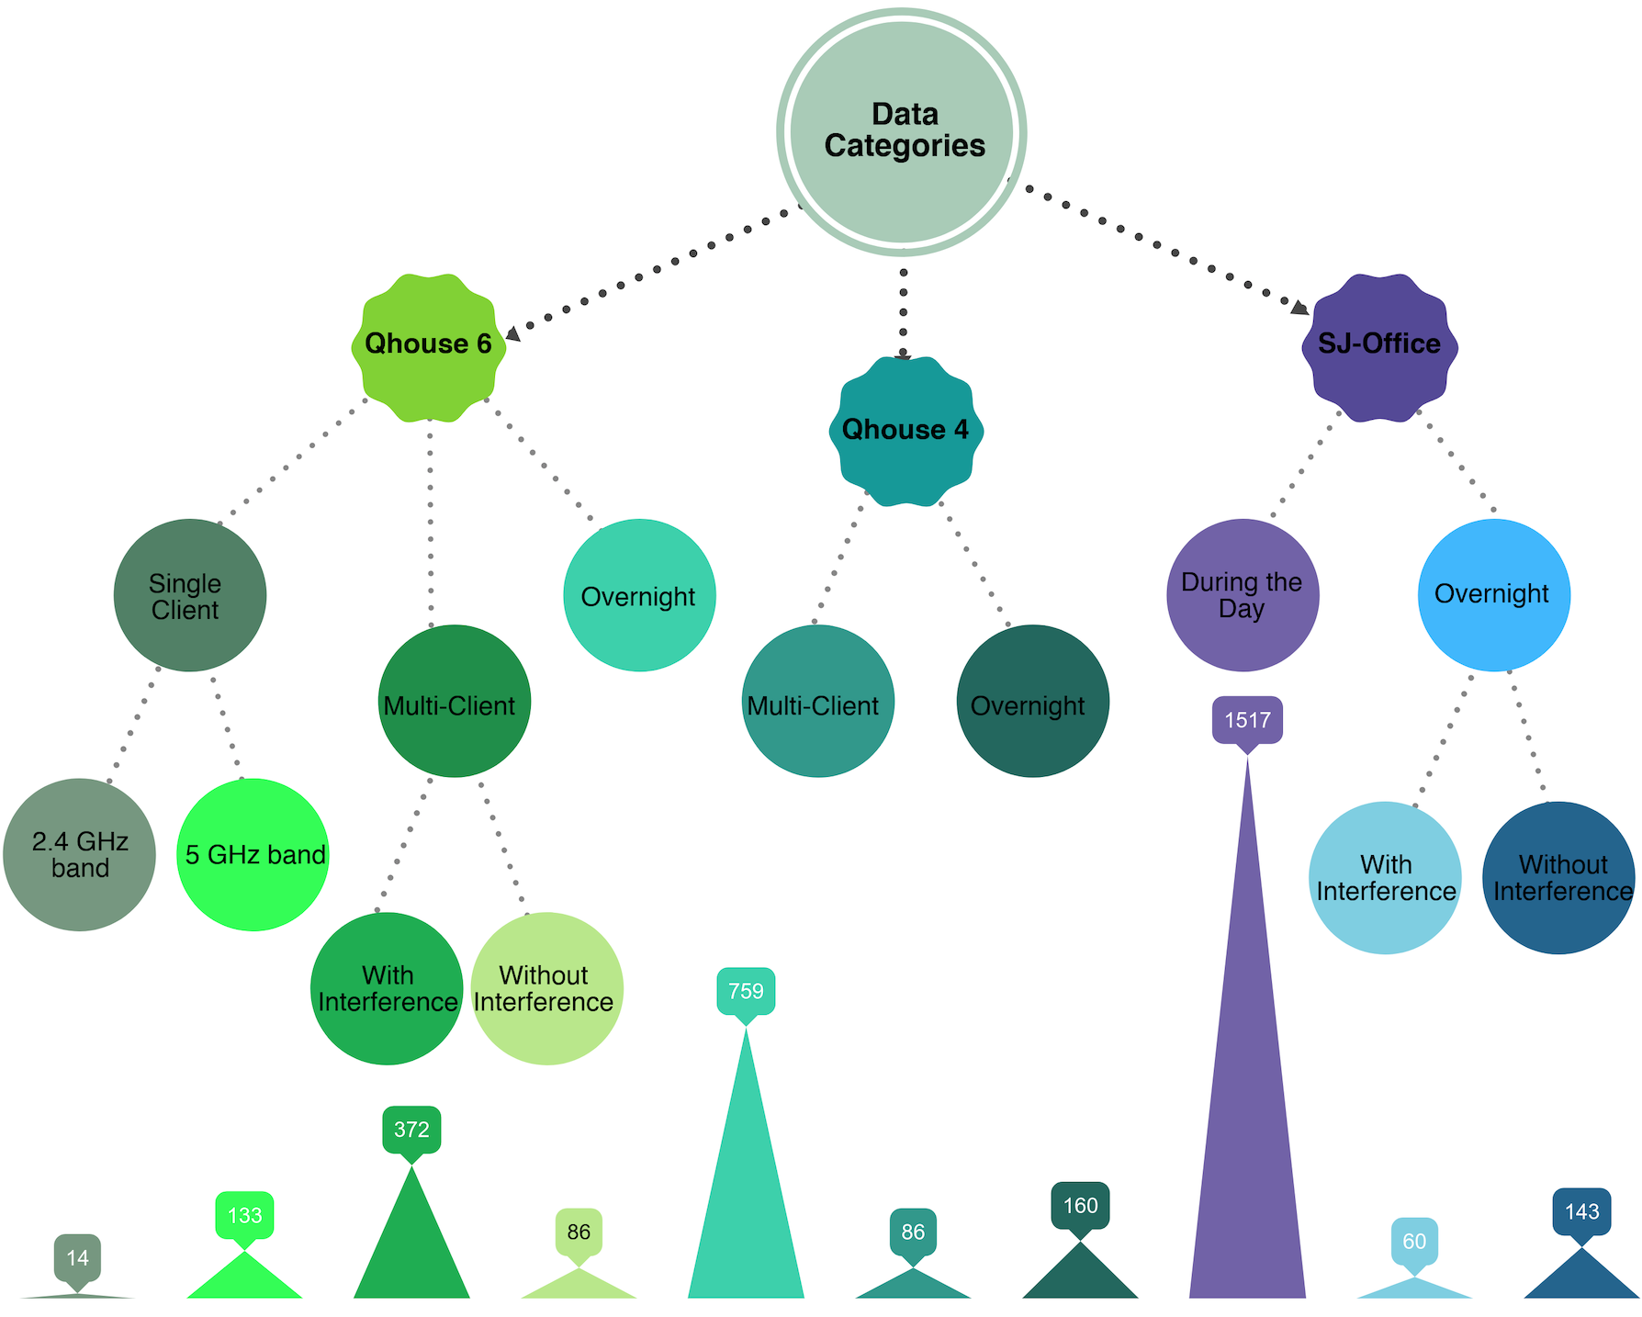
Profile Data Distribution (2)
Duration: 113 hours
Files: 3465
Links: 9777

Slide 9

Publicly Shared CSI Profiles
Publicly available CSI data
Description of type of motion or human behavior for each data sample
Description of environment and floorplan of the location
Data format description
Simple python scripts to load, access and convert the data
Webpage screenshot
In collaboration with Prof. Xinyu Zhang, UCSD [4]
(Link to be available soon)

Slide 10
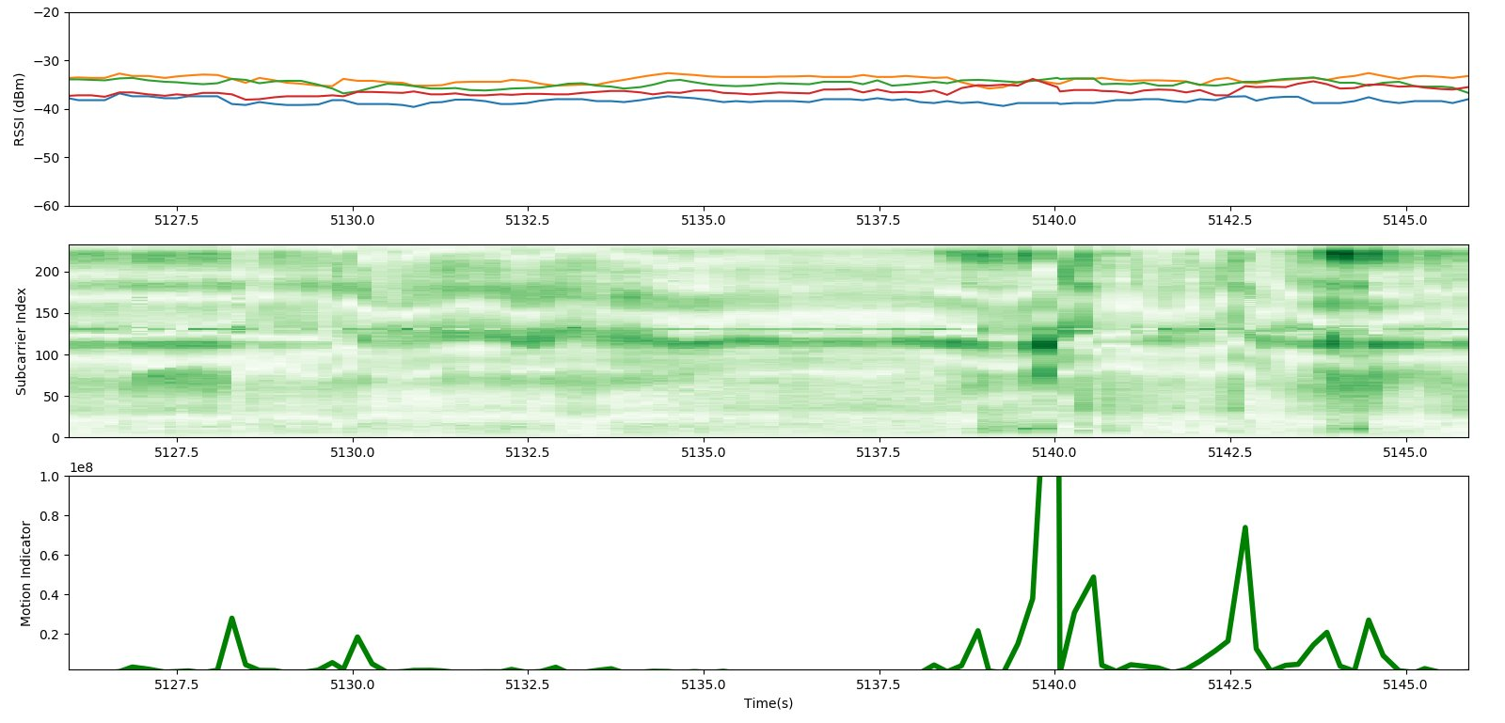
CSI Profile Applications
Get used to available formats
Develop algorithms for many use cases
  Security, home automation etc. [3]
Demo Video
Motion
Person
AP
STA₁
Example Data from
Motion Detection Application

Slide 11
Conclusions
Wi-Fi sensing is growing in demand with many successfully implemented solutions indicating feasibility
Easily available CSI data can ease the initial access problem for developing applications and improving interoperability

Slide 12
References
[1] Wi-Fi sensing, IEEE 802.11-19/1164
[2] Wi-Fi sensing: cooperation and standard support, IEEE 802.11-19/1416
[3] CSI-based Wi-Fi sensing, IEEE 802.11-18/1769
[4] N. Moufadi, X. Zhang, et al. “Robust Passive Localization Using WiFi CSI: A Data-Driven Paradigm”, under review.

