Slide 1
Presentation Material: The Initial Technical Draft Report on Interworking between 3GPP 5G Network & WLAN
Date: 2019-11-13
Authors:

Slide 2
Abstract
Current WLAN access network can not access to 5G core network. So the station can not provide dual access of 5G and WLAN using 5G core networks. Therefore, it needs WLAN interworking to 5G network.
The initial technical draft report on WLAN interworking to 3GPP 5G network describes the interworking reference model and two types of interworking, and defines the necessary functionalities and specific procedures that enable WLAN access networks to interwork with 3GPP 5G network for data throughput improvement and QoS management.

Slide 3
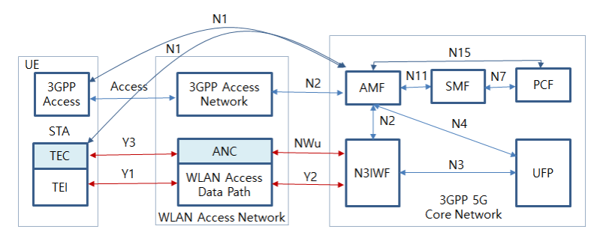
WLAN Interworking Functional Model
These red coloured Y1, Y2, Y3 and NWu interfaces are in the domain of WLAN and may be provided in STA and WLAN access network. The other reference interfaces are referred to 3GPP core network.

Slide 4
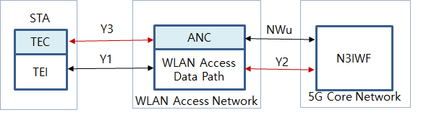
Modification Part in WLAN Domain
Functional entities to be modified
- TEC (Terminal Control) and Access Network Control(ANC) function need to provide NWu
communication protocol and QoS mapping
Signal interface to be defined
- Y2 interface : wireline communication between WLAN access data path and N3IWF
- Y3 interface : NWu communication protocol

Slide 5
Traffic Selection, Switching and Splitting(ATSSS)

Slide 6
Contents of Technical Report11-19-1843-00-AANI-technical-report-november-2019.docx
Definitions, acronyms and abbreviations
Introduction
WLAN interworking reference model
Interworking function and procedures
Gap analysis and recommendations
Conclusions
References

Slide 7
Work Plan
January 2020 meeting : : 1st draft of technical report will be updated
March 2020 meeting : 2nd draft of technical report will be updated
May 2020 meeting : The technical report will be completed. If any comments will be received, then technical report will be updated through discussions during ANNI meeting.

Slide 8
Straw Poll
For the technical report IEEE 802.11-19/1843r0, do you support development of the report ?
Y: 18
N: 0
A: 9

Slide 9
Thank You

