Slide 1
On Unintentional Beamforming
Date: 2019-11-1317-12-14
Authors:
Name | Affiliations | Address | Phone | email
Qinghua Li | Intel | Santa Clara 12 3600 Juliette Lane Santa Clara, CA 95054 USA |  | Qinghua.Li@intel.com
Feng Jiang |  |  |  | Feng1.Jiang@intel.com
Jonathan Segev |  |  |  | Jonathan.Segev@intel.com
Assaf Gurevitz
Robert Stacy

Slide 2
Abstract
Contribution, IEEE 802.11-19/1572r4, discussed a potential problem due to unintentional beamforming in 11az secure ranging. The solution proposed in 1572r4 multiplies the memory size scalar by the number of antennas for storing the secure sounding signals. This contribution depicts a simple solution, which can be implementation specific

Slide 3
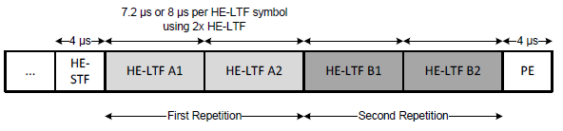
Problem Statement (1/2)
TX antenna 1
…
HE-STF
Signal 1
- Signal 2
Signal 3
- Signal 4
TX antenna 2
…
HE-STF
Signal 1
Signal 2
Signal 3
Signal 4
N_{STS} = 2 , LTF_{REP} = 2
The signals sent by antennas 1 and 2 are the same except the global phases may be different
The received signals may superimpose each other constructively and destructively

Slide 4
Problem Statement (2/2)
TX antenna 1
…
HE-STF
Signal 1
- Signal 2
Signal 3
- Signal 4
TX antenna 2
…
HE-STF
Signal 1
Signal 2
Signal 3
Signal 4
9.6us
RX RSSI
Zero GI
Constructive
interference
Destructive
interference
Unintentional beamforming may cause received signal level stays low for 9.6 us

Slide 5
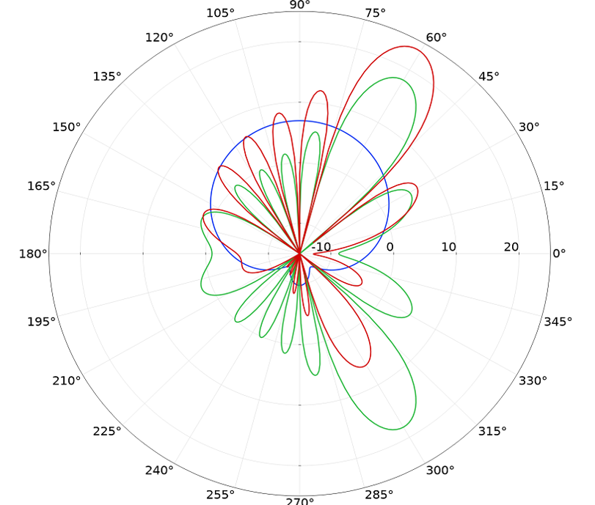
Discussions
The diminishing of received power may only happen for short distance and LOS channels with ideal antenna radiation patterns
The current 11az spec draft meets the regulation requirements
WiFi-compliant device will not transmit due to the power diminishing

Slide 6

Robustness Enhancement ‒ Adding Delayed Signal
TX antenna 1
HE-STF
Signal 1
- Signal 2
Signal 3
- Signal 4
$\sqrt{1−{\left\|β\right\|}^{2}}$ •
HE-STF
Signal 1
Signal 2
Signal 3
Signal 4
TX antenna 2
β •
HE-STF’
Signal 1’
Signal 2’
Signal 3’
Signal 4’
TX power splitting and random phase rotation
Linear or CSD shifts

Slide 7


No Effect to ToA Measurement
$$1$$
Multipaths for TX antenna 1
Delay
ToA
$\sqrt{1−{\left\|β\right\|}^{2}}$
β
Multipaths for TX antenna 2
Delay
Multipaths for TX signal
delayed
Multipaths for TX signal
not delayed
Since the delayed transmission only introduces multipaths after the first channel arrival, it doesn’t affect the ToA estimation

Slide 8







Example
Assuming two antennas have the same channel response i.e. 1
TX antenna 1
1 •
HE-STF
Signal 1
- Signal 2
Signal 3
- Signal 4
$\sqrt{1−{\left\|β\right\|}^{2}}$ •
HE-STF
Signal 1
Signal 2
Signal 3
Signal 4
TX antenna 2
β •
HE-STF
Signal 1’
Signal 2’
Signal 3’
Signal 4’
$$2+2\sqrt{1−{\left\|β\right\|}^{2}}$$
$$2$$
$$2−2\sqrt{1−{\left\|β\right\|}^{2}}$$
RX RSSI

Slide 9




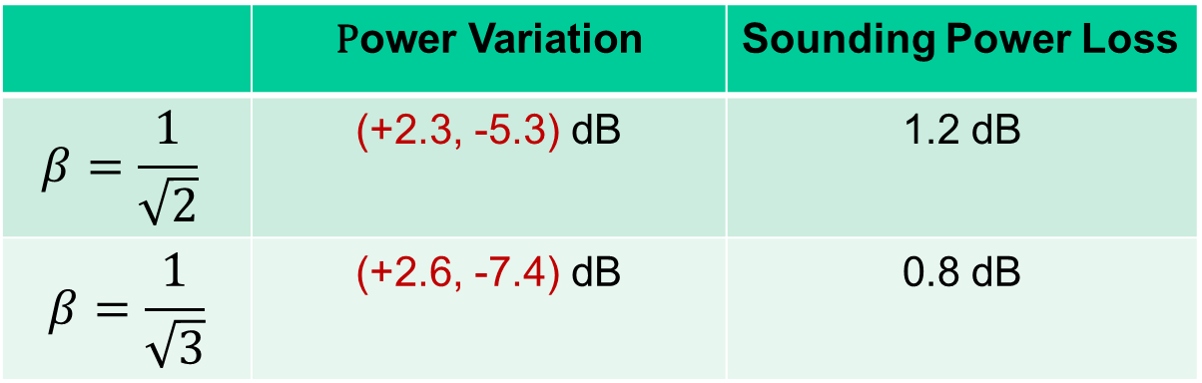
Stabilized Received Power
Assuming two antennas have the same channel response i.e. 1
 | $$\text{P}\text{ower} \text{V}\text{ariation}$$ | Sounding Power Loss
$$β=\frac{1}{\sqrt{2}}$$ | (+2.3, -5.3) dB | 1.2 dB
$$β=\frac{1}{\sqrt{3}}$$ | (+2.6, -7.4) dB | 0.8 dB
$$2+2\sqrt{1−{\left\|β\right\|}^{2}}$$
RX RSSI
$$2$$
$$2−2\sqrt{1−{\left\|β\right\|}^{2}}$$

Slide 10
Conclusions
The current secure ranging signal meets the regulation requirements
The effect of the potential unintentional beamforming can be mitigated by transmitting a delayed sounding signal
The solution can be implementation specific such that no spec change is needed

