Slide 1
Revisit DMG multi-band discovery forwarding
Date: 2019-11-11
Name | Affiliation | Address | Phone | Email
Kazuyuki Sakoda | Sony |  |  | kazuyuki.sakoda(at)sony.com
Mohamed Abouelseoud | Sony |  |  | Mohamed.Abouelseoud(at)sony.com

Slide 2
Agenda
Recap: why we are talking about this feature
Recap: what is DMG multi-band discovery assistance
What is the problem and what is missing in D5.0
Our previous discussion
New direction/activities
Discussion

Slide 3
Motivation
802.11ay introduces DMG multi-band discovery assistance feature to ease forming opportunistic network, i.e., 60GHz mesh network, while maintaining low-latency and robust communication
However, the current DMG multi-band discovery assistance requires association to an AP per a request for discovery assistance
It is preferable to extend the assistance coverage beyond the AP to find neighbor DMG STAs efficiently
TGay had discussions if we should extend the feature, but did not come to the conclusion to include it
This presentation revisits the DMG multi-band discovery extension once again, and suggest to reconsider extending the feature

Slide 4
Recap: why we are talking about this feature (1)
High-bandwidth, low-latency, and robust communication is a key to high quality VR type of application [1]
Ideally, the latency should be bounded < 3~10 msec over the air in order to satisfy system requirements [2]
There are many other application that benefits low latency capability
However, 802.11ad/ay DMG Beacons / exhaustive SSW could occupy the airtime continuously beyond the latency boundary
Big chunk of BHI should be eliminated

Slide 5
Recap: why we are talking about this feature (2)
We also think that multi-AP type of network configuration is helpful to enhance range and robustness of the 60GHz network
Potentially introduce multi-hop communication on top of the 802.11ay MAC/PHY
Even if the routing and forwarding resides on layer 3, 802.11ay should provide tool set to enable such operation on layer 2, such as efficient neighbor discovery and opportunistic link establishment
The same concept as DN-DN link for fixed wireless access use case with TDD DMG STA

Slide 6
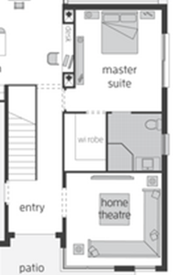
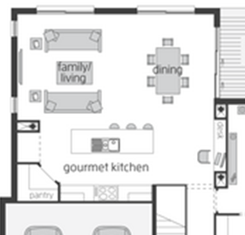
Recap: why we are talking about this feature (2)
DN
Source
(DN)
Sink
(DN)
DN
Sink
(DN)
DN
Source
(DN)

Slide 7
Recap: why we are talking about this feature (3)
What we thought:
It is preferable to make DMG beaconing (SSW beaconing) flexible enough not to block streaming data transfer, i.e., make it on-demand fashion
Assume that typical DMG STA is dual/triple band capable, and collocates with STA operating at lower band such as 2.4/5GHz
A new STA wishing to get onboard a neighboring 60GHz network should be able to find neighbor DMG STAs greedily, even if the neighboring DMG STAs are not performing exhaustive SSW beaconing all times
Use lower band link to help new STA discovering neighboring DMG STA and joining a DMG BSS
→ Motivation for DMG multi-band discovery assistance

Slide 8
Recap: what is DMG multi-band discovery assistance
DEV5
DEV1
DEV1: Existing Device
DA Enabled
DMG AP1
5GHz AP1
DA Enabled
DMG STA5
5GHz STA5
DEV5: New Device wishing to onboard
5GHz AP1 announce its discovery assistance capability (DA Enabled) in Muti-band element in its Beacon/Probe Response frame on lower band. DEV5 (5GHz STA5) recognizes that AP1 has collocated DMG AP1.

Slide 9
Recap: what is DMG multi-band discovery assistance
DEV5
DEV1
DEV1: Existing Device
DA Enabled
DMG AP1
5GHz AP1
Association
Association
DMG STA5
5GHz STA5
DEV5: New Device wishing to onboard
DEV5 (5GHz STA5) wishes to join the network, and joins the 5GHz BSS of AP1

Slide 10
Recap: what is DMG multi-band discovery assistance
DEV5
DEV1
DEV1: Existing Device
DA Enabled
DMG AP1
5GHz AP1
Association
FST Setup Req. /w DA
FST Setup Req. /w DA
Schedule SSW on 60GHz
DMG STA5
5GHz STA5
DEV5: New Device wishing to onboard
DEV5 (5GHz STA5) requests discovery assistance on 60GHz. DEV1 (5GHz AP1) recognizes the request and schedule DMG AP1’s SSW on 60GHz

Slide 11
Recap: what is DMG multi-band discovery assistance
DEV5
DEV1
DEV1: Existing Device
DA Enabled
DMG AP1
5GHz AP1
Association
FST Setup Req. /w DA
FST Setup Resp. /w DA
Schedule SSW on 60GHz
FST Setup Resp. /w DA
Schedule scan on 60GHz
DMG STA5
5GHz STA5
DEV5: New Device wishing to onboard
DEV1 (5GHz AP1) respond with assistance agreement and let DEV5 know of the SSW schedule on 60GHz. DEV5 recognizes when and which channel to scan 60GHz channel

Slide 12
Recap: what is DMG multi-band discovery assistance
DEV5
DEV1
DEV1: Existing Device
DA Enabled
DMG AP1
5GHz AP1
Association
TXSS
FST Setup Req. /w DA
Communication
Schedule SSW on 60GHz
FST Setup Resp. /w DA
Schedule scan on 60GHz
TXSS
DMG STA5
5GHz STA5
DEV5: New Device wishing to onboard
Communication
DMG AP1 performs TXSS at the designated time. If DMG STA5 can receive the signal, it will start communication with DMG AP1 over 60GHz channel.

Slide 13
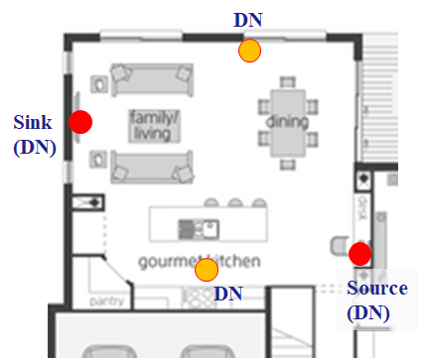
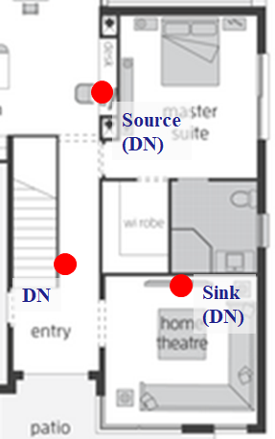
What is the problem? (1)
DEV3: Existing Device
DMG STA3
5GHz STA3
DEV1: Existing Device
DMG AP1
5GHz AP1
DMG STA5
5GHz STA5
DMG STA2
5GHz STA2
DEV5: New Device wishing to onboard
DEV2: Existing Device
We envision that multi-AP type of network configuration is helpful. It is preferable that the newly joining DEV5 can find multiple neighbor STAs
To ask for a discovery assistance, the DEV5 needs to associate to all of its potential neighbor DEVs one by one

Slide 14
What is the problem? (2)
It will be time consuming to repeat asking for discovery assistance one AP after another
There is no guarantee that all the existing DEV in its neighborhood operate 5GHz AP. Some of them might be STA associating to an AP
At the time of scanning, some Wi-Fi driver software may filter duplicate SSID and report back selected AP only to its application (Your laptop and phone only report on SSIDs (not each AP) responding to the scan request)

Slide 15
What is missing in D5.0 (1)
DEV3: Existing Device
DMG STA3
5GHz STA3
DEV1: Existing Device
DMG AP1
5GHz AP1
DMG STA5
5GHz STA5
DMG STA2
5GHz STA2
DEV5: New Device wishing to onboard
DEV2: Existing Device
It would be great if DEV5 can collect all potential neighbor’s SSW information via DEV1 so DEV5 (5GHz ST5) only needs to associate to an AP, and the AP will coordinate the discovery assistance request to its neighbor STAs

Slide 16
What is missing in D5.0 (2)
DEV5
DEV1
DEV3
DEV3: Existing Device
DA Enabled
DMG STA3
5GHz STA3
DEV1: Existing Device
DMG AP1
5GHz AP1
Association
Schedule SSW on 60GHz
FST Setup Req. /w DA
DA Req. Forwarding
Schedule SSW on 60GHz
DA Req. Response
Schedule scan on 60GHz
FST Setup Resp. /w DA
DMG STA5
5GHz STA5
TXSS
DEV5: New Device wishing to onboard
TXSS
Upon reception of DA request, DEV1 forwards the request info to its neighbor STAs, and let them schedule the SSW to ease discovery from DEV1. AP1 respond back aggregated response to STA5.

Slide 17
Our previous discussion
This problem and suggested solution have been discussed in TGay [3][4], and even normative text was ready for review [5]
However, the group did not come to the conclusion to accept the proposal, probably because people thought the use case and the requirements are rare case…
But, wait! We started to see some new directions/activities in 802.11 community and beyond.

Slide 18
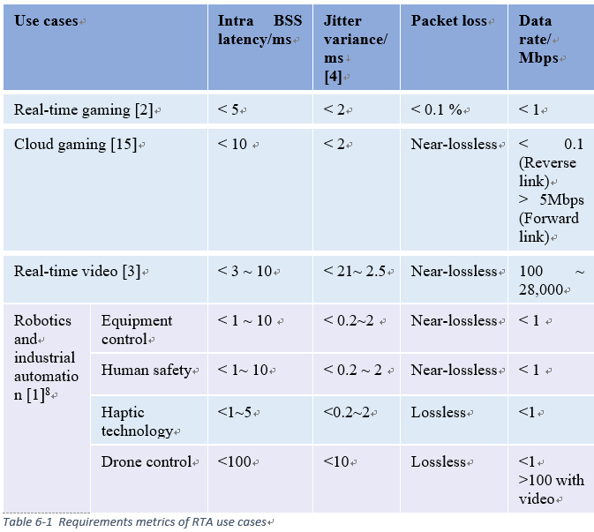
New direction/activities (1)
Real time communication:
RTA TIG walked through requirements on real time applications. It is recognized that low latency communication should be an important KPI in new application space. This argument is definitely valid to 60GHz technology as well.
Looking into telecom world, low latency capability is getting to be one of the most compelling value proposition of 5G, a.k.a. URLLC.
DMG discovery assistance and its proposed extension is all about low latency, high throughput, and robustness. TGay should provide enough tools to design a system meeting the requirements

Slide 19
New direction/activities (2)
Probably, OOB discovery is going to be more popular:
Some people may think multi-band/out-of-band discovery is not going to be useful or popular. At least in history, it was.
However, 802.11ax is also talking about OOB discovery and they started to take it more serious these days [6][7]
We do not need to be shy to leverage OOB discovery in 802.11. Rather, TGay should define complete set of OOB discovery features

Slide 20
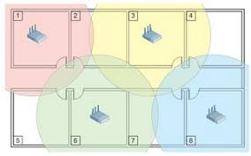
New direction/activities (3)
Wi-Fi sensing, 60GHz, multi-static radar:
SENS TIG has been kicked off. One of the candidate technology/application is 60GHz multi-static radar [8]
The use case assumes multiple DMG STA deployment in a neighborhood at consumer spaces, which is pretty similar to what [1] envisions
It is possible that multi-AP type of deployment will be even more popular together with the use of 60GHz Wi-Fi sensing technology

Slide 21
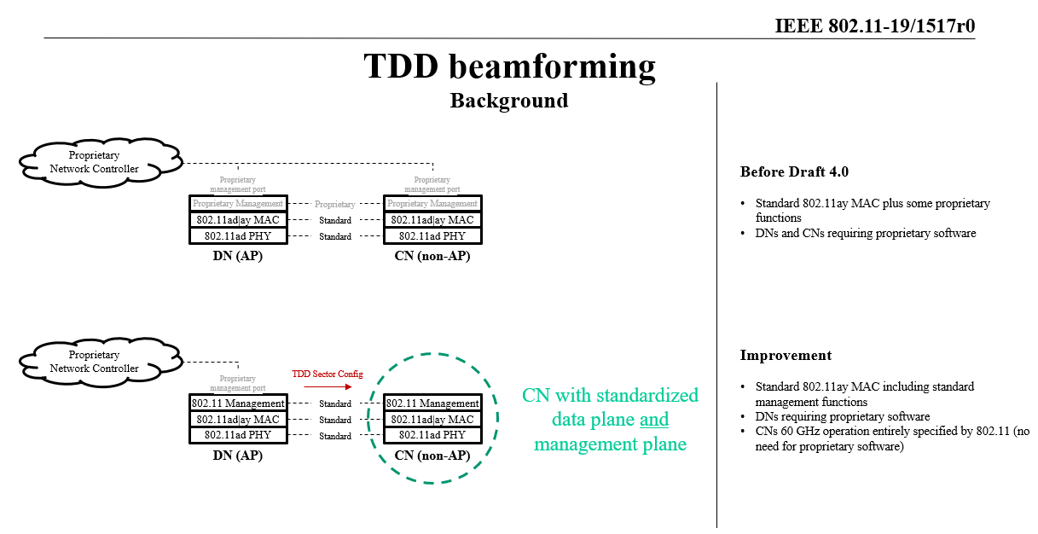
New direction/activities (4)
TGay is going to specify more details on management functions to design DN/CN with TDD mode [9]
It sounds to be reasonable, as TGay will be providing more complete set of tools to form opportunistic networks over 802.11ad/ay devices

Slide 22
Discussion
Should TGay consider to define a bit more complete set of tool to make multi-band discovery efficient?

Slide 23
References
[1] 802.11-18/194r1 “Distribution network use case for consumer devices,” Kazuyuki Sakoda, et.al.
[2] 802.11-18/2009r6 “IEEE 802.11 Real Time Applications TIG Report,” Kate Meng, et.al.
[3] 802.11-19/19r1 “Proposed resolution of CID 3518”, Mohamed Abouelseoud, et.al.
[4] 802.11-19/868r0 “Multi-band comments resolution”, Mohamed Abouelseoud, et.al.
[5] 802.11-19/20r0, “Proposed resolution of CID 3518 text”, Mohamed Abouelseoud, et.al.
[6] 802.11-18/1922, “Considerations on 6GHz Discovery,” Thomas Derham, et.al.
[7] 802.11-18/1966, “6GHz – Out-of-band discovery discussion,” Laurent Cariou, et.al.

Slide 24
References
[8] 802.11-19/1551r1 “Wi-Fi sensing in 60GHz band,” Alecsander Eitan, et.al.
[9] 802.11-19/1517r0, “TDD beamforming configuration,” Payam Torab, et.al.

