Slide 1
Overview of WBA whitepaper on Wi-Fi Sensing
Date: 2019-11-10
Authors:

Slide 2
Abstract
Wireless Broadband Alliance (WBA) has recently published a whitepaper on Wi-Fi Sensing [1]. We provide an overview of the paper that may be useful for the work of the SENS TIG and any future SG and/or TG.

Slide 3
WBA whitepaper -background
In Feb 2019 WBA formed a Wi-Fi Sensing group to develop a whitepaper with the following goals:
Increase industry awareness on Wi-Fi Sensing technology
Introduce Wi-Fi Sensing technology components
Identify use cases and related business opportunities
Discuss standardization gaps for realization of all the use cases
The paper was published in Oct 2019.
Available for download at: https://wballiance.com/resource/wi-fi-sensing/

Slide 4
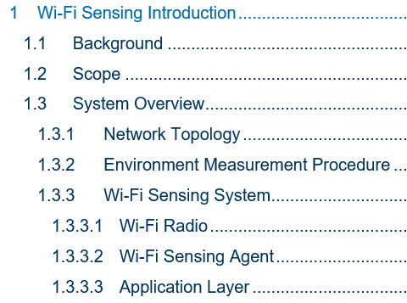
What’s in the paper (1)

Slide 5
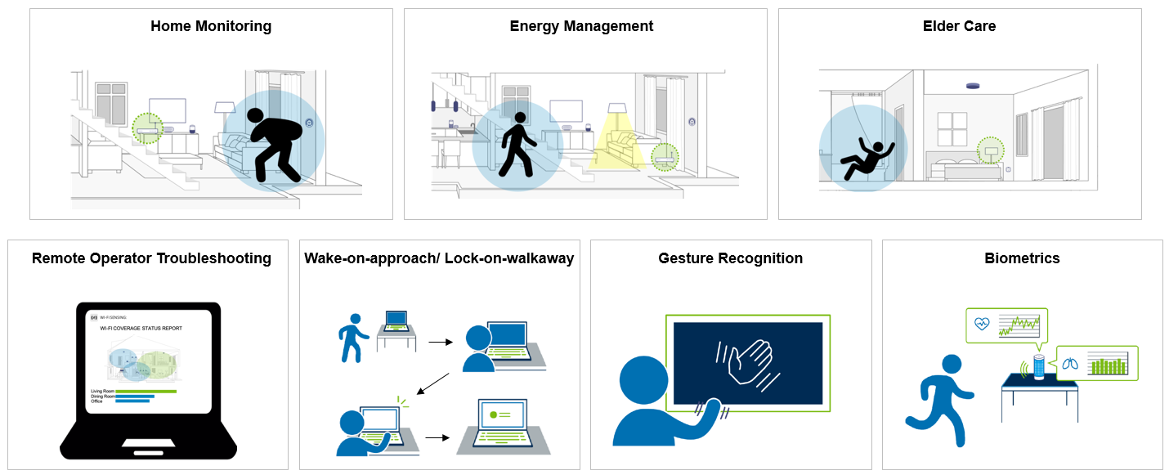
Example Use Cases

Slide 6
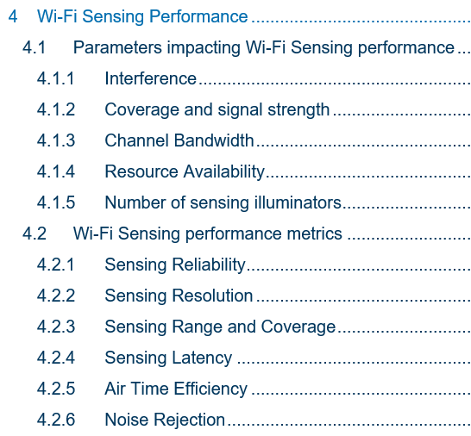
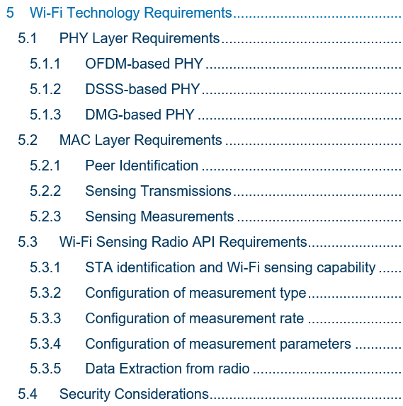
What’s in the paper (2)

Slide 7
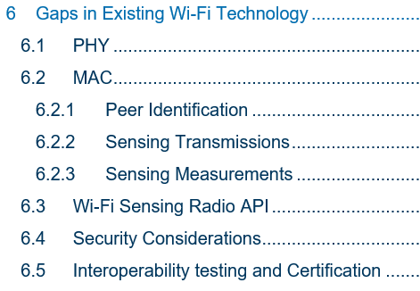
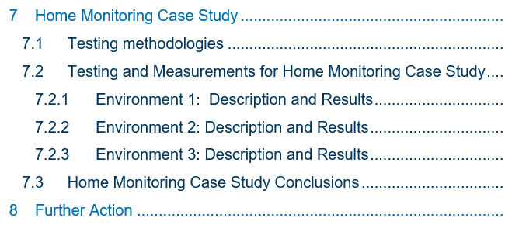
What’s in the paper (3)
Example identified gaps:
PHY
Ensure consistent radio configuration for consecutive measurements
MAC
Peer Identification and exchange of sensing capabilities
Improved measurement mechanisms
Standardized Radio API
Currently no standard API exists to control and extract CSI data from radio
Potential Security Considerations:
Examine potential cases around security

Slide 8
Summary
WBA’s Wi-Fi Sensing white paper provides an overview of the Wi-Fi Sensing technology, use cases and standardization gap analysis that may be useful for the work of SENS TIG and any future SG and/or TG.

Slide 9
References
[1] WBA Wi-Fi Sensing Whitepaper
https://wballiance.com/resource/wi-fi-sensing/

