Slide 1
CSI-based Context-Assisted Indoor Localization
Authors:
Name | Affiliations | Address | Phone | email
Dinesh Bharadia | Professor, UCSD | 9500 Gilman Dr. San Deigo, CA, 92122 | +1-858-822-0168 | dineshb@ucsd.edu
Roshan Ayyalasomayajula | Student, UCSD |  |  | roshana@eng.ucsd.edu
Aditya Arun | Student, UCSD |  |  | aarun@eng.ucsd.edu
Chengfeng Wu | Student, UCSD |  |  | chw357@ucsd.edu
Debashis Dash | Quantenna Communications | 1704 Automation Pkwy San Jose, CA 95131 | +1 669 209 5661 | ddash@quantenna.com

Slide 2
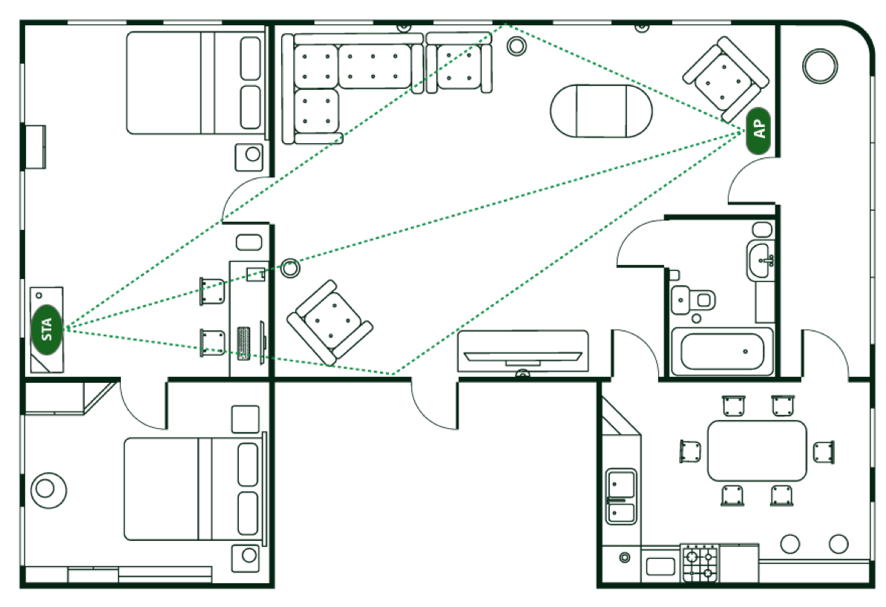
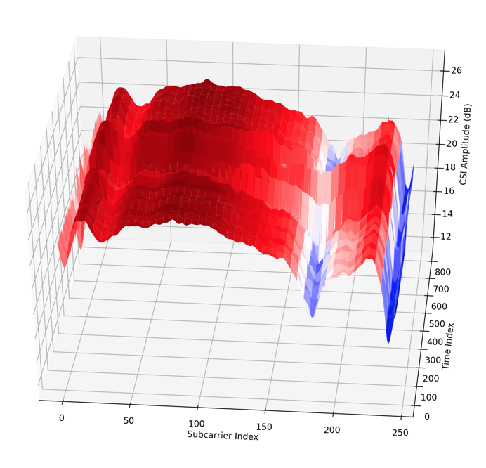
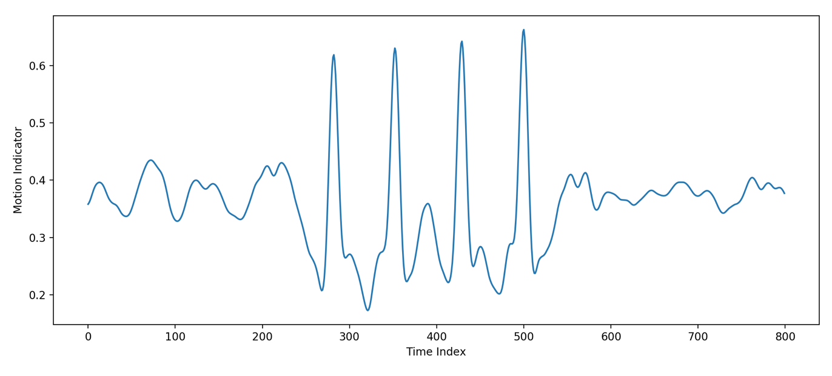
Introduction
What is Wi-Fi Sensing? [1, 2, 3]
  Using existing standardized 802.11-based protocols to sense and track changes in the environment
Status
  Interest in WNG July session
  TIG created in September session to further explore Wi-Fi sensing
Why Wi-Fi?
  Ubiquitous, re-use existing technology for new use cases
  Device-free, extra sensor-free, privacy-friendly
Feasibility
  Large-scale autonomous data collection for localization with context
  CSI based sub-meter accurate Indoor localization within indoor maps
  Requires no retraining for small environment updates

Slide 3
Use Case: Indoor Navigation
CSI Use Cases [1, 2, 3]
  Security, automation, health care etc.
  Indoor Navigation
Indoor Navigation
  Lack of reliable positioning and accurate maps
  Can CSI be a good equivalence?
  Feasibility of context-aware mapping and learning based localization using Wi-Fi CSI

Slide 4
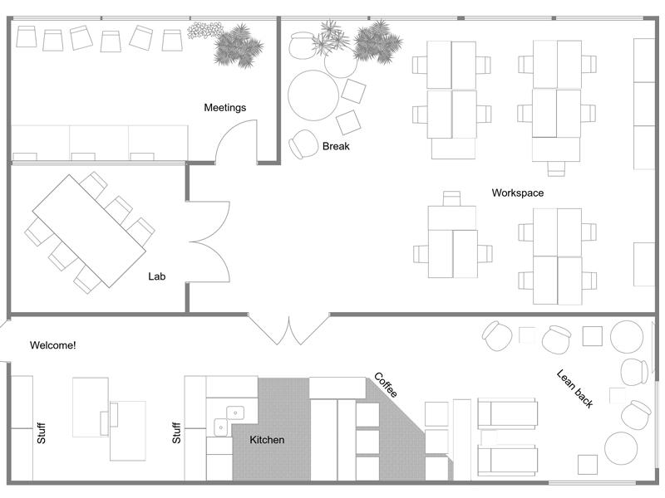
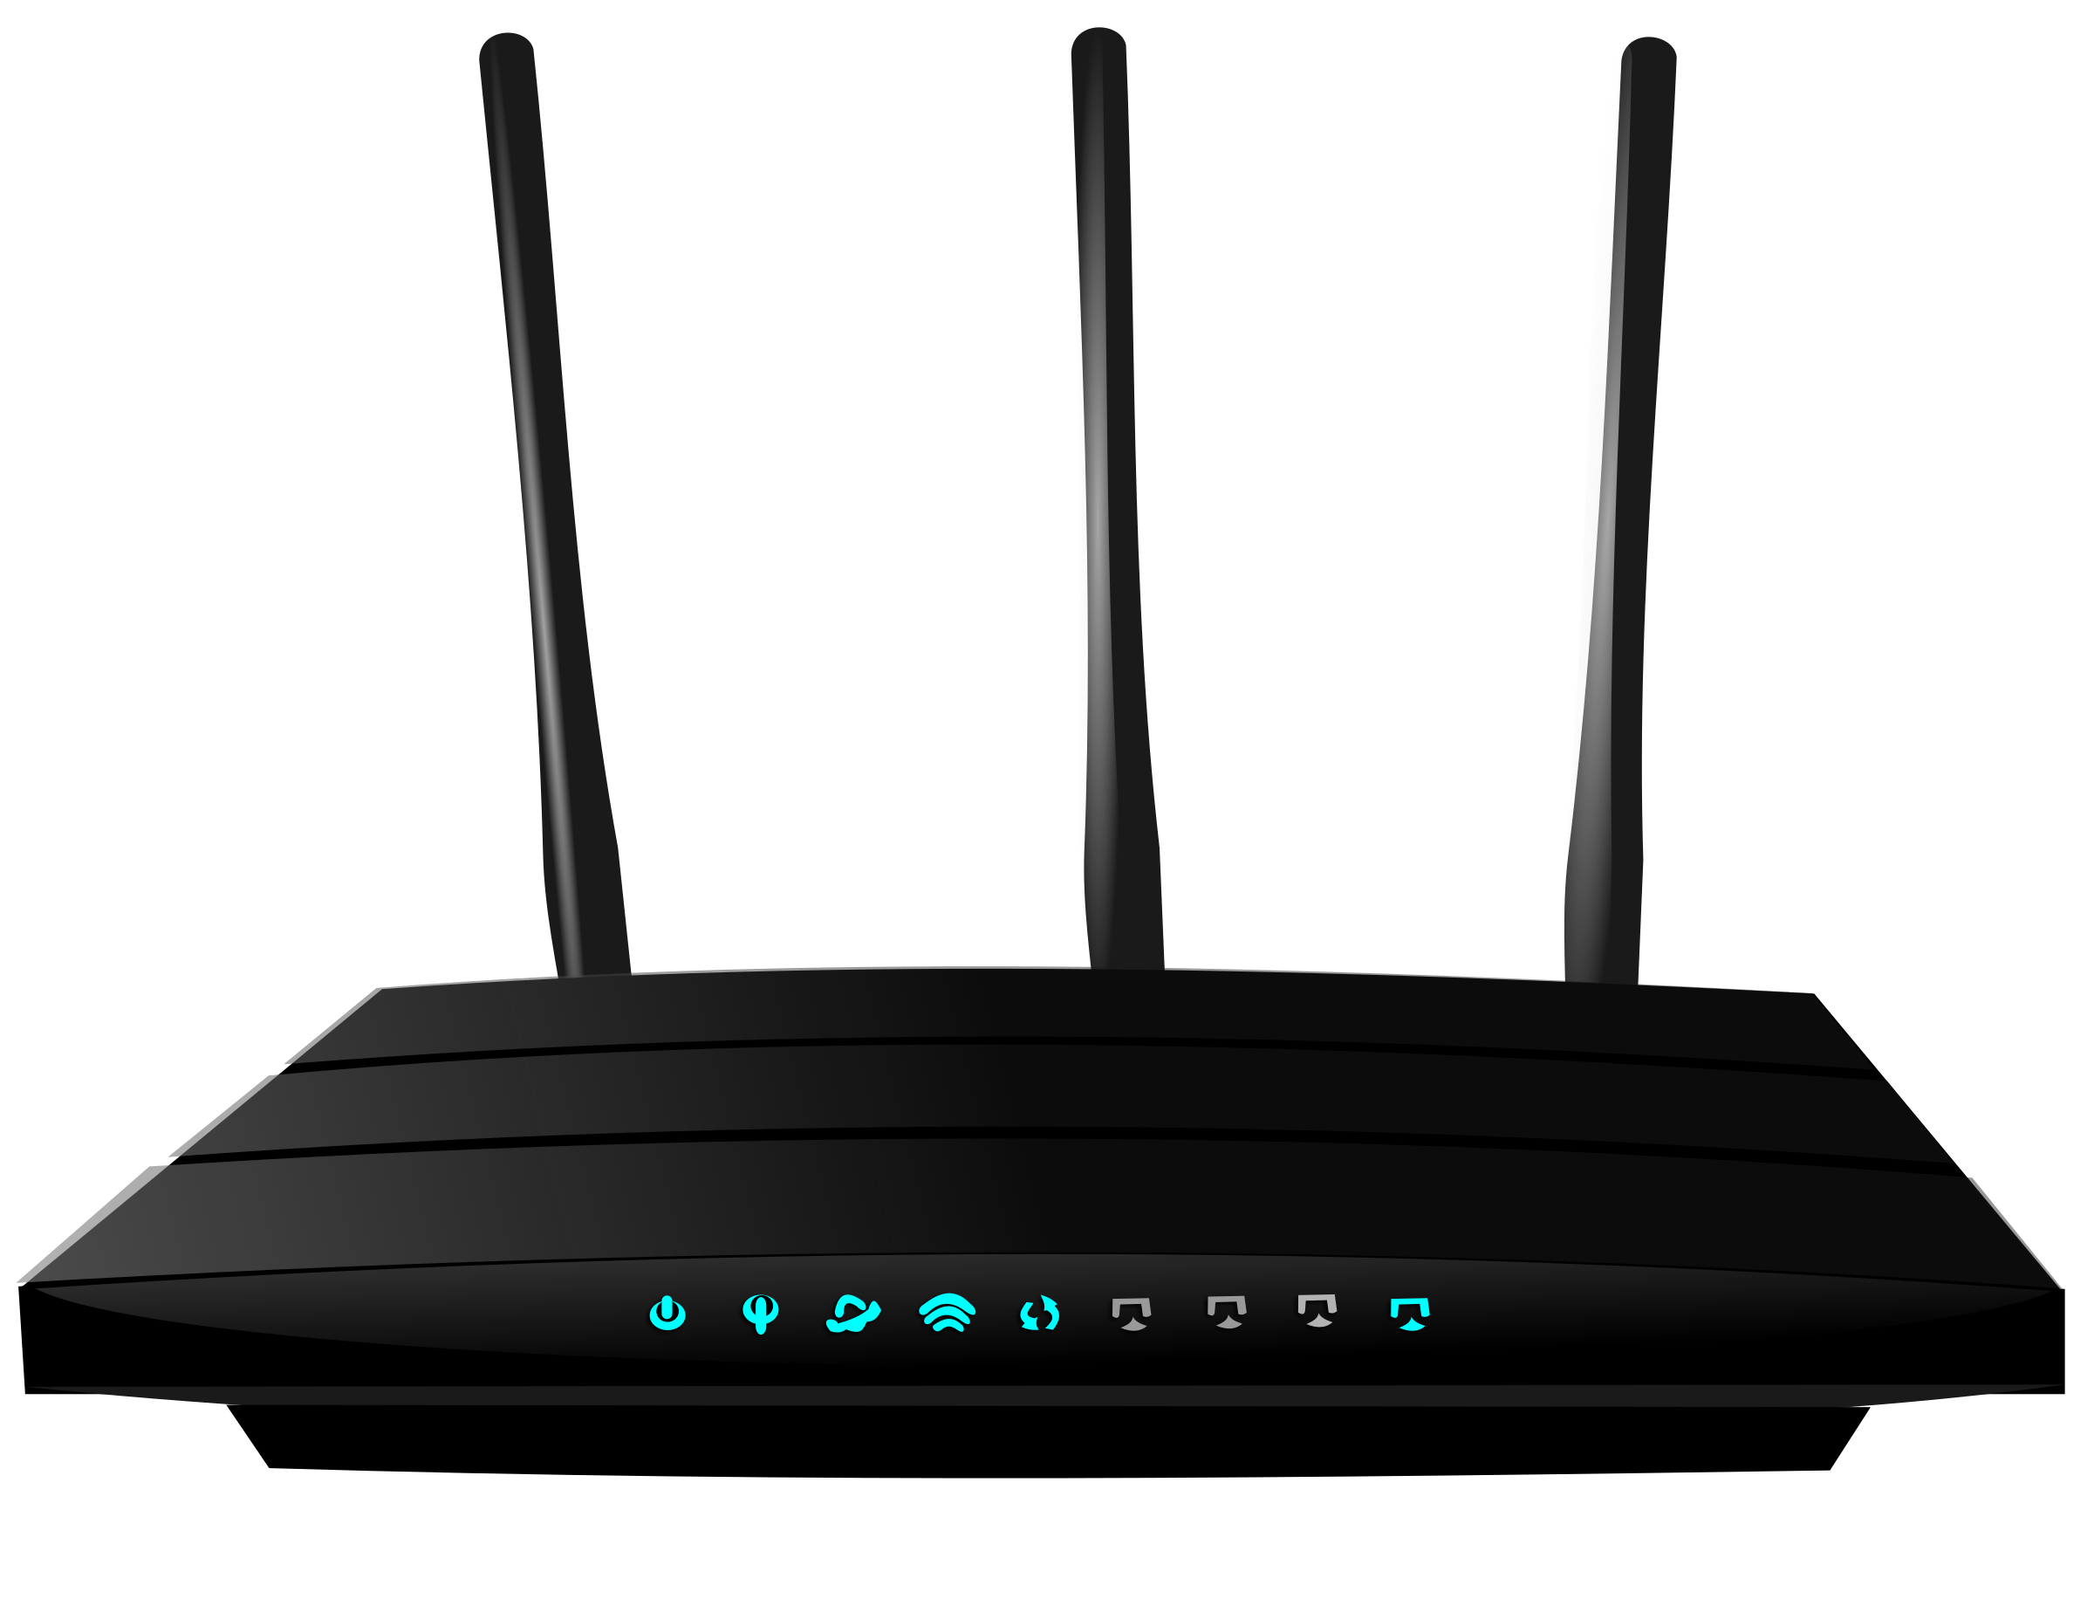
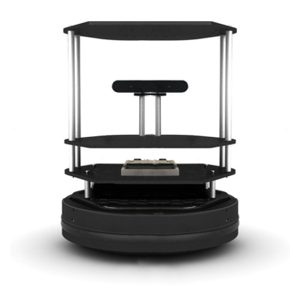



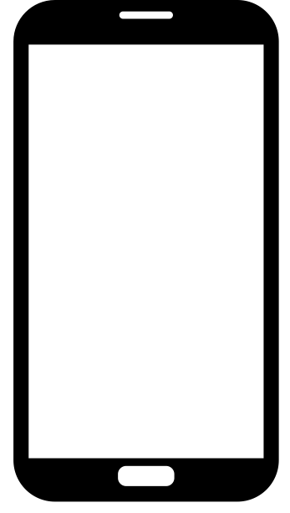
Context-Assisted Learning Based Localization
Automated data collection
  Autonomous platform for mapping the physical environment and capturing synchronized WiFi CSI
  CSI for GPS-equivalence
  Learning network for coherence
Data-driven navigation
  Mapping and localization algorithm using abundant labeled data
MapFind: Context-aware autonomous robot [5]
DLoc: Learning based map-aware localization

Slide 5
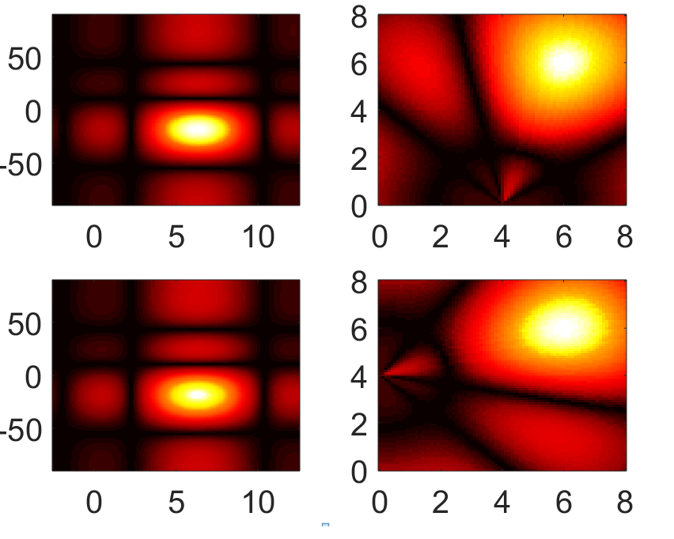
Enabling Deep Learning from AP
Convert CSI to image representation
AP-STA CSI is used to derive AoA-ToF using MUSIC/Spotfi [4]
Polar to XY for localization
Polar to Cartesian
Angle of Arrival, 𝝷°
Y axis (m)
Time of Arrival (m)
X axis (m)

Slide 6
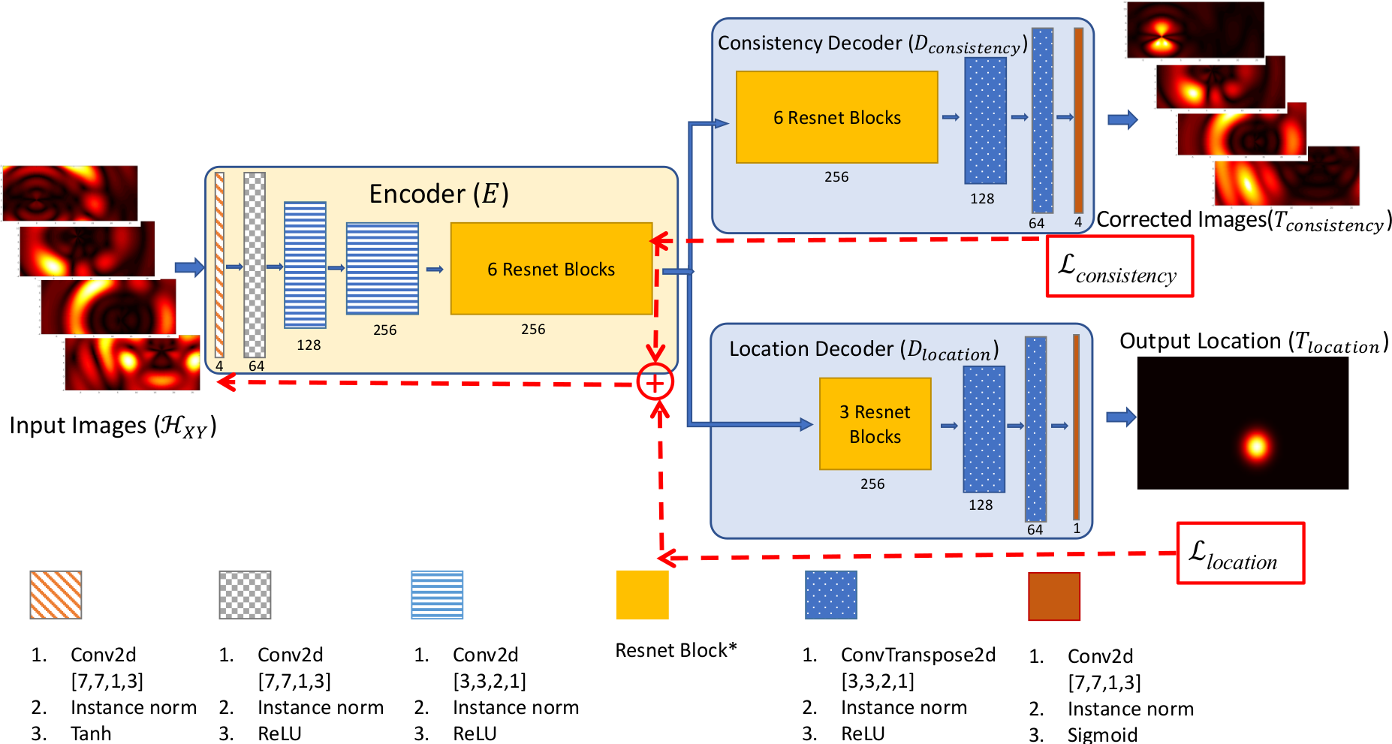
Learning Based Localization
Image-to-Image translation challenges
  Network Architecture
  Loss Functions
  Environment changes and Multi-AP CSI
Multi-AP bring challenges
  ToF offsets/errors cause radial shifts
  Multipaths give spurious peaks
  NLOS paths cause AoA and ToF errors
Learning Network Architecture

Slide 7
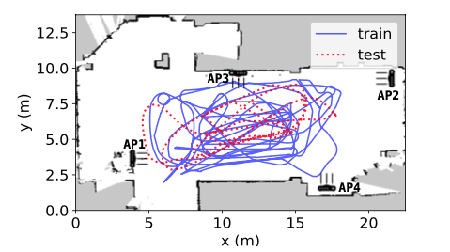
MapFind Mapping and Trajectory

Slide 8
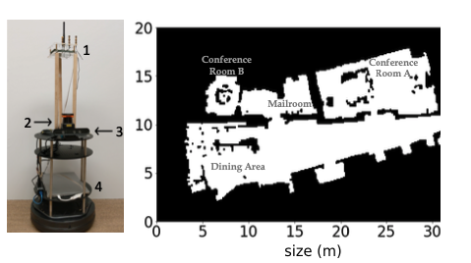
Results: MapFind Autonmous Mapping
1. CSI-enabled AP
2. Lidar
3. Camera
4. Laptop

Slide 9
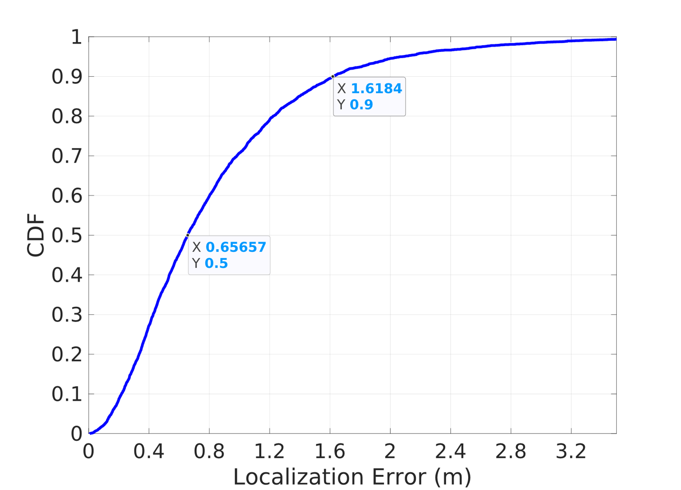
Results: Learning based Localization
Median Error: 65 cm
90th Percentile: 160 cm
Trained on 25k locations and tested on 100k locations in a 18mx8m large space with 4 APs we achieve sub-m accurate Indoor localization. While RSSI based algorithms show median errors up to few meters.

Slide 10
Results: Localization across various Bandwidths
Dloc 80MHz
Dloc 40MHz
Robustness to the change in Bandwidths while inference improves with available CSI BW

Slide 11




Results Across various environments and settings
Model tested on multiple scenarios
  Location of furniture and reflectors are modified to mimic day-to-day changes
Training data and learning network unchanged
Median Localization error still stays sub-meter level
Test Scenario | Median Localization Error(cm)
1(trained) | 65
2 (not seen) | 85
3 (not seen) | 85
4 (not seen) | 91
Scenario-1
Scenario-2
Scenario-3
Scenario-4

Slide 12
Standardization
How can standardization help? [3]
Consistent CSI availability
TX parameter optimization indication e.g. beamforming
Efficient CSI extraction and scheduled CSI
Privacy preserving CSI for client localization

Slide 13
Conclusions
Wi-Fi sensing is growing in demand with many implemented solutions indicating feasibility
  CSI-based solutions close in performance for indoor localization
Standardization can make the CSI extraction process private, efficient and improve interoperability

Slide 14
References
[1] [2] Wi-Fi sensing, IEEE 802.11-19/1164
[2] Wi-Fi sensing: cooperation and standard support, IEEE 802.11-19/1416
[3] CSI-based Wi-Fi sensing, IEEE 802.11-18/1769
[4] “Spotfi: Decimeter Level Localization using WiFi”, Manikanta Kotaru, Kiran Joshi, Dinesh Bharadia, Sachin Katti
[5] "Towards Context-assisted Indoor Navigation", Ayyalasomayajula Roshan, Aditya Arun, Chenfeng Wu, Sanatan Sharma, Deepak Vasisht, Abhishek Sethi, Dinesh Bharadia

