Slide 1
EHT P matrices Discussion
Date: 2020-01-09
Authors:
Name | Affiliations | Address | Phone | email
Dandan Liang | Huawei Technologies Co., Ltd | Huawei Base, Bantian, Shenzhen |  | Dandan.liang@huawei.com
Ming Gan
Yan Xin

Slide 2
Introduction
In 802.11ax, 1x HE-LTF，2x HE-LTF and 4x HE-LTF are defined for MIMO channel estimation [1].
16 spatial streams are one of main features in 802.11be [2].
Methods of reducing 16 spatial streams EHT-LTF overhead are discussed in [3-4]. One method is using a smaller symbol duration, such as 1x EHT-LTF and 2x EHT-LTF. This method has been applied in 11ax.
1x EHT-LTF and 2x EHT-LTF should be applied to 802.11be for backward compatibility and for the extension of MIMO channel estimation.

Slide 3
Introduction
P matrix enables MIMO channel estimation at the receiver [1].
In HT,
In VHT,
,
In HE, the P matrix value is the same as defined in VHT.

Slide 4
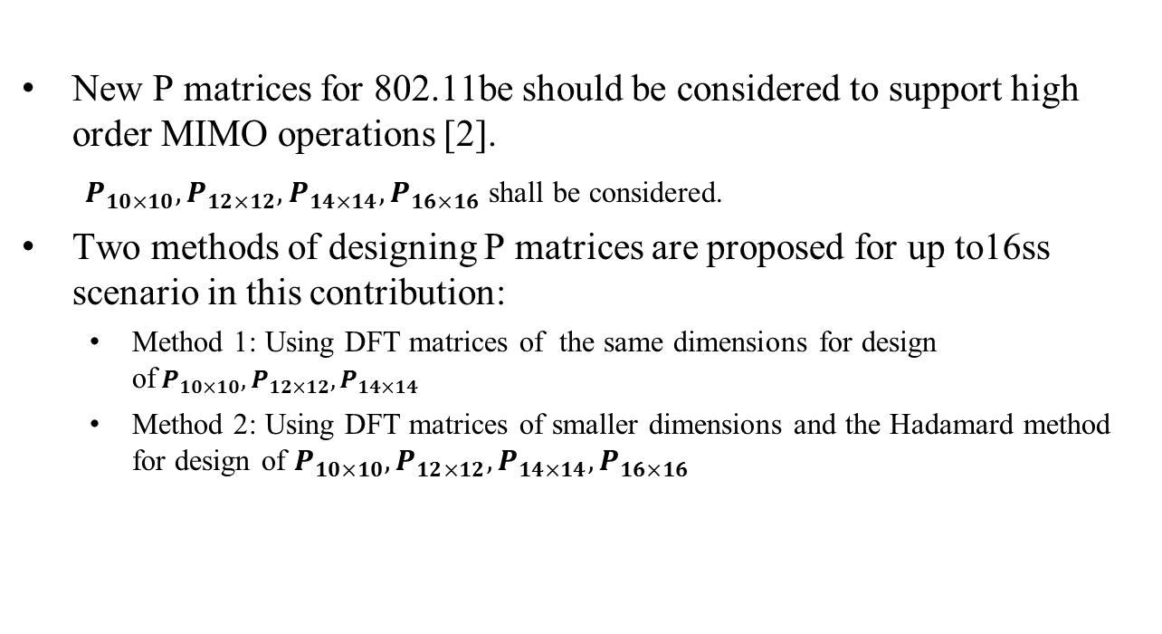
Introduction
New P matrices for 802.11be should be considered to support high order MIMO operations [2].
$P_{10×10},P_{12×12},P_{14×14},P_{16×16}$ shall be considered.
Two methods of designing P matrices are proposed for up to16ss scenario in this contribution:
  Method 1: Using DFT matrices of the same dimensions for design of${ P}_{10×10},P_{12×12},P_{14×14}$
  Method 2: Using DFT matrices of smaller dimensions and the Hadamard method for design of $P_{10×10},P_{12×12},P_{14×14},P_{16×16}$

Slide 5


P Matrices ($P_{10×10}$)
For $P_{10×10},$ $N_{STS,total}=9,10$:
Method 1: Using DFT matrices the same dimensions for design of ${ P}_{10×10}$.
Method 2: Using DFT matrices of smaller dimensions and Hadamard method for design of $P_{10×10}$.
The same methods can be used for designing $P_{14×14}$ as well.
80MHz 4x HE-LTF PAPR is 6.2851dB
80MHz 4x HE-LTF PAPR is 6.2771dB

Slide 6


P Matrices ($P_{12×12}$)
For$P_{12×12},$ $N_{STS,total}=11,12$:
Method 1: Using DFT matrices the same dimensions for design of ${ P}_{12×12}$.
80MHz 4x HE-LTF PAPR is 6.3003dB

Slide 7

P Matrices ($P_{12×12}$)
For $P_{12×12,}N_{STS,total}=11,12$:
Method 2: Using DFT matrices of smaller dimensions and Hadamard method for design of $P_{12×12}$.
  Case 1: based on $P_{3×3}$ Case 2: based on $P_{6×6}$
80MHz 4x HE-LTF PAPR is 6.2369dB
80MHz 4x HE-LTF PAPR is 6.2851dB

Slide 8


P Matrices ($P_{16×16}$)
For $P_{16×16},N_{STS,total}=15,1$6: using $P_{8×8}$ for producing $P_{16×16}$ and using $P_{4×4}$ for producing $P_{8×8}$

Slide 9
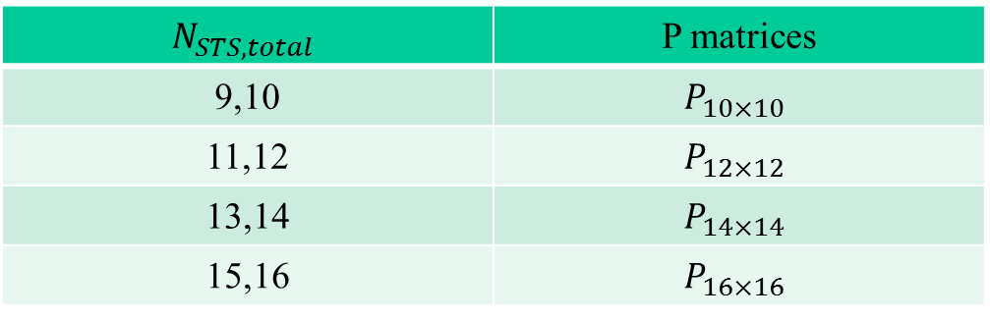

Summary
This contribution proposes two methods for designing EHT P matrices, and the new considered dimension of P matrix is 10, 12, 14 and 16, respectively.
  Method 1: Using DFT matrices for design of${ P}_{10×10},P_{12×12},P_{14×14}$
  Method 2: Using DFT matrices and Hadamard method for design of $P_{10×10},P_{12×12},P_{14×14},P_{16×16}$
$$N_{STS,total}$$ | P matrices
9,10 | $$P_{10×10}$$
11,12 | $$P_{12×12}$$
13,14 | $$P_{14×14}$$
15,16 | $$P_{16×16}$$
Dimension of P matrices required for different numbers
of space-time streams

Slide 10
Straw Poll #1
Do you support to have 1x EHT-LTF and 2x EHT-LTF in 802.11be?

Slide 11

Straw Poll #2
Do you support to have new P matrices of dimensions $10×10, 12×12, 14×14 and 16×16$ for the number of space-time streams larger than 8 in EHT?
  The definition of $P_{10×10},P_{12×12},P_{14×14},P_{16×16}$ is TBD

Slide 12
References
[1] <Part 11: Wireless LAN Medium Access Control (MAC) and Physical
Layer (PHY) Specifications>, 802.11-2016.
[2] Miguel López etc, <Remarks on P matrices for EHT> , IEEE 802.11- 19/1555r0
[3] Junghoon Suh, <Orthogonal Sequence based Reference Signal for LTF Reduction>, IEEE Document 11/19-1585r1
[4] Sammer Vermani etc, <Performance Comparison of LTF Designs for EHT>, IEEE 802.11-19/1867r0

