Slide 1
EHT P matrices Discussion
Date: 2019-xx-xx
Authors:
Name | Affiliations | Address | Phone | email
Dandan Liang | Huawei Technologies Co., Ltd | Huawei Base, Bantian, Shenzhen |  | Dandan.liang@huawei.com
Ming Gan
Yan Xin

Slide 2
Introduction
P matrix enables MIMO channel estimation at the receiver [1].
In HT,
In VHT,
,
In HE, the P matrix value is the same as defined in VHT.

Slide 3
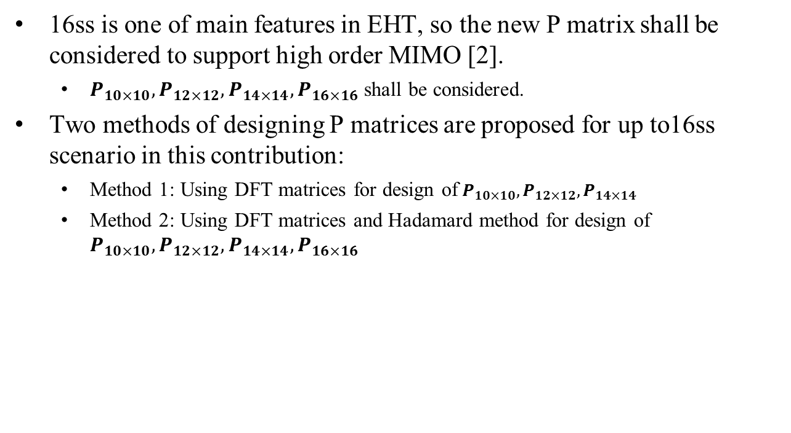
Introduction
16ss is one of main features in EHT, so the new P matrix shall be considered to support high order MIMO [2].
  $P_{10×10},P_{12×12},P_{14×14},P_{16×16}$ shall be considered.
Two methods of designing P matrices are proposed for up to16ss scenario in this contribution:
  Method 1: Using DFT matrices for design of${ P}_{10×10},P_{12×12},P_{14×14}$
  Method 2: Using DFT matrices and Hadamard method for design of $P_{10×10},P_{12×12},P_{14×14},P_{16×16}$

Slide 4


P Matrices ($P_{10×10}$)
For $P_{10×10},$ $N_{STS,total}=9,10$:
Method 1: Using DFT matrices for design of ${ P}_{10×10}$.
Method 2: Using DFT matrices and Hadamard method for design of $P_{10×10}$.
The same methods can be used for designing $P_{14×14}$ as well.
80MHz 4x HE-LTF PAPR is 6.2851dB
80MHz 4x HE-LTF PAPR is 6.2771dB

Slide 5


P Matrices ($P_{12×12}$)
For$P_{12×12},$ $N_{STS,total}=11,12$:
Method 1: Using DFT matrices for design of ${ P}_{12×12}$.
80MHz 4x HE-LTF PAPR is 6.3003dB

Slide 6

P Matrices ($P_{12×12}$)
For $P_{12×12,}N_{STS,total}=11,12$:
Method 2: Using DFT matrices and Hadamard method for design of $P_{12×12}$.
  Case 1: based on $P_{3×3}$ Case 2: based on $P_{6×6}$
80MHz 4x HE-LTF PAPR is 6.2369dB
80MHz 4x HE-LTF PAPR is 6.2851dB

Slide 7


P Matrices ($P_{16×16}$)
For $P_{16×16},N_{STS,total}=15,1$6: using $P_{8×8}$ for producing $P_{16×16}$ and using $P_{4×4}$ for producing $P_{8×8}$

Slide 8
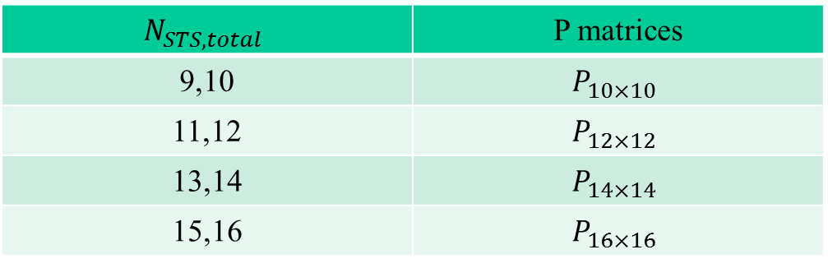

Summary
This contribution proposes two methods for designing EHT P matrices, and the new considered dimension of P matrix is 10, 12, 14 and 16, respectively.
  Method 1: Using DFT matrices for design of${ P}_{10×10},P_{12×12},P_{14×14}$
  Method 2: Using DFT matrices and Hadamard method for design of $P_{10×10},P_{12×12},P_{14×14},P_{16×16}$
$$N_{STS,total}$$ | P matrices
9,10 | $$P_{10×10}$$
11,12 | $$P_{12×12}$$
13,14 | $$P_{14×14}$$
15,16 | $$P_{16×16}$$
Dimension of P matrices required for different numbers
of space-time streams

Slide 9

Straw Poll #1
Do you support to have new P matrices of dimensions $10×10, 12×12, 14×14 and 16×16$ for the number of space-time streams larger than 8 in EHT?
  The definition of $P_{10×10},P_{12×12},P_{14×14},P_{16×16}$ is TBD

Slide 10
References
[1] <Part 11: Wireless LAN Medium Access Control (MAC) and Physical
Layer (PHY) Specifications>, 802.11-2016.
[2] Miguel López etc, <Remarks on P matrices for EHT> , IEEE 802.11- 19/1555r0

