Slide 1
Per-service origin authentication
Authors:

Slide 2
Problem Statement
In order to fulfill requirement R3.3.1, current IEEE 802.11bc TG discussions consider in [1] the use of TESLA protocol to authenticate the AP.
TESLA is a kind of one-way key chain algorithm published as IETF RFC4082. It allows to check the integrity and authenticate the source of each packet in multicast or broadcast data streams by low-cost operations.
The use of this protocol is specified in contribution [1] and consists on the recurrent authentication of the frames.

Slide 3
Problem Statement
IEEE 802.11bc may provide different services simultaneously
Imagine a downstream situation where two eBCS services are transmitted:
4K video stream
Low rate audio transcription for hearing impaired people
The device operating the audio transcription, which may be a constrained device, needs to buffer several frames of the 4K video in order to authenticate the origin
As constrained the received device, the worse the situation

Slide 4
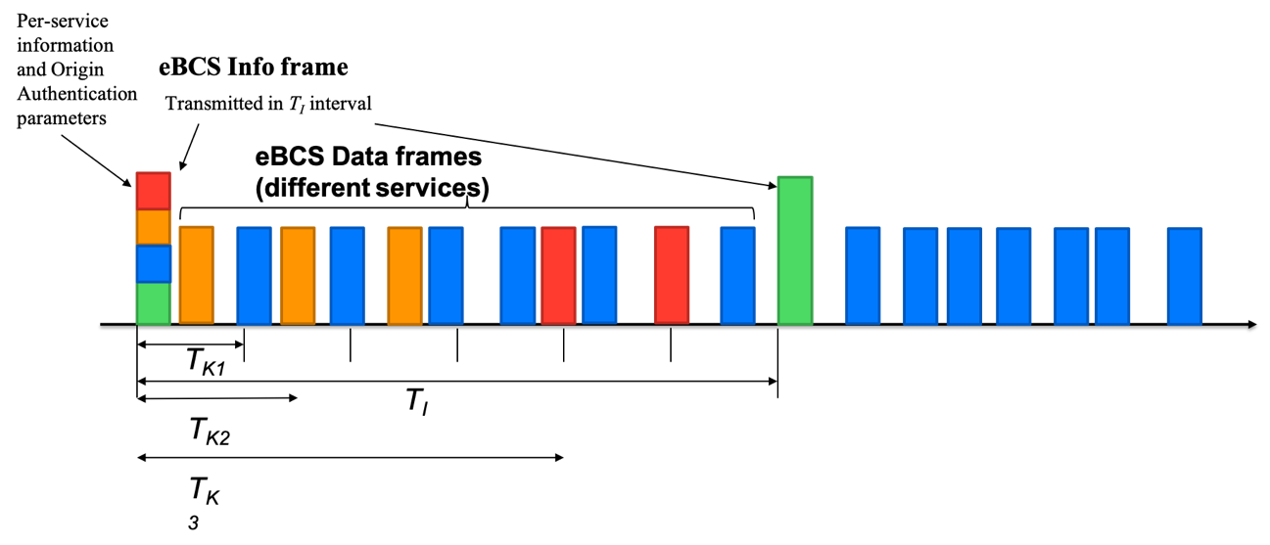
Proposal
If a solution such as the TESLA-based solution is considered by the group:
Provide a separated origin authentication key per service/group of services
This key can be added to the service description
STAs will need to identify the service they are interested in through service discovery and buffer only the frames related to their service.

Slide 5
Proposal
Possible eBCS Info frame considering the Service Description and the Origin Authentication
 | Category | eBCS Public Action | eBCS Sequence number | OA | Public Key | Signature | Timestamp | CP |  | Common eBCS Origin Authentication Parameters | eBCS Service count | eBCS service list
Octets | 1 | 1 | 2 | 1 bit | variable | variable | 8 |  | 1 bit | 0-variable | 1 | 0-variable
 | Length | eBCS ID | Content with restriction | Human readable description | URL | eBCS Service Origin Authentication | eBCS Origin Authentication parameters
bits | 16 | Variable | 1 | Variable | Variable | 1 | variable
 | Length | eBCS Sequence number | Key of current sequence | Distance | Key of the last index | Key of distance | eBCS Info frame period | eBCS rekeying period
bits | 16 | 2 | Variable | 8 | Variable | Variable | 2 | 2

Slide 6
Straw Poll
Should IEEE 802.11bc amendment include the possibility of having different origin authentication keys per service?
Yes
No
Abstain

Slide 7
References
[1] 11-19-1802-00-00bc-tesla-improvement

