Slide 1
Multi-AP Group Establishment
Date: 2020-01-02
Authors:
Name | Affiliation | Address | Email
Sun, Bo | ZTE Corporation | No.9 Wu Xing Section Xi Feng Road Xi’an, Shaanxi Province P.R. China | sun.bo1@zte.com.cn
Yang, Dan
Fang, Yonggang | ZTE(TX) |  | yfang@ztetx.com

Slide 2
Introduction
Multi-AP as one of the EHT key features has been discussed in several contributions [1][2][3].
In IEEE 802.11 September meeting, we presented a basic multi-AP transmission procedure for EHT [4], generally including:
Under multi-AP scenarios, a group of APs connected via wired or wireless backhaul links is called a multi-AP network or a multi-AP group.
In a “preparation stage” prior to multi-AP transmission, it suggested the STA may propose to its associated AP a set of recommended neighbour APs to participate following Multi-AP joint/coordinated transmissions.
A Straw Poll of proposing STA to recommend candidate APs participating in multi-AP transmission was run. (Result: Yes: 14 / No: 1 / Abstain: 48).
In this contribution, we further discuss the establishment of a multi-AP group for a multi-AP transmission during the “preparation stage”.

Slide 3
Multi-AP group conception (1/2)
The conception of static multi-AP group and dynamic multi-AP group:
Static multi-AP group
A static multi-AP group is a set of APs that any two or more APs of the group can potentially perform multi-AP transmissions, e.g. DL joint-transmissions, coordinated OFDMA transmissions, etc.
The APs in the static multi-AP group are connected via wired or wireless backhaul link with or withour a central AP.The conception of static multi-AP group may apply to typical managed network scenarios, such as enterprise network, home network and commercial network.
Each member of the static multi-AP group should announce the static multi-AP group information in its own BSS.
Dynamic multi-AP group
A dynamic multi-AP group is a set of APs that will participate in the following multi-AP transmissions.
APs in the dynamic multi-AP group should be a subset of the static multi-AP.
An AP in the static multi-AP group may belong to different dynamic multi-AP groups.

Slide 4
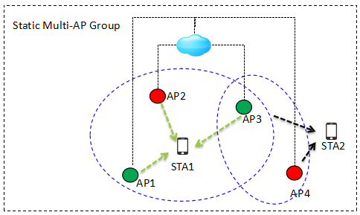
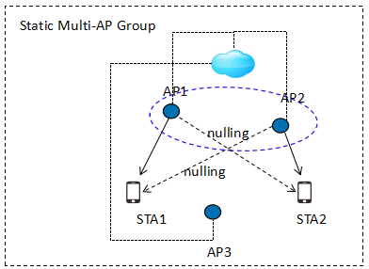
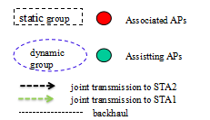
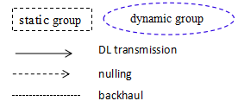
Multi-AP group conception (2/2)
Two examples about static and dynamic multi-AP group in joint/coordinated transmissions are illustrated as Fig. 1 and Fig. 2 .
Fig. 1
Fig. 2

Slide 5
Dynamic Multi-AP Group Discussion
A dynamic multi-AP group could maintain for several multi-AP transmssions.
However, the distribution strategy of buffered data or members' availability, etc., may change dynamically prior to the multi-AP transmission, especially for a mobile STA. Thus the participants of the dyanmic multi-AP group for a STA may be reselected before multi-AP transmission by the associated AP.
An example of dynamic multi-AP group is illustrated in Fig. 3.
AP2
(AP1, AP2) perform a dynamic multi-AP group for DL joint-transmission to STA1.
STA1 moves to a new position and recommends (AP2, AP3) for the next DL joint-transmission.
(AP2,AP3) then form a new dynamic multi-AP group to perform the following DL joint-transmission to STA1.
AP3
dynamic group 1
AP1
dynamic group 2
joint transmission 1
joint transmission 2
STA1
STA1
mobility
Fig. 3

Slide 6
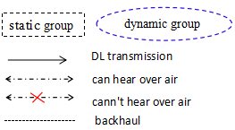
Dynamic Multi-AP Group Establisment
A STA recommends the candidate APs for its dynamic multi-AP group.
In many cases, members of static or dynamic multi-AP group may not be able to hear each other over the air, as illustrated in Fig. 4. Thus the associated AP can hardly decide the best candidates in the dynamic mutli-AP group for a STA,especially in a dynamic radio environment, without prompt measurement reports from the STA.
The STA has the up-to-date knowledge of radio environments for a DL transmission, e.g. APs' singal strength, and knows better which APs' transmission will interfere with its reception, etc..
The associated AP may use the recommendation from the STA to establish a dynamic multi-AP group for the multi-AP transmission.
STAs may need a confirmation from the associated AP about the member of the dynamic multi-AP group.
Static Multi-AP Group
AP2
(AP1,AP2,AP3) are in a static multi-AP group.
(AP1, AP2) can not hear each other, (AP2, AP3) can not hear each other either.
(AP1,AP2, AP3) form a dynamic multi-AP group and perform a joint transmission to STA1.
AP1
STA1
AP3
Fig. 4

Slide 7
Summary
Multi-AP group related conceptions are proposed: static multi-AP group and dynamic multi-AP group.
The establishment of a dynamic multi-AP group is discussed.
Further study may include：
Multi-AP group establishment optimization
Multi-AP transmission procedure optimization

Slide 8
Straw Poll 1
Do you support that the AP should deliver the information of the static multi-AP group within the BSS ?
A static multi-AP group is a set of APs connected with backhaul in which any two or more members can potentially perform multi-AP transmissions.

Slide 9
Straw Poll 2
Do you support that a STA may recommend candidate APs for a dynamic multi-AP group ?
The associated AP may use the recommendation from the STA to establish and trigger a dynamic multi-AP group formation for multi-AP transmissions.

Slide 10
Straw Poll 3
Do you support that an AP should deliver the information of dynamic multi-AP group to its associating STA(s)?
A dynamic multi-AP group is a set of APs that will participate in the future multi-AP transmissions.

Slide 11
References
[1] 11-18-1509-00-0eht-features-for-multi-ap-coordination
[2] 11-18-1926-00-0eht-terminology-for-ap-coordination
[3] 11-18-1982-01-0eht-consideration-on-multi-ap-coordination-for-eht
[4] 11-19-1129-02-00be-consideration-on-multi-ap-coordination

