Slide 1
Reducing Channel Access Delay for RTA Traffic
Date: 2019-11-12
Authors:
Name | Company | Address | Phone | Email
Mohamed Abouelseoud | Sony Corp |  |  | Mohamed.Abouelseoud@gmail.com
Kazuyuki Sakoda |  |  |  | Kazuyuki.Sakoda@sony.com
Liangxiao Xin |  |  |  | Liangxiao.Xin@sony.com
Akira Kishida | NTT |  |  | akira.kishida.fs@hco.ntt.co.jp
Kengo Nagata
Suhwook Kim | LG Electronics |  |  | suhwook.kim@lge.com

Slide 2
Background
802.11be is targeting technologies to limit worst case latency and jitter [1]
Current EDCA cannot solve the problem of worst case latency
  EDCA is designed to provide good average latency (AC queues access probability and STA access probability may lead to worst case latency)
MU UL and DL transmission enable serving more users at the same time which can help with latency, channel access delay is still a problem
Using Multi-link/Multi-channel to improve latency is proposed in [2],[3],[4]
There is an overhead in scheduling small amount of data especially in periodic and persistent traffic
  Enhancement to trigger-based access and use of RU allocation configuration is proposed in [5]
  Persistent RU allocation is proposed in [6]

Slide 3
RTA traffic analysis
RTA traffic can be:[7]
  Large in size and frequent ( interactive video (VR, AR), Medical application, Real time video,…)
  Large in size and less frequent ( Emergency service,..)
  Small in size and frequent ( mobile gaming, robotics and industrial automation, cloud gaming, drone control,…)
  Small in size and less frequent (controllers, IoT,….)
Small in size RTA traffic should be specially treated without affecting ongoing traffic
Frequent and periodic traffic can be expected and prepared for
Large in size RTA traffic that is less frequent can be handled but will affect ongoing traffic
Large in size RTA traffic that is frequent might be harder to satisfy in lower band due to bandwidth limitation (mmW might be a candidate)

Slide 4
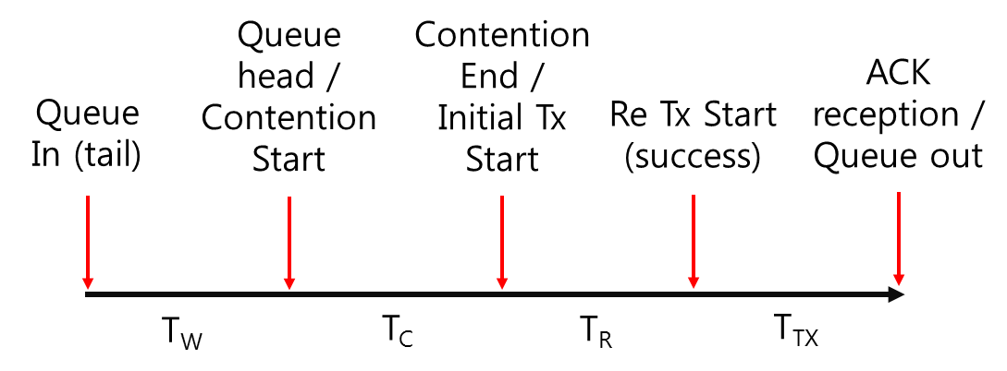
Packet delay components
In [8], for EDCA packet latency has been broken into various components:
  Queuing delay (T_{w}): Time waiting in the transmitter’s queue
  Contention delay (T_{c}): Time to gain initial channel access
  Retransmission time (T_{R}): Time to recover from a transmission failure
  Transmission time (T_{TX}): Time to transmit the packet till an ack is received
In order to limit worst case delay and jitter we should consider limiting all components of the packet delay

Slide 5
How to handle small frequent RTA traffic?
Assuming traffic is periodic for frequent/persistent traffic allows us to limit maximum latency constraint
  Allocating small periodic resources to RTA traffic
  Use persistent/configuration based RU allocation to allocate resources
When traffic is persistent, frequent or periodic, AP/STA can know and estimate when the RTA packet will be ready to be transmitted (UL or DL)
Persistent channel allocation can help by allocating resource for transmission but channel access delay still contributes to the RTA packet delay

Slide 6
RTA small in size and frequent traffic
Proposal: Small and periodic RTA traffic can be expected and STAs can prepare for channel access before its arrival

Slide 7
Proposal: How to reduce or avoid channel access delay for RTA traffic ?
Assuming Queuing delay and retransmission delay are zero
Once the RTA packet is queued, knowing the RTA packet generation periodicity or the RU allocation periodicity, the STA can estimate when the next packet will arrive or will be sent
When the STA is aware of the expected arrival time of the RTA packet, it can have the option to contend for channel access before the packet arrival in case the channel is busy
When the STA gains access of the channel:
  If RTA packet is queued, STA transmits the RTA packet
  If RTA packet is not yet queued and the time to the expected arrival time of the packet is small, the STA can reserve the channel ( example: sending null packet till the expected RTA packet arrival)
  If RTA packet is not yet queued and the time to the expected arrival time of the packet is large, the STA does not reserve the channel

Slide 8
Proposal: examples of pre-packet arrival channel contention
Before the arrival of the RTA packet or the allocated time for RTA transmission by “Early CW period”, The STA monitors the channel
If the channel is busy during this time, STA contends for channel access
If the channel is not busy, the STA keeps monitoring the status of the channel. If the channel gets busy before the packet arrival, the STA contends for channel access
The STA might gain access to the channel even before the RTA packet arrival by “early channel access period” and reserves the channel (sends null packets) till the expected RTA packet arrival.

Slide 9
Summary
Minimizing channel access delay is important to limit the worst case latency and jitter over WLAN
For small and periodic RTA traffic, the STA knowing the expected time of RTA packets arrival can contend for channel access before the arrival of the packet

Slide 10
Reference
802.11-18/1231r6 “EHC draft proposed PAR,” Laurent Cariou
802.11-19/1615r0, “Multi-band/Multi-channel Operation for Low Latency and Jitter,” Liuming Lu, et.al.
802.11-19/1081r1, “Multi-Link Aggregation: Latency Gains,” Abhishek Patil, et.al.
802.11-19/1223r0, “Improving WLAN reliability,” Antonio del la Oliva, et.al.
802.11-19/1118r1, “Enhancements for Time-Critical Data Transmission” Thomas Handte, et.al.
802.11-19/1538r1 “Use of Uplink Persistent Allocation for RTA,” Xin Zuo, et.al.
802.11-19/1175r0 “Considerations of New Queue Mechanism for Real-Time Application” Xin Zuo, et.al.
802.11-19/0762r1 “Latency analysis for EHT” Suhwook Kim, et. al.

