Slide 1
Detection and Timing of Adaptive Repetition
Date: 2019-11-11
Authors:

Slide 2
Abstract
Adaptive repetition feature (document 11-19-1055) was presented in July.
Both simulation results and measured results from implementation on commercial HW have been demonstrated. The live-running adaptive-repetition demo was shown during ITS WC 2019 in Singapore.
The adaptive repetition feature passed motion.
The goal of this present submission is to address some technical details left open by the motion.

Slide 3
Adaptive Repetition Summary (1)
Adaptive message repetition is a simple, efficient, and reliable technique.
It was initially described in submissions NGV 11-18-1577 and 11-18/1186 , and further elaborated in 11-19-1055.
  It is fully backword compatible
  It provides performance gain for 802.11p stations as well ad NVG stations.

Slide 4
Adaptive Repetition Summary (2)
  Legacy IEEE 802.11p stations see each retransmission as a standalone message
    Performance validated on real HW (1 to 2 dB) due to temporal diversity
    Duplicated messages naturally filtered by application (already performed by higher protocol layers)
    No software update needed
  Initial PPDU and retransmissions can be combined by NGV stations, either when sent in legacy IEEE 802.11p or new format NGV mode
    +4 dB performance boost for 1 retransmission
    +7 dB performance boost for 3 retransmissions

Slide 5
Adaptive Repetition Summary (3)
The recommended approach sends the repetitions as a burst, separated by a small time gap, typically set as SIFS (32 µsec)

Slide 6
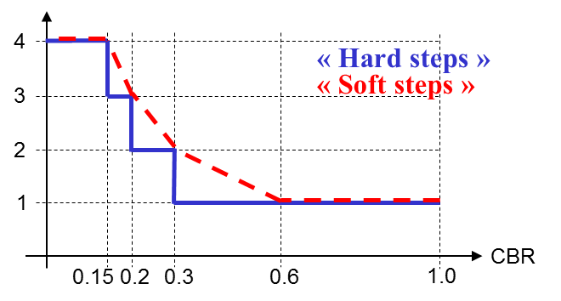
Adaptive Repetition Summary (4)
Adaptive Retransmission Control: exemplary control schemes (done at upper layers, e.g. 1609)
The number of retransmissions can be gradually increased as the occupancy of the channel goes down. In congested environment (high CBR), retransmissions are disabled. Exemplary schemes for controlling the number of repetitions:
« Hard steps »
Recommended method, but open for discussion
Measured CBR | Number of Rep. | Traffic increase for this transmitter
≥ 0.3 | 0 | No increase in traffic
[0.2 – 0.3[ | 1 | x2
[0.15 – 0.2[ | 2 | x3
< 0.15 | 3 | x4
Average number of transmissions

Slide 7
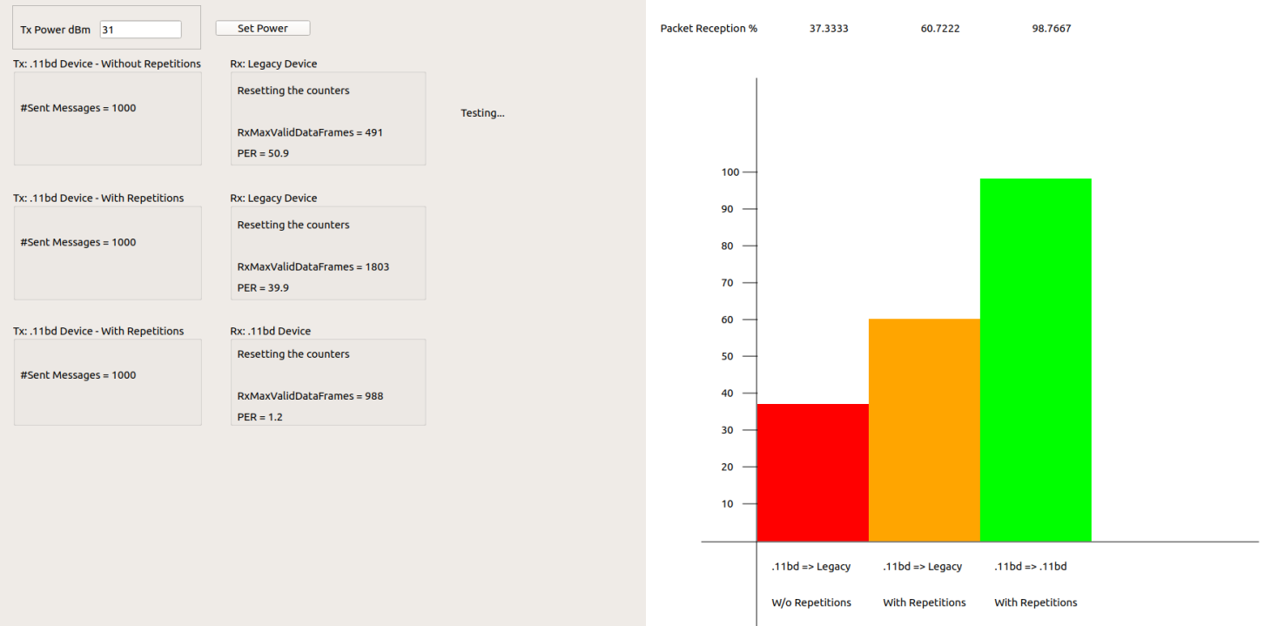
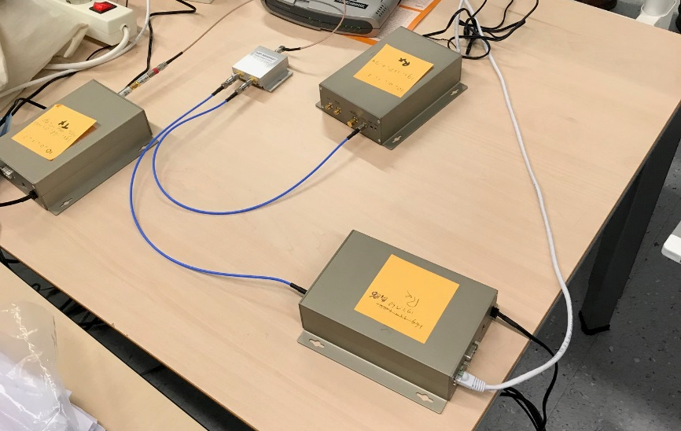
Performance Demonstrated on Real Commercial IEEE802.11p/bd HW: setup
Cable
Rx
EVK
11p
PRR
Tx
11bd
Repeat
attenuator
Legacy 11p receiver (no modifications)
No repetition: 11p performance
Repetition: slight performance increase (~0.5 dB)
11p
Legacy
Repeat
EVK
11p/bd
11p
Legacy
11p/bd Transmitter
No repetition: 11p mode
Repetitions: 11bd mode
11bd
Rx
Rx
11bd Tx
EVK
11bd
11p Rx
Legacy

Slide 8


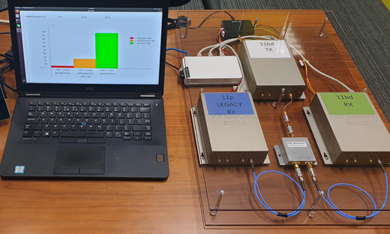
Live running demo at ITS WC Singapore, October 2019

Slide 9
Motion #19 (11-19/0514)
Move to include the following text to section 3 in 11bd SFD
“ 11bd shall support adaptive repetition of 11p PPDU when operating on OCB broadcast mode in 10MHz bandwidth.
The signaling of the adaptive repetition is TBD.
The time between repeated 11p PPDUs is TBD.”
Mover: James Lepp
Second: Dongguk Lim
Result: 16Y/0N/11A

Slide 10
Follow-up on: “The time between repeated 11p PPDUs is TBD” (1)
There are several alternatives for the time gap between repeated PPDUs:
The recommended approach by NXP is to send the repetitions as a burst, separated by a small time gap, typically set as SIFS (32 µsec)
  SIFS is the minimum gap that maintains interoperability with 802.11p stations, although measurements on commercial IEEE 802.11p device indicate smaller values possible
  Time gap should be lower than the min AIFS (58 µsec), to avoid other messages sent in between
  Each PPDU burst looks like a single transmission to CCA at other stations within range
Experiments on commercial HW show that 32 µsec is a safe sweet spot.

Slide 11
Follow-up on: “The time between repeated 11p PPDUs is TBD” (3)
PHY:
Not ready for
the next packet
MAC:
Arbitration Collisions
in between repetitions

Slide 12
Follow-up on: “The signaling of the adaptive repetition is TBD” (1)
There are several alternatives for the signaling / recognition of adaptive repetitions.
The recommended approach by NXP is to:
  Not use any signaling (100% compatible with legacy stations, zero performance loss)
  Keep the repetitions identical to the initial message.
  Implicit signaling & repetition detection at the NGV receiver is robust enough

Slide 13
Follow-up on: “The signaling of the adaptive repetition is TBD” (2)
Robust repetition detection at the NGV receiver can be performed, for example but not limited to, by means of:
Time gap measurement (time between successive received packets)
Signal Field symbol Resemblance (not enough by itself, but brings information)
Resemblance metric between successive received packets (example: EVM metric at equalized constellation level)
Combinations of the above

Slide 14
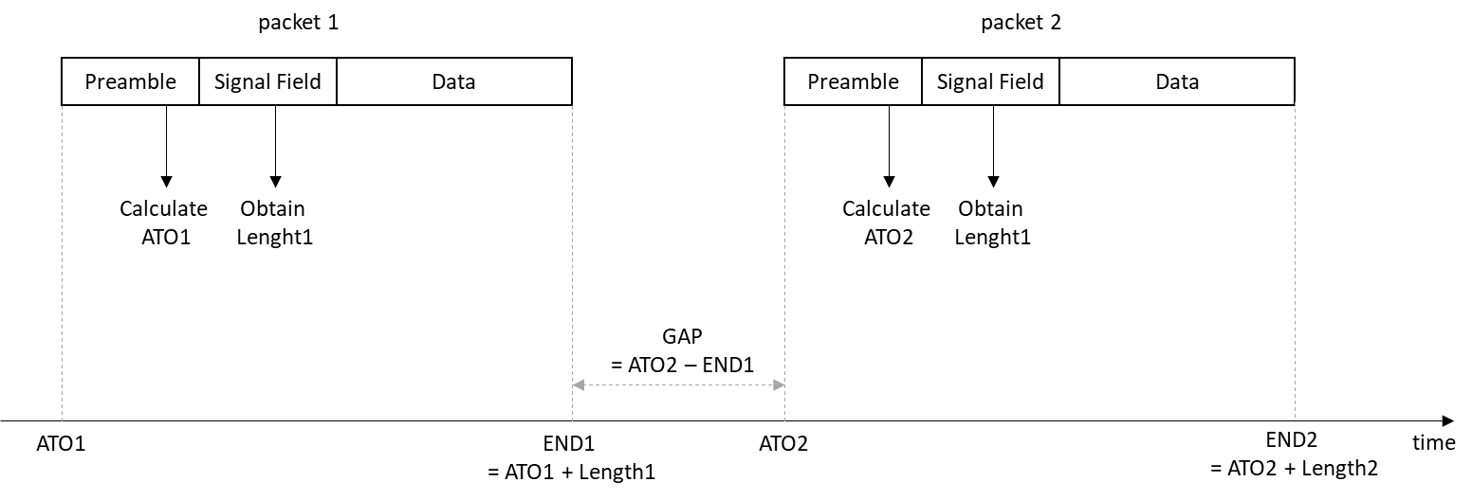
Follow-up on: “The signaling of the adaptive repetition is TBD” (3)
Exemplary scheme for repetition detection based on implicit timing gap measurement:
When a new packet is acquired, measure the time gap from end of previous packet: GAP.
If T0 is within interval [32-delta:32+delta], consider it as a repetition from previous packet.
Recommendation for delta is a very small value like 1µsec.

Slide 15
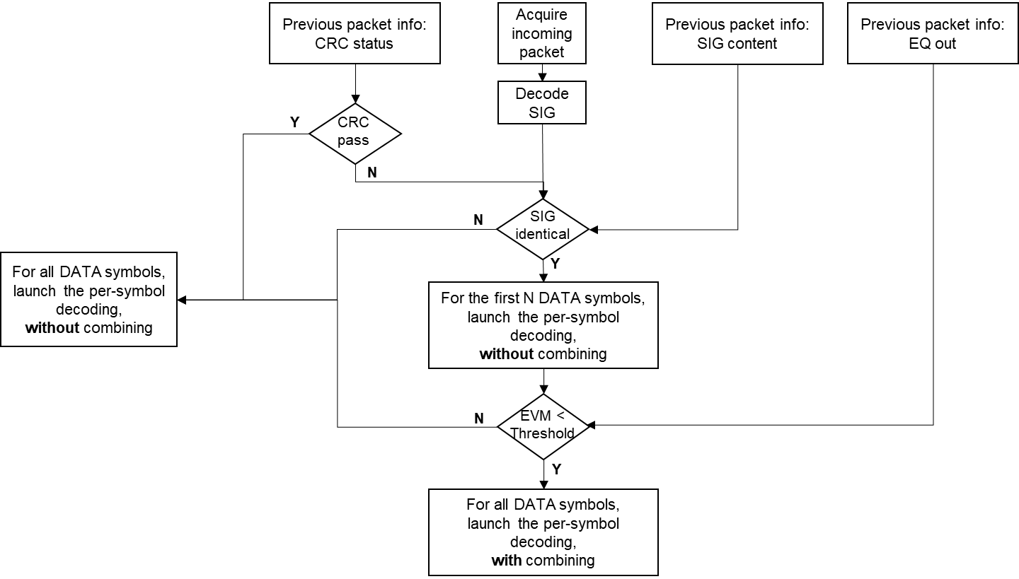
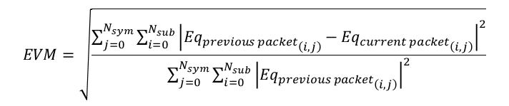
Follow-up on: “The signaling of the adaptive repetition is TBD” (4)
Exemplary scheme for detection based on implicit resemblance metric:
$$EVM=\sqrt{\frac{\sum_{j=0}^{N_{sym}}{\sum_{i=0}^{N_{sub}}{{\left|{{Eq}_{previous packet}}_{\left(i,j\right)}−{{Eq}_{current packet}}_{\left(i,j\right)}\right|}^{2}}}}{\sum_{j=0}^{N_{sym}}{\sum_{i=0}^{N_{sub}}{{\left|{{Eq}_{previous packet}}_{\left(i,j\right)}\right|}^{2}}}}}$$

Slide 16
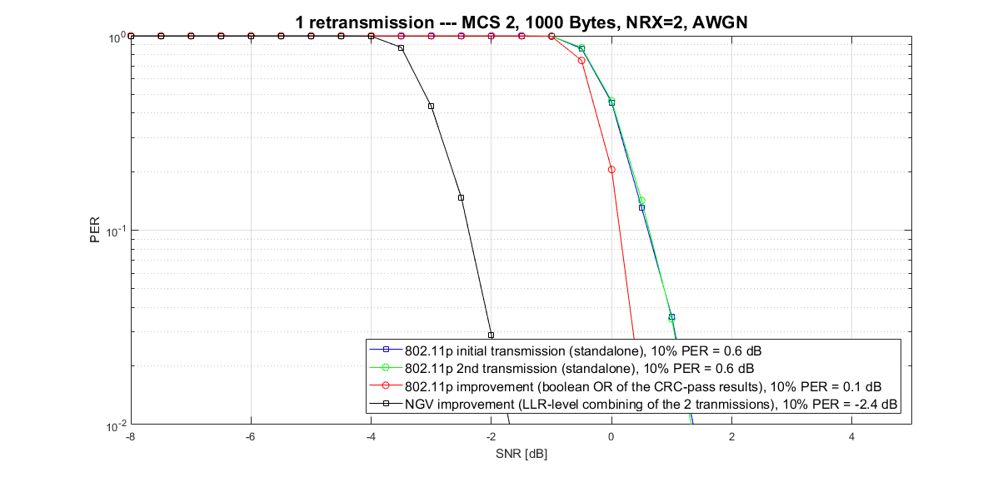
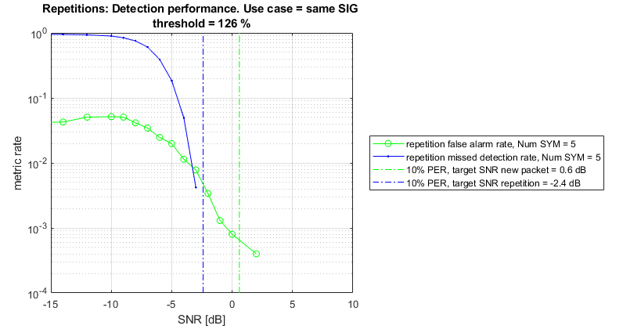
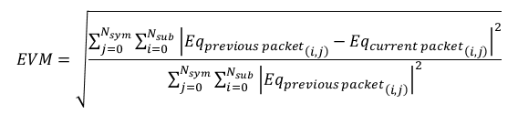
Follow-up on: “The signaling of the adaptive repetition is TBD” (5)
Repetition detection simulations based on implicit resemblance metric:
First, PER simulations are run
Secondly, missed detection & false alarm simulations are run
Repetitions: detection performance, using 5 OFDM symbols
$$EVM=\sqrt{\frac{\sum_{j=0}^{N_{sym}}{\sum_{i=0}^{N_{sub}}{{\left|{{Eq}_{previous packet}}_{\left(i,j\right)}−{{Eq}_{current packet}}_{\left(i,j\right)}\right|}^{2}}}}{\sum_{j=0}^{N_{sym}}{\sum_{i=0}^{N_{sub}}{{\left|{{Eq}_{previous packet}}_{\left(i,j\right)}\right|}^{2}}}}}$$
► Identify SNR levels for 10% PER: 0.6 and 2.4 dB
► Very few OFDM DATA symbols (e.g. 5) are required to get a good enough resemblance indicator (≤1% false alarm & missed detection) at target SNR levels
► Minor memory, processing and latency impact at NGV receiver side

Slide 17
Conclusions
We address two open points on a previously accepted motion
The signaling of the adaptive repetition is TBD
  We recommend not to signal the adaptive repetition to maintain the backward compatibility with 11p and because it’s implicitly signaled
The time between repeated 11p PPDUs is TBD
  We recommend to set this gap as SIFS (32 µsec)

Slide 18
Straw poll #1
Do you agree to make the following changes in SFD
“11bd shall support adaptive repetition of 11p PPDU when operating on OCB broadcast mode in 10MHz bandwidth.
The inter-frame space between repeated 11p PPDUs is SIFS.
There shall be no explicit signaling of the adaptive repetition indication in MAC and PHY”

Slide 19
Straw poll #2
Do you agree that the time between repeated 11p PPDUs is equal to the SIFS time (32 us)?
Y
N
A

Slide 20
Straw poll #3
Do you agree that the 11p PPDU used for adaptive repetition transmission is the same as the “half-clocked” PPDU format defined in Section 17 of 802.11mc?
Y
N
A

Slide 21
Straw poll #4
Do you agree that no explicit signaling shall be defined for 11p PPDU adaptive repetition transmission?
Y
N
A

