Slide 1
Timing Measurement for Low Latency Features
Date: 2019-11-12
Authors:
Name | Company | Address | Phone | Email
Akira Kishida | NTT |  |  | akira.kishida.fs@hco.ntt.co.jp
Yasuhiko Inoue
Yusuke Asai
Yasushi Takatori
Kengo Nagata
Suhwook Kim | LG Electronics |  |  | suhwook.kim@lge.com
Kazuyuki Sakoda | Sony |  |  | Kazuyuki.Sakoda@sony.com
Mohamed Abouelseoud |  |  |  | Mohamed.Abouelseoud@gmail.com
Liangxiao Xin |  |  |  | Liangxiao.Xin@sony.com

Slide 2
Abstract
According to EHT PAR [1], the scope of TGbe includes at least one mode of operation capable of improved worst case latency and jitter.
  To achieve the above scope of PAR, latency and jitter should be measured Quantitatively.
As well as IEEE 802.11a/b/g/n/ac/ax, IEEE 802.11be will use unlicensed spectra, low-latency and jitter functions depend on the surrounding environments.
  Therefore, measurement of quality of low-latency and jitter is quite important.
  Direct measurement is one of the most precise methods to evaluate the quality.
This presentation discusses necessity of measurement for IEEE 802.11be low-latency functions.
  IEEE 802.11v (already merged to IEEE 802.11-2016) defines timing measurement and fine timing measurement as parts of WNM (Wireless Network Management).
    However, WNM offers measurement functions only for medium access delay of successful transmission.
  In addition to medium access delay, contention time and retransmission time should be also measured for real-time applications (RTAs).
  Statistical measurement for worst case latency or jitter should be needed, which requires a number of measurement results.

Slide 3
Need for Features of Measurement
RTA Report [2] indicates various use cases of real-time applications and their requirements.
  It should be clarified how much delay occurs in a BSS(s) to meet the requirement of corresponding RTA.
From the perspective of network operator, low-latency features in IEEE 802.11be should be controlled based on the results of timing measurement.
  Timing measurement can offer recognition or prediction of “Worst Case” for RTA.
  For example, low-latency queue proposed in [3] can be utilized based on the results of timing measurement.

Slide 4
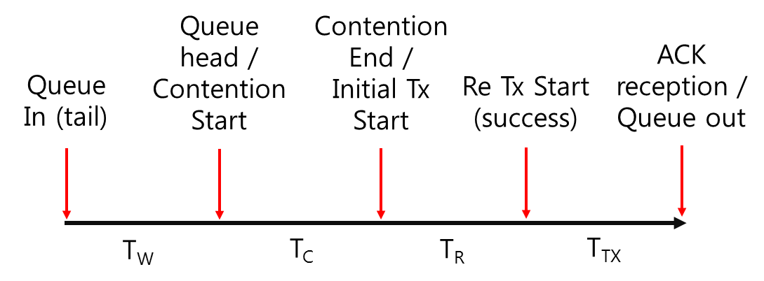
Time Categorization for Latency Analysis
“Wi-Fi Time Sensitive Networking (17/1734r1)”[4] comprises packet delay as follows.
  Packet Delay = Queueing Delay + Packet Transmission Time
“Latency analysis for EHT (19/0762r1)”[5] divides packet delay as follows.
T_{W}: Contention waiting time
  Time to transmit previously arrived packets
T_{C}: Contention time
T_{R}: Additional time for retransmission
  Time spent for failed transmission
T_{TX}: Transmission time for successful data frame and ACK

Slide 5
Time Categorization for Latency Analysis (cont’d)
This figure shows an example of divided time categories based on “Latency analysis for EHT (19/0762r1)”[5]
Sending STA
Recieving STA
T_{W}: Contention waiting time
Previous transmission
Queue in
Contention start
Backoff Time
T_{C}: Contention time
Busy for another transmission
Initial transmission
Backoff (carry over)
×
Transmission
failed
T_{R}: Additional time for retransmission
Backoff Time
Busy for another transmission
Contention for retransmission
Backoff (carry over)
T_{W}: Contention waiting time
T_{C}: Contention time
T_{R}: Additional time for retransmission
T_{TX}: Transmission time for successful
data frame and ACK
T_{TX}: Transmission time for successful data frame
and ACK
Successful data
transmission and ACK

Slide 6
Existing Features of Timing Measurement: WNM
WNM (Wireless Network Management) defined in IEEE 802.11-2016 establishes Timing Measurement / Fine Timing Measurement procedures.
  However, timing Measurement in WNM can measure only medium access delay of successful transmission (portion of T_{TX}).
T_{W}: Contention waiting time
T_{C}: Contention time
T_{R}: Additional time for retransmission
T_{TX}: Transmission time for successful
data frame and ACK

Slide 7
Timing Measurement procedure in WNM
Timing Measurement is initiated by transmitting Timing Measurement Request frame.
Timing Measurement frame and corresponding Ack frame are used to measure time difference between STAs.
  Timing Measurement frame is an Action frame.
Measurement period

Slide 8
Scope of Timing Measurement in WNM
Timing Measurement in WNM can measure only medium access delay of successful transmission (portion of T_{TX}).
However, real time applications are greatly affected by contention time (T_{C}) and retransmission time (T_{R}).
  Contention time increases according to transmissions by other STAs.
  Retransmission affects immediately n increase of latency.
Additional function(s) to measure T_{C} and T_{R} should be needed in IEEE 802.11be.
Sending STA
Recieving STA
T_{W}
Previous transmission
Backoff Time
T_{C}
Busy for another transmission
Need to measure
for RTA in
IEEE 802.11be
Backoff (carry over)
×
T_{R}
Backoff Time
Busy for another transmission
Backoff (carry over)
T_{TX}
Measurement period
by timing measurement defined in
WNM

Slide 9
Timing Measurement for IEEE 802.11be
As explained, additional measurement functions that can measure contention time and retransmission time should be required.
Statistical information about latency and jitter should be measured and notified to determine whether target RTA can be utilized or not.
  Statistical information: Average latency for certain period, worst case latency and jitter, et, al.

Slide 10
Conclusions
To obtain more detailed availability of low-latency and jitter features, following functions should be discussed in TGbe.
  Additional function(s) to measure contention time and retransmission time.
  Additional function(s) to measure and notify statistical information about latency and jitter.

Slide 11
Strall Poll 1
Do you agree that measurements of contention time (T_{C}) and retransmission time (T_{R}) are useful for controlling low-latency features?
  Y: N: A: Need more Information:

Slide 12
Strall Poll 2
Do you agree that discussions of measurement and report functions for low-latency should be continued?
  Y: N: A: Need more Information:

Slide 13
References
[1] 802.11/18-1231r1 “EHT draft proposed PAR”
[2] 802.11/19-0006r6 “RTA report draft”
[3] 802.11/19-1524r0 “Latency enhancement for EHT”
[4] 802.11/17-1734r0 “Wi-Fi Time Sensitive Networking”
[5] 802.11/19-0762r1 “Latency analysis for EHT”

