Slide 1
Multi-link Framework
Date: 2019-11-11
Authors:

Slide 2
Recap
Multi-link logical entity: A logical entity that has one or more affiliated STAs. The logical entity has one MAC data service interface and primitives to the LLC and a single address associated with the interface, which can be used to communicate on the DSM [1].
NOTE –A Multi-link logical entity allows STAs affiliated with the multi-link logical entity to have the same MAC address
NOTE – The exact name can be changed
Multi-link operation (MLO) device: A logical entity that enables common management signaling between a collection of one or more Multi-Link Logical Entities (MLLEs) [2]
Note – the exact name can be changed later

Slide 3
Framework
This two-layer structure [2] shown below conflicts the terminology of “device” in 802.11md as described in [3]
There are two layers for multi-link concept, the lower layer is entity, the upper layer is device.
However, all of these two layers belong to the terminology of “device” in 802.11md
The definition for each layer is vague
Each layer has an exception
One STA in a lower layer could be categorized as multi-link entity
One multi-link entity in an upper layer could be categorized as multi-link device
In this contribution, we try to solve the above issues
One STA does not belong to multi-link, but we are open to add new operation for this STA if needed
Try to reuse the existing architectures or do some minor change on them, although the corresponding operation FST can be replaced to accommodate the new requirement of 802.11be

Slide 4
Could One STA Belong to Multi-link?
Now for the STA, we have non-tunable single band STA, or tunable single band STA
For non-tunable single band STA, it only supports one band/sub-band, but can change the operating channel within this band/sub-band. The range of working frequency is relative small
For tunable single band STA, it can support more than one band/sub-band but work in one band at a time. The range of working frequency is relative large
Reference [4] regarded a special case (a STA) as multi-link logical entity
A STA that only supports one radio (original name in [4]), but could camp on different links
Base on the above descriptions, both non-tunable single band STA and tunable single band STA can be regarded as multi-link device
However, such categorization is not reasonable
First, it does not keep consistent with multi-band capable device in the draft where it has more than one STA
There is big difference between STA and multi-link device, one only allows the traffic to be sent in one link at a time, but the other allows the traffic to be sent more than one link simultaneously
No more extra one link maintenance work like multi-link device for single band STA because only one link is configured to work at a time and this configuration is much quasi-static

Slide 5
Could One STA Belong to Multi-link?
Besides the categorization, is there any necessity to simplify the protocols for single band STA in 802.11be?
We are open to it, but we need evaluate its benefit first
How often does the single band STA change its working channel
How much is the overhead for one extra link maintenance for single band STA
Now we also have neighbor report, fast BSS transition, BSS transition management and so on in the draft to achieve the traffic steering for the single band STA. Are they enough?
In the context of multi-link AP device, is there any other work to do?

Slide 6
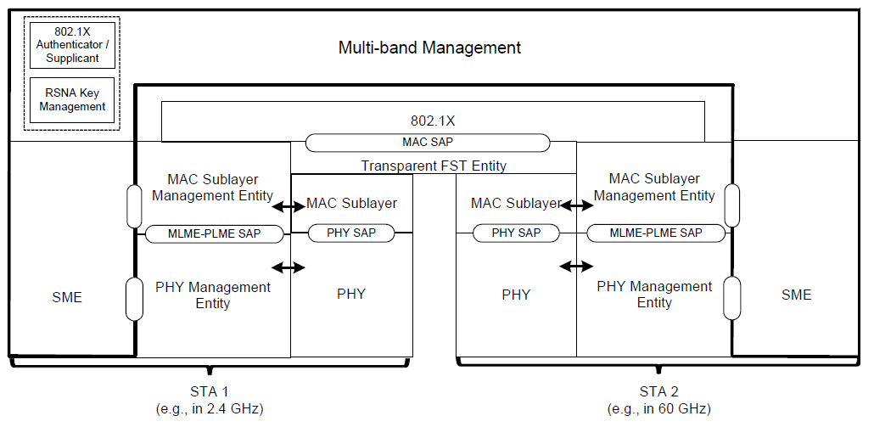
The existing architectures in 802.11REVmd D3.0
In 802.11REVmd D3.0 (4.9.4 Reference model for multi-band operation), it says
A multi-band capable device can manage operation over more than one frequency band/channel. The operation across the different frequency bands/channels can be simultaneous or nonsimultaneous.
A multi-band capable device can also support multiple MAC sublayers.
The multi-band procedures (see 11.32 (Multi-band operation)) allow a pair of multi-band capable devices to discover, synchronize, (de)authenticate, (re)associate, disassociate, and manage resources with each other on any common band/channel that is supported by both STAs.
There are two kinds of multi-band capable device
One is to support transparent FST
Only supports the function of flow level[2]
But all the STAs share the same MAC
SAP as packet level architecture [2] and
multi-link logical entity [1]

Slide 7
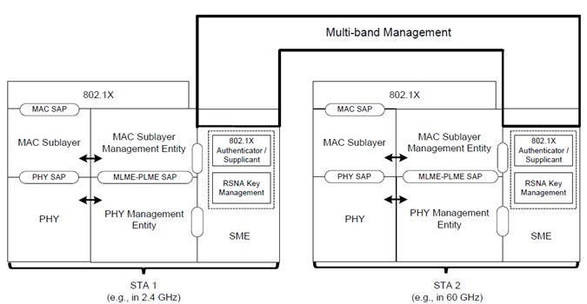
The existing architectures in 802.11REVmd D3.0
The other supports non-transparent FST
Only supports the function of flow level[2]
And each STA has its own MAC SAP as
the flow level architecture [2]
As pointed in [3]，here we also do not advocate to use FST but only want to point out that architecture exists in draft.
FST procedure is much complicate, and it also does not clearly describe how to deliver the same kind of traffic over multiple bands simultaneously. The new operation is needed to support the function of packet level
Based on the above reference models, we propose a clear terminology for multi-link in the next slide
Try to reuse the existing architectures, and keep consistent with terminology of multi-band capable device

Slide 8
Multi-link capable device
Multi-link capable device: A device that has more than one affiliated STA, which can operate in different frequency bands/channels.
Multi-link capable transparent device: A device that has more than one affiliated STA, which can operate different frequency bands/channels. The device has a single MAC SAP presented to the logical link control (LLC) layer for all of the affiliated STAs that are identified by one common MAC address.
Whether the affiliated STA has its own MAC address is TBD
Multi-link capable non-transparent device: A device that has more than one affiliated STA, which can operate in different frequency bands/channels. The device has a single MAC SAP presented to the logical link control (LLC) layer for each affiliated STA that is identified by a MAC address.
Multi-link capable AP device: A multi-link capable device, where each affiliated STA is an AP.
Multi-link capable non-AP device: A multi-link capable device, where each affiliated STA is a non-AP STA

Slide 9
Summary
A more accurate unified framework for multi-link operation is proposed and it keeps the consistent with the existing architecture of the related multi-band capable device in the draft
Multi-link capable device, multi-link capable transparent device and multi-link capable non-transparent device
To facilitate the process of the multi-link feature, we suggest to discuss the operations for multi-link capable transparent device and multi-link capable non-transparent device separately
They may be combined after full discussion later

Slide 10
References
[1] IEEE 802.11-19/0773r7 Multi-link Operation framework
[2] IEEE 802.11-19/0823r2 Multi-link aggregation
[3] IEEE 802.11-19/1231r3 Multiband and Multichannel Operation in IEEE 802.11be
[4] IEEE 802.11-19/1542r0 multi-link broadcast addressed frame reception

Slide 11
SP 1
Multi-link capable device: A device that has more than one affiliated STA, which can operate in different frequency bands/channels.
Multi-link capable transparent device: A device that has more than one affiliated STA, which can operate different frequency bands/channels. The device has a single MAC SAP presented to the logical link control (LLC) layer for all of the affiliated STAs that are identified by one common MAC address.
Whether the affiliated STA has its own MAC address is TBD
Multi-link capable non-transparent device: A device that has more than one affiliated STA, which can operate in different frequency bands/channels. The device has a single MAC SAP presented to the logical link control (LLC) layer for each affiliated STA that is identified by a MAC address.

Slide 12
SP2
Multi-link capable AP device: A multi-link capable device, where each affiliated STA is an AP.
Multi-link capable non-AP device: A multi-link capable device, where each affiliated STA is a non-AP STA

Slide 13
Backup
Q: Could we still use the terminology of multi-band capable device for 802.11be
A: Suggest to change multi-band to multi-link, in order to match the multi-link feature in 802.11be well. Meanwhile we can reuse the existing architectures of multi-band capable device or do some minor change on them without any conflict, an example of the minor change: replace “Transparent FST Entity” in the figure of slide 4 with “Common high MAC”.
Q: What is the relationship between FST and this proposal.
A: FST is the protocol of multi-band operation based on the architectures of multi-band capable device in the REVmd D3.0. However, this proposal does not touch any related operation protocols for the multi-link capable device. The group could think about the more advanced protocols to meet the new requirement in 802.11be.
Q: What is the relationship between FST and multi-link operation
A: Although FST and multi-link operation are all based on the existing architectures in the draft with slight difference, they could be different.

