Slide 1
Calibration of Implicit Sounding
Date: 2019-11
Authors:
Name | Affiliations | Address | email
Yunping (Lily) Lv | Huawei | Nanjing, China | lvyunping@huawei.com
Bo (Boyce) Yang |  | Nanjing, China
Fangchao (Dylan) Yuan |  | Nanjing, China

Slide 2
Abstract
[1][2][3][4] propose to consider implicit sounding in TGbe, in order to reduce overhead for 16ss and multi AP cases.
On the other hand, implicit sounding needs accurate calibration to maintain channel reciprocity, although the procedure of calibration does not need to be part of the standard.
In this contribution, we show our lab test results on calibration accuracy, proving the feasibility of implicit sounding.
Notes:
Actually.

Slide 3
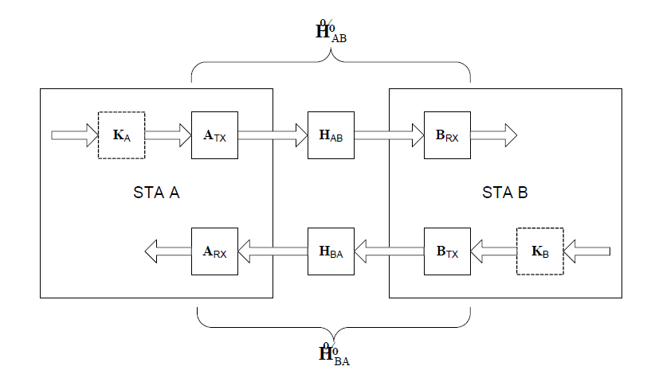
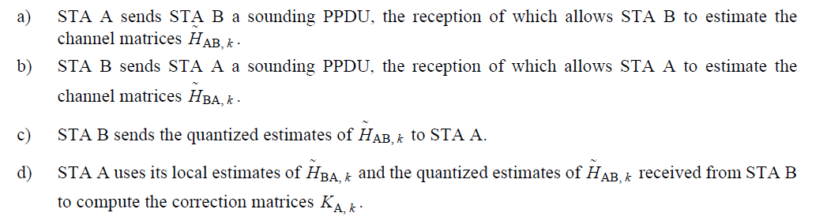
Recap of calibration
802.11n calibration
  Calibration in 802.11n is an ‘absolute calibration’, involving both AP and STAs.
  After calibration procedure, the correction matric KA/KB can be computed which is used to restore baseband-to-baseband channel reciprocity.

Slide 4
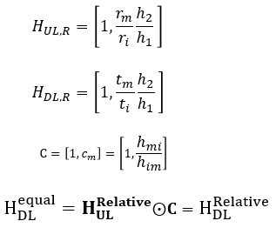
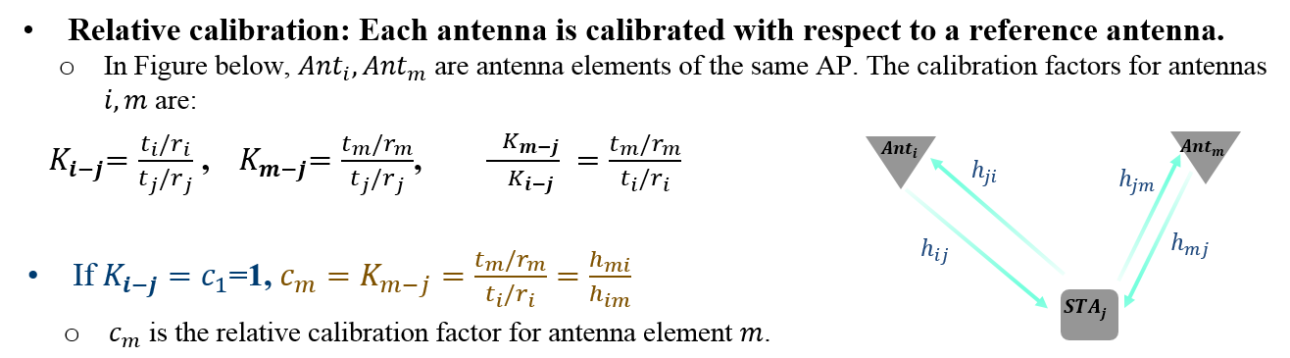




Recap of calibration
Relative calibration [1]
  Different from absolute calibration, relative calibration only involves AP side.
  Each antenna is calibrated with a reference antenna, getting a relative factor C
  Use relative factor C to compensate steering matrix for MIMO/BF.
$$h_{im}$$
$$h_{mi}$$
$$h_{1}$$
$$h_{2}$$

Slide 5

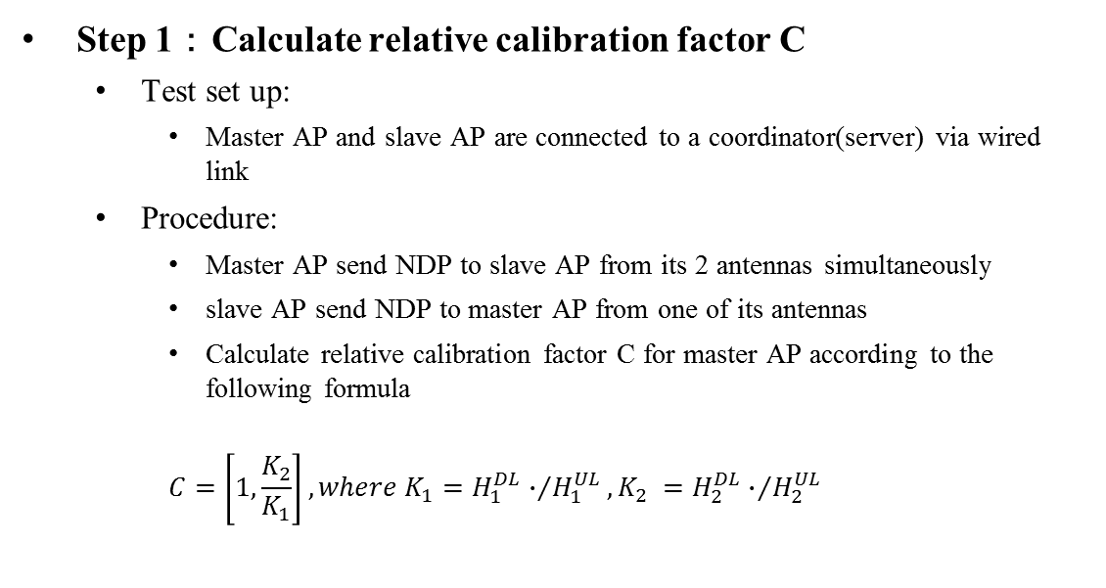



Relative Calibration Accuracy Test
Step 1：Calculate relative calibration factor C
  Test set up:
    Master AP and slave AP are connected to a coordinator(server) via wired link
  Procedure:
    Master AP send NDP to slave AP from its 2 antennas simultaneously
    slave AP send NDP to master AP from one of its antennas
    Calculate relative calibration factor C for master AP according to the following formula
    $$C=\left[1,\frac{K_{2}}{K_{1}}\right],where K_{1}={H_{1}^{DL}∙}/{H_{1}^{UL}},K_{2} ={H_{2}^{DL}∙}/{H_{2}^{UL}}$$
Master AP
$$H_{1}^{DL}$$
$$H_{2}^{DL}$$
$$H_{1}^{UL}$$
$$H_{2}^{UL}$$
Slave AP
NDP M2S
……
Master AP
NDP S2M
……
Slave AP

Slide 6
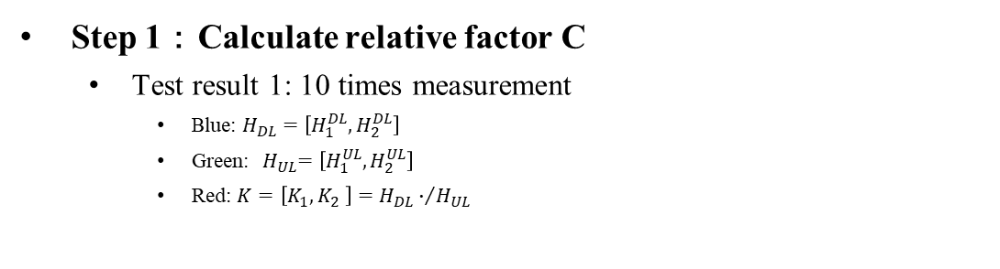
Relative Calibration Accuracy Test
Step 1：Calculate relative factor C
  Test result 1: 10 times measurement
    Blue: $H_{DL}=\left[H_{1}^{DL},H_{2}^{DL}\right]$
    Green:${ H}_{UL}=\left[H_{1}^{UL},H_{2}^{UL}\right]$
    Red: $K=\left[K_{1},K_{2} \right]={H_{DL}∙}/{H_{UL}}$
Observation:
The calibration factor does not change much for measurements at different times
Additional HE-LTF can further improve calibration accuracy

Slide 7

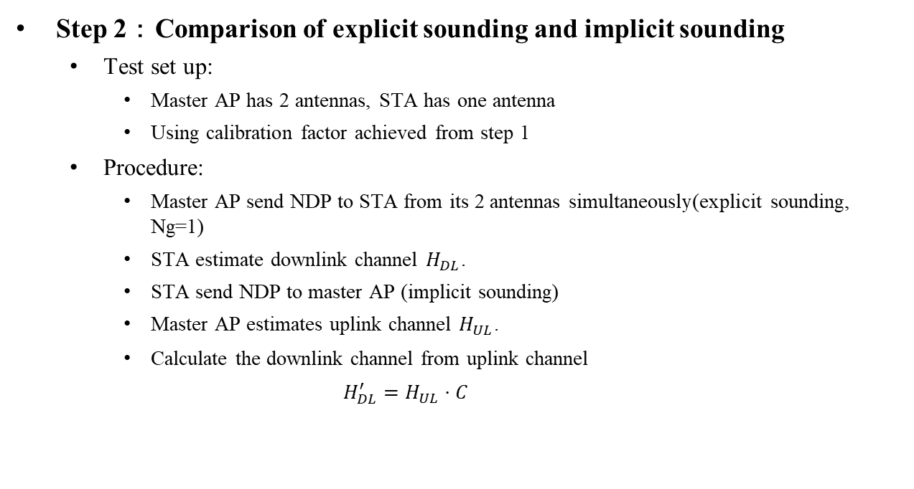



Relative Calibration Accuracy Test
Step 2：Comparison of explicit sounding and implicit sounding
  Test set up:
    Master AP has 2 antennas, STA has one antenna
    Using calibration factor achieved from step 1
  Procedure:
    Master AP send NDP to STA from its 2 antennas simultaneously(explicit sounding, Ng=1)
    STA estimate downlink channel $H_{DL}$.
    STA send NDP to master AP (implicit sounding)
    Master AP estimates uplink channel $H_{UL}$.
    Calculate the downlink channel from uplink channel
    $$H_{DL}^{′}=H_{UL}⋅C$$
Master AP
$$H_{1}^{DL}$$
$$H_{2}^{DL}$$
$$H_{1}^{UL}$$
$$H_{2}^{UL}$$
STA
Explicit Sounding NDP
……
Master AP
Implicit
Sounding NDP
……
STA

Slide 8
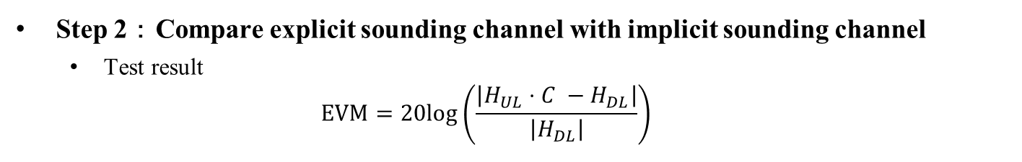
Relative Calibration Accuracy Test
Step 2：Compare explicit sounding channel with implicit sounding channel
  Test result
  $$EVM=20log\left(\frac{\left|H_{UL}⋅C −H_{DL}\right|}{\left|H_{DL}\right|}\right)$$
Observation:
Additional error of implicit sounding with Channel calibration is about -37dB@50% if no repeated HE-LTF.
Additional HE-LTF could further improve the performance.

Slide 9
Data Transmission with Implicit Sounding
Calibration
Sounding
MU/JT Transmission
Master AP
Cali NDP
Data Transmission
Slave AP
Cali NDP
NDP Trigger
Data Transmission
STA
Sounding NDP
Three stages are involved. Almost no additional complexity to STAs:
Calibration: involving AP only, could be left to implementation
Sounding: existing trigger mechanism, with additional feedback type (Sounding NDP)
Data transmission：no changes
Meanwhile, implicit Sounding NDP is transmitted by non-AP STA, which is transparent to the antenna numbers of AP or distributed APs.
Notes:
Forward compatibility to 32 antennas or 64 antennas or distributed APs

Slide 10
Conclusion
Relative calibration involves AP only, adding no complexity to the STAs.
Test results show that implicit sounding with relative calibration can estimate the channel status very accurately.
Introducing Implicit sounding almost add no complexity to STAs.

Slide 11
References
[1] 19/767 Implicit Channel Sounding in IEEE 802.11 (Feasibility Study)
[2] 19/768 Implicit Channel Sounding in IEEE 802.11
[3] 19/1268 Implicit sounding overhead analysis
[4] 18/1191 MU sounding improvements

