Slide 1
Precoding performance using implicit channel estimation
Date: 2019-11-08
Authors:

Slide 2
Introduction
Current 802.11 sounding protocols are based on sounding followed by explicit sounding feedback
These explicit protocols can potentially take up a lot of airtime
Implicit sounding [1, 2] has been suggested as a way to reduce sounding overhead
Overhead of different schemes (implicit vs. explicit) was compared in [4]

Slide 3
Introduction
An important question is how well implicit channel estimation (CE) performs when used with precoding
This submission looks at precoding performance using either implicit or explicit channel estimates
We use a combination of measured and simulation results

Slide 4
Implicit channel estimation
Channel estimate obtained for “reverse” channel
Beamformer may request BFee to send NDP
Or wait for an ad-hoc opportunity …
BFer estimates reverse channel from the NDP (or other packet)
BFer adjusts reverse channel with calibration coefficients and uses it as an approximation of the forward channel

Slide 5
Experimental & simulation setup
Channel measurements were taken in different environments
Shield Box
Office environment
BFer: 4x4 AP
BFee: 2x2 STA
H matrix collected using NDP on both ends
2x4 AP→STA channels
4x2 STA→AP channels

Slide 6
Experimental & simulation setup (2)
Calibration was performed off-line on the measured (reverse) channels (MATLAB)
Calibration coefficients were determined using MMSE criterion
Precoding based on explicit DL channel was compared with precoding based on calibrated UL channel
Using the measured channels in simulation
Both BF and MU

Slide 7
Setup
$$N_{RX,STA}=N_{TX,STA}$$
$$N_{RX,AP}=N_{TX,AP}$$
$$H^{(cal)}={\left(H^{STA→AP}\right)}^{T}.\left(\begin{matrix}C_{1} & ⋯ & 0 \\ ⋮ & ⋱ & ⋮ \\ 0 & ⋯ & C_{N}\end{matrix}\right)$$

Slide 8
Results for BF
Three different scenarios are considered
Performance without BF
Performance with BF using explicit channel information
Performance with BF using calibrated implicit channel information
Channel measurements were taken in shielded environment and in office environment
As recorded by the Wi-Fi devices
Measured and calibrated channels were used in MATLAB simulation to find performance

Slide 9
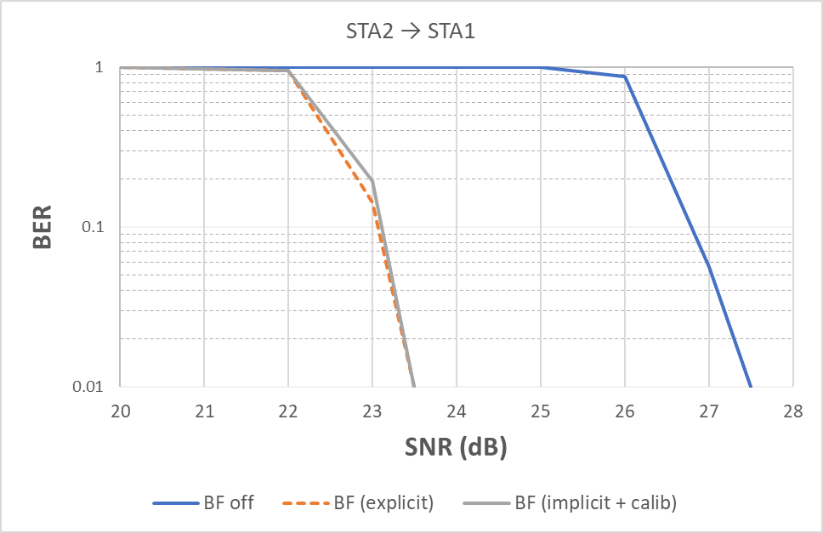
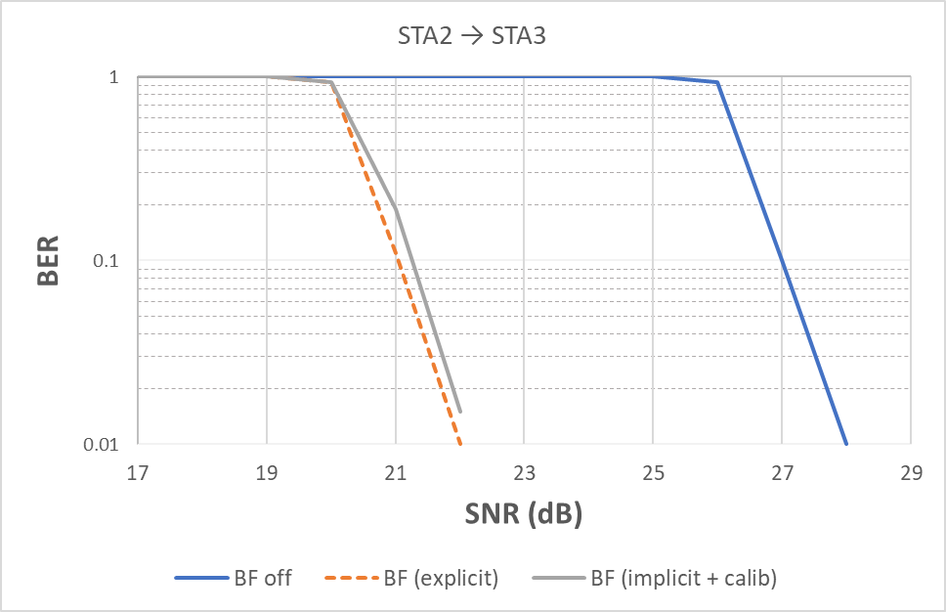
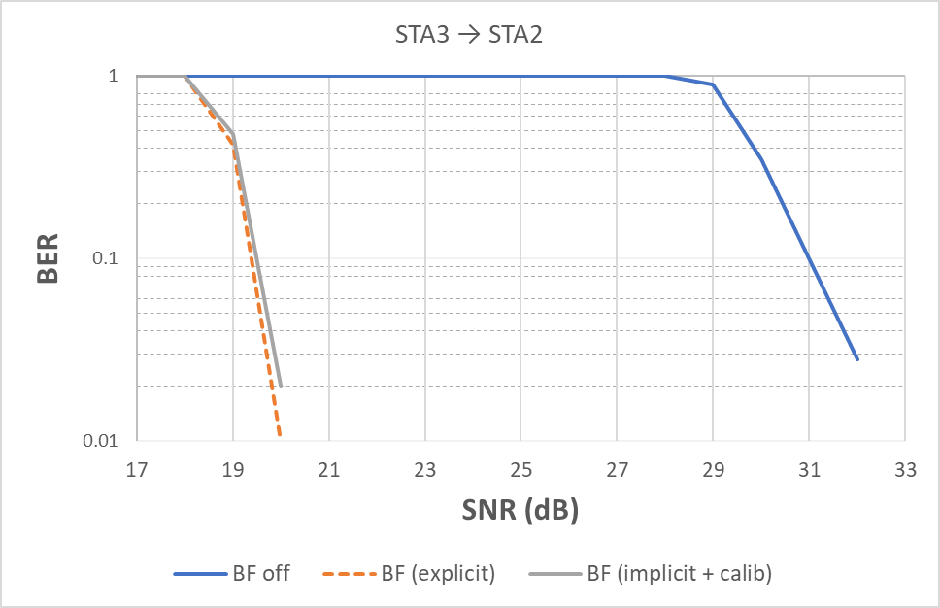
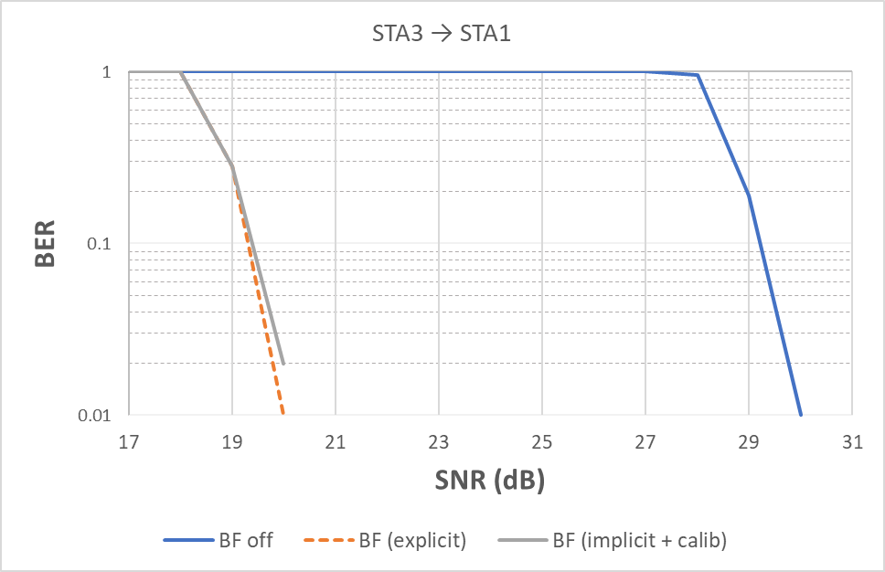
SU BF performance - shieldbox
MCS 7, 2 SS
Setup in shielded environment
Virtually no difference between Implicit CE with and explicit CE

Slide 10
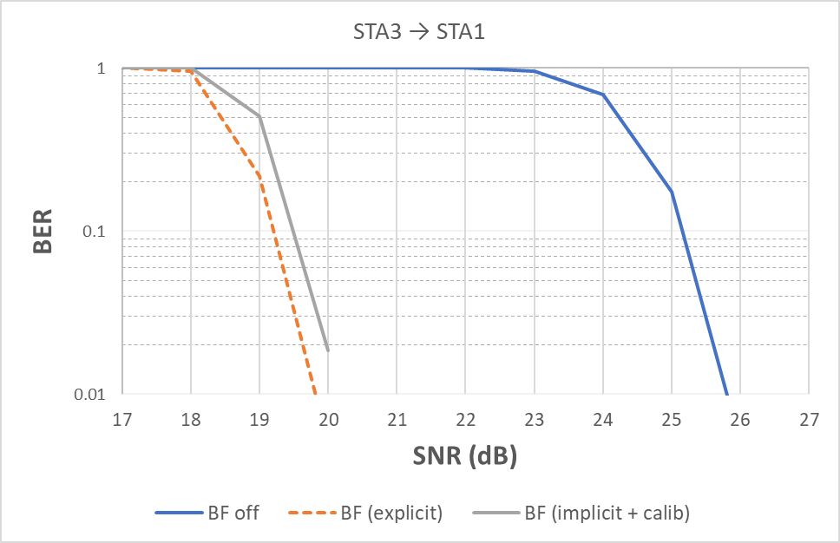
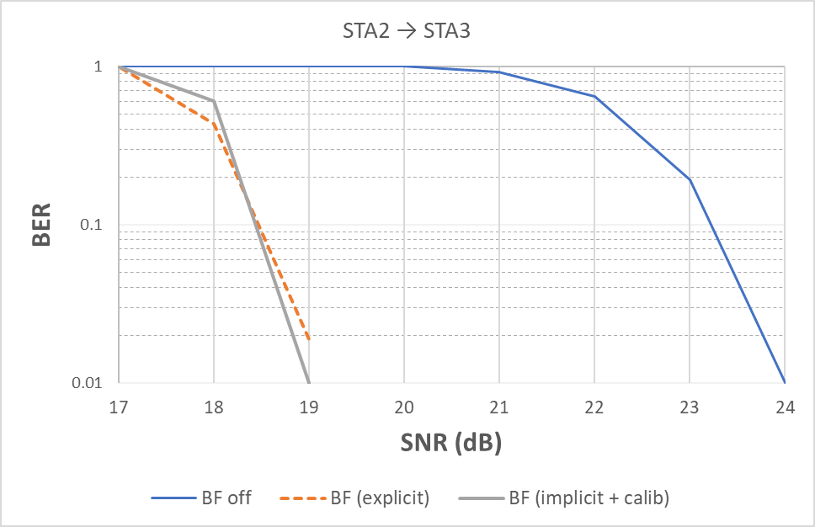
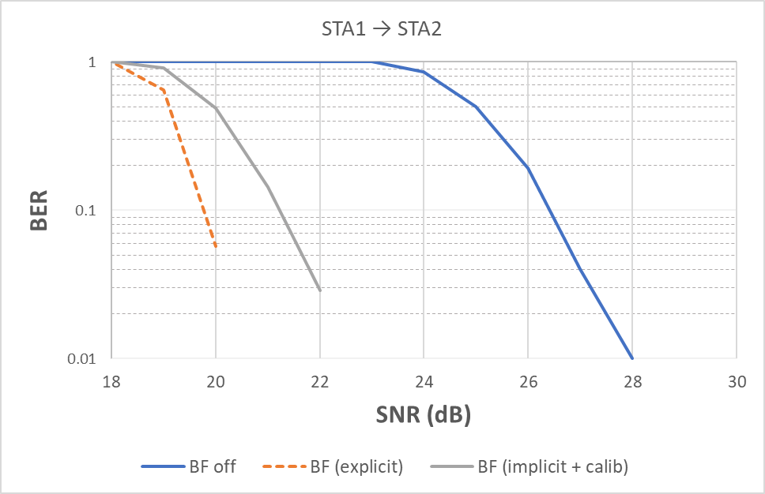
SU BF performance – over the air
MCS 7, 2 SS
Measurements taken in office environment
Minor degradation from implicit feedback

Slide 11
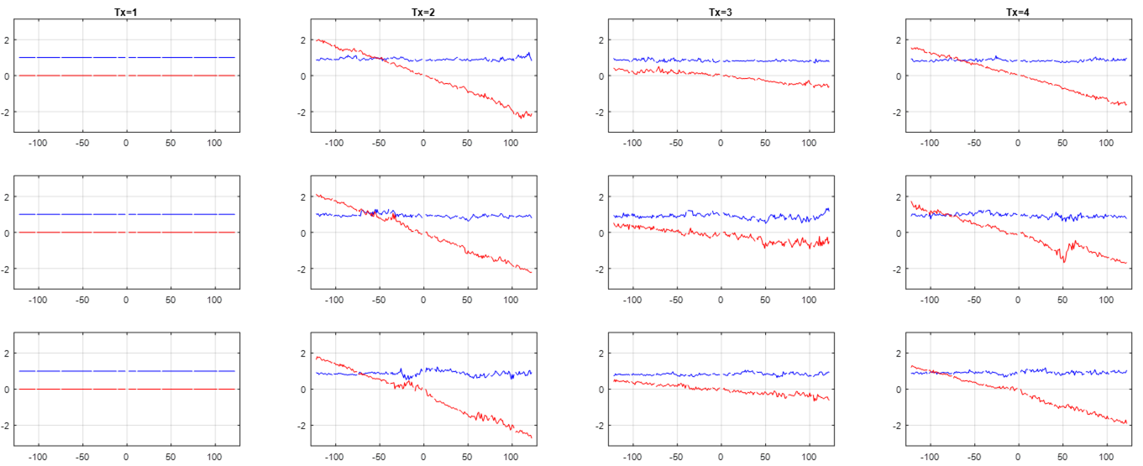
Calibration coefficients
phase
amplitude

Slide 12
Results for MU
Three different scenarios considered
MU with 4-stream feedback
MU with 8-stream feedback
MU with implicit (calibrated) channel feedback
AP is 8x8, STA is 2x2
Channels are simulated channel D with added impairments to model front-end
Amplitude offset
Random phase offsets

Slide 13
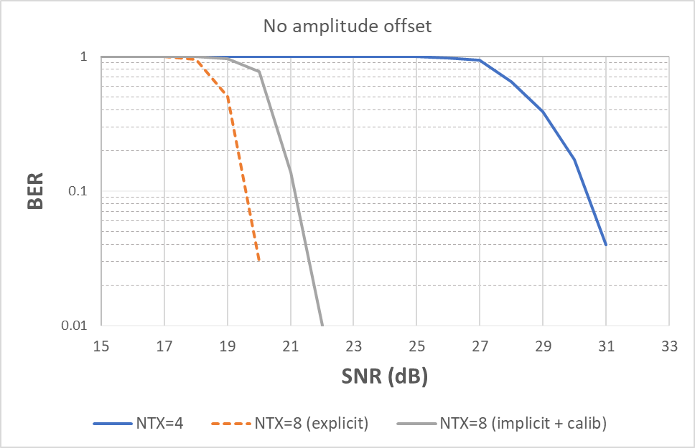
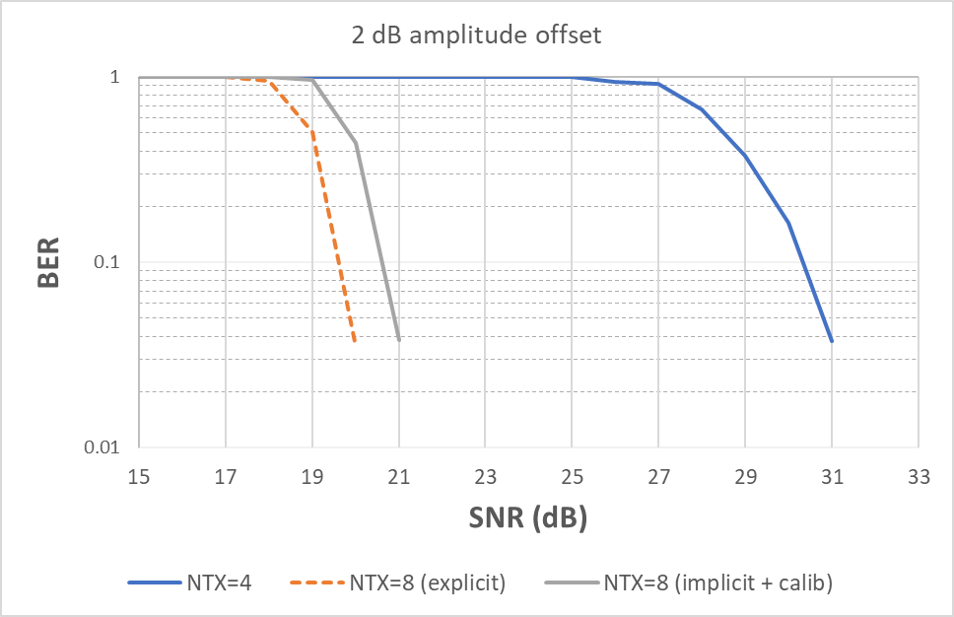
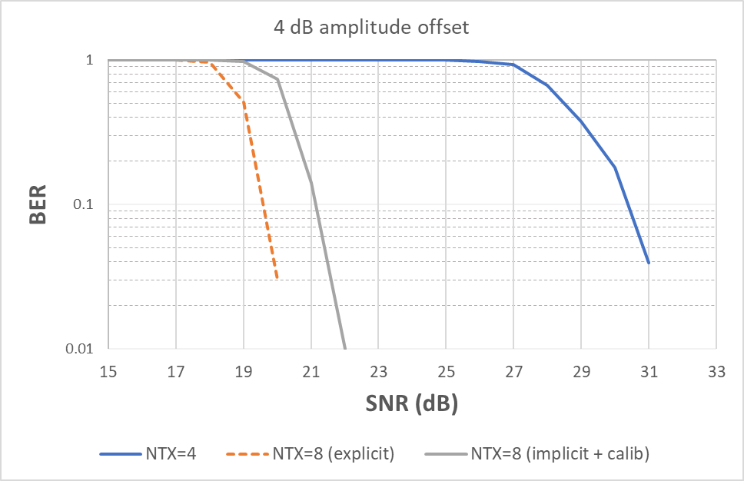
MU performance
Simulated Channel D with various amplitude offsets
Random phase offsets
Major improvement relative to 4SS feedback
1 – 1.5 dB difference relative to 8SS feedback

Slide 14
Summary
Presented results for precoding based on implicit channel estimation
Simple calibration algorithm used
More advanced algorithms could be considered
SU performance
Little to no degradation
MU performance
Major improvement over 4-stream feedback
Minor degradation relative to 8-stream feedback
NOTE: impact of overhead not considered in assessing performance

Slide 15
Conclusion
Implicit channel estimation with calibration is a good candidate method for reducing sounding overhead

Slide 16
References
[1] MU sounding improvements, IEEE 802.11-18/1191
[2] Implicit Channel Sounding in IEEE 802.11, IEEE 802.11-19/0768
[3] Implicit Channel Sounding in IEEE 802.11 (Feasibility Study), IEEE 802.11-19/0767
[4] Implicit sounding overhead analysis, IEEE 802.11-19/1268

