Slide 1
AP assisted ML operation
Date: 2019-06-03
Authors:

Slide 2
Content
Performance evaluation of single radio STAs with all TIDs mapped to each link.
Proposals to improve link transition decision.

Slide 3
Introduction
Three step Multi-link operation proposed in [1].
  Step 2: TID-to-link mapping
  Step 3: Non-AP MLLE STA uses power state signaling to operate on enabled links.
With respect to AP MLLE control on link transition, there can be following types:
  Fully AP controlled where AP dynamically uses step 2 to enable/disable links.
  Moderate AP controlled where AP assigns TID-to-link mapping statically in step 2 and STA uses step 3 for transitions.
Throughput and latency performance of single radio STA MLLEs can be significantly improved with step 3 transitions for packets of a TID if it is enabled everywhere.
  If all TIDs mapped to each enabled link it improves performance for all TIDs.
Notes:
why we need STA initiated switch ?
Decision might be for throughput improvement due to relatively long-term bad link quality (e.g., due to congestion).
Decision might be for latency improvement due to a short term restriction on channel access, for example,
The associated AP not scheduling the STA within the non-AP MLLE in current (or few) TXOPs for DL or MU-UL.
Some STA (in the same BSS or OBSS) other than the associated AP starts transmitting a long packet.

Slide 4
Simulation Scenario
1 AP MLLE with 3 links with equal BW of 40 MHz.
  One single radio non-AP STA MLLE operating non-concurrently on one link as its primary link.
  STA MLLE switches to different link during transmissions not to the STA.
  No TID restriction.
Other Inter and intra-BSS traffic:
  4 OBSS APs each transmitting DL to its own STAs on each link with varying load corresponding to certain percentage of airtime.
  BSS containing the EHT STA under consideration also has DL traffic to some other STAs in each link with the same load.
Two modes of link transition:
  Mode 1: Equal probability of selecting a link to switch to.
  Mode 2: Assume perfect knowledge of current NAV condition at the time of switch and select the least congested link.
Notes:
Caveat: we don’t model the exact signaling variants proposed in this presentation but rather assume the information about current NAV settings on all links is provided to STA at the time of the switch
duration of switch: NAV duration.

Slide 5
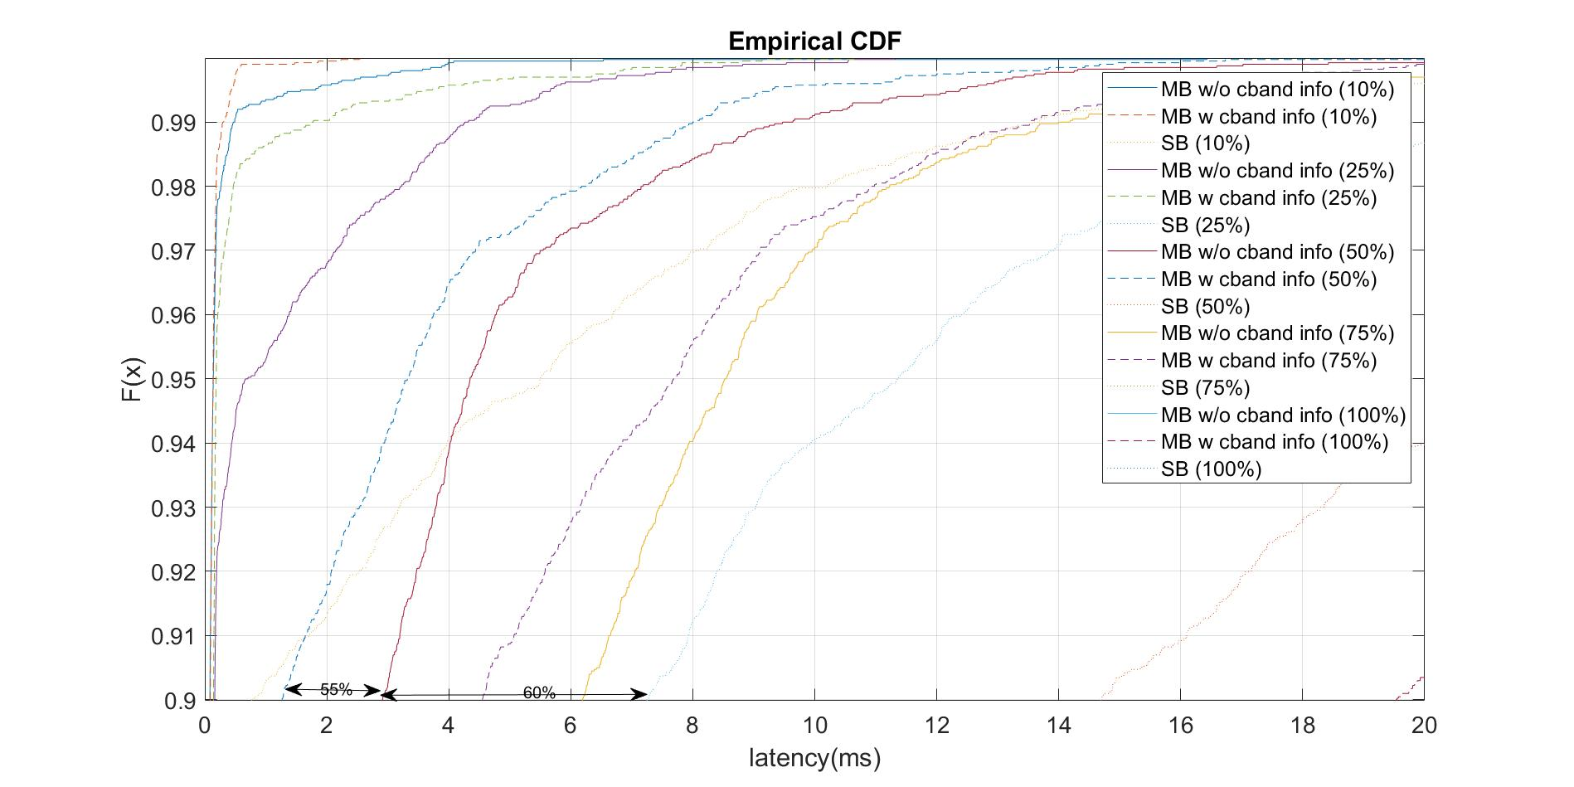
Latency Sim Results
ML with CL info @ 50% other traffic load
With bursty
traffic
ML without CL info @ 50% other traffic load
SL @ 50% other traffic load
90 percentile latency reduction of ~60% without cross-link info
and further 50% with that info.

Slide 6
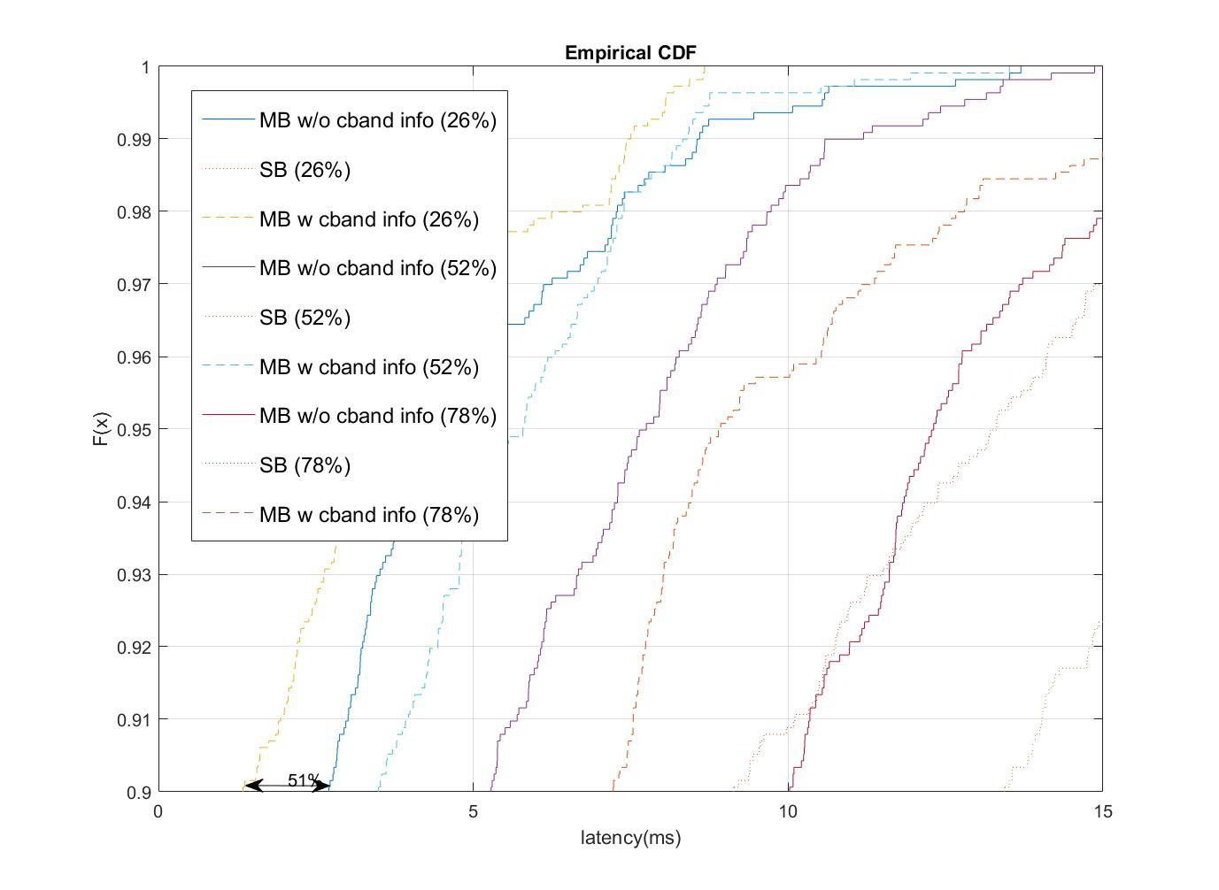
Latency Sim Results (contd.)
ML with CL info @ 26% other traffic load
With CBR traffic
ML without CL info @ 26 % other traffic load
SL @ 26 % other traffic load
90 percentile latency reduction of ~50% with additional info

Slide 7
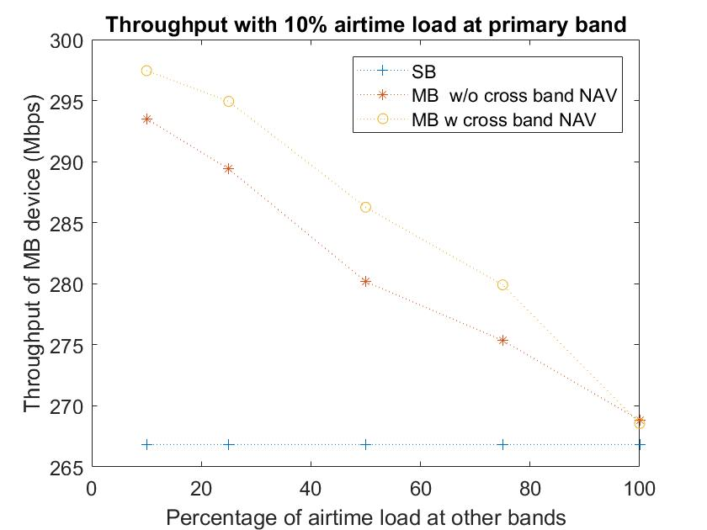
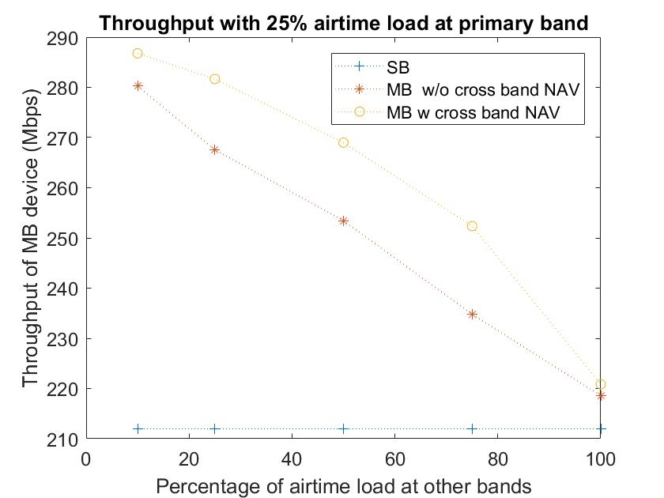
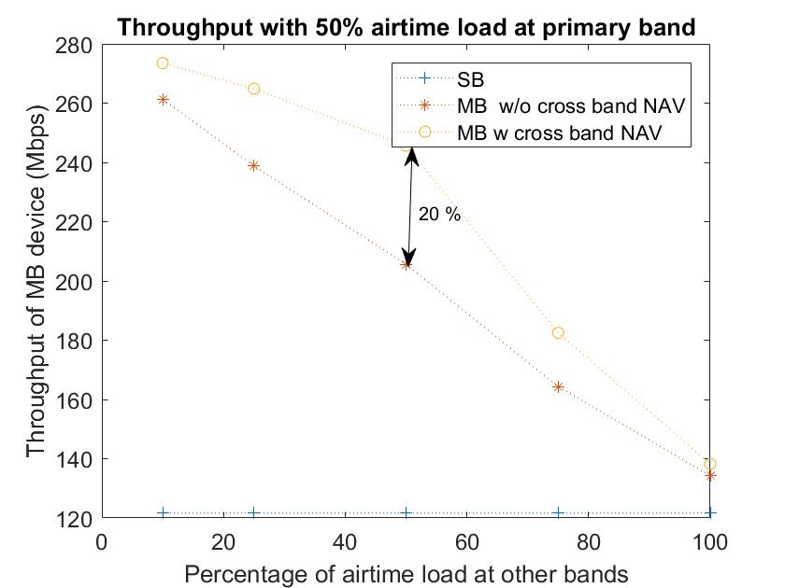
TCP Iperf Throughput Sims
Does not account for overhead of STA presence signaling in new link.

Slide 8
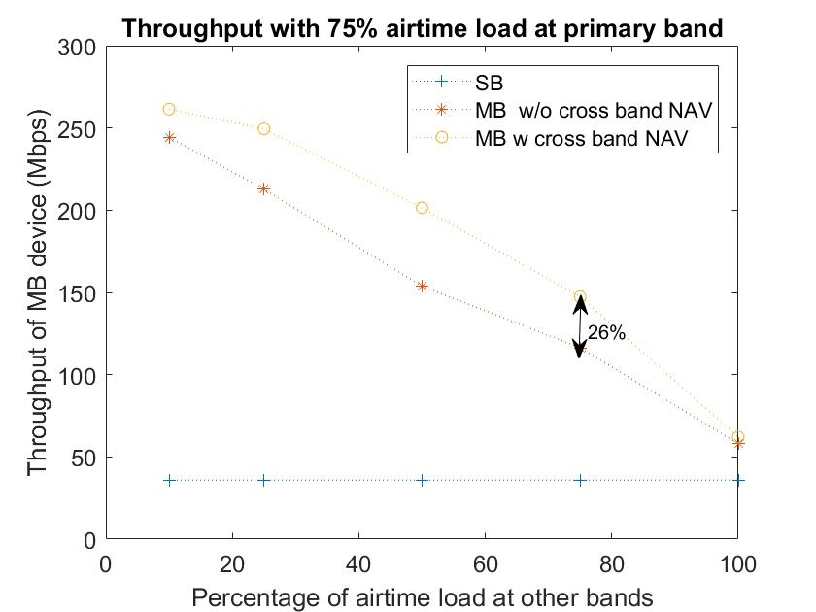
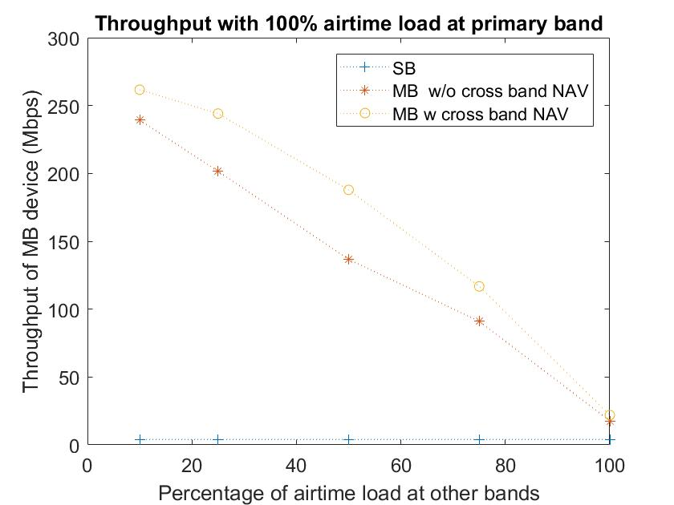
TCP Iperf Traffic Sim results
> 100% throughput gain without cross-link info and further
~25% gain with that info.

Slide 9
AP assisted link transition
The previous results show step 3 link transitions can significantly improve performance for Single radio STA MLLEs with no TID restriction.
If STA MLLE does not know current cross-link network conditions, transition to an already busy link may affect performance of the non-AP MLLE.
Proposal: AP MLLE assists STA MLLE for link transitions by providing additional information.
  Mode 1 (no control): AP provides some general information about other links.
  Mode 2 (semi-control): AP recommends certain links for transitioning to.
STA uses this information to decide whether to switch to another link and which link to switch to.
Notes:
Outside TWT SP (or in absence of it)

Slide 10
Mode 1
In this mode the AP MLLE advertises information about other links in some Mgt frames (e.g., Beacon) transmitted on each link.
The information could be carried in a new element or in the Neighbor Report element.
A simple information to include is the BSS load. Depending on granularity of measurement intervals we can have two options
  Option 1: use the 802.11 BSS Load element if the interval is unit of beacon intervals.
  Option 2: use some other element (new ?) if the interval is less than a beacon interval.

Slide 11
Example of link transition under mode 1
Link 2 busy: 75 %
AP MLLE
Link 3 busy: 25 %
Cross-link BSS load
Non-AP MLLE
Beacon
AP 1
…
STA 1
Link 1
Tx/Rx activities
Link switch
AP 2
STA 2
Link 2
time
AP 3
STA 3
Link 3
: Beacons
: Data between this MLLE pair
: Data NOT between this MLLE pair
: Awake
: Doze (Off)

Slide 12
Mode 2
AP recommends link(s) where it is likely to schedule a given STA; STA is expected to be awake in those link(s) using PS mechanisms.
For each link, the AP MLLE signals:
  The time interval for which the signaling is valid is defined by
    End of the interval.
    Start of the interval.
      May be optional if assumed to start from the time when the frame was transmitted.
  For each STA MLLE, signal whether the STA will be scheduled for transmission within that time interval. For example, by including a bitmap where,
    “1” => STA is likely to be scheduled after the AP is aware of its presence (e.g., via NFRP).
    “0” => STA is not likely to be scheduled.
The above signaling may be contained in a Broadcast frame (e.g., similar to OPS).
Alternatively, it could also be unicast to each STA (A-Ctrl, Mgt frame).

Slide 13
Example link transition under mode 2
Link 2 End: 40ms
Bmap: 000
AP MLLE
Recommended links
Link 3 End: 50ms Bmap: 010
Non-AP MLLE
Broadcast Mgt frame
40ms
AP 1
…
STA 1
Link 1
Tx/Rx activities
Link switch
AP 2
STA 2
Link 2
time
AP 3
STA 3
Link 3
: Mgt frame
: Data between this MLLE pair
: Data NOT between this MLLE pair
: Awake
: Doze (Off)

Slide 14
Summary
Even for single radio STAs TID-to-link mapping enabled everywhere improves STA performance via step 3 transitions.
Propose AP provide cross link information to assist single radio STA MLLEs that are transitioning to another link for efficient load balancing.

Slide 15
References
“Multi-link: steps for using a link”

Slide 16
Straw Poll 1
Do you agree that an AP that is part of an AP MLLE can transmit the BSS load information of other APs that are part of the same MLLE ?
- whether we use existing or new mechanism is TBD
Notes:
Do you agree to define cross-link signaling for an AP in an AP MLLE to assist a non-AP MLLE to select one or more links among the enabled links for frame exchange ?
The signaling information includes BSS Load.
The signaling mechanism is TBD.

Slide 17
Straw Poll 2
Do you agree to define cross-link signaling for an AP in an AP MLLE to recommend a non-AP MLLE to wake up in one or more links among the enabled links for frame exchange ?
  The signaling mechanism is TBD.

Slide 18
Backup Slides

Slide 19
Additional simulation Scenarios (Config 2)
Topology:
  1 DUT AP MLLE with upto 3 links (first two 80 MHz, another 40 MHz) with 1 ML DUT Non-AP STA MLLE and associated to one legacy STA in each link.
  4 OBSS APs each with 1 legacy STA in each link; no hidden node.
Traffic:
  Scenario 1: UL 512B packet generated every 20ms from DUT Non-AP STA MLLE @MCS4 using VO.
  Scenario 2: DL 512B packet generated every 20ms from DUT Non-AP STA MLLE @MCS4 using VO.
  Scenario 3: DL 6MB packet generated every 1s from DUT Non-AP STA MLLE @MCS4 using VO.
  Network load : DL CBR traffic @MCS0 from 5 APs capturing fraction of the airtime; packet size: 90KB using VI.

Slide 20
Transmission schemes (Config 2)
Baseline (Single Link): 2x2 NSS at the “primary” link with 80 MHz BW (“Single link”).
Non-concurrent ML: when “primary” link not available, attempt to transmit via the one of the other two links (“Opp”).
  2x2 NSS configs.
  If no UL Data packets but queued DL packet, STA transmits PS Poll in new link.
  For 3 link case, assume that the current link condition (“NAV settings) is perfectly known at STA
  at the time of switch.
    In practice, a coarse information may be provided by AP in beacon.
Concurrent ML operation: given packet can be transmitted from one of either bands (“2/3 links”).
  2x2 NSS configs.
TXOP duration ~ uniform (1.5ms,5ms).

Slide 21
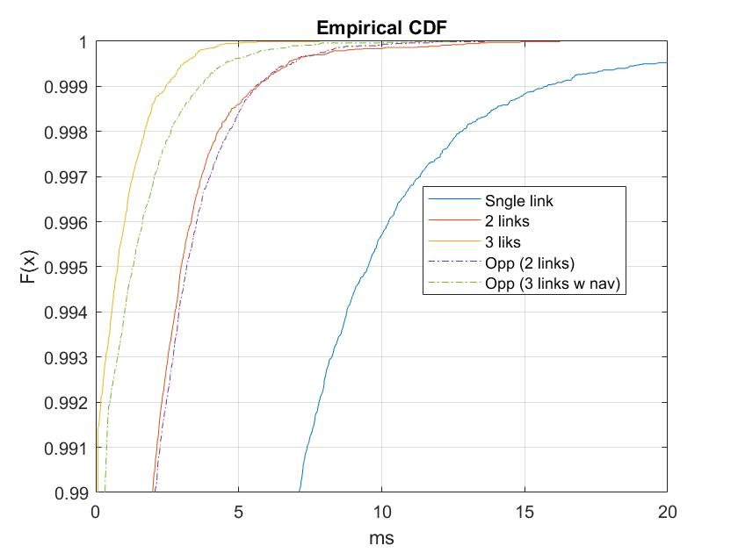
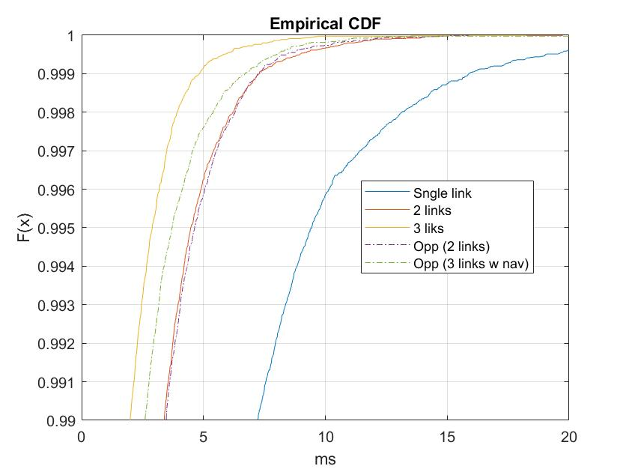
Scenario 1 Simulation Results (Config 2)
Primary link load: 10% of airtime,
Other link: 25%
Primary link load: 10% of airtime,
Other link: 50%
For low to moderate OBSS load, non-concurrent ML good enough to satisfy UL latency requirements (i.e., < 10ms delay)

Slide 22
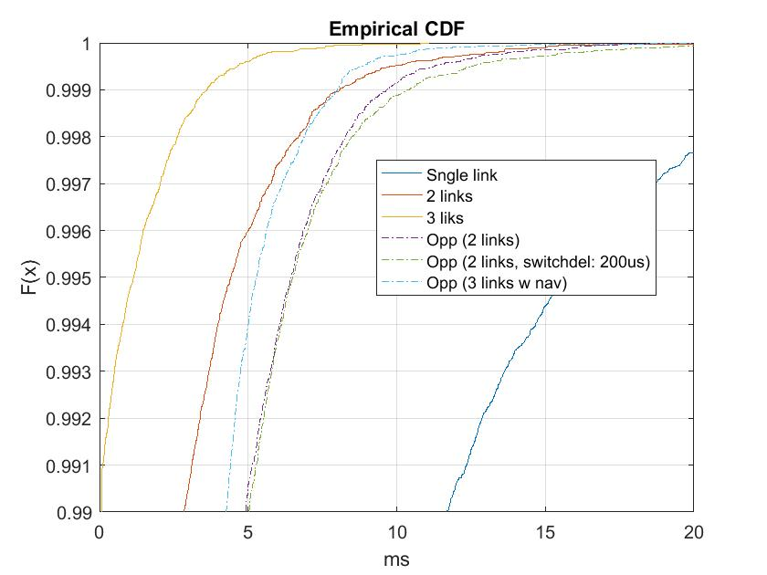
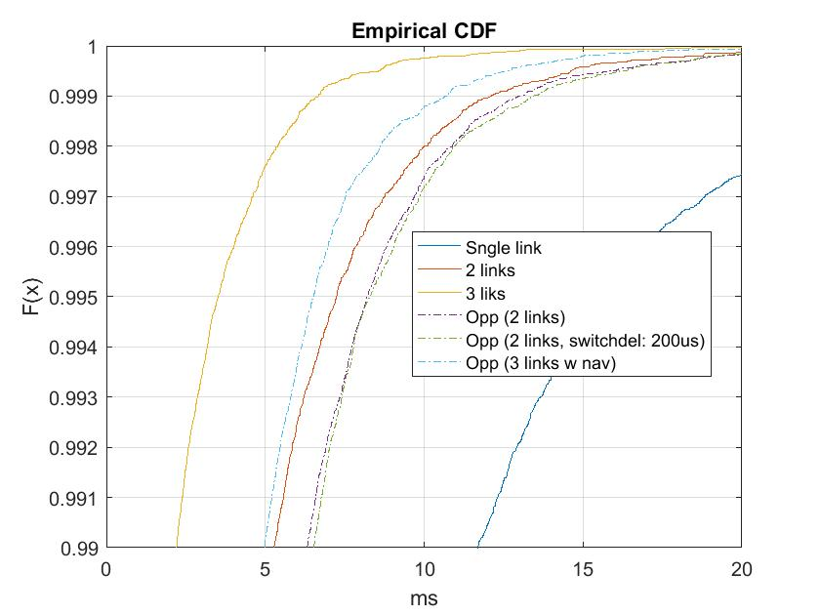
Scenario 2 Simulation Results (Config 2)
Primary link load: 10% of airtime,
Other links: 25%
Note: Non-concurrent ML (“Opp”) with 3 optional
links provide comparable performance as the concurrent
2 Links case.
Primary link load: 10% of airtime,
Other links: 50%
For low OBSS load, non-concurrent ML good enough to satisfy DL latency requirements (i.e., < 10ms delay)

Slide 23
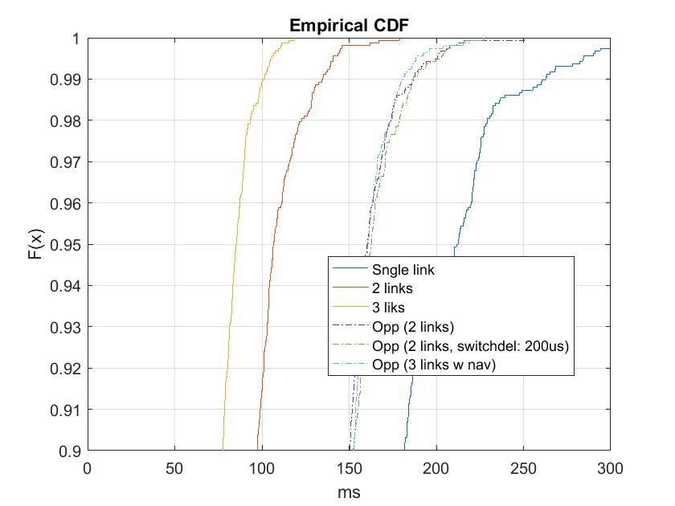
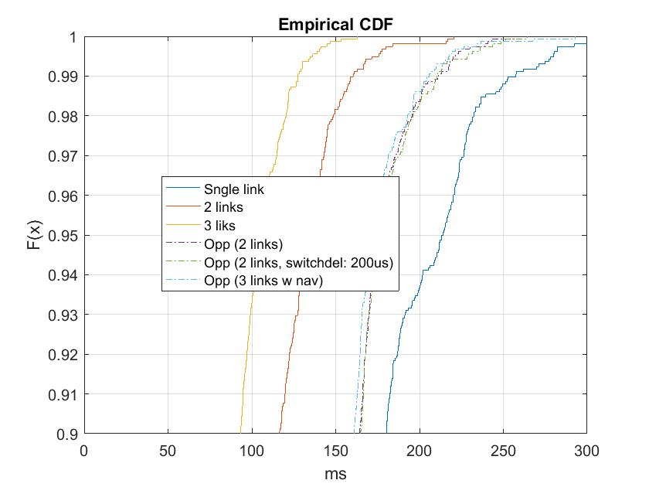
Scenario 3 Simulation Results (Config 2)
Primary link load: 10% of airtime,
Other links: 25%
Primary link load: 10% of airtime,
Other links: 50%
For high input load, latency performance of Non-concurrent ML deteriorates to somewhat mid-way between SL and concurrrent ML operations.

