Slide 1
Multi-Link Operation Performance Evaluation
Date: 2020-01-30
Authors:

Slide 2
Multi-Link Simulation Set Up
Refer 11-19/1927r1 for the detail of simulation topology, traffic generation, MAC parameter configuration, and the considering MLO mechanisms. [1]
  Parameters:
    Background traffic
      Symmetrical UDP traffic on both links/channels.
      Different % of loading will be tested.
      Randomized TXOP limit (between 1ms and 5.4ms) is used for each <AP, STA>.
    Each UDP packet is 1460B. Each UDP packet burst is 14.6KB (10 UDP packets).
    Target EHT AP/STA
      Running UDP UL/UDP mixed/TCP DL traffic and measure performance.
  Various mechanisms of MLO are tested.
    Non-IDC interference scenario: SPC, MPC, MPC+
    Low-IDC interference scenario: CSPC, CMPC, CMPC+
    High-IDC interference scenario: CSPC, C+MPC, C+MPC+

Slide 3
Topology
AP1
Link 1
STA1
AP2
Link 1
STA2
OBSS on Link 1
AP3
Link 1
STA3
AP4
Link 1
STA4
AP5
Link 1
STA5
EHT AP
Link 1/Link 2
EHT STA
EHT BSS
AP6
Link 2
STA6
AP7
Link 2
STA7
OBSS on Link 2
AP8
Link 2
STA8
AP9
Link 2
STA9
AP10
Link 2
STA10

Slide 4
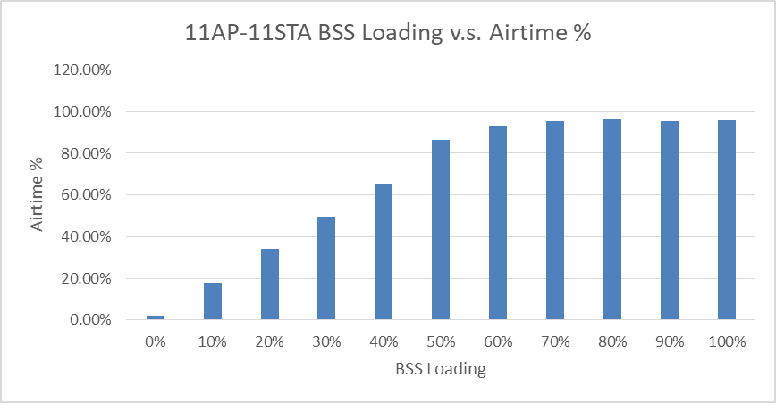
Simulation Result (1/4)
OBSS Loading in %

Slide 5
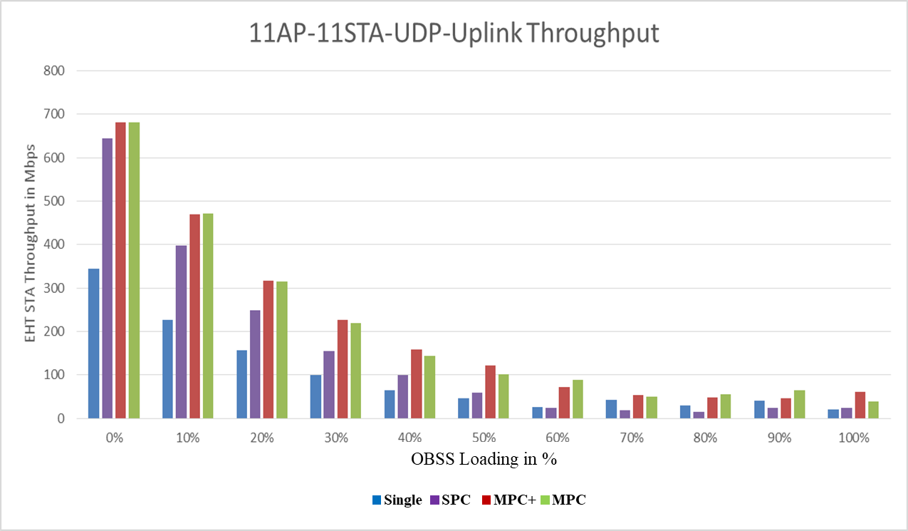

Simulation Result (2/4)
OBSS Loading in %

Slide 6
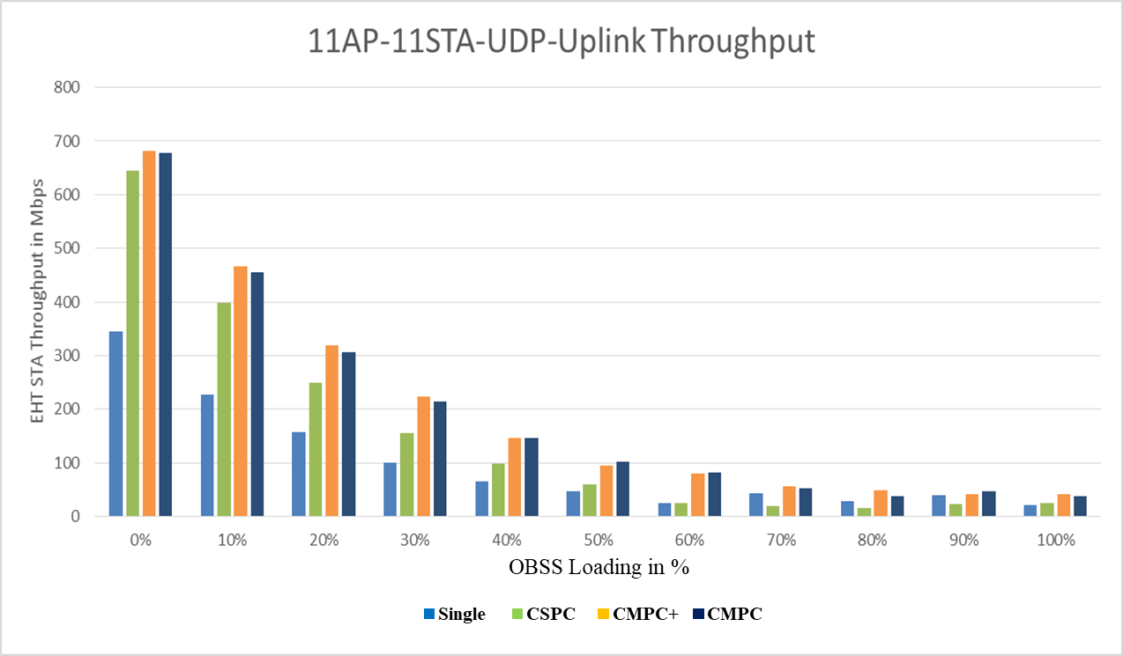
Simulation Result (3/4)

Slide 7
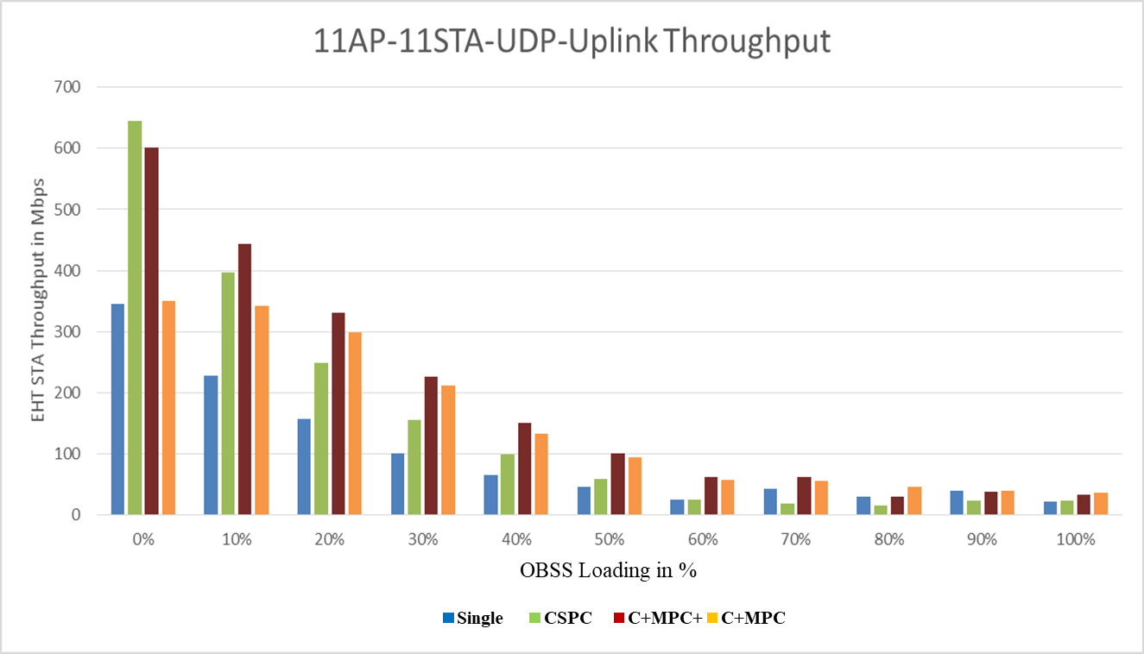
Simulation Result (4/4)

Slide 8
Conclusion
In non-IDC interference scenario (SPC, MPC, MPC+)
  MPC and MPC+ shows higher throughput gain than SPC in all OBSS traffic load cases.
    MPC and MPC+ have an almost same performance.
  In the light OBSS traffic load case, the performance gap between the SPC and MPC (also MPC+) is not much.
In Low IDC interference scenario (CSPC, CMPC, CMPC+)
  CMPC and CMPC-CS shows higher throughput gain than CSPC-CS in all OBSS traffic load cases.
    CMPC+ has a minor performance gain than CMPC.
  In the light OBSS traffic load case, the performance gap between the SPC and MPC (also MPC+) is not much.

Slide 9
Conclusion
High IDC interference scenario (CSPC, C+MPC, C+MPC+)
  When the channel utilization is low, C+MPC+ and CSPC shows higher throughput gain than C+MPC.
  When the channel utilization is high, C+MPC+ and C+MPC shows higher throughput gain than CSPC.
It seems that the STA can decide its MLO mechanism depending a device constraint, and traffic load, and STA’s desired performance criteria (e.g., throughput, latency, power consumption).

Slide 10
References
[1] https://mentor.ieee.org/802.11/dcn/19/11-19-1927-01-00be-multi-link-operation-simulation-methodology.pptx

Slide 11
SP1
Do you support the following MLO mechanism?
  A STA of a MLD performs a contention on a primary channel of a link 1.
  After obtaining a TXOP on the link, the MLD checks a channel status of a link 2 for PIFS.
    If the channel status of the Link 2 is IDLE, the MLD transmits frames over the link 1 and the line 2.
      NOTE- The method of the channel status determination needs more consideration (e.g., ED only, or PD and NAV).
    Otherwise, the MLD transmits frames on the link 1 only.

Slide 12
SP2
Do you support the following MLO mechanism?
  A STA of a MLD performs a contention independently on each primary channel of the link 1 and the link 2.
  After obtaining a TXOP on either the link 1 or the link 2, the MLD transmits frames on the link on which the TXOP is obtained.
    NOTE- PIFS based link access is not used.

Slide 13
SP3
Do you support the following MLO mechanism?
  A STA of a MLD performs a contention independently on each primary channel of the link 1 and the link 2.
  After obtaining a TXOP on either the link 1 or the link 2, the MLD checks a channel status of another link for PIFS.
    If the channel status of another link is IDLE, the MLD transmits frames over the link 1 and the link 2.
      NOTE- The method of the channel status determination needs more consideration (e.g., ED only, or PD and NAV).
    Otherwise, the MLD transmits frames on the link on which the TXOP is obtained.

