Slide 1
Multi-Link Operation Performance Evaluation
Date: 2019-11-09
Authors:

Slide 2
Multi-Link Simulation Set Up
Refer 11-19/1927r0 for the detail of simulation topology, traffic generation, MAC parameter configuration, and the considering MLO mechanisms. [1]
Parameters:
Background traffic
Symmetrical UDP traffic on both links/channels.
Different % of loading will be tested.
Randomized TXOP limit (between 1ms and 5.4ms) is used for each <AP, STA>.
Each UDP packet is 1460B. Each UDP packet burst is 14.6KB (10 UDP packets).
Target EHT AP/STA
Running UDP UL/UDP mixed/TCP DL traffic and measure performance.
Various mechanisms of MLO (SPC, MPC, MPC+) are tested.

Slide 3
Topology
AP1
Link 1
STA1
AP2
Link 1
STA2
OBSS on Link 1
AP3
Link 1
STA3
AP4
Link 1
STA4
AP5
Link 1
STA5
EHT AP
Link 1/Link 2
EHT STA
EHT BSS
AP6
Link 2
STA6
AP7
Link 2
STA7
OBSS on Link 2
AP8
Link 2
STA8
AP9
Link 2
STA9
AP10
Link 2
STA10

Slide 4
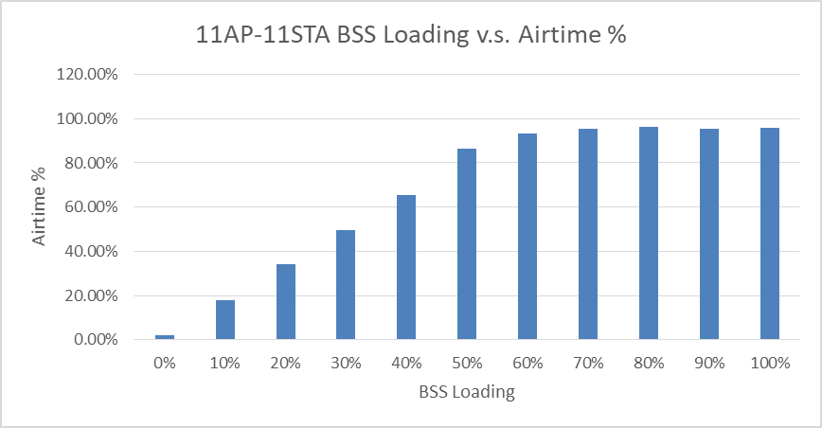
Simulation Result (1/3)
OBSS Loading in %

Slide 5
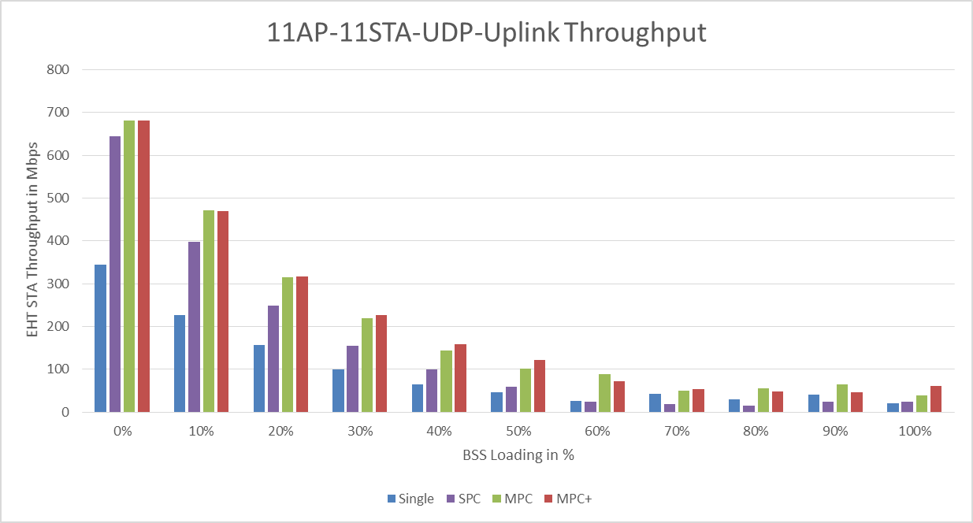
Simulation Result (2/3)
OBSS Loading in %

Slide 6
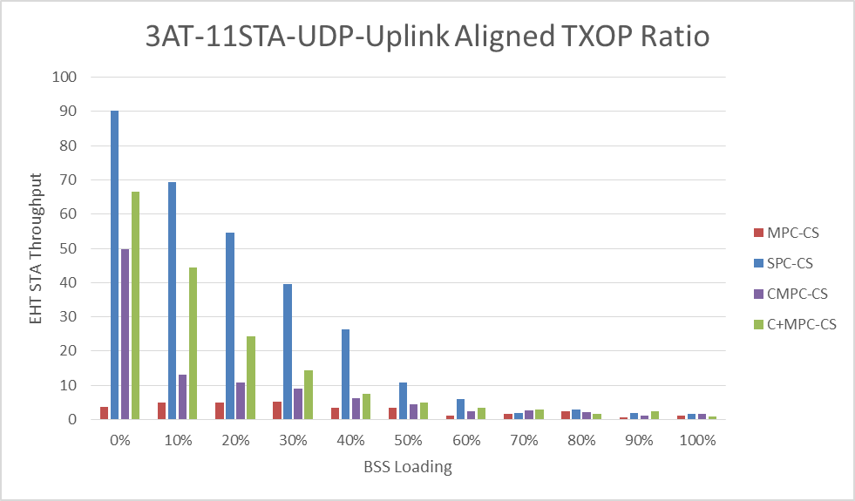
Simulation Result (3/3)
OBSS Loading in %

Slide 7
Conclusion
In non-IDC interference scenario,
MPC and MPC+ shows higher throughput gain than SPC in all OBSS traffic load cases.
But, MPC and MPC+ have an almost same performance.
The performance gap between the SPC and MPC (also MPC+) varied depending on the OBSS traffic load.
In the light OBSS traffic load case, the performance gap between the SPC and MPC (also MPC+) is not much.
It seems that the STA can decide its MLO mechanism depending a desired criteria (e.g., throughput, latency, power consumption).
The follow-up submission will consider the IDC interference scenario.

Slide 8
References
[1] https://mentor.ieee.org/802.11/dcn/19/11-19-1927-00-00be-multi-link-operation-simulation-methodology.pptx

