Slide 1
Multi-Link Operation Simulation Methodology
Date: 2020-01-30
Authors:

Slide 2
Introduction
This submission proposes the Multi-Link Operation simulation methodology for evaluating simulation results more fairly.
Also, we proposes the unified terminologies of the Multi-Link Operation mechanisms for more better understanding and comparing the simulation results among submissions.

Slide 3
Multi-Link Operation Simulation Set Up
Topology
  A link 1 is 80 MHz channel in 5 GHz band.
  A link 2 is 80 MHz channel in 6 GHz band.
  An HE AP 1 serves an HE BSS 1 on the link 1.
  An HE AP 2 serves an HE BSS 2 on the link 2.
  An EHT AP serves an EHT BSS on the link 1 and the link 2.
  An HE STAs 1-5 are associated with the HE AP 1.
  An HE STAs 6-10 are associated with the HE AP 2.
  An EHT STA is associated with the EHT AP.

Slide 4
Multi-Link Operation Simulation Set Up
HE BSS 1
HE AP 1
Link 1
HE STA 1
Topology
HE BSS 2
HE AP 2
Link 1
HE STA 2
HE BSS 3
HE AP 3
Link 1
HE STA 3
HE BSS 4
HE AP 4
Link 1
HE STA 4
HE BSS 5
HE AP 5
Link 1
HE STA 5
EHT AP
Link 1/Link 2
EHT STA
EHT BSS
HE AP 6
Link 2
HE STA 6
HE BSS 6
HE AP 7
Link 2
HE STA 7
HE BSS 7
HE AP 8
Link 2
HE STA 8
HE BSS 8
HE BSS 9
HE AP 9
Link 2
HE STA 9
HE BSS 10
HE AP 10
Link 2
HE STA 10

Slide 5
Multi-Link Operation Simulation Set Up
Traffic Generation
  Background traffic
    The HE AP i generates X Kbps CBR traffic to the HE STA j.
    The HE STA i generate X Kbps CBR traffic to the HE AP j.
  Target traffic
    The EHT AP generates Y Kbps CBR UDP traffic to the EHT STA.
    The EHT STA generates Y Kbps CBR UDP traffic to the EHT AP.
  CBR traffic is an UDP packet whose size is 1,460 Bytes and UP is set to 0 (i.e., AC_BE).

Slide 6
Multi-Link Operation Simulation Set Up
MAC Parameter Configuration
  RTS/CTS : On/Off.
  TXOP limit
    For the background traffic, the TXOP limit is randomized between 1ms and 5.4ms.
    For the target traffic, the TXOP limit is fixed to 5.4ms.
  MCS: Any MCS can be used that can reach the TXOP limit.
    The chosen MCS is used by all STAs.
  TXOP Bursting : No.
  A-MPDU size : 256.

Slide 7
Multi-Link Operation Simulation Results
Channel utilization ratio of the given OBSS load.
EHT STA throughput (Mbps).
HE STA throughput (Mbps).
Multi-Link TXOP ratio
  I.e., The ratio of the TXOPs on which the STA can use more than one links to receive and/or transmit frames.

Slide 8
Multi-Link Operation Mechanisms
For more better understanding and comparing the Multi-Link Operation simulation results, we suggest the unified terminologies for the Multi-Link Operation mechanisms in the next slides.
However, this does not prevent other members to propose other Multi-Link Operation mechanisms.

Slide 9
Multi-Link Operation Mechanisms
Single-Link Operation (Single) : Single PPDU transmission on single link (i.e., legacy operation).

Slide 10
Multi-Link Operation Mechanisms
Multi-Link Operation: Independent PPDU transmissions on multiple links. It is categorized as the following:
  Single Primary Channel based link access plus PIFS based other link access (SPC).
  Multiple Primary Channel based link access (MPC).
  Multiple Primary Channel based link access plus PIFS based other link access (MPC+)

Slide 11

Single Primary Channel based link access plus PIFS based other link access ($\text{SPC}$)
A STA of a MLD performs a contention on a primary channel of a link 1.
After obtaining a TXOP on the link, the MLD checks a channel status of a link 2 for PIFS.
  If the channel status of the Link 2 is IDLE, the MLD transmits frames over the link 1 and the line 2.
    NOTE- The method of the channel status determination needs more consideration (e.g., ED only, or PD and NAV).
  Otherwise, the MLD transmits frames on the link 1 only.
TXOP
TXOP
TXOP
TX
RX
TX
RX
TX
RX
STA 1
Link 1
3 | 2 | 1 | 0
2 | 1 | 0
3 | 2 | 1 | 0
TXOP
MLD
busy
busy
TX
RX
busy
STA 2
Link 2

Slide 12

Multiple Primary Channel based link access
($\text{MPC}$)
A STA of a MLD performs a contention independently on each primary channel of the link 1 and the link 2.
After obtaining a TXOP on either the link 1 or the link 2, the MLD transmits frames on the link on which the TXOP is obtained.
  NOTE- PIFS based link access is not used.
TXOP
TXOP
TX
RX
busy
TX
RX
STA 1
Link 1
3 | 2 | 1 | 0
4 | 3
2 | 1 | 0
TXOP
TXOP
TXOP
MLD
busy
TX
RX
TX
RX
TX
RX
STA 2
Link 2
2 | 1 | 0
3 | 2 | 1 | 0
1 | 0

Slide 13
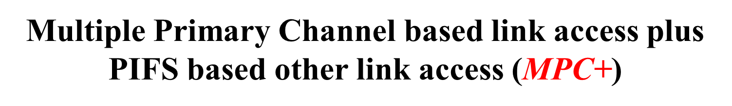
Multiple Primary Channel based link access plus PIFS based other link access ($\text{MPC}\text{+}$)
A STA of a MLD performs a contention independently on each primary channel of the link 1 and the link 2.
After obtaining a TXOP on either the link 1 or the link 2, the MLD checks a channel status of another link for PIFS.
  If the channel status of another link is IDLE, the MLD transmits frames over the link 1 and the link 2.
    NOTE- The method of the channel status determination needs more consideration (e.g., ED only, or PD and NAV).
  Otherwise, the MLD transmits frames on the link on which the TXOP is obtained.
TXOP
TXOP
TXOP
TXOP
TX
RX
TX
RX
TX
RX
TX
STA 1
Link 1
3 | 2 | 1 | 0
3
2 | 1 | 0
0
TXOP
TXOP
MLD
busy
TX
RX
TX
RX
busy
STA 2
Link 2
2 | 1 | 0
7 | 6 | 5 | 4

Slide 14
Multi-Link Operation Mechanisms
Constrained Multi-Link Operation: Independent PPDU transmissions on multiple links, under the following one constraint,
    While a MLD is receiving a frame addressed to itself on a link, the MLD does not transmit other frames on other link.
      NOTE- If a MLD can ensure that it is not an intended receiver of this frame, the MLD can transmit.
  Constrained Multiple Primary Channel based link access (CMPC).
  Constrained Multiple Primary Channel based link access plus PIFS based other link access (CMPC+).

Slide 15


Constrained Single Primary Channel based link access plus PIFS based other link access ($\text{CS}\text{PC}$)
MLO has the following constraint,
  While a MLD is receiving frames addressed to itself on a link, the MLD does not transmit other frames on other link.
Other channel access rules are same as in slide 11. ($\text{SPC}$).
TXOP
TXOP
TXOP
TX
RX
TX
RX
TX
RX
STA 1
Link 1
3 | 2 | 1 | 0
2 | 1 | 0
3 | 2 | 1 | 0
TXOP
MLD
busy
busy
TX
RX
busy
STA 2
Link 2

Slide 16


Constrained Multiple Primary Channel based link access
($\text{CM}\text{PC}$)
MLO has the following constraint,
  While a MLD is receiving frames addressed to itself on a link, the MLD does not transmit other frames on other link.
Other channel access rules are same as in slide 12 ($\text{MPC}$).
TXOP
TXOP
TX
RX
busy
TX
RX
STA 1
Link 1
3 | 2 | 1 | 0
2 | 1 | 0
3
2 | 1 | 0
TXOP
TXOP
TXOP
MLD
busy
TX
RX
TX
RX
TX
RX
STA 2
Link 2
2 | 1 | 0
2 | 1 | 0
1 | 0

Slide 17


Constrained Multiple Primary Channel based link access plus PIFS based other link access ($\text{CM}\text{PC}\text{+}$)
MLO has the following constraint,
  While a MLD is receiving frames addressed to itself on a link, the MLD does not transmit other frames on other link.
Other channel access rules are same as in slide 13 ($\text{MPC}\text{+}$).
TXOP
TXOP
TXOP
TXOP
TX
RX
TX
RX
TX
RX
TX
STA 1
Link 1
3 | 2 | 1 | 0
3
2 | 1 | 0
0
TXOP
TXOP
MLD
busy
TX
RX
TX
RX
busy
STA 2
Link 2
2 | 1 | 0
7 | 6 | 5 | 4

Slide 18
Multi-Link Operation Mechanisms
Constrained+ Multi-Link Operation: Independent PPDU transmissions on multiple links, under the following two constraint,
    While a MLD is receiving a frame addressed to itself on a link, the MLD does not transmit other frames on other link.
      NOTE- If a MLD can ensure that it is not an intended receiver of this frame, the MLD can transmit.
    While a MLD is transmitting a frame on one link, the channel access of other link of the MLD is disallowed (e.g., the backoff is paused).
  Constrained+ Multiple Primary Channel based link access (C+MPC).
  Constrained+ Multiple Primary Channel based link access plus PIFS based other link access (C+MPC+).

Slide 19
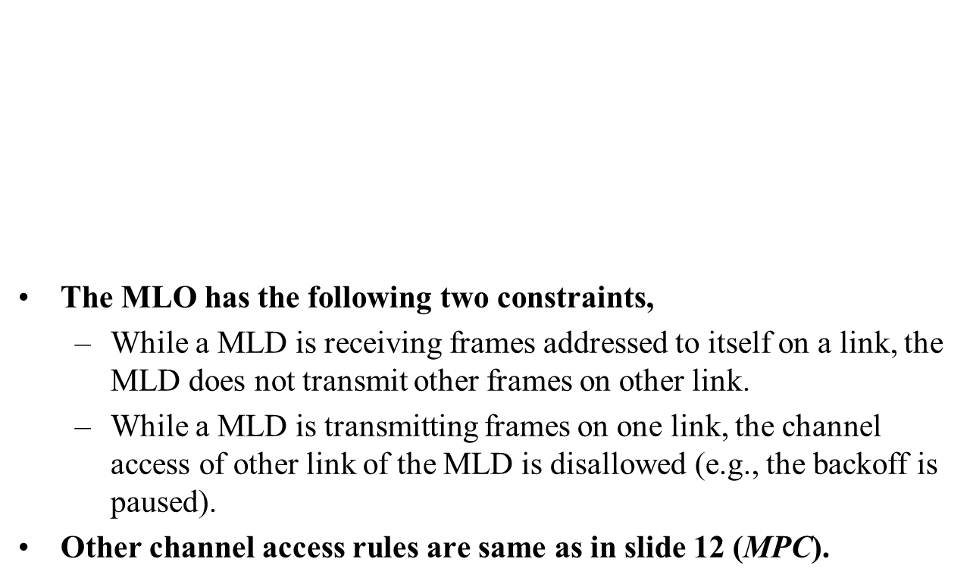
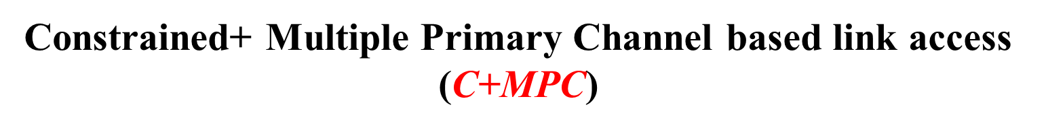
Constrained+ Multiple Primary Channel based link access
($\text{C}\text{+}\text{M}\text{PC}$)
The MLO has the following two constraints,
  While a MLD is receiving frames addressed to itself on a link, the MLD does not transmit other frames on other link.
  While a MLD is transmitting frames on one link, the channel access of other link of the MLD is disallowed (e.g., the backoff is paused).
Other channel access rules are same as in slide 12 ($\text{MPC}$).
TXOP
TXOP
TX
RX
Back-off is paused
TX
RX
STA 1
Link 1
3 | 2 | 1 | 0
4
3 | 2 | 1
TXOP
TXOP
MLD
Back-off is paused
TX
RX
Back-off is paused
TX
STA 2
Link 2
7 | 6 | 5 | 4
3 | 2 | 1 | 0
1 | 0
2 | 1 | 0

Slide 20
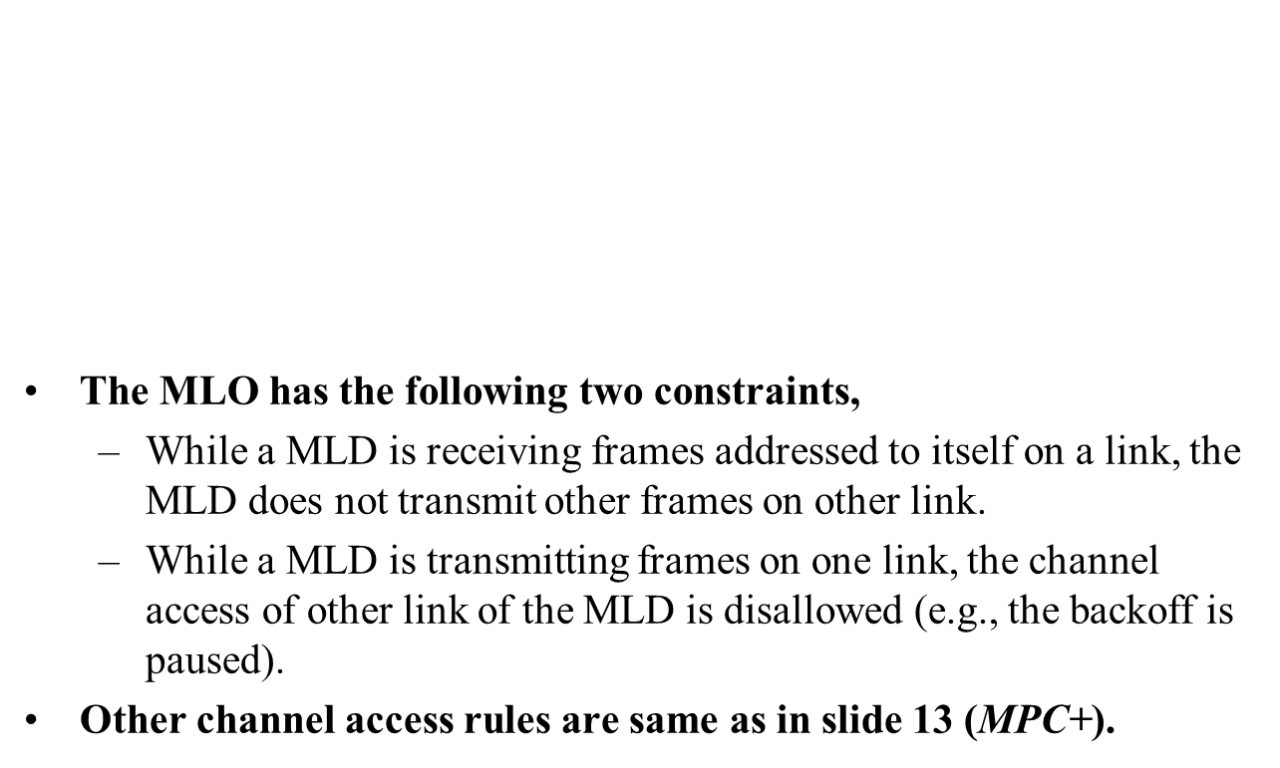
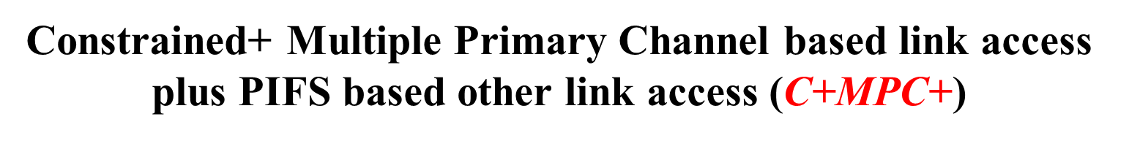
Constrained+ Multiple Primary Channel based link access plus PIFS based other link access ($\text{C}\text{+}\text{M}\text{PC}\text{+}$)
The MLO has the following two constraints,
  While a MLD is receiving frames addressed to itself on a link, the MLD does not transmit other frames on other link.
  While a MLD is transmitting frames on one link, the channel access of other link of the MLD is disallowed (e.g., the backoff is paused).
Other channel access rules are same as in slide 13 ($\text{MPC}\text{+}$).
TXOP
TXOP
TXOP
TXOP
TX
RX
TX
RX
TX
RX
TX
STA 1
Link 1
1 | 0
3
2 | 1 | 0
0
TXOP
TXOP
MLD
busy
Back-off is paused
TX
RX
TX
RX
busy
Back-off is paused
STA 2
Link 2
3 | 2 | 1 | 0
7 | 6 | 5 | 4

Slide 21
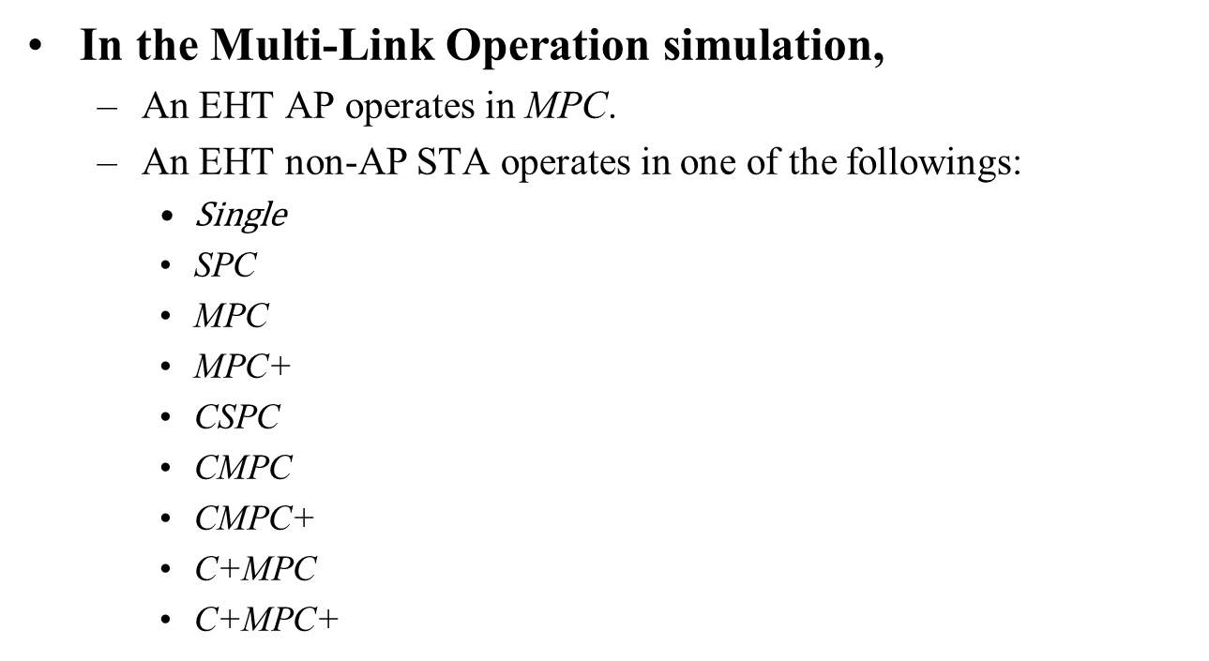
Multi-Link Operation Mechanisms
In the Multi-Link Operation simulation,
  An EHT AP operates in $\text{MPC}$.
  An EHT non-AP STA operates in one of the followings:
    $\text{S}\text{ingle}$
    $\text{SP}\text{C}$
    $\text{MPC}$
    $\text{MPC}\text{+}$
    CSPC
    $\text{CM}\text{PC}$
    $\text{CM}\text{PC}\text{+}$
    C+MPC
    C+MPC+

Slide 22
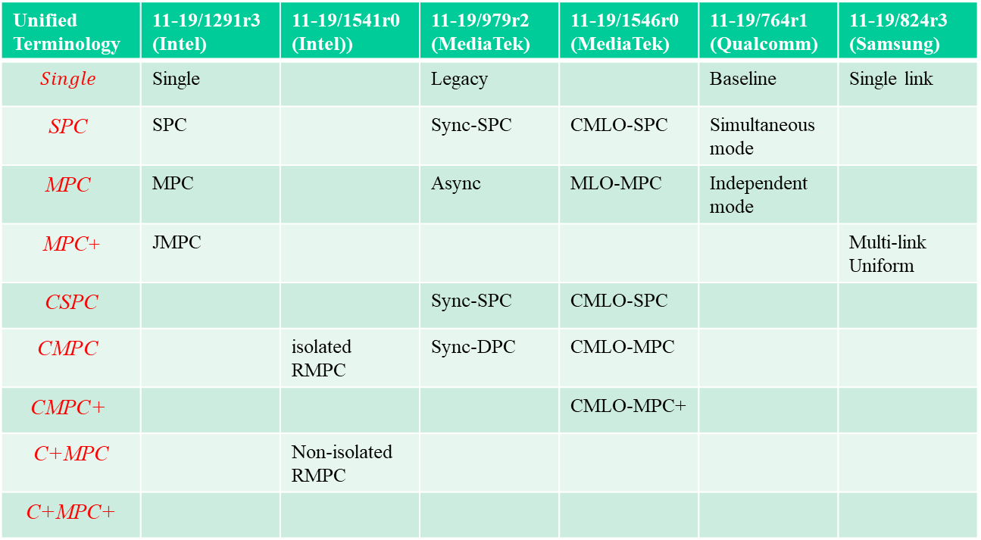
Multi-Link Operation Mechanisms
MLO terminology mapping with previous contribution
Unified Terminology | 11-19/1291r3 (Intel) | 11-19/1541r0 (Intel)) | 11-19/979r2 (MediaTek) | 11-19/1546r0 (MediaTek) | 11-19/764r1 (Qualcomm) | 11-19/824r3 (Samsung)
$$Single$$ | Single |  | Legacy |  | Baseline | Single link
$$\text{SPC}$$ | SPC |  | Sync-SPC | CMLO-SPC | Simultaneous mode
$$\text{MPC}$$ | MPC |  | Async | MLO-MPC | Independent mode
$\text{MPC}$+ | JMPC |  |  |  |  | Multi-link Uniform
CSPC |  |  | Sync-SPC | CMLO-SPC
$$\text{CM}\text{PC}$$ |  | isolated RMPC | Sync-DPC | CMLO-MPC
$$\text{CM}\text{PC}\text{+}$$ |  |  |  | CMLO-MPC+
C+MPC |  | Non-isolated RMPC
C+MPC+

Slide 23
References
[1] https://mentor.ieee.org/802.11/dcn/19/11-19-1291-03-00be-performance-aspects-of-multi-link-operations.pptx
[2] https://mentor.ieee.org/802.11/dcn/19/11-19-1541-00-00be-performance-aspects-of-multi-link-operations-with-constraints.pptx
[3] https://mentor.ieee.org/802.11/dcn/19/11-19-0979-02-00be-multi-link-operation-follow-up.pptx
[4] https://mentor.ieee.org/802.11/dcn/19/11-19-1546-00-00be-legacy-performance-impact-on-multi-link-operation.pptx
[5] https://mentor.ieee.org/802.11/dcn/19/11-19-0764-01-00be-multi-link-aggregation-gain-analysis.pptx
[6] https://mentor.ieee.org/802.11/dcn/19/11-19-0824-03-00be-multi-band-operation-performance.pptx

